Slide 1
Workforce pressure points
Building the NHS nursing workforce in England
Figures and tables | December 2020

Slide 2
Figures

Slide 3
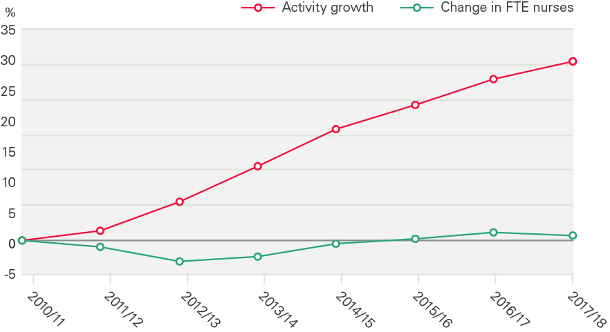
Figure 1: Service output and FTE nursing staff numbers in the NHS Hospital and Community Health Service, 2010/11-2017/18

Slide 4
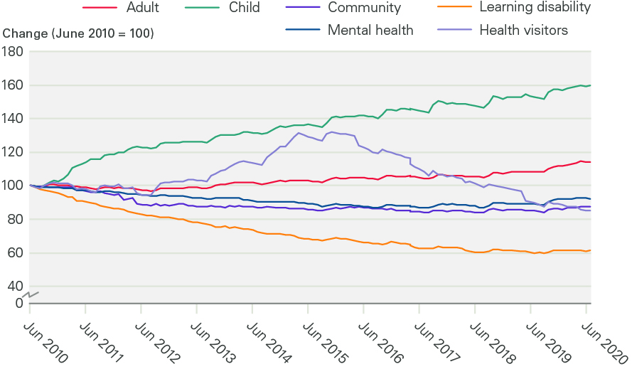
Figure 2: Change in registered nursing workforce by work area (index 100 = June 2010), June 2010 - June 2020

Slide 5
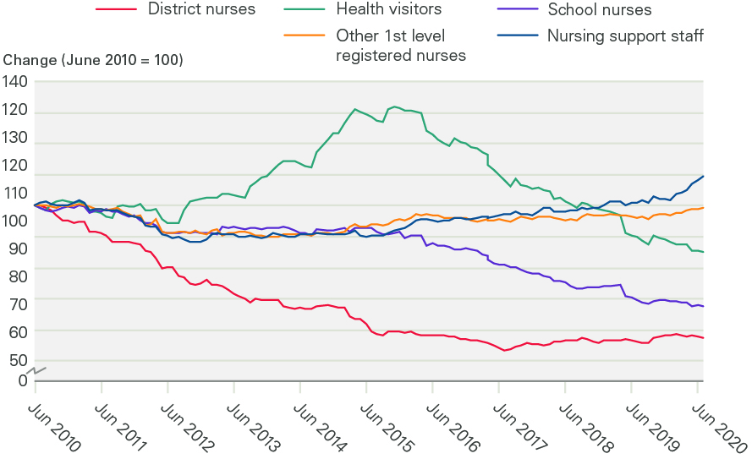
Figure 3: Change in community nursing and health visiting, selected occupations (index 100 = June 2010), June 2010 - June 2020

Slide 6
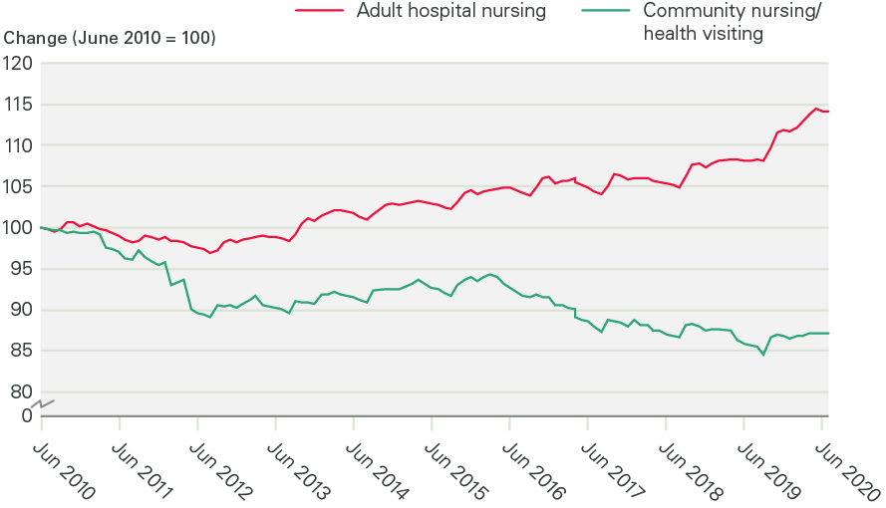
Figure 4: Change in adult hospital nursing and community nursing/health visiting in the NHS in England (index 100 = June 2010), June 2010 - June 2020

Slide 7
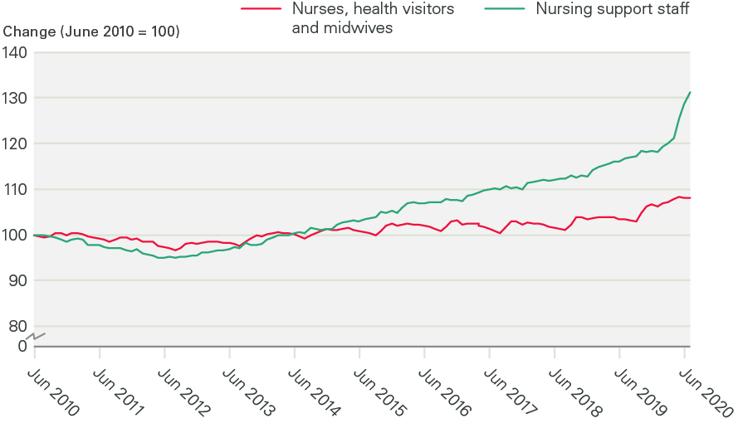
Figure 5: Change in FTE nurses, health visitors, midwives and nursing support staff in the NHS in England (index 100 = June 2010), June 2010 - June 2020

Slide 8
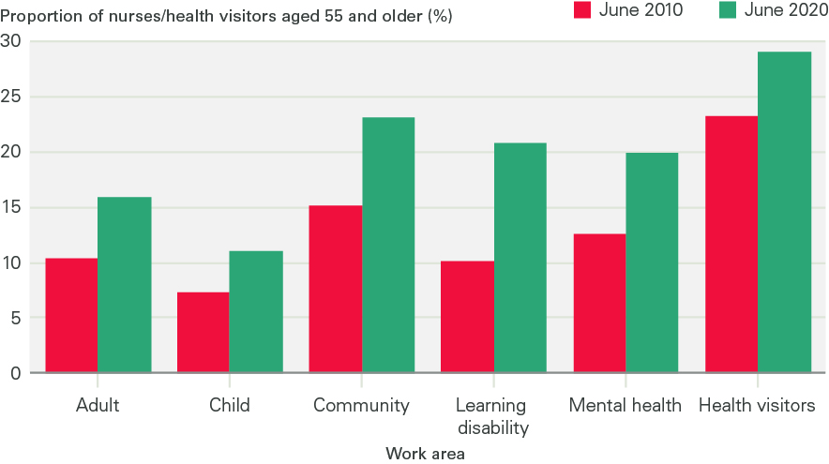
Figure 6: Age profile of nurses and health visitors in NHS England by work area, 30 June 2010–30 June 2020 (headcount*)

Slide 9
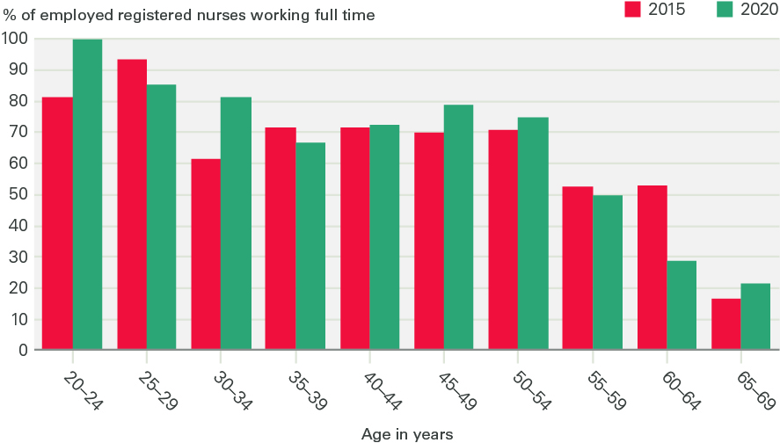
Figure 7: Proportion of employed registered nurses working full time in 2015 and 2020 (headcount*)

Slide 10
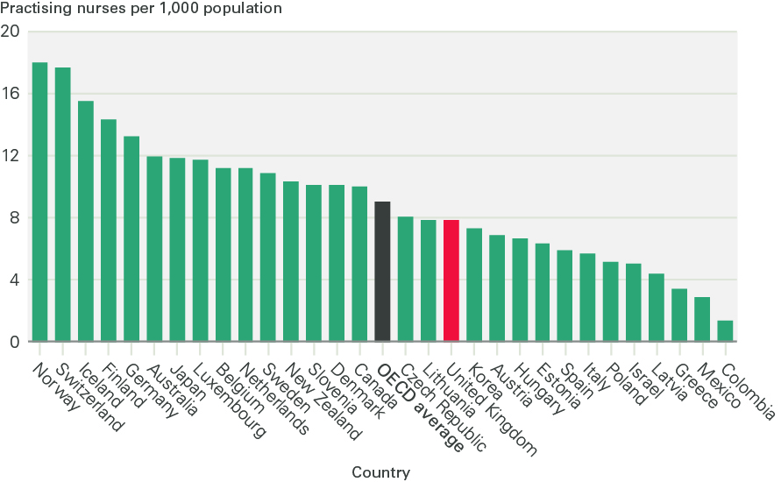
Figure 8: Practising nurses per 1,000 population, 2019 or most recent year

Slide 11
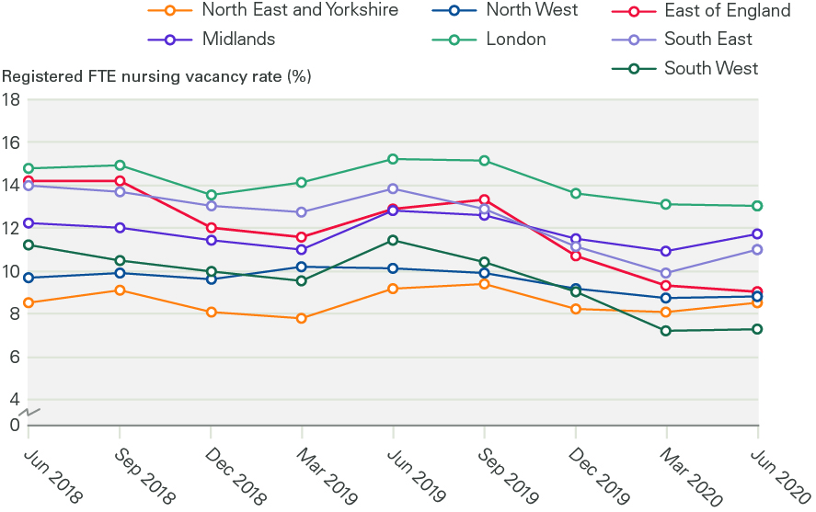
Figure 9: Registered FTE nursing vacancy rates by region, 2018–2020

Slide 12
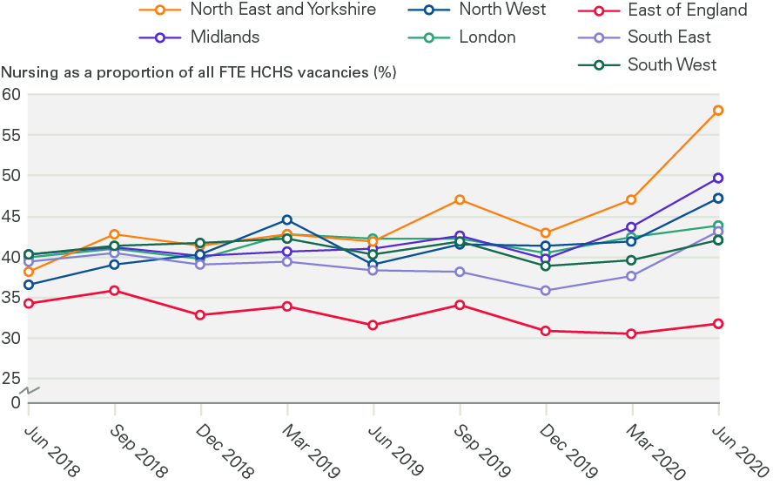
Figure 10: Proportion of NHS FTE vacancies accounted for by nursing by region, 2018-2020

Slide 13
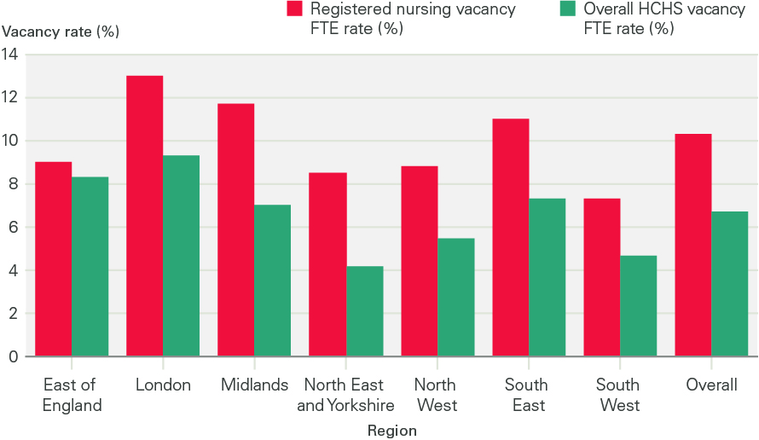
Figure 11: Overall and registered nursing FTE vacancy rates by region, June 2020

Slide 14
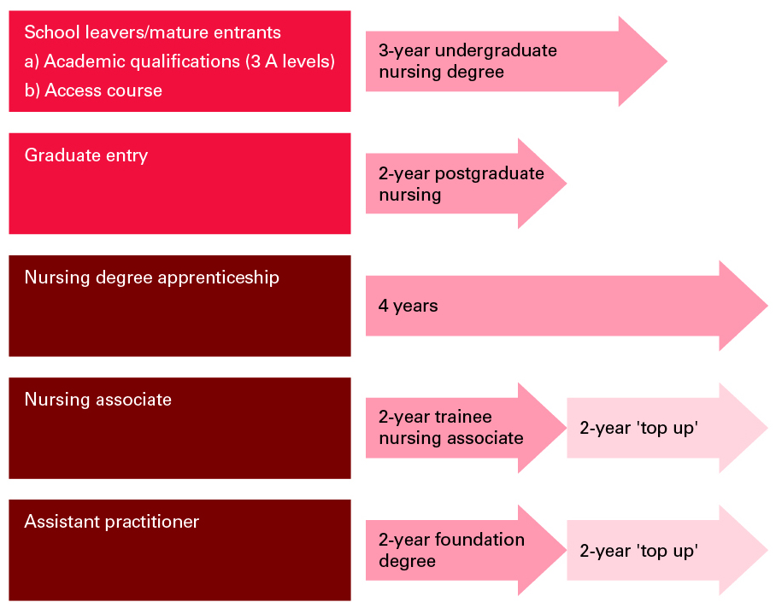
Figure 12: The supply pipeline: routes into the registered nurse workforce in the UK

Slide 15
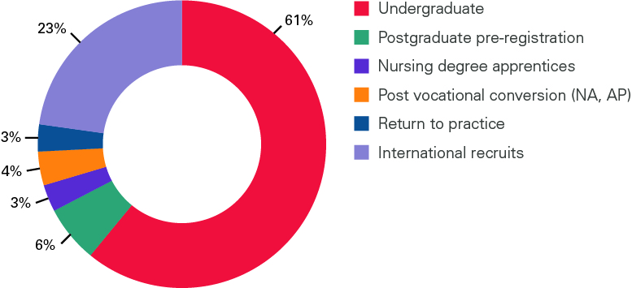
Figure 13: Estimate of annual supply of registered nurses in England by source

Slide 16
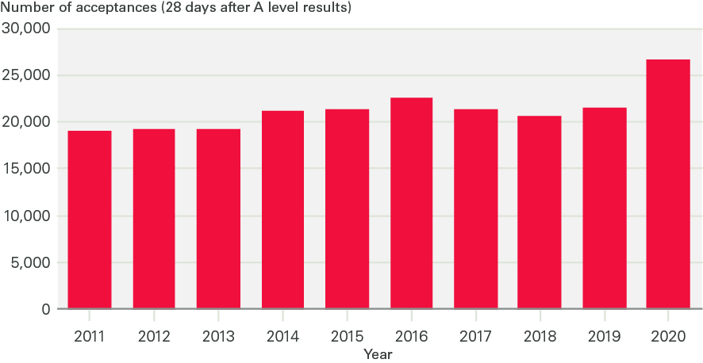
Figure 14: Acceptances to nursing degree courses in England (28 days after A level results)

Slide 17
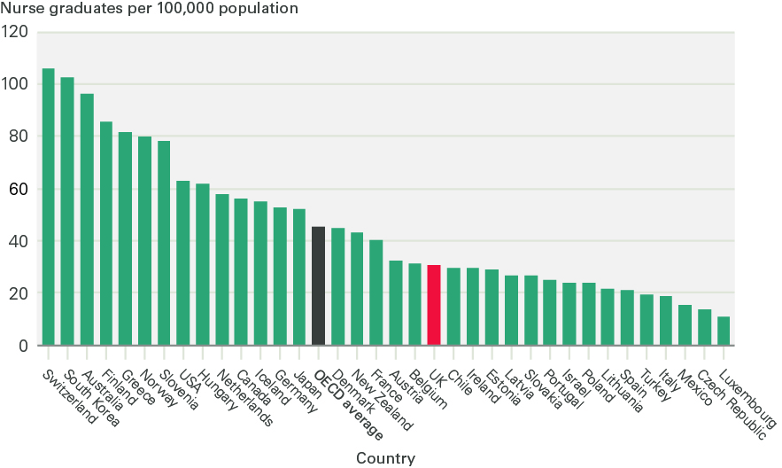
Figure 15: Number of nurse graduates per 100,000 population, OECD countries, 2019 or most recent year

Slide 18
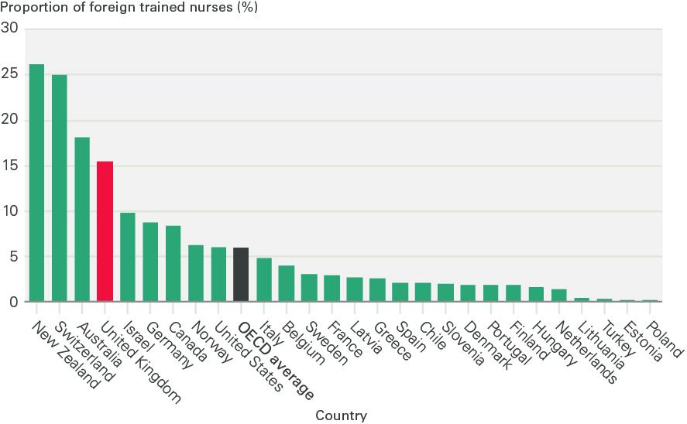
Figure 16: Foreign-trained nurses working in OECD countries, 2019 or most recent year

Slide 19
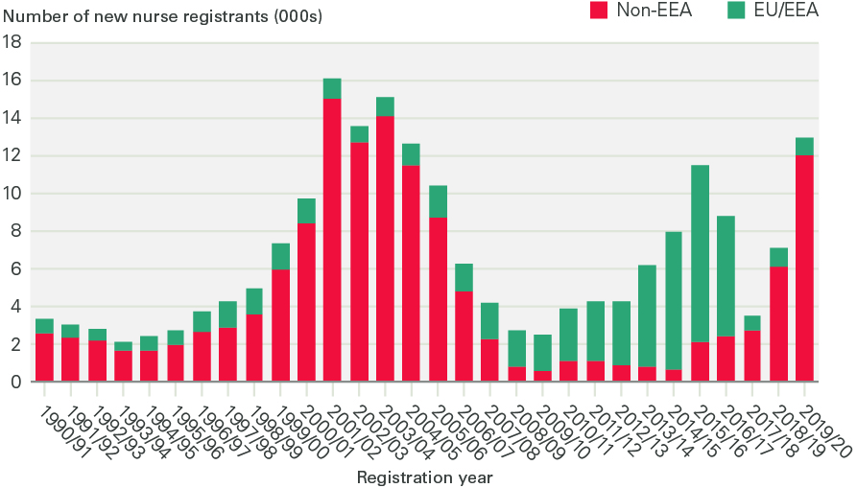
Figure 17: Annual growth in rate of emergency hospital admissions by age and gender (2000/01 to 2017/18)

Slide 20
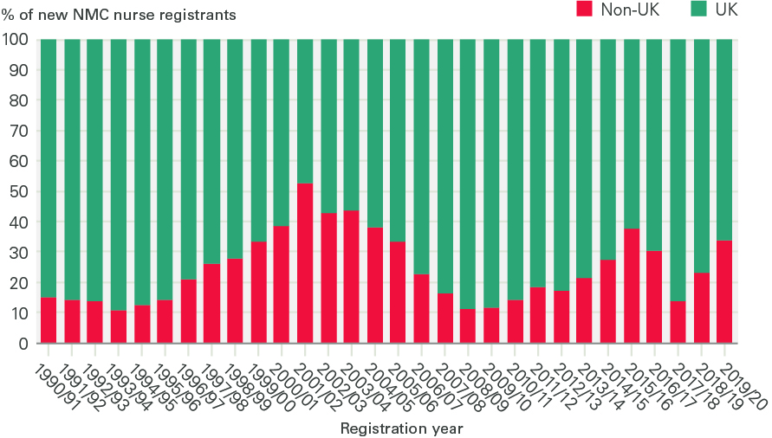
Figure 18: Annual percentage intake of new NMC registrants from UK and international sources, 1990/91 to 2019/20

Slide 21
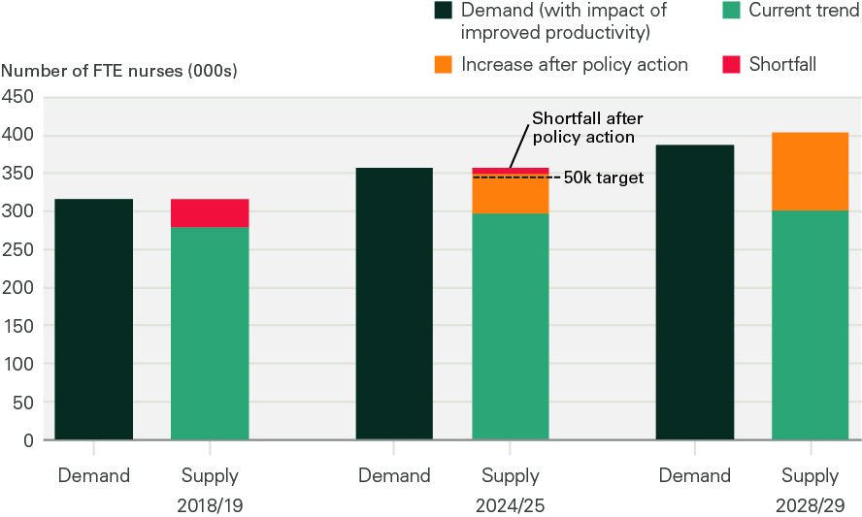
Figure 19: Nurse demand and supply, 2018/19, 2024/25 and 2028/29

Slide 22
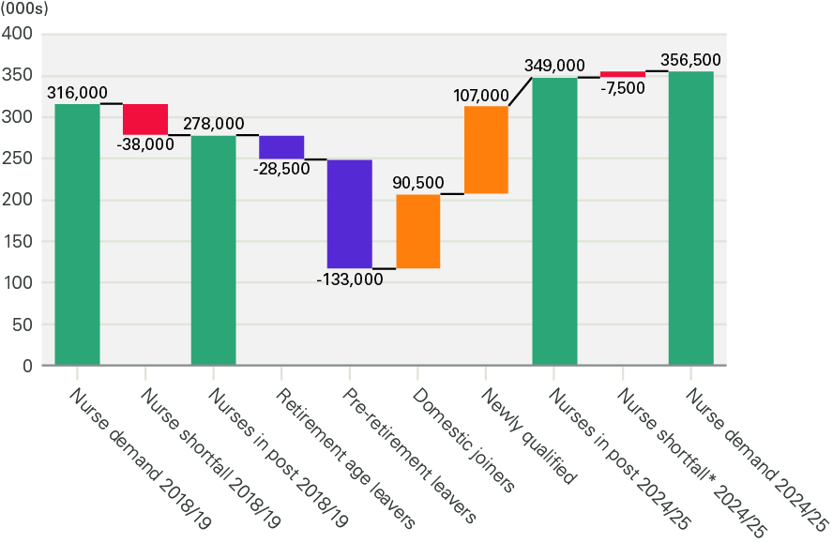
Figure A1: a) Nursing demand and supply projections for England based on policy action to increase the supply of nurses, 2018/19 - 2024/25

Slide 23
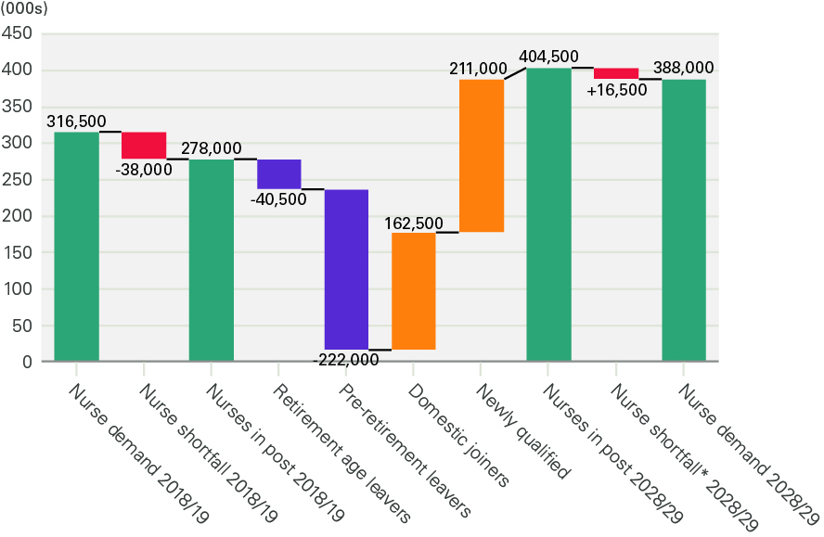
Figure A1: b) Nursing demand and supply projections for England based on policy action to increase the supply of nurses, 2018/19 – 2028/29

Slide 24
Tables

Slide 25
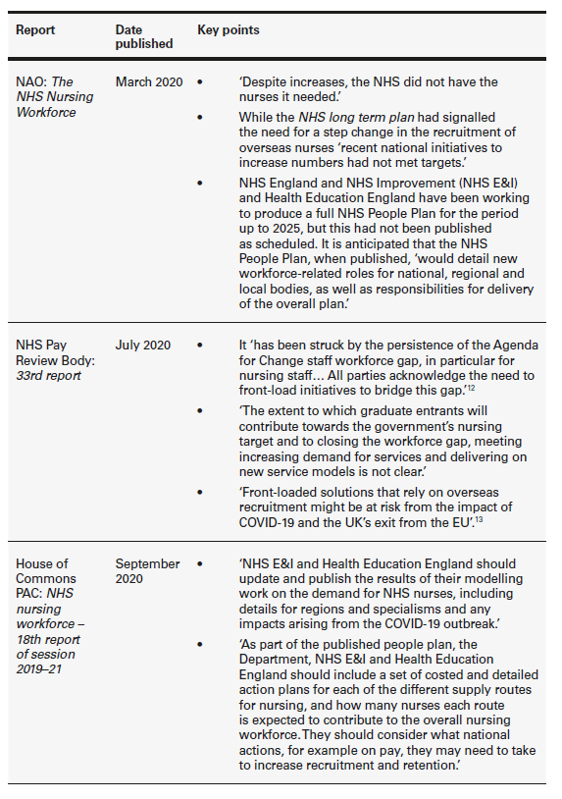
Table 1: Key points from recent NHS nursing workforce reports

Slide 26
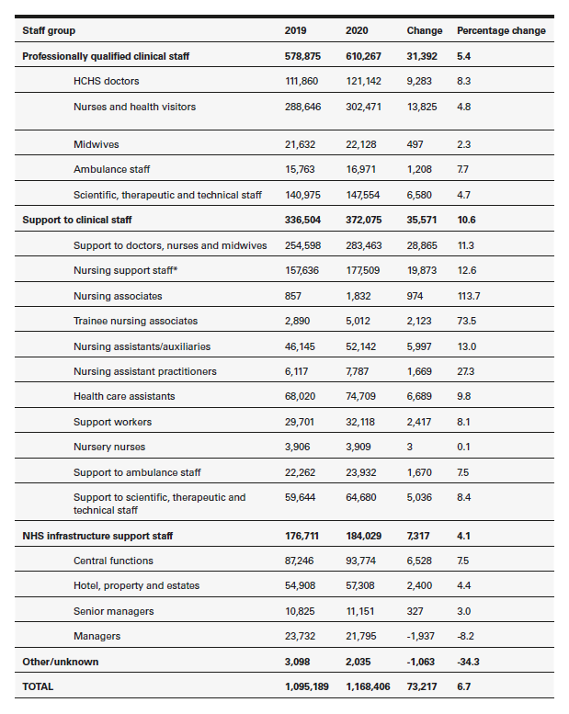
Table 2: Change in staff groups (FTE) in the NHS in England (%), June 2019–June 2020

Slide 27
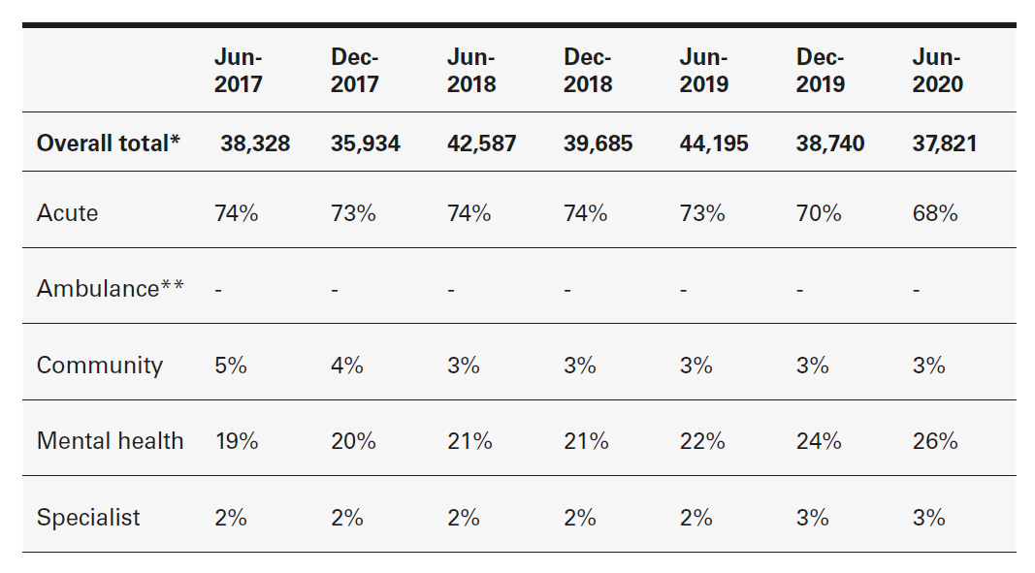
Table 3: Registered FTE nurse vacancies by service area in England, percentages* and overall total, June 2017–June 2020

Slide 28
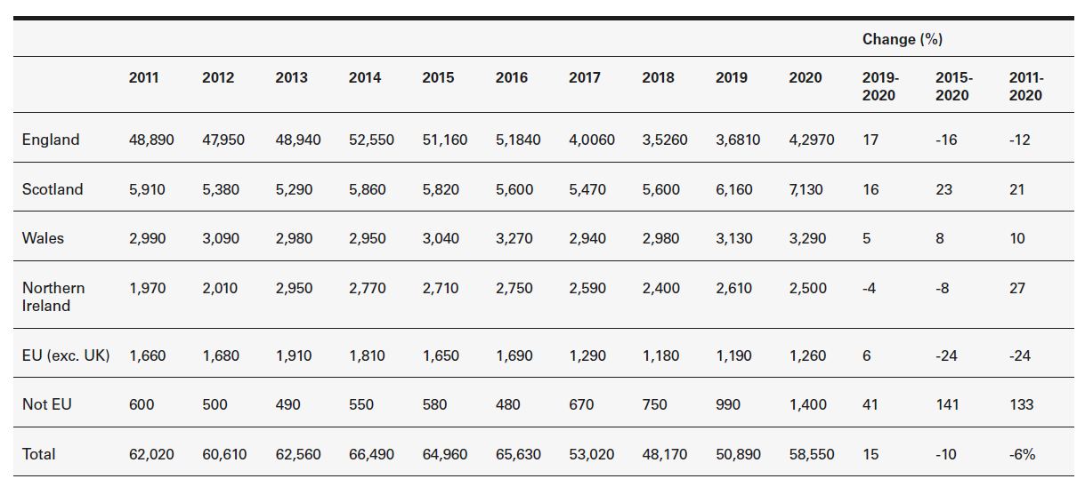
Table 4: Number of applicants for nursing degrees by country of domicile

Slide 29
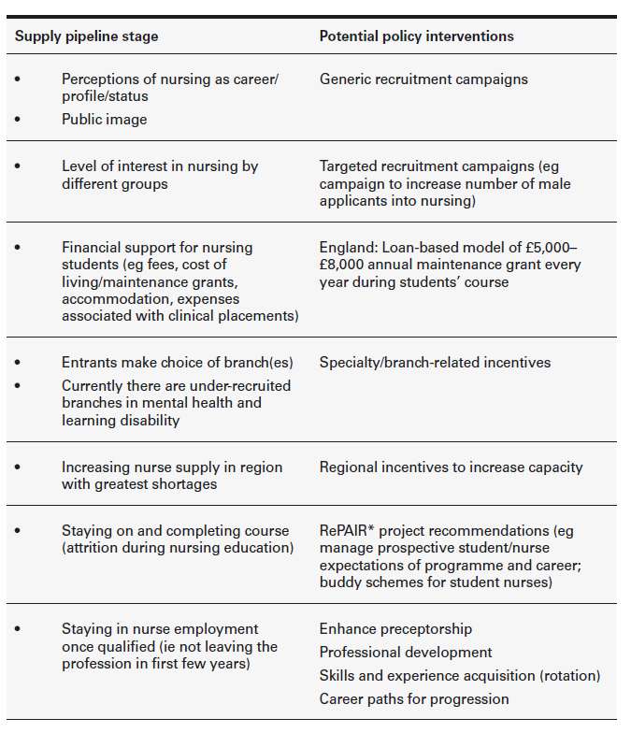
Table 5: Key stages in the domestic registered nurse supply pipeline and related policy options

