Slide 1
Nurses’ pay over the long term: what next? James Buchan, Nihar Shembavnekar and Nuha Bazeer
November 2021

Slide 2
Summary

Slide 3
What does this report cover?
Pay is a critical aspect of the relationship between the NHS as an employer and its staff.
Nursing is the key workforce shortage area in the NHS, with registered nurses accounting for a quarter of full-time equivalent staff but more than 40% of vacancies in the NHS hospital and community service sector.
Pay is a vital factor (although not the only factor) influencing the supply of nurses to the NHS.
In this report, we analyse long-term trends in nurses’ earnings in the UK and OECD data on international comparisons, drawing on stakeholder input for additional insights.
We reflect on the pay determination process for NHS nurses and consider the implications for policy in light of insights from international comparisons.

Slide 4
Key findings
On average, NHS nurses’ basic earnings in England grew by 13% in nominal terms over the decade to March 2021, but fell by 5% in real terms (after accounting for inflation).
Between 1989 and 2019, female full-time nurses’ real-terms weekly earnings grew by a very similar factor to overall full-time employee earnings in the UK, but the year-on-year growth rates in earnings for the two groups differed markedly.
Female full-time nurses’ average gross weekly earnings doubled in real terms between 1988 and 2009.
After inflation, since 1989, female full-time nurses’ average weekly earnings have grown more rapidly than comparable public sector occupations in the UK such as police officers and secondary teachers.
However, the public sector pay cap period of 2010–2017 led to a real-terms earnings decrease for nurses.
The outcome of longer term comparisons can be very different if different start dates are chosen for the analysis.

Slide 5
Key findings (cont.)
On average, OECD data highlights that hospital nurses’ earnings in the UK are lower than the corresponding averages in key comparator economies such as Australia, Canada, New Zealand and the United States, both in absolute and in relative terms.
We assess that over the long term, with the exception of the public sector pay cap period, the independent and evidence-based review body approach has contributed to overall pay stability for nurses.
Nonetheless, the NHS Pay Review Body has identified the need for further reform of the system, including an examination of pay rates and career pathways for experienced and advanced practice nurses, the use of targeted pay supplements, pay equity and the overall reward package.
Increasing divergence in the approaches of the UK countries to NHS staff pay also merits further attention.
This report underscores the relevance of a comprehensive NHS workforce strategy which places the staff reward package front and centre and acknowledges the centrality of pay as a powerful driver of staff motivation and retention.

Slide 6
Selected charts

Slide 7
Three-quarters of NHS nurses are covered by Band 5 and Band 6 of the Agenda for Change framework
Distribution of NHS nurses and health visitors (FTE) in England across Agenda for Change pay bands, December 2020
Around 44% of NHS Hospital and Community Service nurses were in Band 5 in December 2020, with a further 32% being in Band 6.
Basic earnings generally account for over 80% of nurses’ overall earnings and over 90% of overall earnings for higher bands.
Due to data constraints, we do not explore trends in nurses’ non-basic earnings (eg overtime pay and local area supplements), and ‘Total Reward’ in the form of pensions and other benefits, although these are important issues.
Source: NHS Digital
Notes: The data are sourced from NHS Digital’s Electronic Staff Record (ESR) system. Full-time equivalent (FTE) figures are rounded to the nearest whole number. Due to rounding and a small number of Band 2 – Band 4 employees from the data not having been shown (as these do not represent qualified nurses, who start at Band 5), the percentages shown may not sum to 100%.

Slide 8
On average, NHS nurses’ earnings fell in real terms between 2011 and 2021
Index of nominal and real-terms mean annual basic earnings per FTE, NHS HCHS nurses and health visitors in England, March 2011 to March 2021
Nominally, NHS nurses’ average FTE earnings grew by 1.3% per year between March 2011 and March 2021.
In the same period, annual price inflation as measured by the Consumer Prices Index including owner occupiers’ housing costs (CPIH), the ONS’ lead measure of inflation, averaged 1.7%.
So on average, NHS nurses’ earnings fell in real terms in the 2011–2020 period.
Source: NHS Digital staff earnings data, ONS CPIH data
Note: Earnings data are sourced from NHS Digital’s ESR system and CPIH estimates are sourced from ONS data. NHS Digital defines mean annual basic pay per FTE to be the ‘mean amount of basic pay paid per 1 Full-Time Equivalent post in a 12 month period’. We use ONS data on the 12-month CPIH for March in each year from 2011 to 2021 to estimate real‑terms earnings.

Slide 9
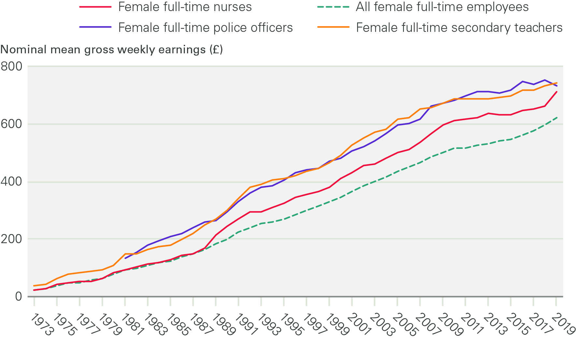
Over the last three decades, the average earnings of female full-time nurses have exceeded the overall UK average and moved closer to comparable professions
Nominal mean gross weekly pay, female full-time nurses and female
full‑time employees in selected other occupations in the UK, 1973–2019
ONS data on average earnings allow us to explore longer term trends in UK nurses’ earnings (not restricted to the NHS).
As 9 in 10 UK nurses are female and as a higher proportion of nurses work part time than for all employees, we restrict our analysis to female full-time nurses.
Female full-time nurses’ nominal average earnings have exceeded the overall average since 1988.
Since the 1980s, female full-time nurses’ earnings have moved closer to comparable public sector professions such as policing and teaching.
Source: ONS Annual Survey of Hours and Earnings and New Earnings Survey
Note: The data represent female full-time employees only. 2020 data have not been included as they are provisional and may reflect some impacts of the COVID-19 pandemic. Estimates for police officers refer to police officers at sergeant level and below. Time-series data for female full-time police officers are available from 1981 onwards, though 1997 data are missing, so we estimate mean gross weekly pay by taking the average of the values for 1996 and 1998.

Slide 10
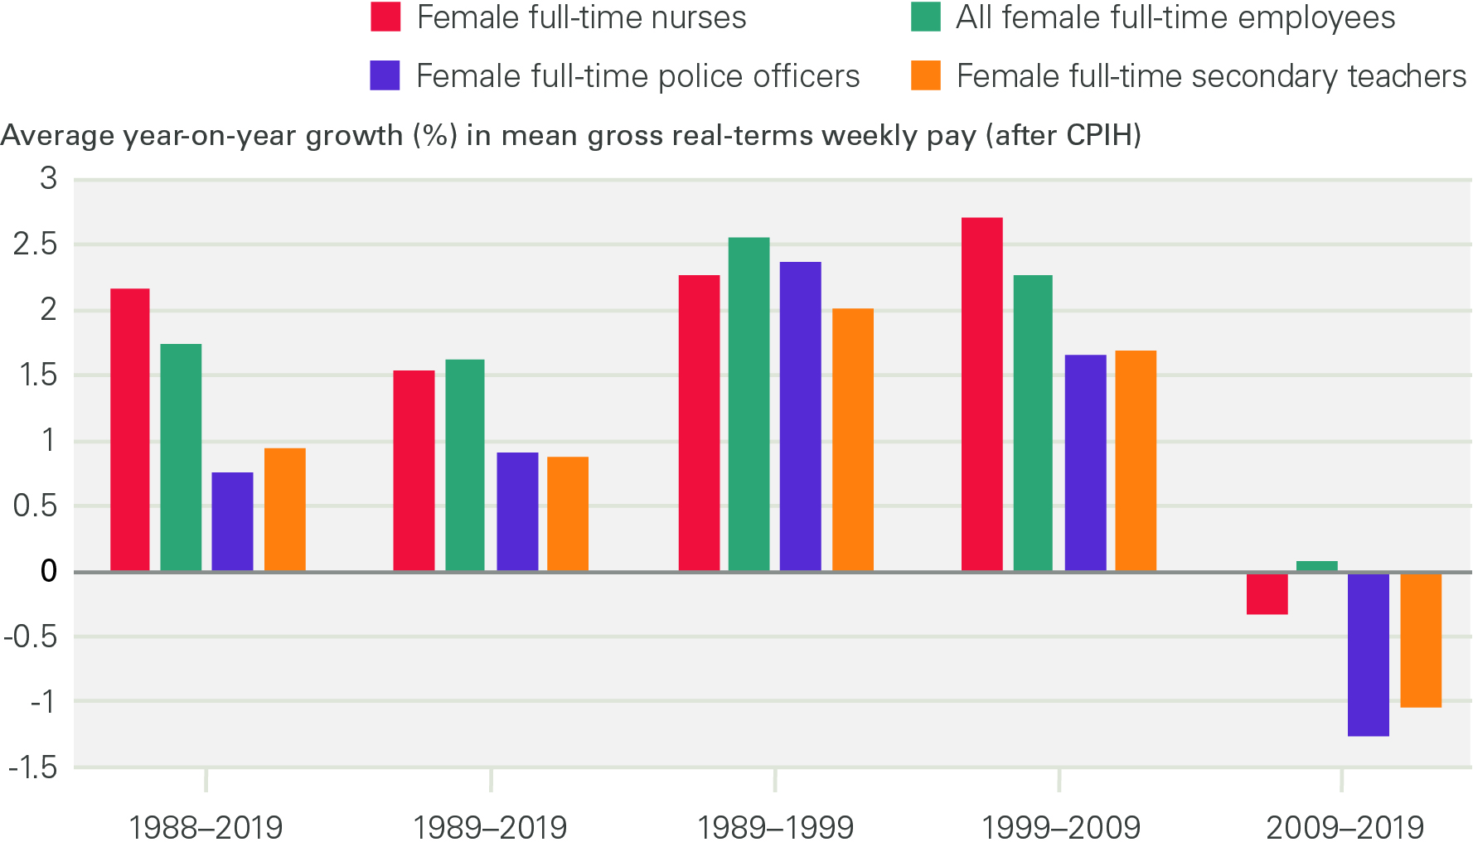
An interesting story emerges when we consider trends in nurses’ real-terms earnings relative to comparable professions
Average annual real-terms growth in mean gross weekly earnings, female
full-time nurses and female full-time employees in selected other occupations in
the UK, time periods between 1988 and 2019
Between 1988 and 2019, year-on-year growth in female full-time nurses’ nominal mean gross weekly earnings exceeded CPIH inflation in the UK.
This picture was largely reversed with the 2010–2017 public-sector pay cap (the period of ‘austerity’).
However, the real-terms fall in nurses’ earnings between 2009 and 2019 was less severe than for policing and teaching.
Different start dates can lead to different results (eg the year-on-year growth rate for nurses’ earnings in 1989–2019 is significantly different from that in 1988–2019).
Source: ONS Annual Survey of Hours and Earnings and New Earnings Survey; ONS CPIH data
Note: The data represent female full-time employees only. Compound annual growth rates are calculated to estimate average year-on-year earnings growth over different periods. 1988 is used as a starting year as ONS CPIH data currently go back to January 1989. 2020 data have not been included as they are provisional and may reflect some impacts of the COVID-19 pandemic. Estimates for police officers refer to police officers at sergeant level and below.

Slide 11
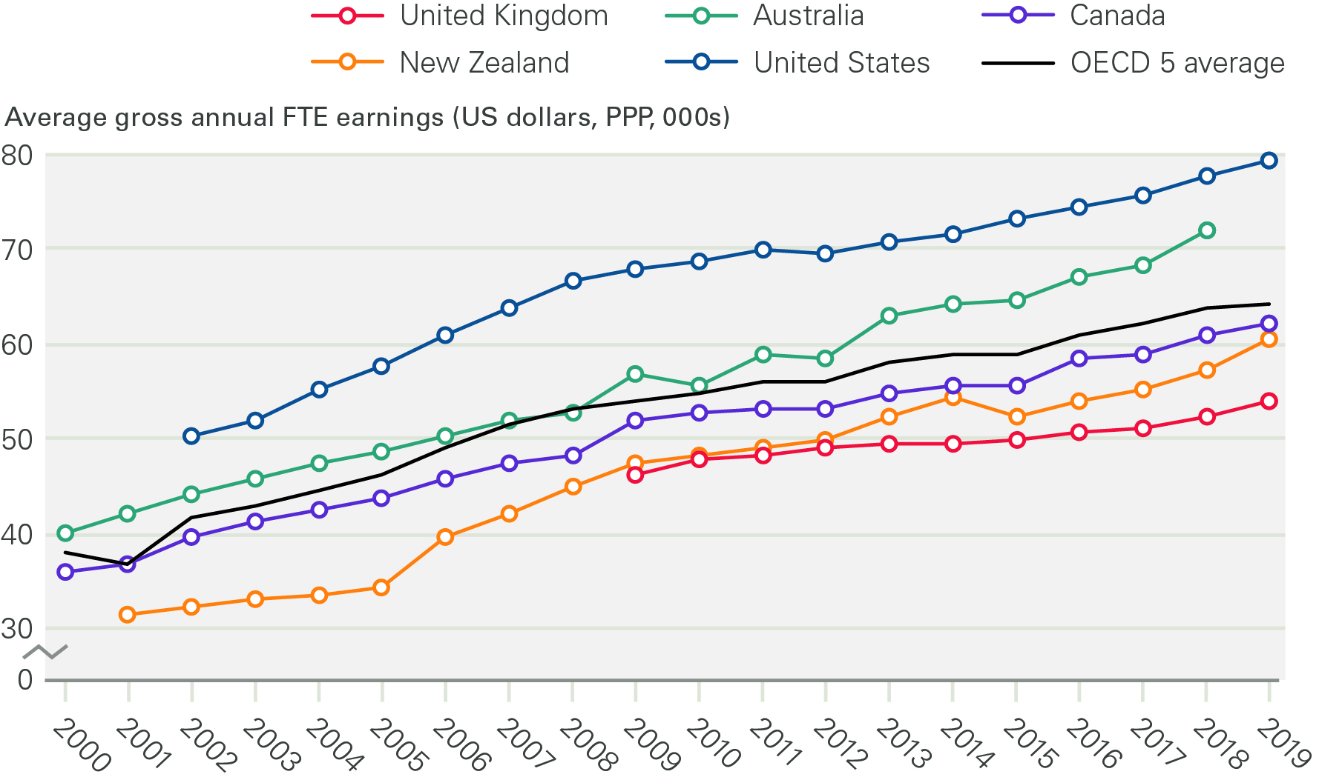
On average, hospital nurses in the UK earn less than their counterparts in key OECD comparator countries in absolute terms
Hospital nurses’ (full time) average gross annual FTE earnings in selected
OECD countries, 2000–2019
OECD data provide insights into how hospital nurses’ earnings vary across countries with broadly comparable systems.
After adjusting for purchasing power parity (PPP), a measure of living standards, hospital nurses’ earnings in the UK were lower than in key comparator countries such as Australia and the US between 2009 and 2019 (the ‘OECD 5’ in the chart refers to the UK, Australia, Canada, New Zealand and the US).
Source: OECD Health Statistics: Remuneration of health professionals (https://stats.oecd.org/)
Note: These estimates are based on OECD data on hospital nurses’ remuneration. The ‘OECD 5’ refers to the UK, Australia, Canada, New Zealand and the United States. UK data apply to England only and begin in 2009 as they are sourced from NHS Digital’s ESR system, which NHS trusts started using in 2009. For further detail on the data, see the full report.

Slide 12
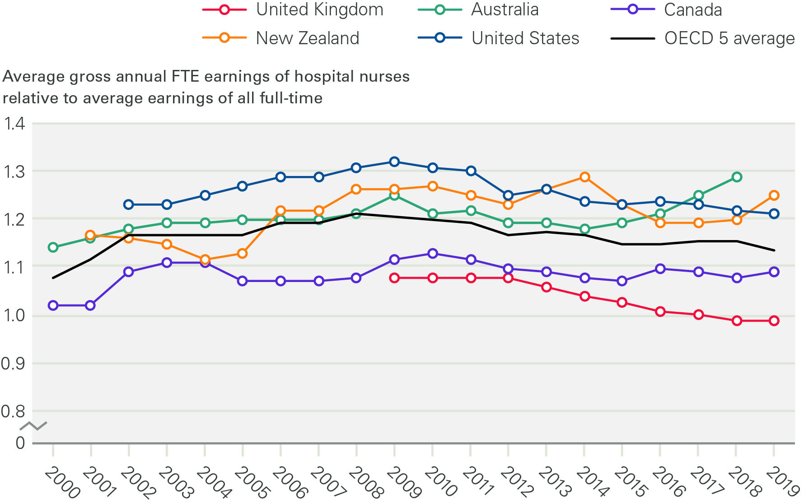
On average, hospital nurses in the UK also earn less than their counterparts in key OECD comparator countries in relative terms
Hospital nurses’ average FTE earnings relative to average full-time employee earnings, selected OECD countries, 2000–2019
Further, OECD data show the ratio of mean hospital nurses’ earnings to the mean earnings of all full-time employees.
This is a measure of hospital nurses’ earnings relative to other workers in the same country (economy).
By this measure, too, the UK was below key comparator countries in 2009 and has fallen further since.
Notwithstanding some data limitations, the negative impact of the UK’s public-sector pay cap of 2010–2017 is clearly visible.
Source: OECD Health Statistics: Remuneration of health professionals (https://stats.oecd.org/) Note: These estimates are based on OECD data on hospital nurses’ remuneration. The ‘OECD 5’ refers to the UK, Australia, Canada, New Zealand and the United States. UK data apply to England only and begin in 2009 as they are sourced from NHS Digital’s ESR system, which NHS trusts started using in 2009. For further detail on the data, see the full report.

Slide 13
Discussion
Over the last three decades, the average earnings of female full-time nurses in the UK have exceeded the average earnings of all female full-time employees (we restrict attention to female full-time nurses and employees to avoid comparison issues raised by differences in part-time working and hours worked).
After inflation is accounted for, UK nurses’ average earnings increased up to 2009 and fell over the last decade due to the impact of the 2010–2017 public sector pay cap, but the fall was less severe than for other public sector professions such as policing and teaching.
Over the long term, with the exception of the public sector pay cap period in the last decade, the review body approach has contributed to overall pay stability for UK nurses.
However, hospital nurses’ pay in the UK trails behind key OECD comparator countries in both absolute and relative terms.
We welcome the NHS Pay Review Body having recently identified the need for further reform of the system, particularly in terms of examining the pay rates and career pathways for more experienced nurses, the use of targeted pay supplements and the overall reward package.

Slide 14
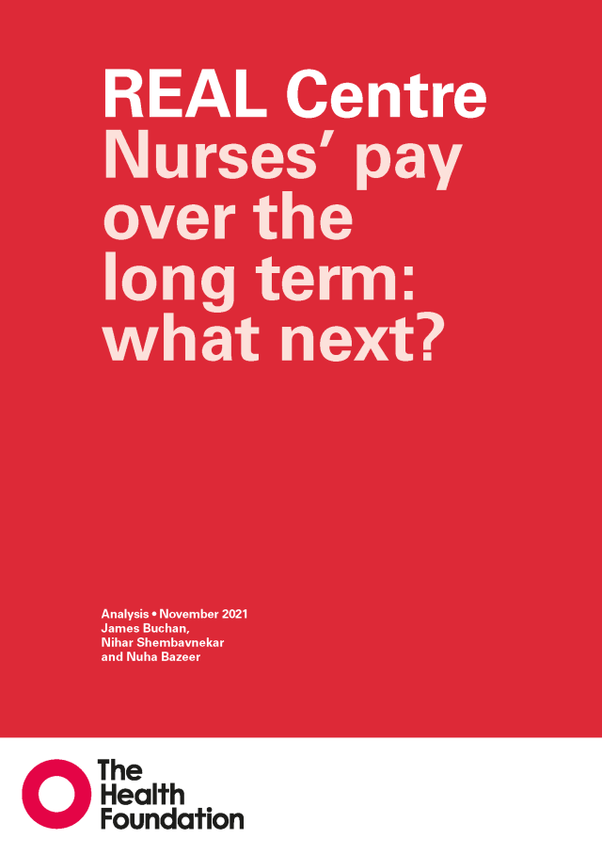
About the REAL Centre
The Health Foundation’s REAL Centre (Research and Economic Analysis for the Long term) provides independent analysis and research to support better long-term decision making in health and social care.
Its aim is to help health and social care leaders and policymakers look beyond the short term to understand the implications of their funding and resourcing decisions over the next 10–15 years. The Centre will work in partnership with leading experts and academics to research and model the future demand for care, and the workforce and other resources needed to respond. The Centre supports the Health Foundation's aim to create a more sustainable health and care system that better meets people’s needs now and in the future.
Download the full report: health.org.uk/publications/nurses-pay-over-the-long-term-what-next
Get in touch: REALCentre@health.org.uk

