Slide 1


Welcome to:
Optimising medicines; involving residents:
The Northumbria Care Home Project
Share and Spread Event
Please tweet your comments and pictures with the #NHCTShine

Slide 2


Get involved!
WiFi (subscriber login)
Newcastle_WiFi_SPARK
Login: arc
Password: Racecard
#NHCTShine
@NorthumbriaNHS
@NHCTPharmacy

Slide 3
Annie Laverty
Director of Patient Experience

Slide 4




Optimising Medicines, Involving Residents: Learning from the Northumbria Shine Project
Wasim Baqir
on behalf of the SHINE project team

Slide 5
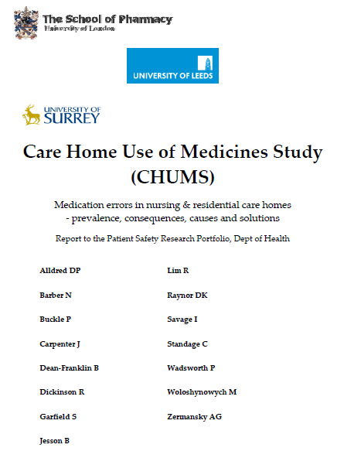
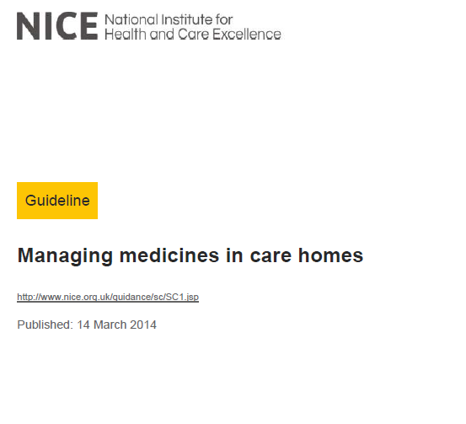
Medicines Use in Care Homes
Excess medicines (unnecessary, inappropriate)
Lack of structured review
Lack of patient involvement

Slide 6
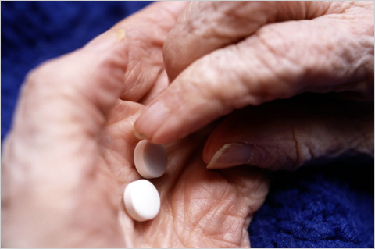
Ethel

Slide 7

Our objective
Optimise medicines use in
care home residents…
…ensuring that residents or their family are fully involved in any decisions around prescribing and stopping medicines

Slide 8
A clinico-ethical framework for multidisciplinary review of medication in nursing homes
Is the medication currently performing a function?
Is the medication still appropriate when taking co-morbidities into consideration?
Is the medication safe?
Are there medicines missing that the patient should be taking?
Is the patient/family/carer fully involved in any decision about their medicines

Slide 9

Review
Medicines Screen & review by Shine Pharmacy Team
MDT
MDT discussion
POAS consultant, CBT nursing team, Care home nurses
Shared Decisions
Patient, family & carers involved in any decisions
Follow up
Hotline for urgent advice
Follow up
Discussion with GP

Slide 10
Results and Learning

Slide 11
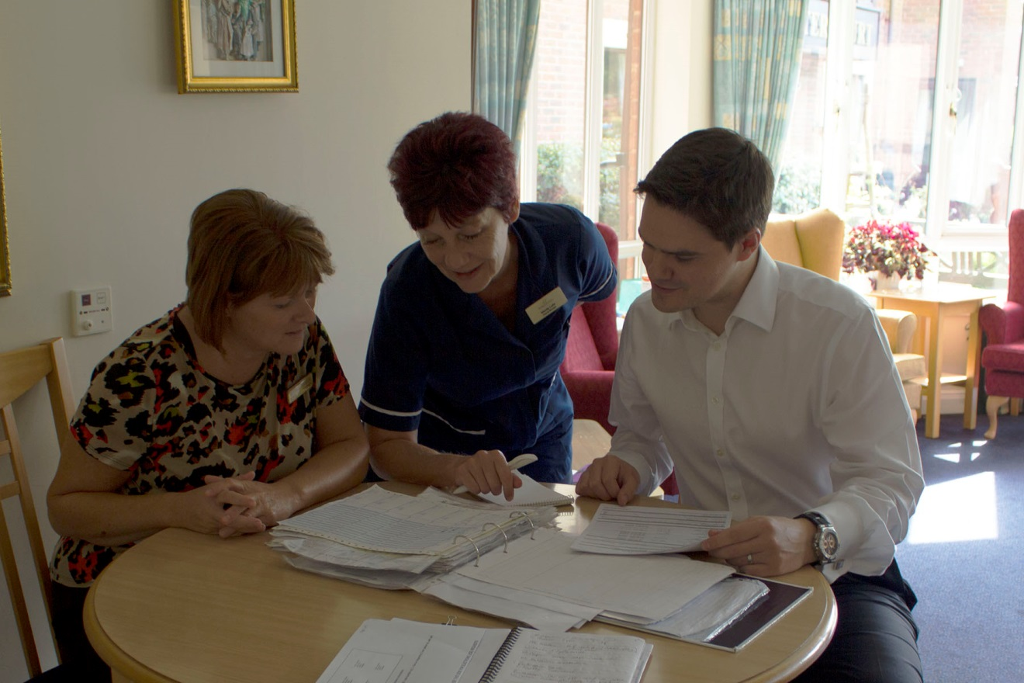
What worked well?
Pharmacist led reviews
MDTs with pharmacists and care home nurses

Slide 12
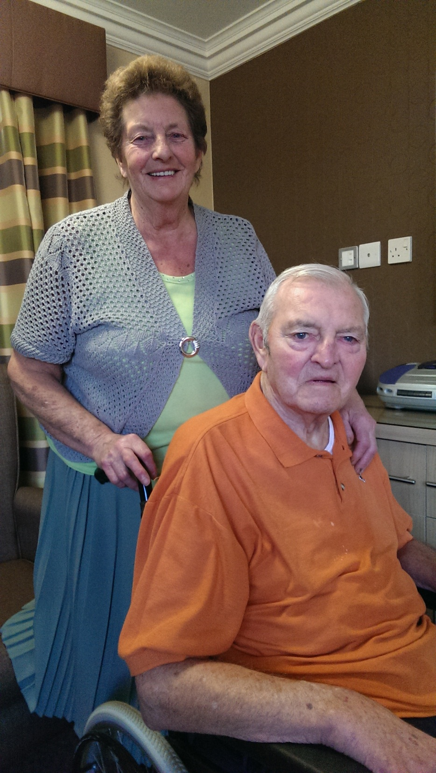
Our goal…
Residents and family discussing the issues as a member of the MDT

Slide 13
Involving Patients: Our Model
Patient 1:1
Family 1:1
Family by letter
Advo-
cacy
16%
39%
41%
4%

Slide 14
Working with GPs & Residents

Slide 15

Working with POAS
POAS at each MDT was inefficient
Three levels of psychiatry involvement developed…
  Existing patient (team alerted)
  New patient referral
  Email or telephone advice
Relationships

Slide 16
The numbers!
422 residents reviewed in 20 care homes
16 general medical practices
1346 interventions in 91% (384) patients
  15 different types of intervention
  Most common: STOP Medicines

Slide 17
Stopping Medicines
704 medicines stopped
17.4% reduction in medicines use
Average number of medicines per resident: 9→7

Slide 18
“He explained things in layman terms. Pharmacist couldn’t tell us to take [mum] off the medication but he told us the pros and the cons and it was our decision and at least we were able to make an informed decision from the information from the pharmacist”
Daughter of resident

Slide 19

“Because there are so many things you are not sure about with elderly people and their medication and health condition. Anything that gives you an opportunity to talk to someone directly and get feedback and get confirmation or alternative suggestions, that is great as far as I am concerned”.

Slide 20
Jane, 89y
Sits quietly; never engages; drowsy
“She’s been like this for years; that’s how our Jane is”
Nurse
“Mum’s always been like this”
Daughter

Slide 21
Improving Quality whilst reducing Costs

Slide 22
Prescribing
Net Savings
£77,852
£184 saved for every 1 resident reviewed
>£70 million could be saved across England

Slide 23
Models |  | 0 | 1 | 2¹ | 3 | Totals
n patients |  | 115 | 160 | 21 | 126 | 422
Outputs
Intervention/patient | 3.2 |  | 3.5 | 3.8 | 2.7 | 3.2
Medicine stopped/patient | 1.7 |  | 1.9 | 2.4 | 1.2 | 1.7
Net saving/patient | £204.02 |  | £233.84 | £203.71 | £100.77 | £184.48
Cost of delivering service
Cost per patient | £57.81 |  | £92.09 | £73.75 | £77.29 | £77.42
Summary
For every £1 invested… | £3.53 saved |  | £2.54 saved | £2.76 saved | £1.30 saved | £2.38 saved

Slide 24
Other Efficiencies
Reduced medicines waste
Medicines administration time
  6.6 hours per week saved per home
“Our drugs round had decreased by approximately 20%. It is less stressful for residents as they are not taking as much medication and are more compliant as they were part of the review process”
Care home nurse

Slide 25
“As a manager I feel special to have been chosen for this project. I think it is beneficial and forward thinking to be involved in the research of medication for the elderly; this is often overlooked and not to the forefront either. I told anyone that would listen that we were part of the Shine project with pride”
Care home manager

Slide 26
The
Team
Wasim Baqir – Project Lead
Prof Julian Hughes (POAS/Newcastle Uni) – Clinical Lead
Peter Derrington – Project Manager
Nisha Desai/ Steven Barrett – Clinical Pharmacists
Annie Laverty (Director of Patient Experience)
Jo Mackintosh – Patient Experience
Dr Jane Riddle – GP Advisor
Yvonne Storey – Communications
Richard Copeland/ David Campbell – Senior Pharmacy Support
Sandra Gray/John Connelly (Age UK) – Patient Advocate

Slide 27



http://tinyurl.com/NHCTShine
Involving residents, sharing decisions about medicines, leads to better quality and less costly care

Slide 28
Capacity Assessments
in Care Homes
Professor Julian Hughes
Northumbria Healthcare NHS Foundation Trust and PEALS Research Centre, Newcastle University

Slide 29
Plan
Covering the basics
The Shine Way
Presuming capacity
The issue of medication
Capacity and complexity
Validation
Conclusions

Slide 30
To start at the end
‘The means by which we evaluate, and arrive at our conclusions about the afflicted person’s competency may well ultimately be a test of our own competency as thoughtful, judicious, humane human beings.’
Sabat SR. The experience of Alzheimer’s disease: life through a tangled veil; p334. Blackwell, Oxford, 2001

Slide 31
The basics

Slide 32
Back to the beginning
MCA 2005 – Section 1: the principles
A person is assumed to have capacity
All practicable steps must be taken to help the person to make a decision
People are entitled to make unwise decisions
Any actions taken on behalf of a person who lacks capacity must be in the person’s best interests
Before any action is taken it should be the least restrictive of the person’s rights and freedom of action

Slide 33
Assessment of capacity – definition
Section 2(1):
‘…a person lacks capacity in relation to a matter if at the material time he is unable to make a decision for himself in relation to the matter because of an impairment of, or a disturbance in the functioning of, the mind or brain.’

Slide 34
Assessment of capacity – two-stage test
(see Code of Practice §§ 4.10-4.13)
Stage 1: Does the person have an impairment of, or a disturbance in the functioning of, their mind or brain?
Stage 2: Does the impairment or disturbance mean the person is unable to make a specific decision when they need to?

Slide 35
Assessment of capacity – two-stage test
(see Code of Practice §§ 4.10-4.13)
Stage 1: Does the person have an impairment of, or a disturbance in the functioning of, their mind or brain?
Stage 2: Does the impairment or disturbance mean the person is unable to make a specific decision when they need to?
Understand
Retain
Use or weigh
Communicate

Slide 36
Best interests
Any actions taken on behalf of a person who lacks capacity must be in the person’s best interests

Slide 37
Some of the checklist (1)
Avoid discrimination
Consider all the relevant circumstances
Put off the decision if the person is likely to regain capacity
Encourage the person to participate as fully as possible
If the decision is about life-sustaining treatment, ensure it is not motivated by a desire to bring about the person’s death

Slide 38
The checklist (2)
So far as is reasonably ascertainable consider:
  The person’s past wishes and feelings
  The person’s present wishes and feelings
  The person’s values and beliefs likely to influence the decision
  Other factors the person might consider, e.g. cultural background, religious beliefs, political convictions, past behaviour or habits and any effects on others that might be relevant to the person

Slide 39
The checklist (3)
If it is practicable and appropriate, consult:
  Anyone named by the person
  Anyone engaged in caring for the person
  Anyone interested in the person’s welfare
  Any donee of a LPA (or EPA)
  A deputy appointed by the court

Slide 40
Lasting Power of Attorney
MCA Sections 9-14
(And remember deputyship)
Two types:
  Property and affairs LPA
    Can be used when the person still has capacity
  Personal welfare LPA
    Can only be used when the person lacks capacity

Slide 41
The Shine Way
Informal assessments
Senior nurse asked: “does the resident have capacity to make decisions about treatment?”

Slide 42
Presuming Capacity

Slide 43
When should capacity be assessed?
Code of Practice Section 4.34
‘Assessing capacity correctly is vitally important to everyone affected by the Act. Someone who is assessed as lacking capacity may be denied their right to make a specific decision – particularly if others think that the decision would not be in their best interests or could cause harm. Also, if a person lacks capacity to make specific decisions, that person might make decisions they do not really understand. Again, this could cause harm or put the person at risk. So it is important to carry out an assessment when a person’s capacity is in doubt. It is also important that the person who does an assessment can justify their conclusions.’

Slide 44
The issue of medication
Capacity to decide who makes decisions?
Is it global judgements?
Is it specific judgements?
Should people in care homes be required to demonstrate a higher level of capacity than the person on the Clapham Omnibus?

Slide 45
Capacity and Complexity
Being on the side of the resident
The danger of paternalism
Autonomy and dependence
The role of clinical judgement

Slide 46
Validation study(1)
(with thanks to James Clark)
22 residents in one EMI nursing home (NB)
Interviewed for about 15 minutes (in one case one hour)
Capacity to decide to be involved in decisions about medication
Good and bad points of deciding to have decisions made for them discussed
Asked to repeat this information
Asked to make a decision

Slide 47
Validation study(2)
Results
Average age 81 years
Clinical Dementia Rating Scale (CDR): 2.66
Both informal and formal assessments matched in 86% of cases (19/22)
Informal interview good sensitivity: picked up those who lacked capacity, but was not specific

Slide 48
Validation study(3)
Mrs A: 83, very dependent, problems with agitation, CDR high, difficult to engage, speech problems, but then very clear about her views: satisfied with care and wanted decisions made for her
Mrs B: 65, very fluent, but unable to make a decision and reasoning based on false beliefs, despite being given extended time

Slide 49
Conclusions
Capacity assessments are not easy
But we need to get them right
Pressure of time (and training)
Citizenship in care homes
And ‘own competency as thoughtful, judicious, humane human beings.’

Slide 50
THANK YOU julian.hughes@ncl.ac.uk

Slide 51
Shared Decision Making
Steven Barrett,
Senior Clinical Pharmacist

Slide 52
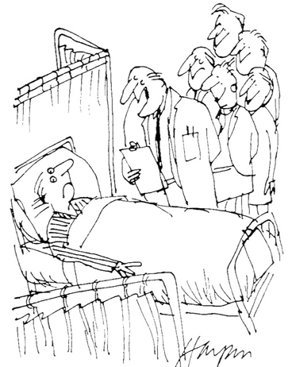
“When we want your opinion, we’ll give it to you”
http://www.advancingqualitynw.nhs.uk/sandbox/SDM3/Information-for-Clinicians.html#

Slide 53
Using Shared Decision Making
Collaborative conversation between patient and health professional to reach a healthcare choice together
Professional provides evidence-based options - outcomes, benefits, risks, uncertainties
Patient provides their experiences, values, preferences

Slide 54
3 Questions Approach
What are my options?
What are the benefits and harms?
How likely are these?
Shepherd HL et al. Patient Educ Couns (2011)
Notes:
This research found that when patients asked three specific questions, it improved the information given by their doctor and increased the doctor facilitating them to be involved in decision making.
The three questions about the information provided by physicians about treatment options were:
What are my options?
What are the benefits and harms?
How likely are these?
The study was conducted in family practices in Sydney, Australia, during 2008–09.
The authors concluded that asking these three questions improved information given by family physicians and increased physician facilitation of patient involvement. They also concluded that these questions can drive evidence-based practice, strengthen patient–physician communication and improve safety and quality.

Slide 55





http://www.health.org.uk/areas-of-work/ programmes/shared-decision-making/learning/

Slide 56
Examples of SDM Tools
Brief Decision Aids
    http://www.patient.co.uk/decision-aids/
Option Grids
    http://www.optiongrid.org/
Patient decision aids
    http://sdm.rightcare.nhs.uk/
Cates plots
    http://www.nntonline.net/

Slide 57
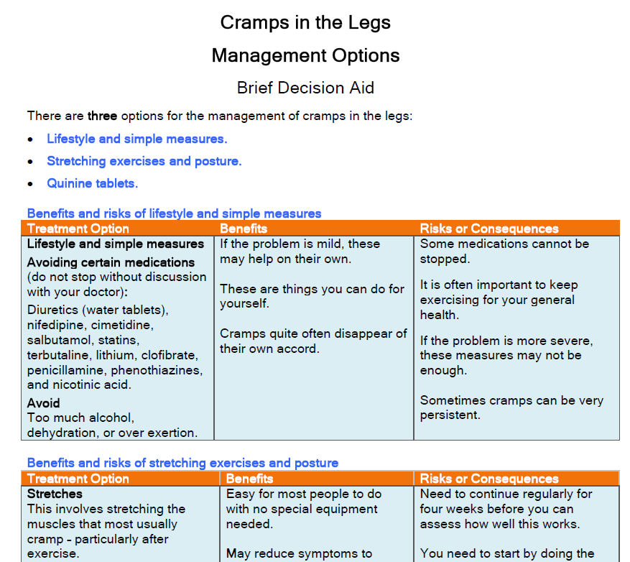

Slide 58

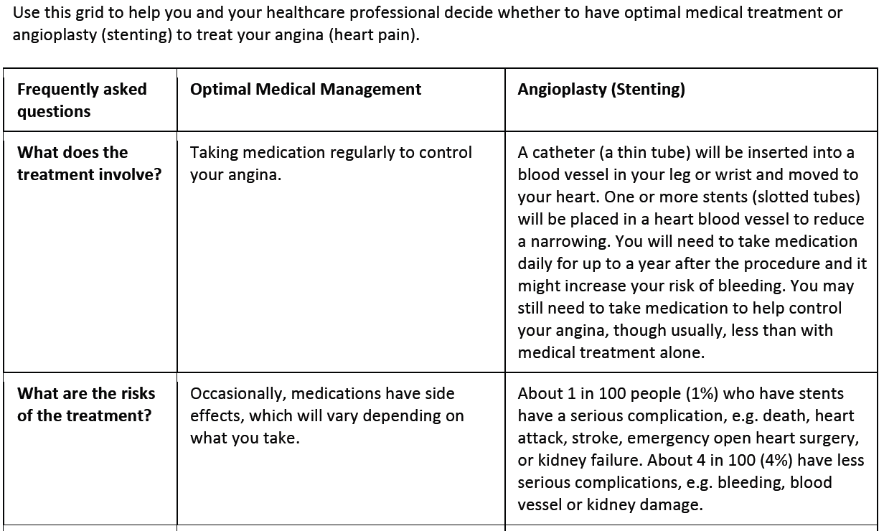
Treatment of stable angina

Slide 59

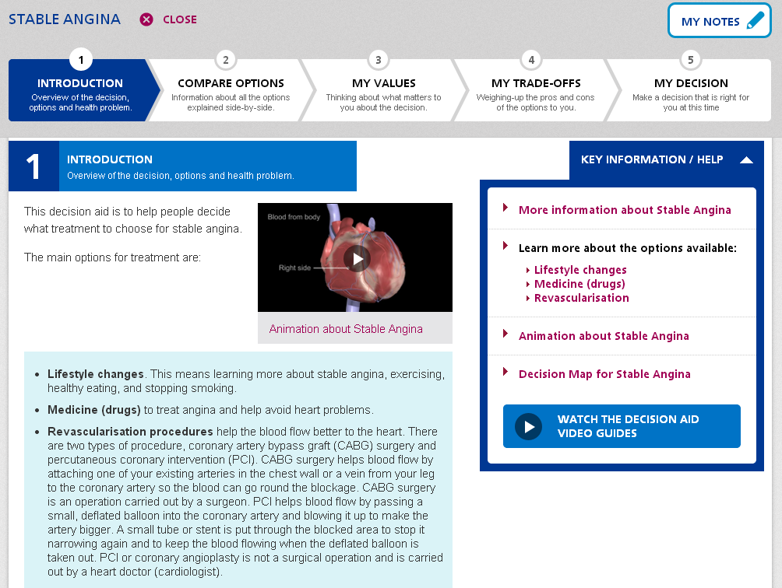

Slide 60
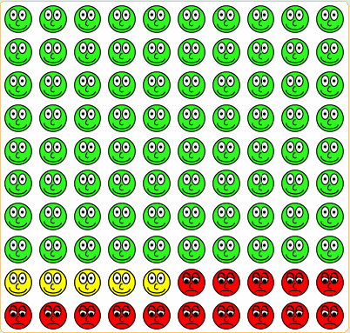
Statin Prescribed
These people will
not have a CV event, whether or not they take a statin
These people will be saved from having a CV event because they take a statin
These people will have a CV event, whether or not they take a statin

Slide 61
Interactive Examples

Slide 62
A Care Home Managers View Point
Sylvia Dixon,
Care Home Manager

Slide 63

Break
Please tweet your comments and pictures with the #NHCTShine

Slide 64
Being involved:
a carer’s reflections
Dorothy O’Neill,
Carer

Slide 65
How to undertake a medication review
Nisha Desai,
Senior Clinical Pharmacist

Slide 66
Overview
What is a medication review?
What is the importance of a medication review?
Real life cases

Slide 67
What is a medication review?

Slide 68
Definition
“A structured, critical examination of a patient’s medicines with the objective of reaching an agreement with the patient about treatment, optimising the impact of medicines, minimising the number of medication-related problems and reducing waste”

Slide 69
Levels of medication review
Level 0
Level 1
Level 2
Level 3
Adhoc
Opportunistic
Prescription Review
Treatment Review
With medical notes
Clinical Medication Review
Face-to-face

Slide 70
Clinical medication review
Conducted by a prescriber
Involves patient/carer
Access to various sources of information
  e.g. GP records, hospital notes, care home records

Slide 71
Key Questions

Slide 72

Key questions to ask
Is the medicine safe and appropriate?
Does the resident want to take the medicine?

Slide 73
Key question 1
Has patients condition/co-morbidities changed?
Medicines may have been prescribed acutely
Risk vs benefit
Ethical considerations during end of life care

Slide 74
Key question 2
Drug-drug interactions
Drug-food interactions
Drug-disease interactions
Dose
Formulation
Is the medicine safe and appropriate?

Slide 75
Key question 3
Adherence
Reasons for non-adherence (if a problem)
Residents’ understanding of risks/benefits of taking a medicine
Is the medicines safe and appropriate?
Does the resident want to take the medicine?

Slide 76
Missing medicines?
Are there any medicines, not currently prescribed, that the patient would benefit from?
Has the patient previously been on the medicine?
If so, why was it discontinued?
Has the medicine ever been considered?
If yes, why was it not commenced?

Slide 77
Case Studies

Slide 78
Case study 1
PMH:
  Essential hypertension – 2002
  Hip fracture (# Left NOF) – 2007
  Osteoporosis – 2007
  Hip fracture (# Right NOF) - 2013
94 yr old female
Residential home
Good communication – talks and can retain info.
Has capacity (wants to involve daughter as well)
Mobilises independently with gutter frame
Good nutritional status
No problems with medicines adherence

Slide 79
Case study 1
Acute medication:
    Canesten HC cream as directed
Repeat medication:
    paracetamol 1g QDS
    amitriptyline 10mg ON
    calcium carbonate and colecalciferol chewable tabs 1.5g/10microg 1 BD
    E45 Shower cream as directed
    E45 cream apply PRN
    gabapentin 600mg TDS
    Piroxicam gel 0.5% apply BD
    senna 15mg ON
    docusate sodium 200mg BD
    nefopam 60mg TDS

Slide 80
Case study 1
WHAT CHANGES, IF ANY, WOULD YOU MAKE TO THIS RESIDENTS’ MEDICATION?

Slide 81
Case study 1
Medication | Information
Paracetamol | Takes 1g QDS habitually. No complaints of pain.
Amitriptyline | Commenced 2008 for pins & needles (Hx Herpes Zoster 2006). Current falls risk (geriatrician letter states to r/v).
Gabapentin | Commenced 2008 post #.
E45 Shower cream | Not issued since 2012.
Piroxicam gel | Uses PRN to both knees. Maybe 1-2 times/week.
Senna | Takes regular. Bowels stable.
Docusate sodium | Takes regular. Bowels stable.
Nefopam | Commenced post #NOF – was due a r/v 2/52 after but never happened.
ANY OTHER NEW MEDICATION?

Slide 82
Case study 1
Medication | Outcome
Paracetamol | Takes 1g QDS habitually. No complaints of pain. Switch to PRN and to reduce quantity ordered.
Amitriptyline | Commenced 2008 for pins & needles (Hx Herpes Zoster 2006). Current falls risk (geriatrician letter states to r/v). Stop medicine.
Gabapentin | Commenced 2008 post #. To reduce to 300mg TDS after stable without amitriptyline.
E45 Shower cream | Not issued since 2012. Removed from repeat list.
Piroxicam gel | Uses PRN to both knees. Maybe 1-2 times/week. Continue.
Senna | Takes regular. Bowels stable. Continue.
Docusate sodium | Takes regular. Bowels stable. Continue.
Nefopam | Commenced post #NOF – was due a r/v 2/52 after but never happened. Stop medicine.
Bisphosphonate | Previously been on alendronic acid, but no documentation of it being stopped. Has hx of falls, but patient did not like it. Not to start.

Slide 83
Case study 2
  PMH:
  Hypertension
  Iron deficiency anaemia
  Hiatus hernia
  Type 2 DM
  Oesophageal ulcer (2012)
  Frequent falls (2013)
89 year old male
Residential home
Ability to hold a conversation but no capacity to make decisions about medication (liaise with daughter)
Mobilises with wheelchair
Fair appetite, has a large breakfast . BMI = 25.5
No problems with medicines adherence

Slide 84
Case study 2
Acute medication:
    lansoprazole 30mg OD
Repeat medication:
    paracetamol 1g QDS
    aspirin dispersible 75mg OM
    citalopram 20mg OM
    simvastatin 40mg ON
    ramipril 2.5mg OM
    Ensure Plus Liquid Feed Milkshake 1 TDS
    thiamine 100mg BD
    vitamins 1 OM
    vitamin b co strong 1OM
    Pro-Cal shot 30mls OD
    codeine phosphate 30mg QDS
    olive oil ear drops 2 drops BD to both ears
    Hydromol ointment apply QDS PRN
    lansoprazole 15mg OD
    zopiclone 15mg ON PRN

Slide 85
Case study 2
WHAT CHANGES, IF ANY, WOULD YOU MAKE TO THIS RESIDENTS’ MEDICATION?

Slide 86
Case study 2
Medication | Outcome
Citalopram | New to practice and old notes not comprehensive. No PMH of depression.
Ensure Plus | Current BMI 25.5 and eating well.
Procal | Current BMI 25.5 and eating well.
Thiamine | No current indication.
Vitamins | No current indication.
Vitamin B Co Strong | No current indication.
Olive oil ear drops | No current indication. Acute episode.
Simvastatin | Secondary prevention. DM & HTN but no cardiac events.
Lansoprazole | Confirmed on 15mg OD (previous ulcer).
Zopiclone | No current indication. Was commenced whilst in-patient at NTGH. No trouble sleeping, has naps during day.

Slide 87
Case study 2
Medication | Outcome
Citalopram | New to practice and old notes not comprehensive. No PMH of depression. Reduced to 20mg OD alt.days for 2/52 then stop.
Ensure Plus | Current BMI 25.5 and eating well. Stopped dietary supplements.
Procal | Current BMI 25.5 and eating well. Stopped dietary supplements.
Thiamine | No current indication. Discontinued.
Vitamins | No current indication. Discontinued.
Vitamin B Co Strong | No current indication. Discontinued.
Olive oil ear drops | No current indication. Acute episode. Discontinued.
Simvastatin | Secondary prevention. DM & HTN but no cardiac events. Discussion with daughter and happy to discontinue.
Lansoprazole | Updated records and confirmed on 15mg OD (previous ulcer)
Zopiclone | No current indication. Was commenced whilst in-patient at NTGH. No trouble sleeping, has naps during day. Discontinued.

Slide 88
THANK YOU FOR LISTENING

Slide 89
A Nurses Perspective
Melanie Johnson,
Nurse Practitioner / Nurse Manager

Slide 90
Closing Remarks
And Q & A
Wasim Baqir,
Research & Development Pharmacist

Slide 91
Thank You for Attending

