Slide 1
Staffing matters; funding counts
Workforce profile and trends in the English NHS
July 2016

Slide 2
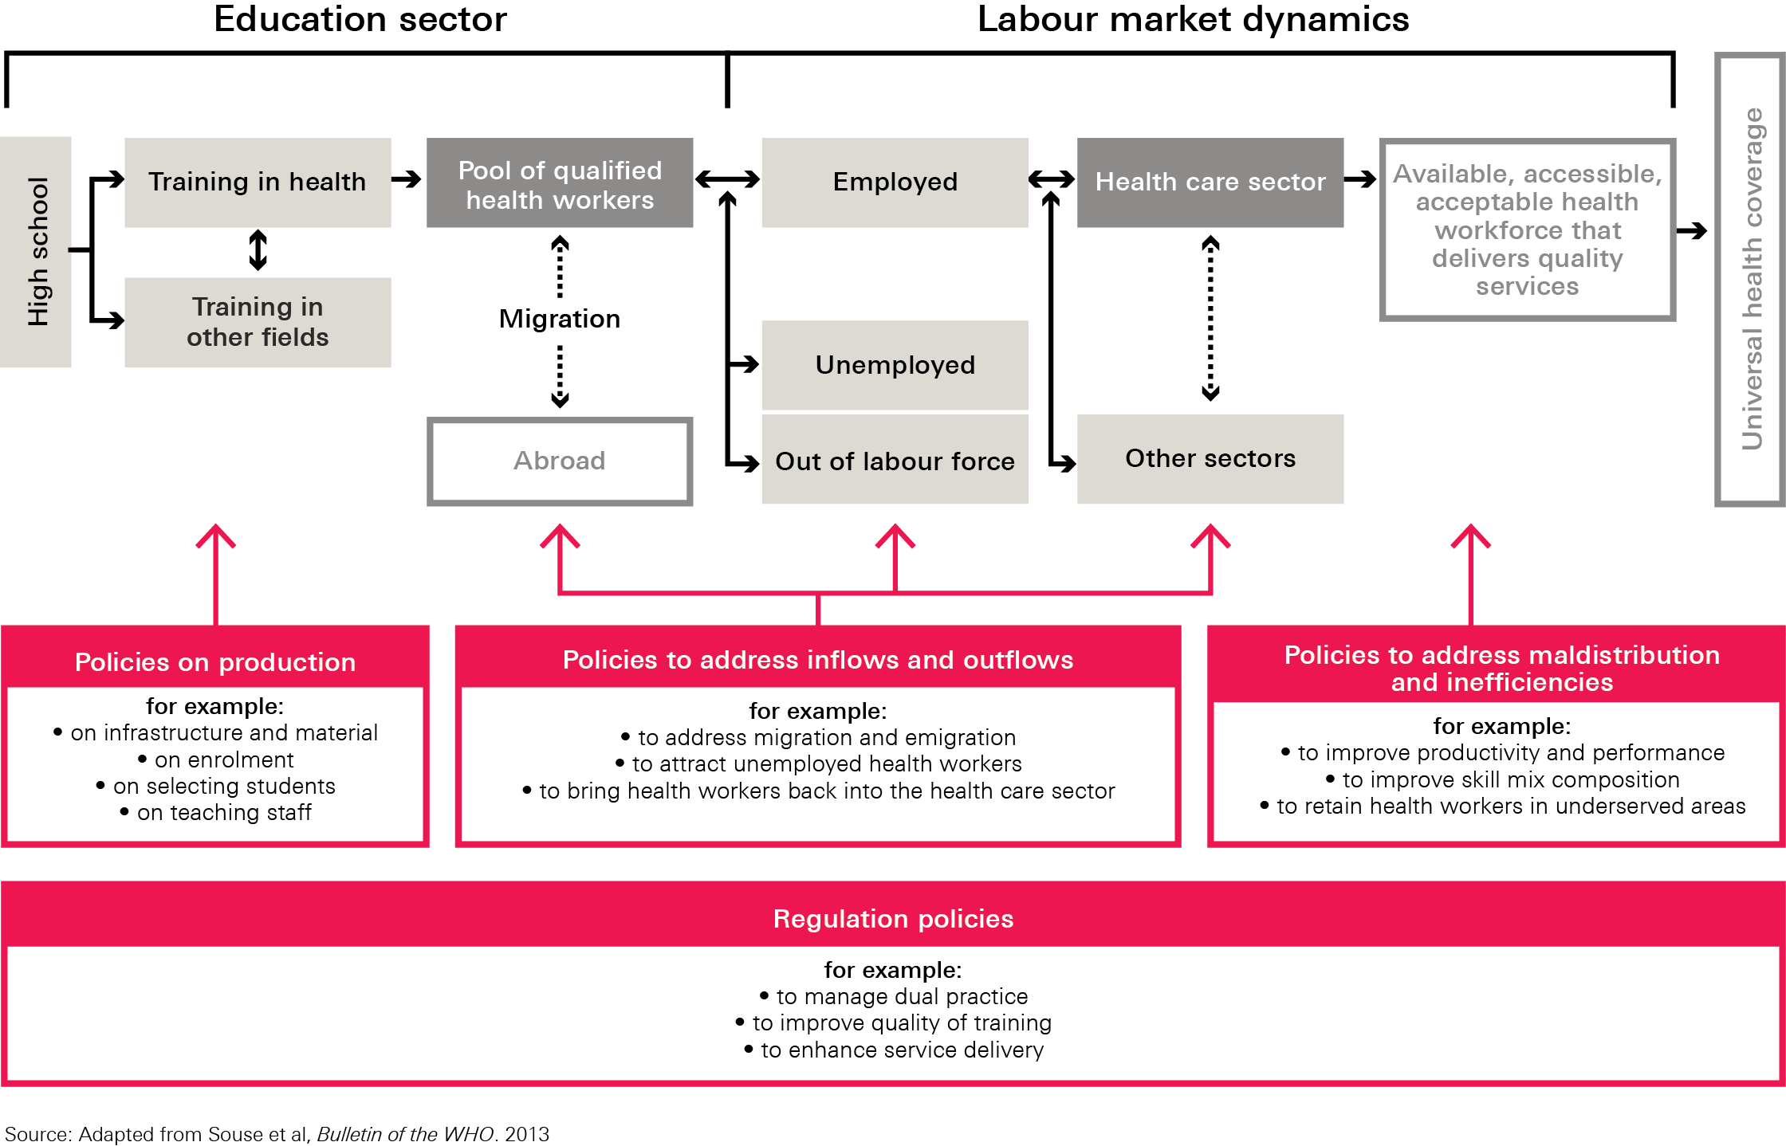
Figure 1: A Labour market framework for the health care workforce

Slide 3
Table 1: Recent workforce policy reports
Organisation | Report title | Publication date
National Audit Office | Managing the supply of NHS clinical staff in England15 | February 2016
NHS Improvement | Evidence from NHS Improvement on clinical staff shortages. A workforce analysis16 | February 2016
Department of Health | Operational productivity and performance in English NHS acute hospitals: Unwarranted Variations. An independent report for the Department of Health by Lord Carter of Coles17 | February 2016
NHS Pay review body | NHS Pay review body: Twenty-Ninth Report18 | March 2016
The Health Foundation | A perfect storm: an impossible climate for NHS providers12 | March 2016
Migration Advisory Committee | Partial review of the Shortage Occupation List. Review of nursing19 | March 2016
The Health Foundation | Fit for purpose? Workforce policy in the English NHS20 | March 2016
Public Accounts Committee | Managing the supply of NHS clinical staff in England. Fortieth Report of Session 2015–1621 | April 2016
Nuffield Trust | Reshaping the workforce to deliver the care patients need22 | May 2016

Slide 4
Table 2: National changes in NHS workforce planning in England, selected list, 2000–16
Year | Change | Year | Change
2000 | NHS Plan published – NHS staffing growth targets published NHS HRH Plan published | 2009 | Medical Education England (MEE) and Professional Advisory Boards (PABs) established
2001 | 27 regional Workforce Development Confederations (WDC) established Primary Care Trusts (PCT) established NHS Modernisation Agency created NHS Workforce Review Team (WRT) established to produce national annual recommendations for planning for all of the main clinical staff groups National Workforce Development Board established | 2010 | Department of Health (DH) publishes Developing the Healthcare Workforce proposing to create a new body which would supersede both MEE and the PABs. Health Education England (HEE) was to ‘go live’ in April 2012
2002 | Strategic Health Authorities (SHA) created | 2010 | DH contract a management consultancy to set up and run the Centre for Workforce Intelligence (CfWI), to be ‘the national authority on workforce planning and development and the primary source of workforce intelligence’ National Workforce Review team closed down as a result; some staff and functions transferred to CfWI
2004 | WDCs ended, merged with SHAs NHS Employers established | 2013 | HEE becomes operational, absorbing MEE (a year later than initially planned); SHAs abolished PCTs abolished; Clinical Commissioning Groups (CCGs) established NHS Institute for Innovation and Improvement closed
2005 | Modernisation Agency replaced with NHS Institute for Innovation and Improvement | 2016 | CfWI closed down; some functions transferred to DH, and HEE NHS Improvement established (by merger of Monitor, Trust Development Agency and other bodies)
2006 | Number of SHAs reduced from 28 to 10

Slide 5
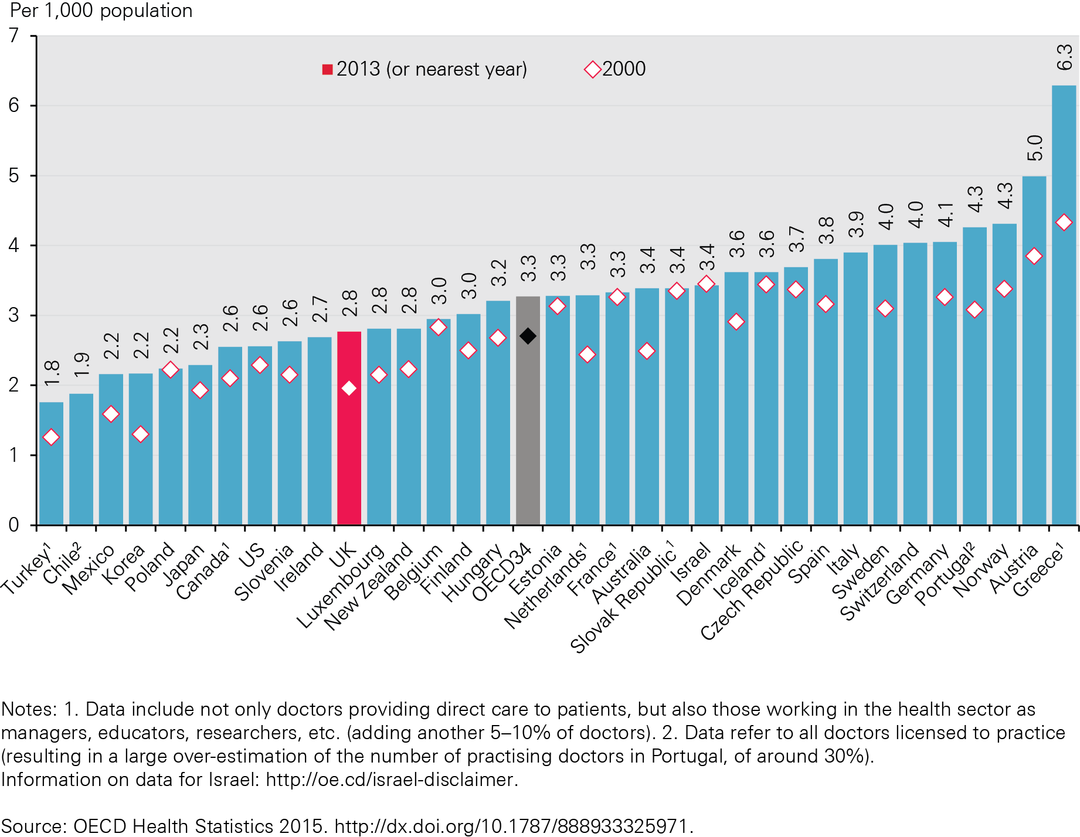
Figure 2: Number of doctors/1,000 population in OECD countries, 2000 and 2013 (or nearest year)

Slide 6
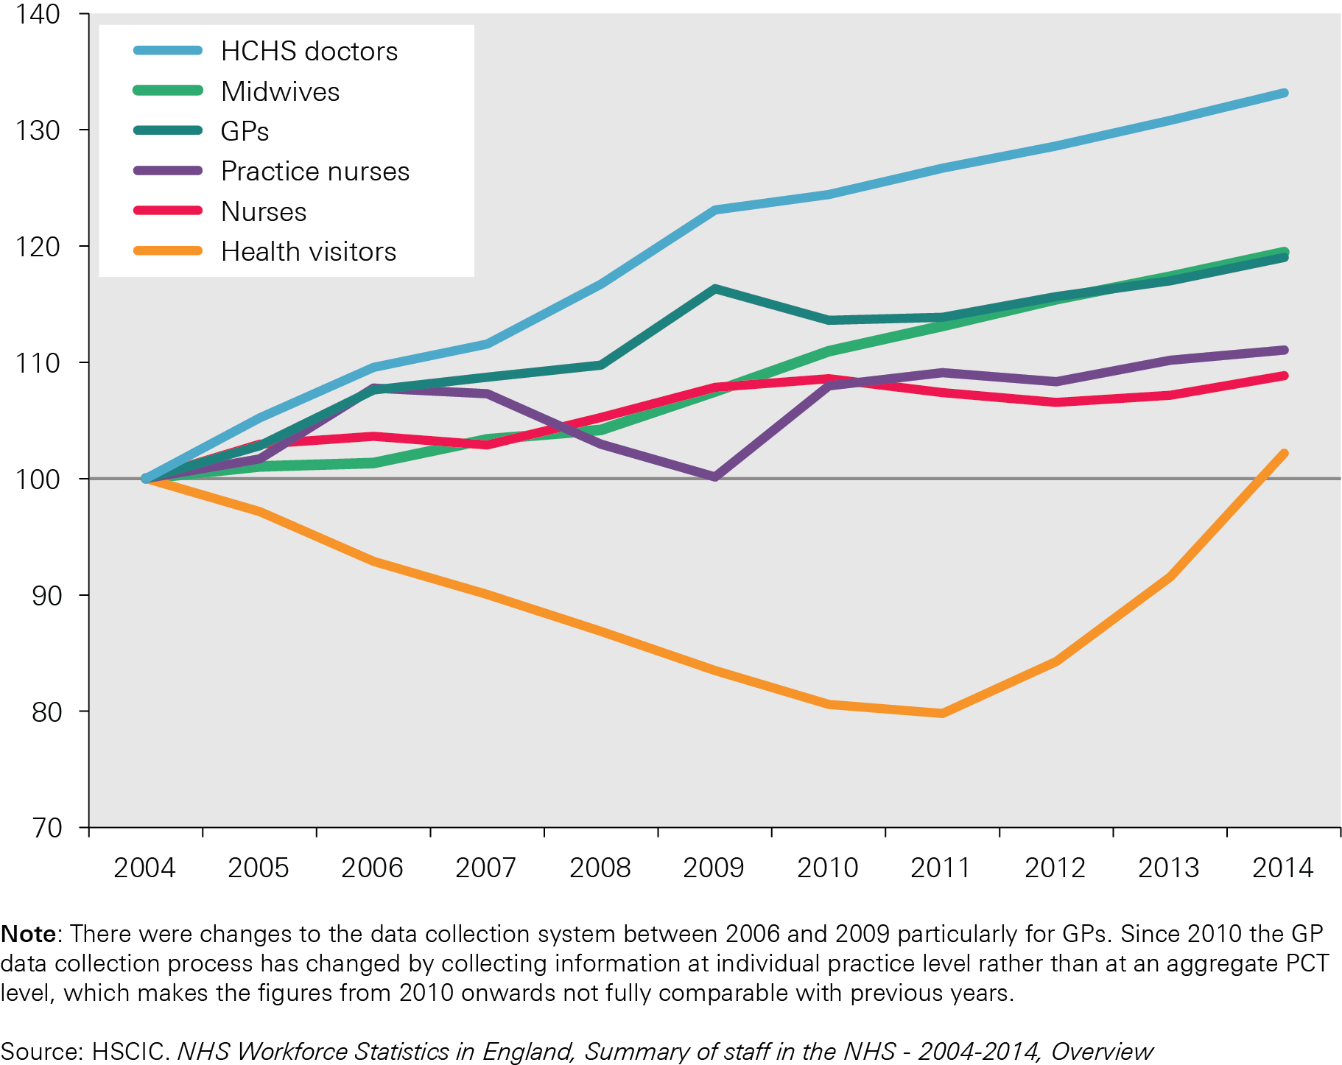
Figure 3: Change in selected occupations in the English NHS 2004–14 (FTE)

Slide 7
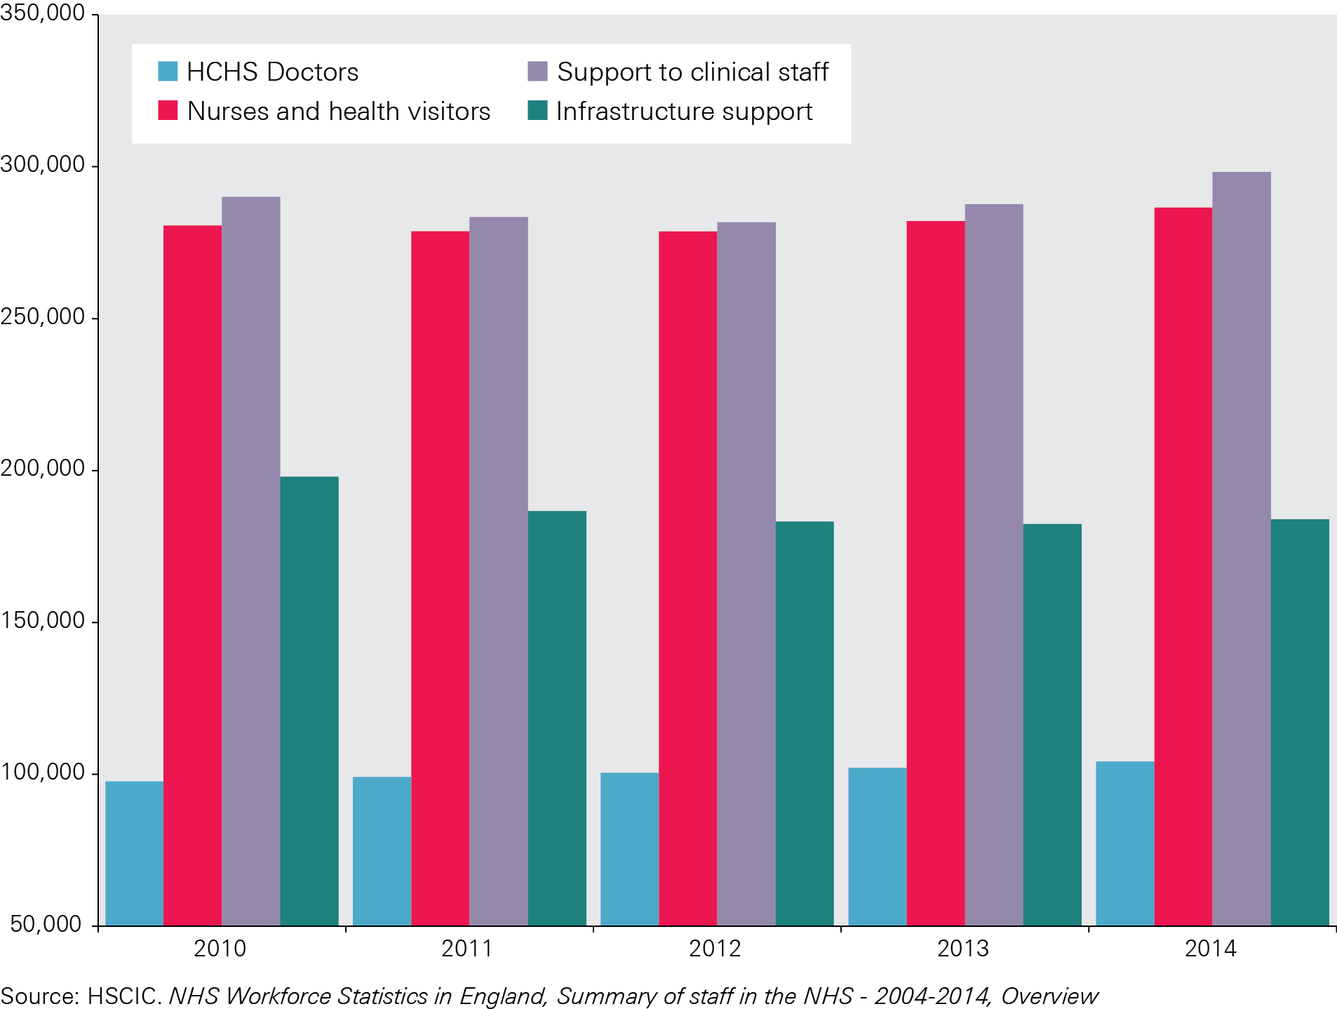
Figure 4: Number of nurses employed in acute, general and elderly sectors, excluding bank and agency staff (FTE)

Slide 8
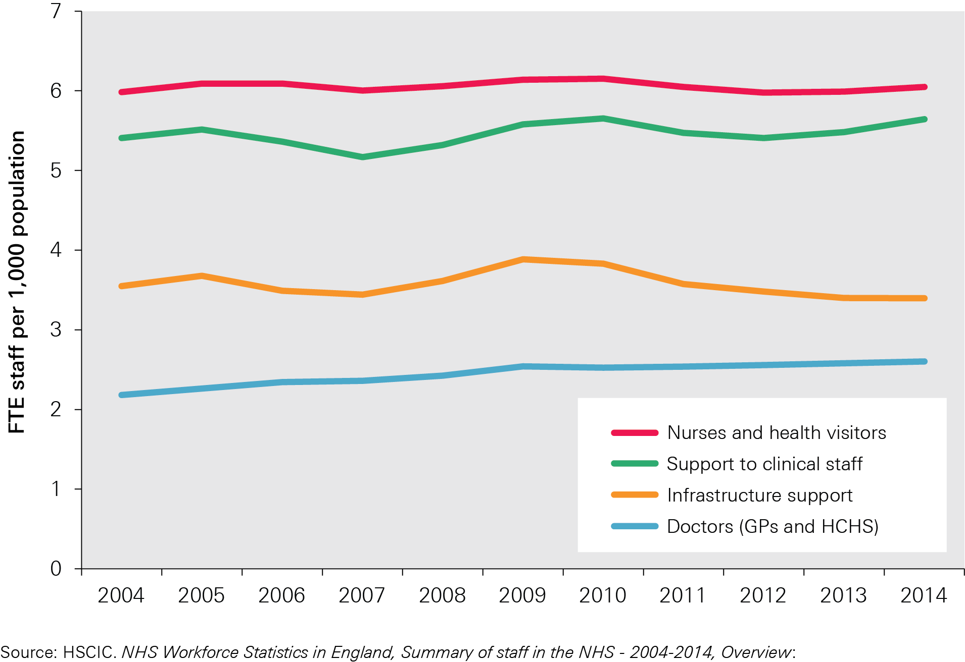
Figure 5: Staff:population ratios, 2004–14

Slide 9
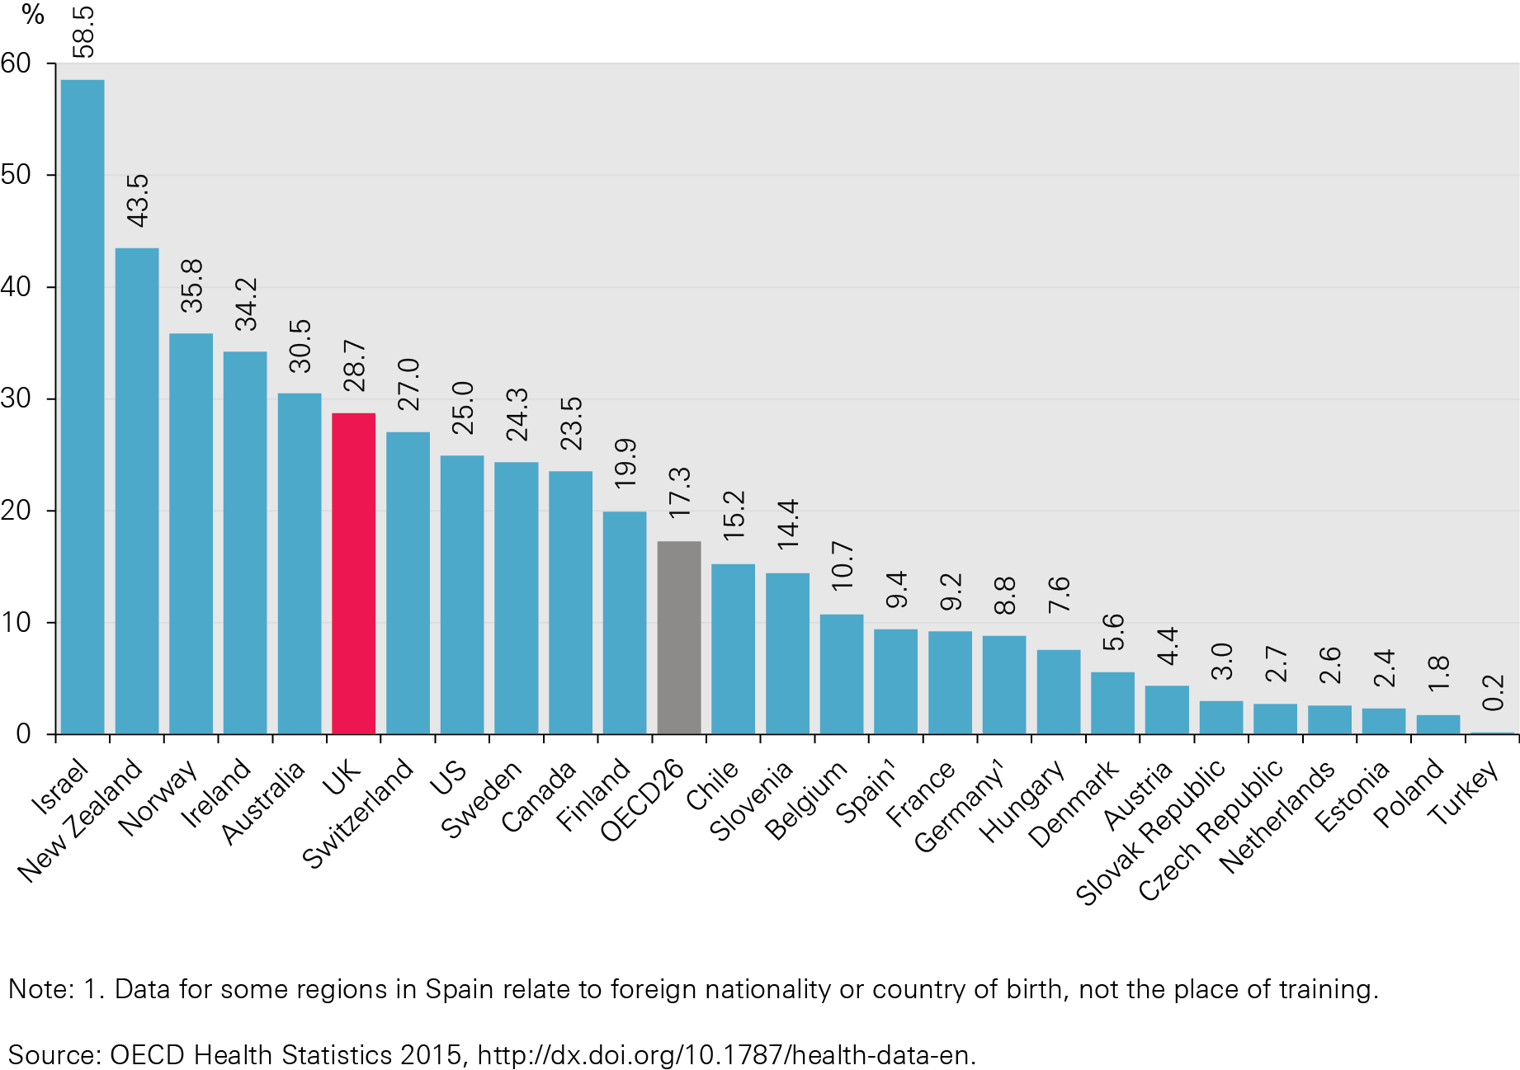
Figure 6: Percentage of doctors who were foreign trained, 2013

Slide 10
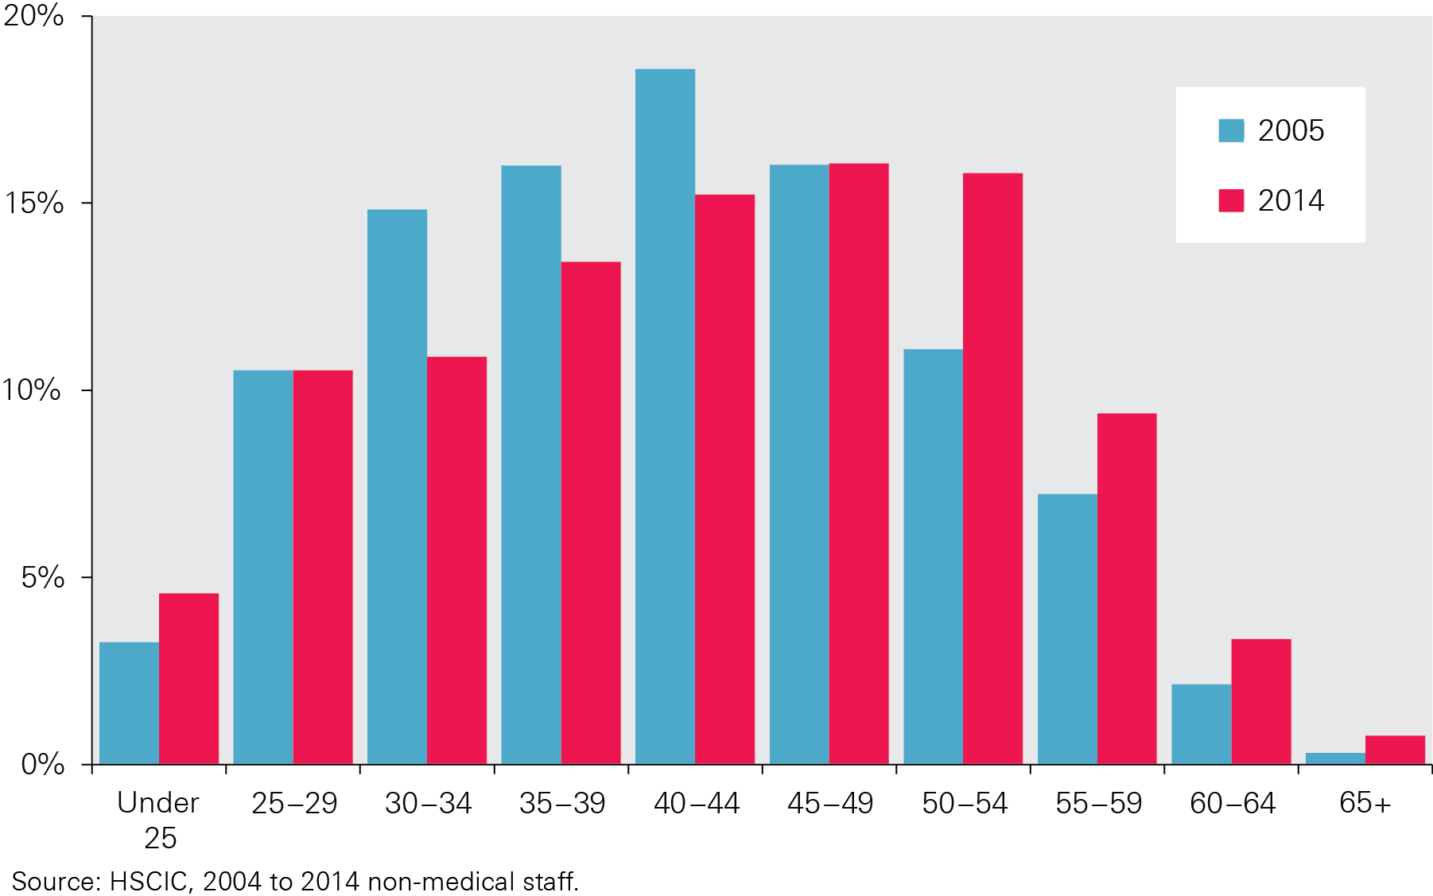
Figure 7: Qualified nurses, midwives and health visitors (headcount) by age group, 2005 and 2014

Slide 11
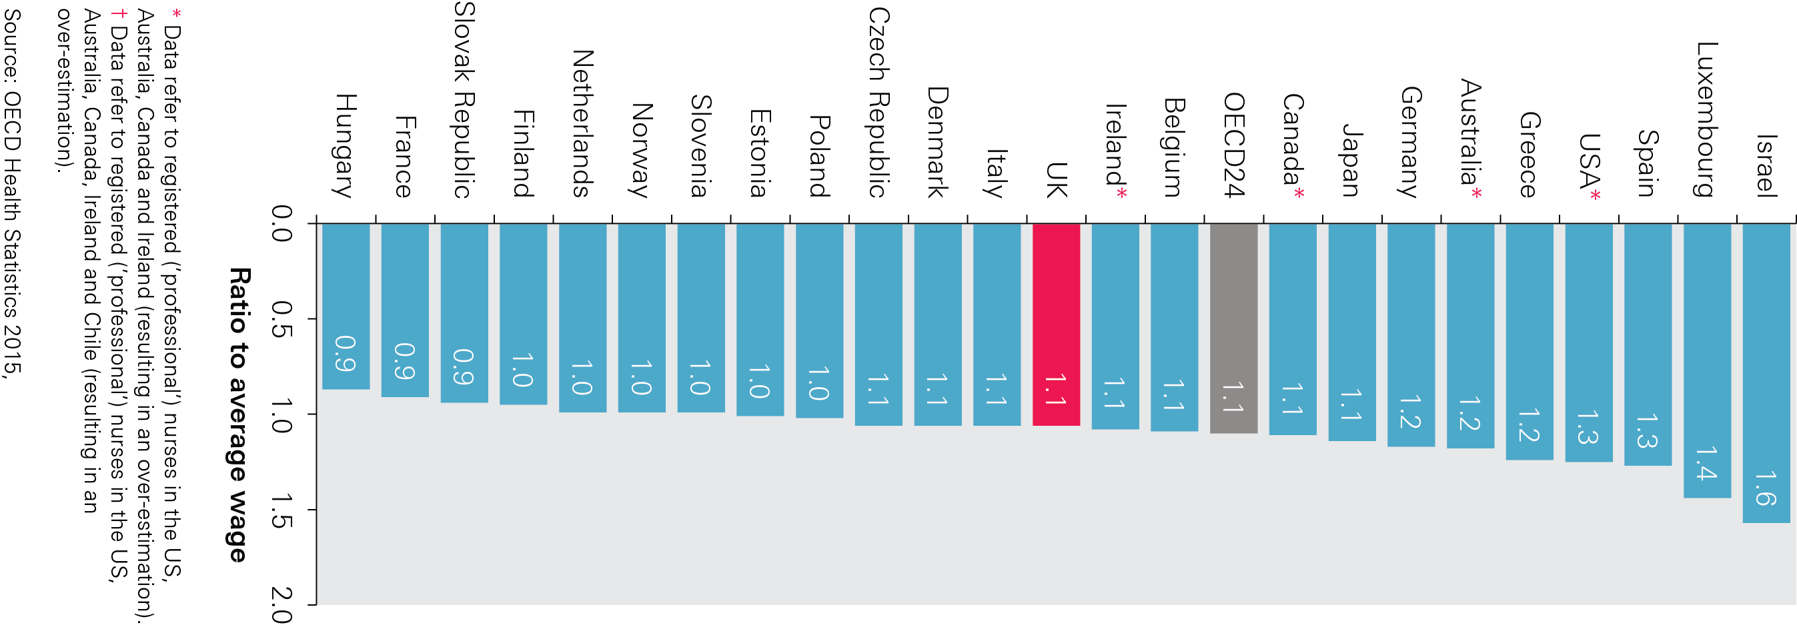
Figure 8: Remuneration of hospital nurses, ratio to average wage, 2013 (or nearest year)

Slide 12
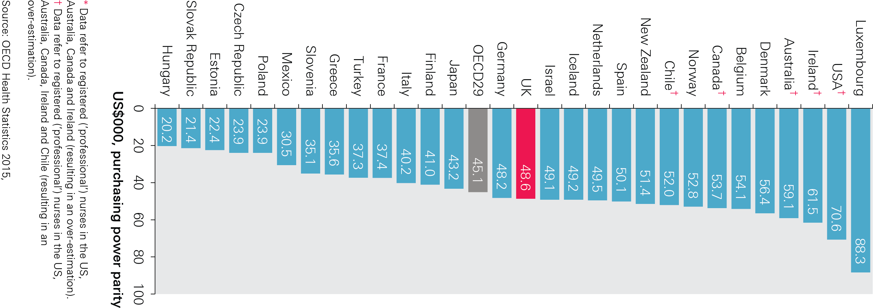
Figure 9: Remuneration of hospital nurses, US$000 purchasing power parity, 2013 (or nearest year)

Slide 13
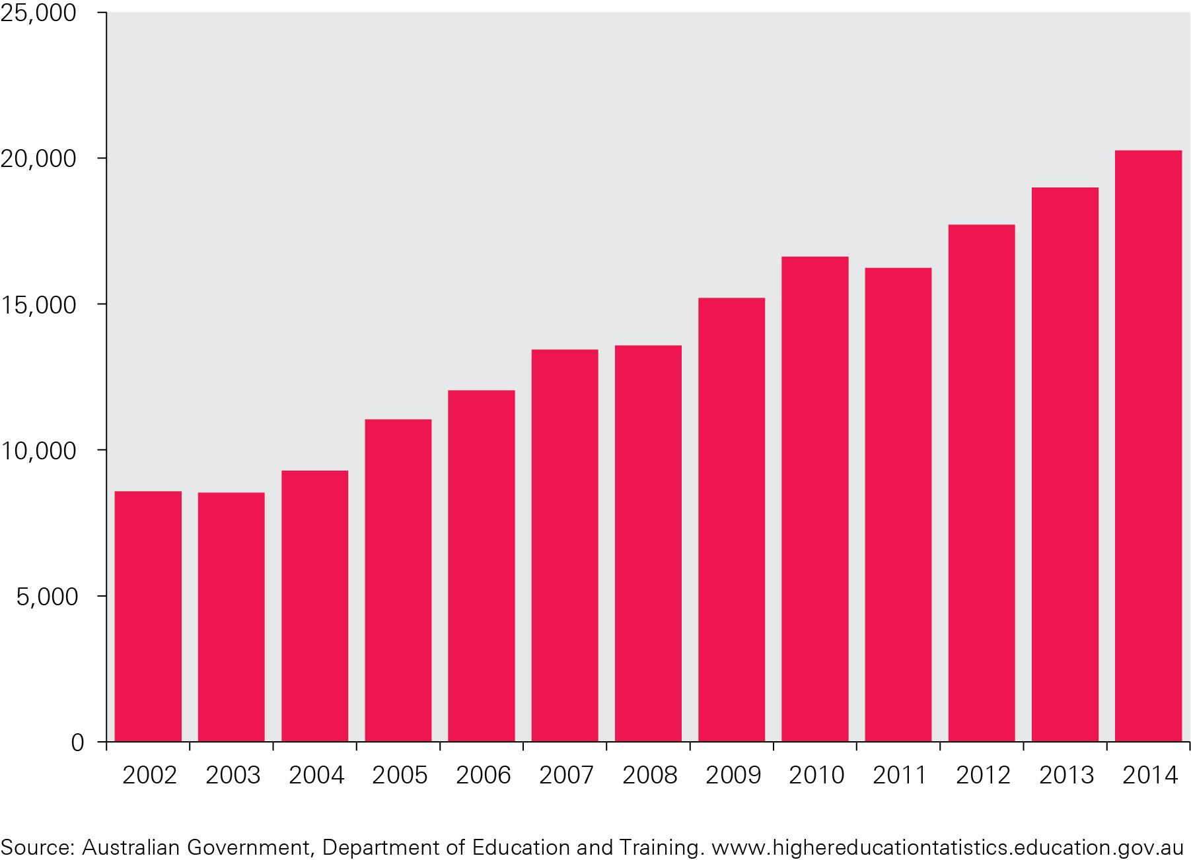
Figure 10: Commencing enrolments of students for general nursing courses in Australia, 2002–14

Slide 14
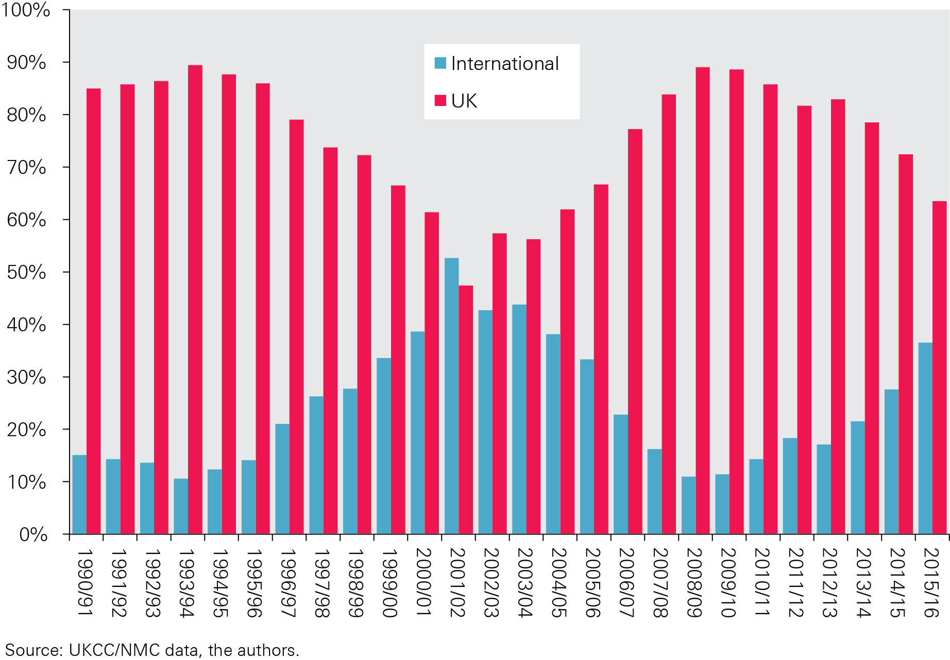
Figure 11: International and UK sources as a % of total new admissions to the UK nursing register, 1990/91–2015/16 (initial registrations)

Slide 15
The Health Foundation is an independent charity committed to bringing about better health and health care for people in the UK.
We connect what works on the ground with effective policymaking and vice versa.

Slide 16
Subscribe to our email newsletter
Register for email alerts to be notified about our latest work
Follow us on Twitter, Facebook, YouTube or LinkedIn

