Slide 1
NHS finances outside the EU
Health Foundation analysis of the impact on NHS finances of the UK leaving the European Union
July 2016

Slide 2
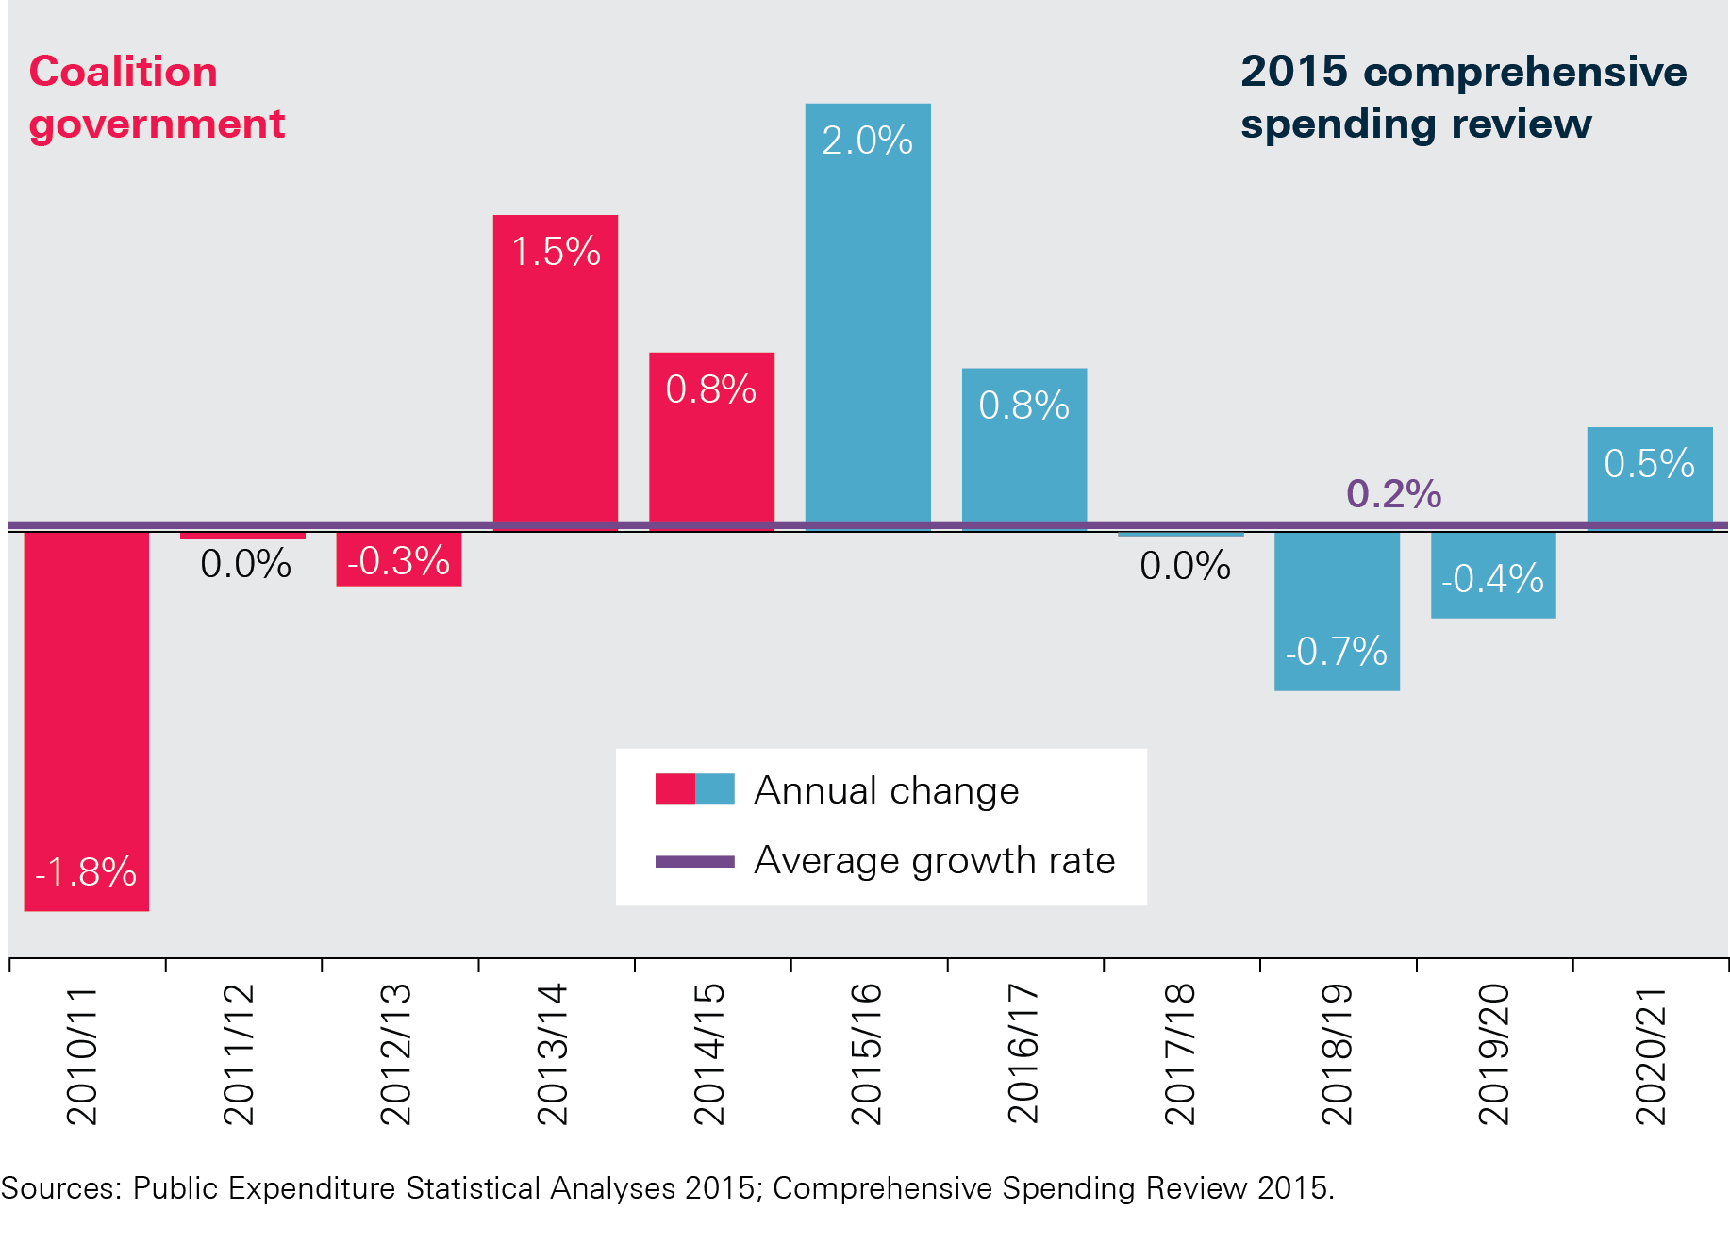
Annual change in NHS spend per head in England, real terms, 2010/11–2020/21
Notes:
Public Expenditure Statistical Analyses 2015
Comprehensive Spending Review 2015

Slide 3
OBR projections for economic growth, March 2016
 | 2015 | 2016 | 2017 | 2018 | 2019
GDP real terms annual growth | 2.2 | 2.0 | 2.2 | 2.1 | 2.1
Public sector net borrowing as % GDP | 3.8 | 2.9 | 1.9 | 1.0 | -0.5
Inflation (CPI) | 0 | 0.7 | 1.6 | 2 | 2.1
GDP deflator | 0.3 | 1.1 | 1.9 | 2.0 | 1.9

Slide 4
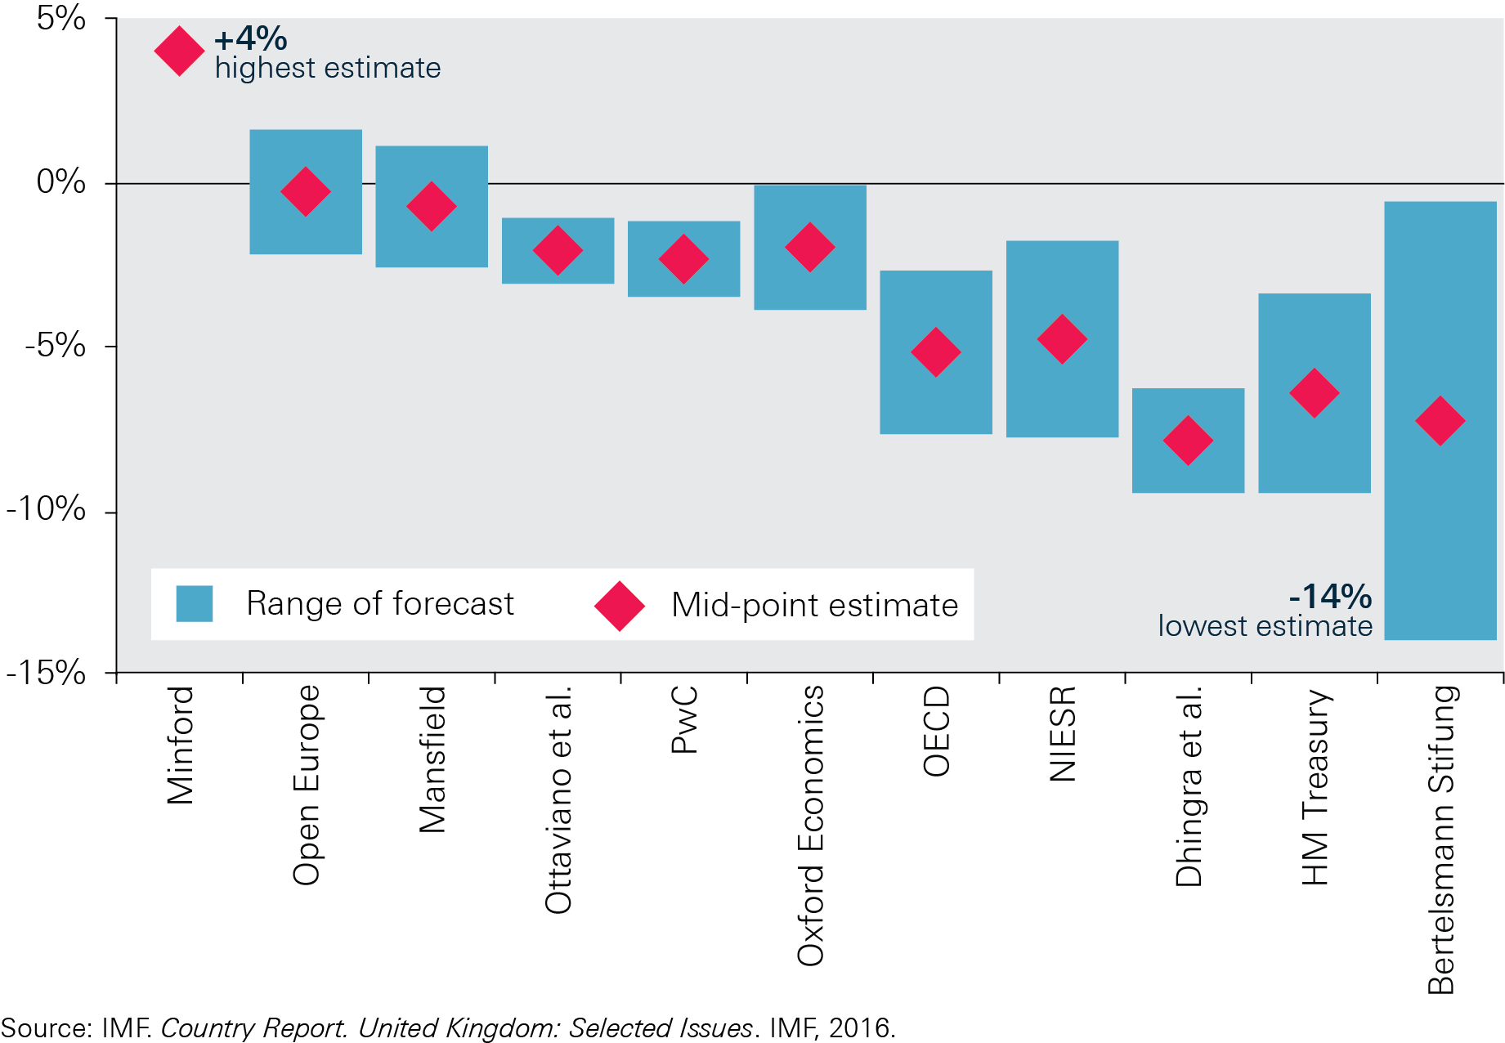
Forecasts of change to GDP in 2030/31 following UK leaving the EU
Notes:
IMF Country Report. (2016). United Kingdom: Selected Issues.

Slide 5
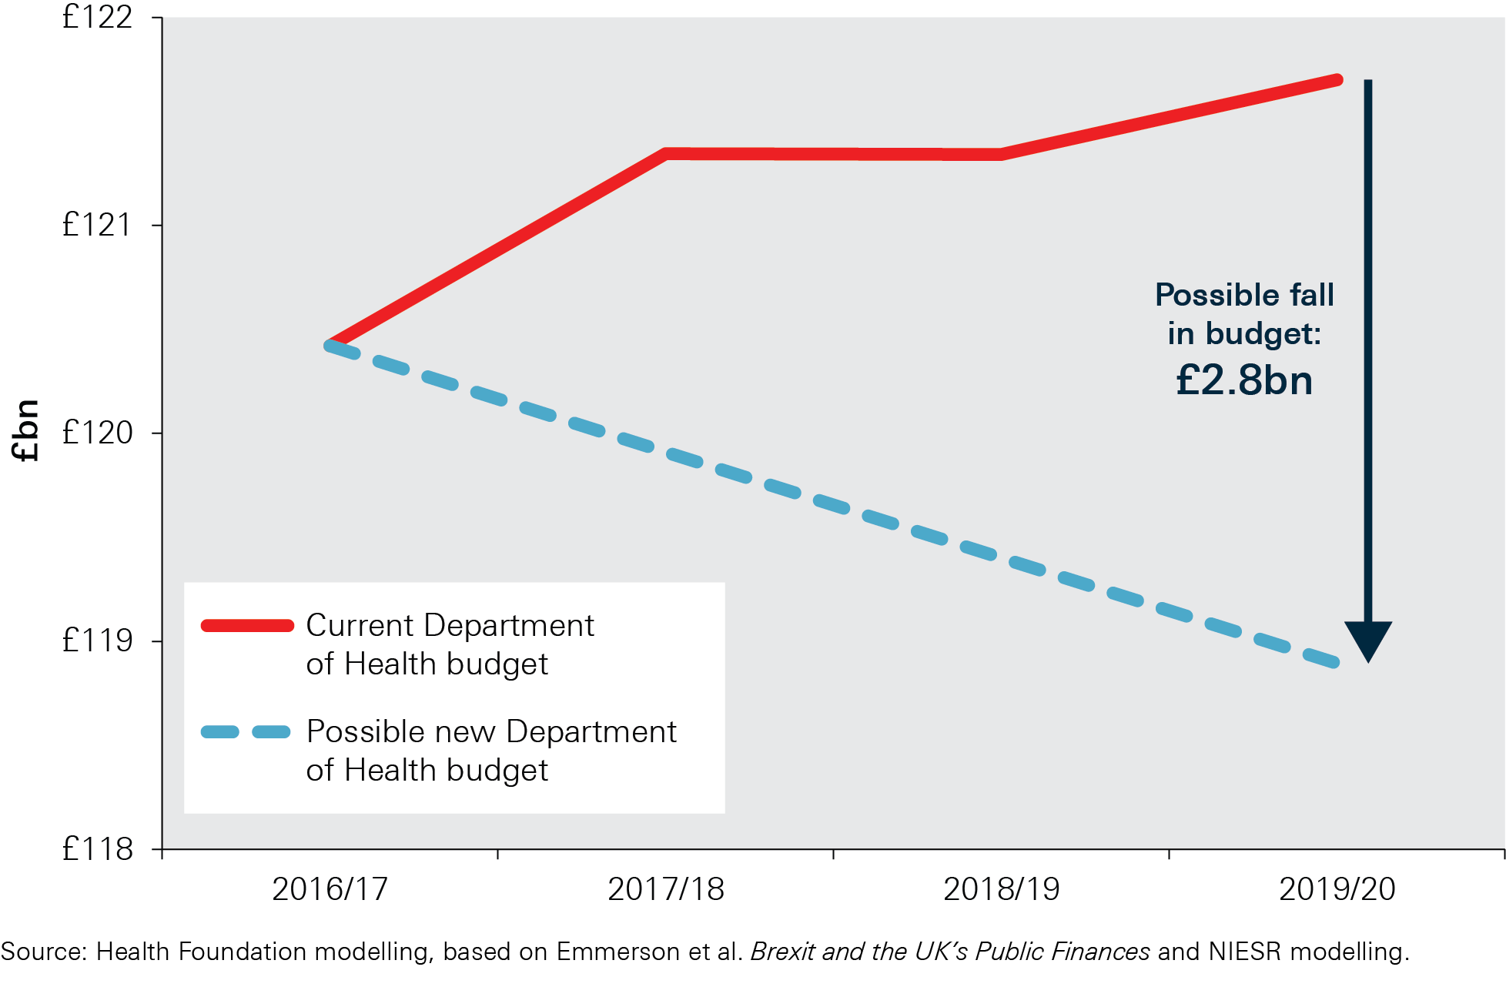
Estimated fall in budget for the Department of Health
Notes:
Department of Health Annual Report and Accounts 2014-15

Slide 6
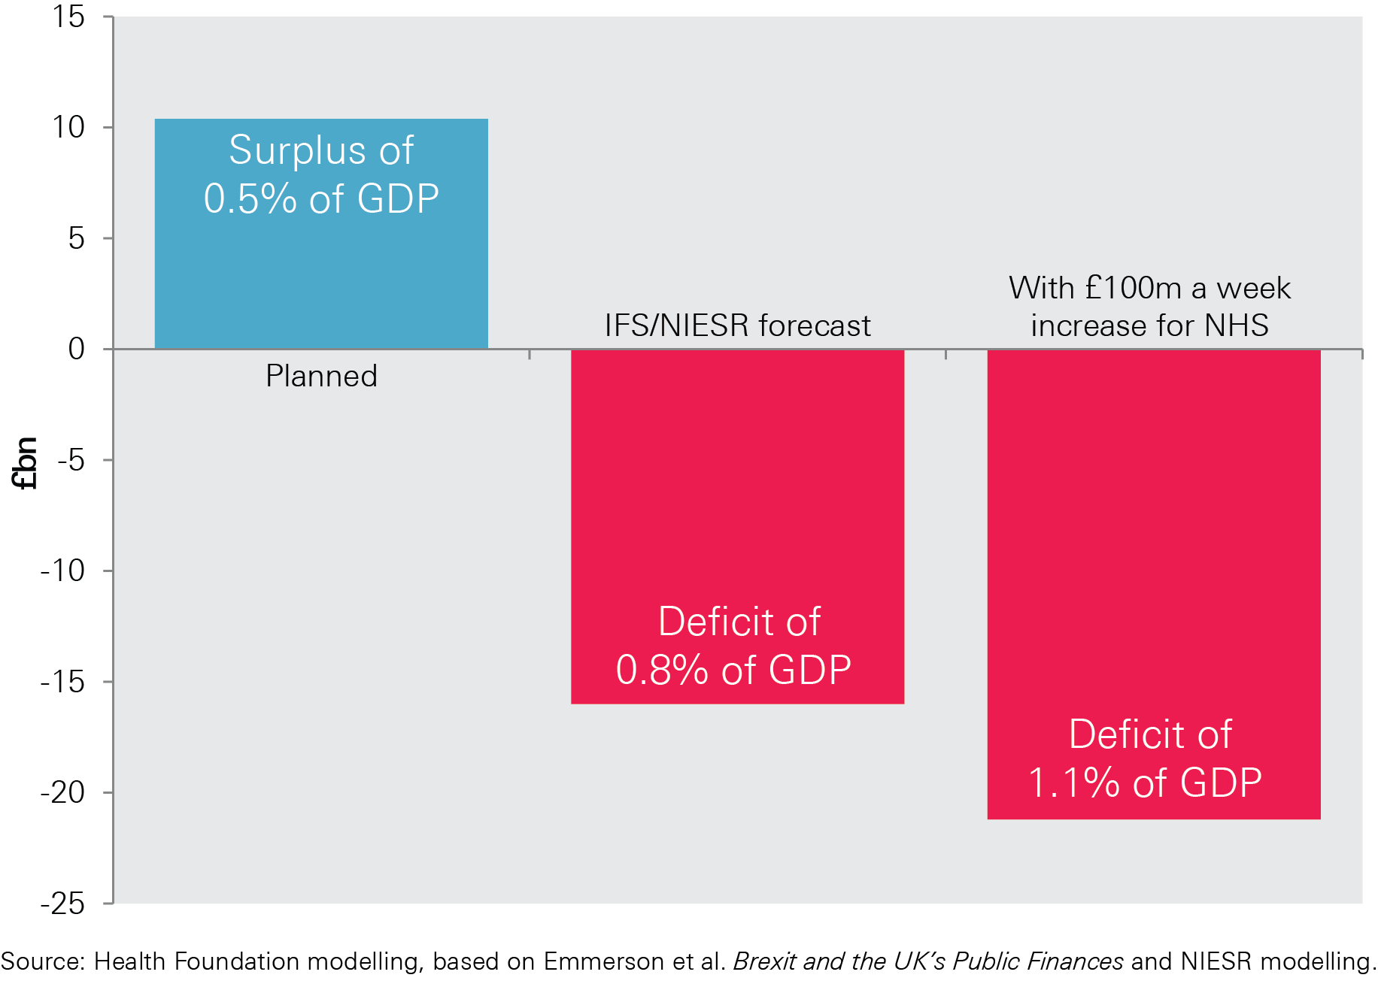
Impact of NIESR forecast on planned budget surplus, and impact of £100m a week increase
Notes:
Department of Health Annual Report and Accounts 2014-15

Slide 7
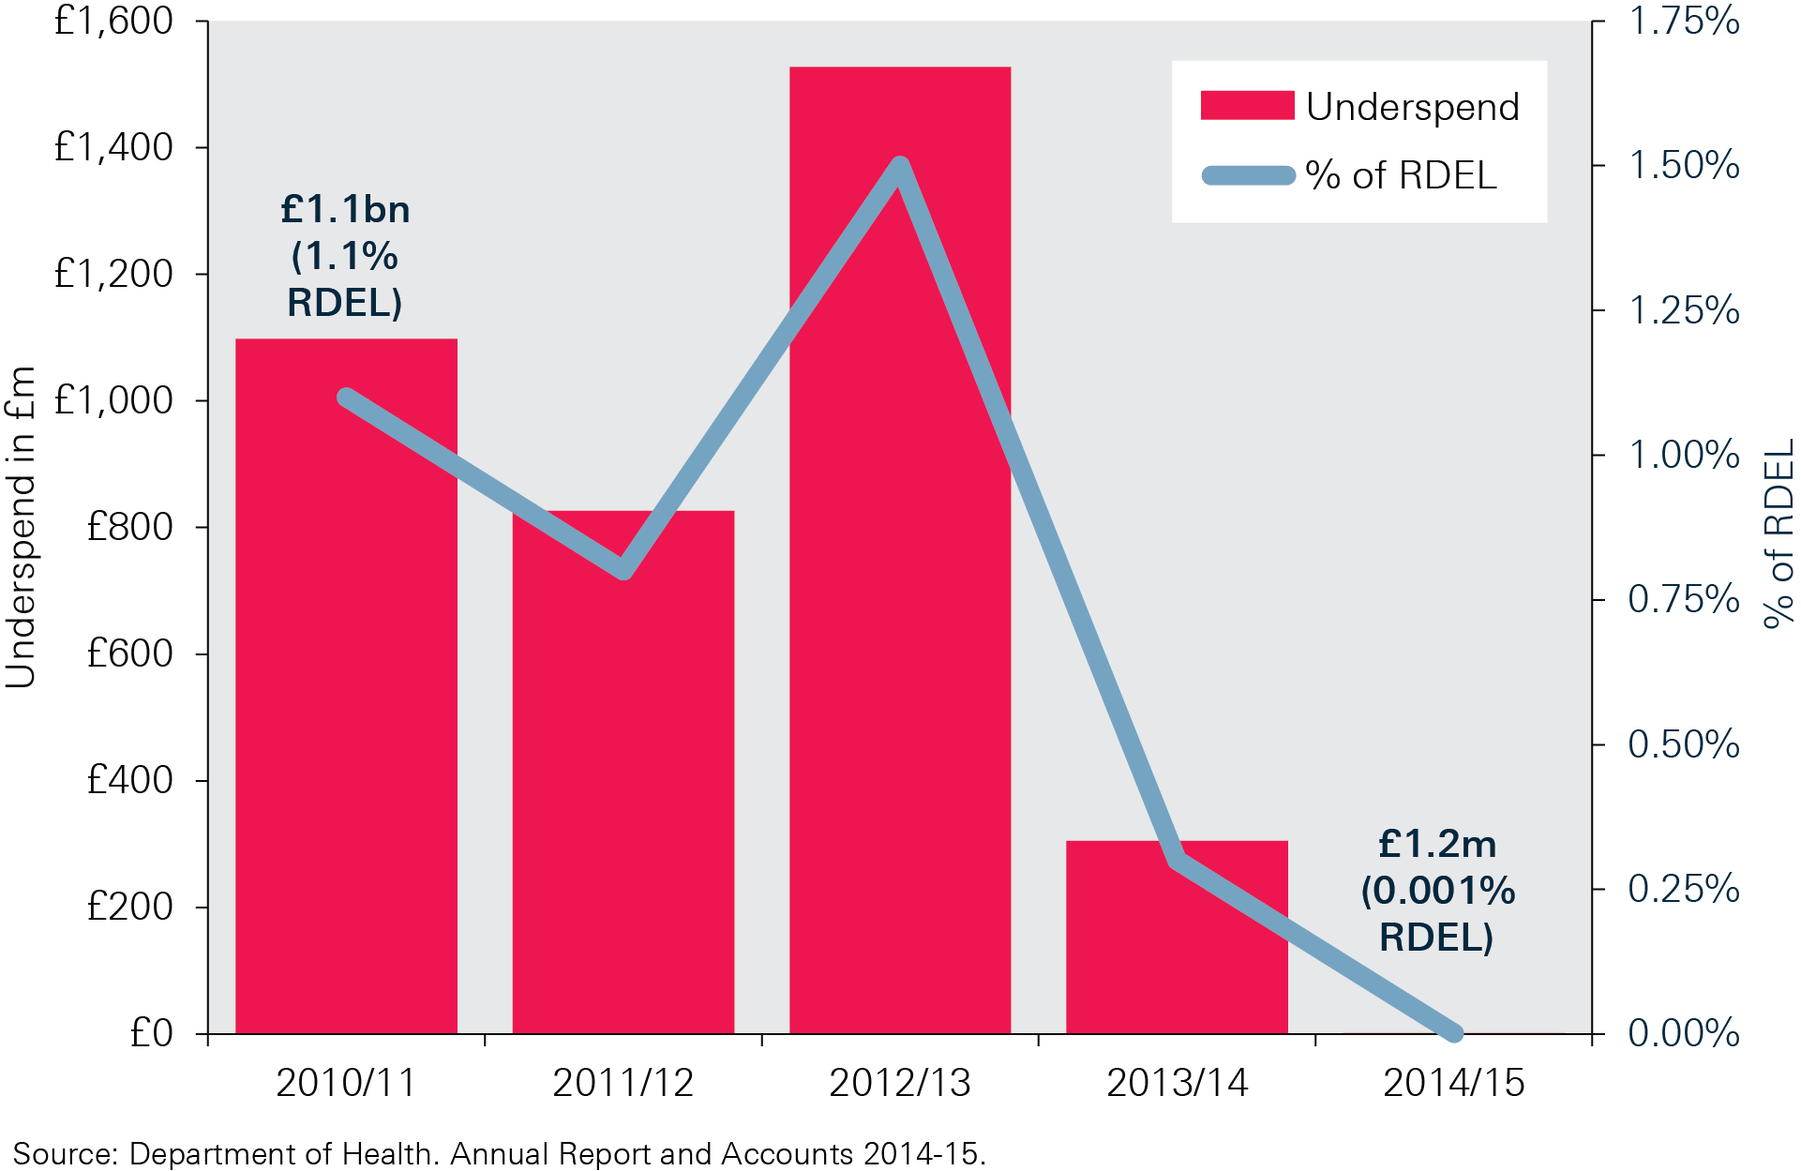
Recent spending against the Department of Health budget, 2010/11–2014/15 (cash terms)
Notes:
Department of Health Annual Report and Accounts 2014-15

Slide 8
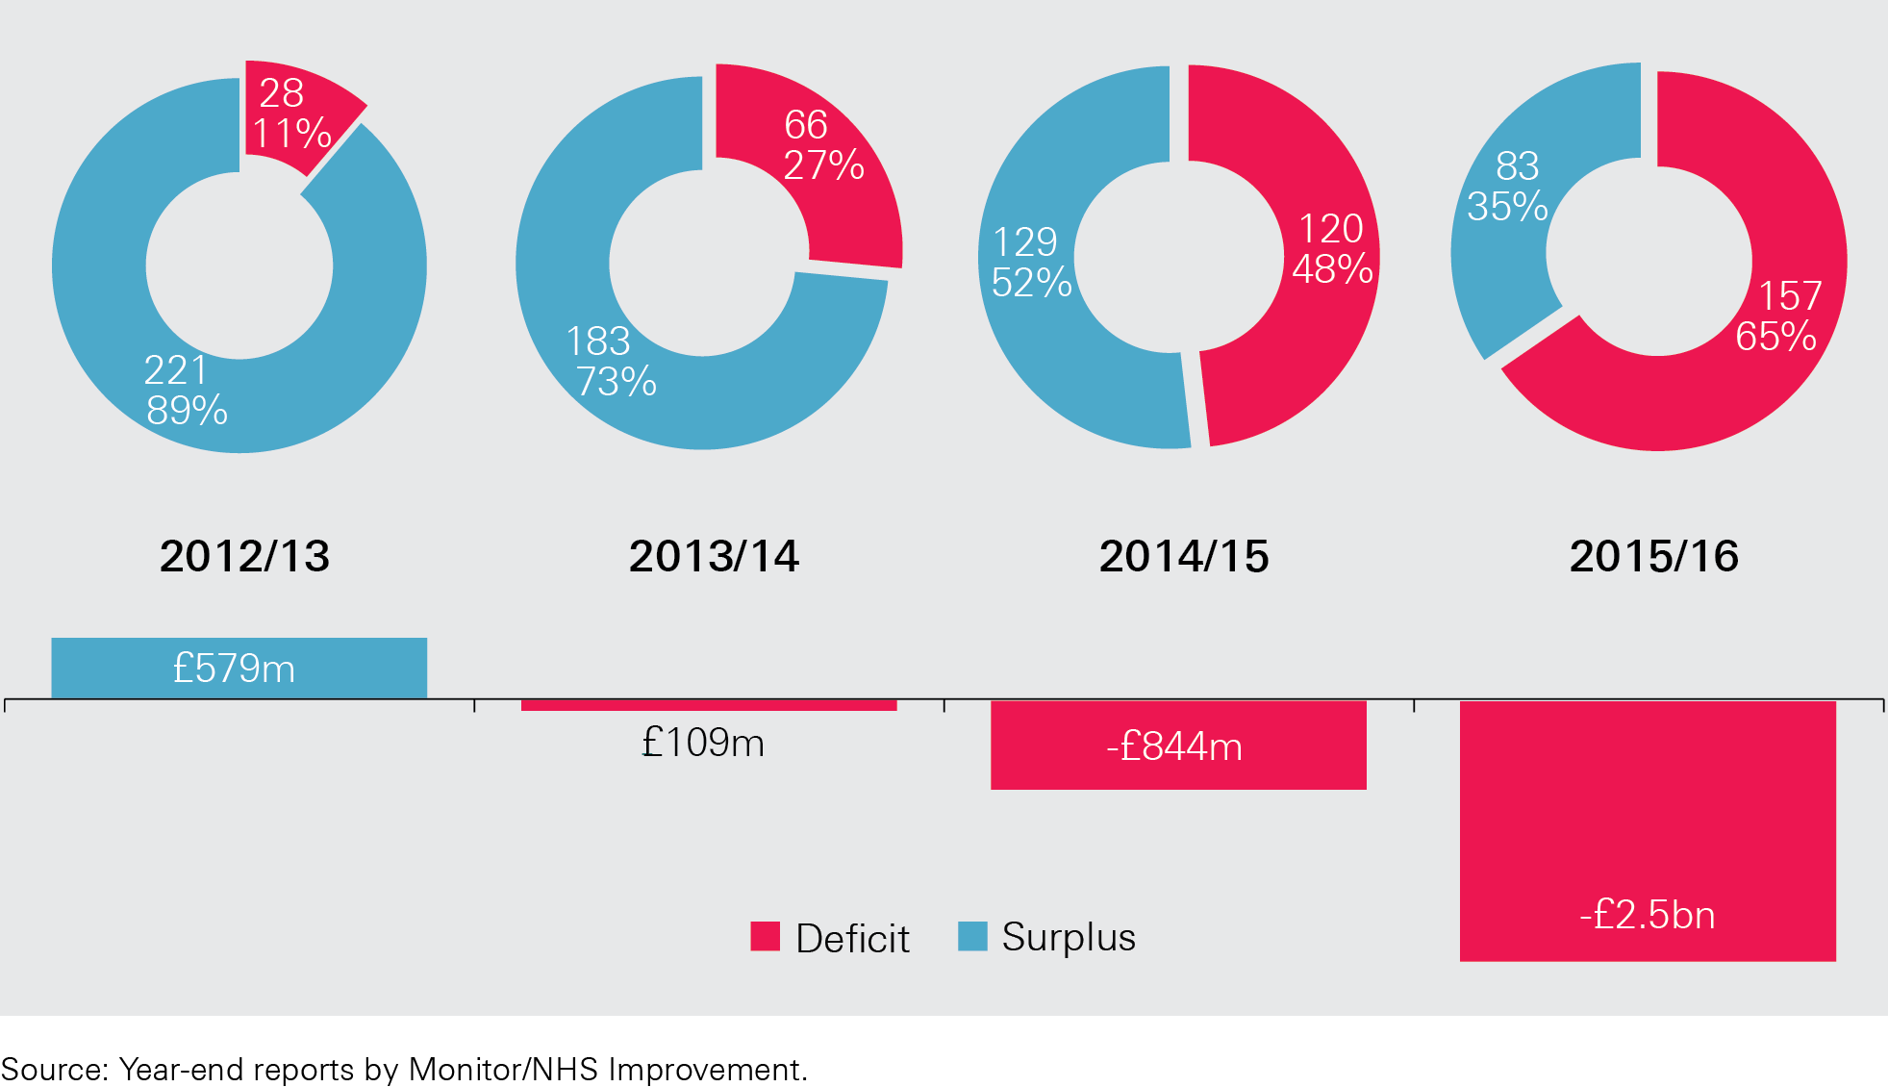
NHS provider surplus/deficit, 2013/13–2015/16
Notes:
Year-end reports by Monitor/NHS Improvement

Slide 9
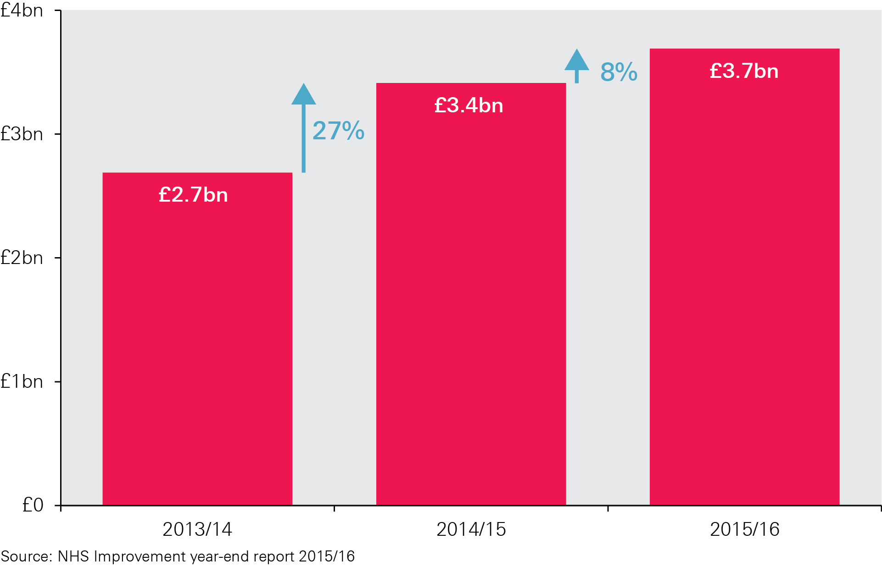
Agency staff cost 2013/14–2015/16
Notes:
Year-end reports by Monitor/NHS Improvement

Slide 10
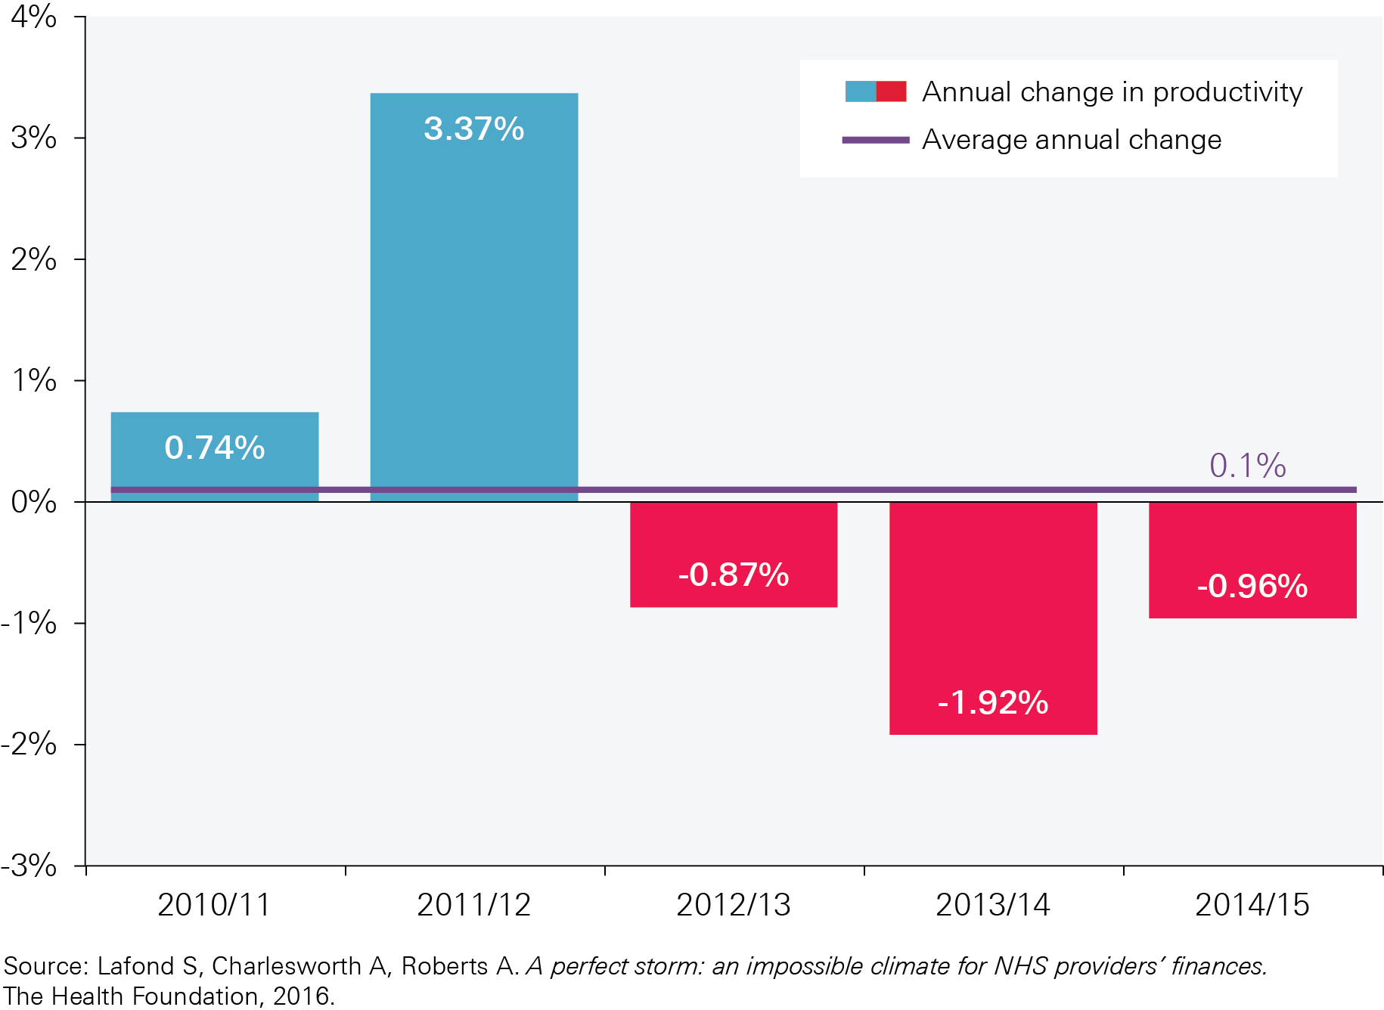
Annual change in hospital productivity, 2009/10–2014/15
Notes:
Year-end reports by Monitor/NHS Improvement

Slide 11
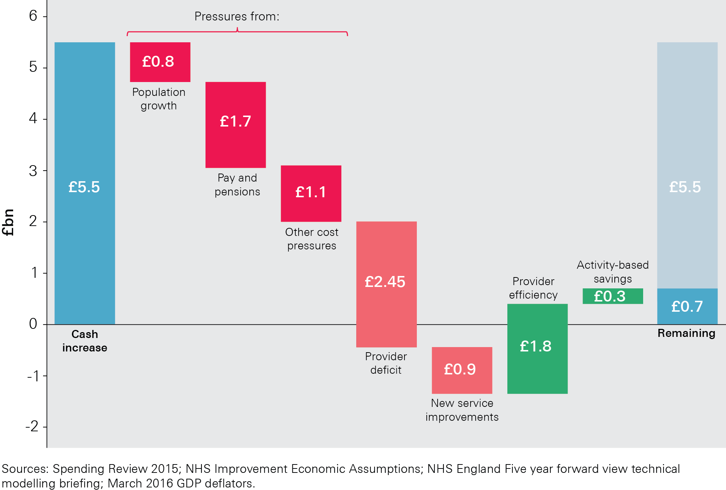
NHS England cash increase for 2016/17 – the impact of cost and demand pressures and efficiency savings
Notes:
Year-end reports by Monitor/NHS Improvement

Slide 12
NHS funding gap scenarios
 | Funding gap in 2019/20 (£bn, 2016/17 prices)
Efficiency growth | Gap based on current budget | Gap based on possible new budget if the UK leaves the EU
0.0% | £11.9 | £14.7
1.0% | £7.2 | £10.0
1.5% | £5.0 | £7.8
2–3% | £0.5 | £3.3

Slide 13
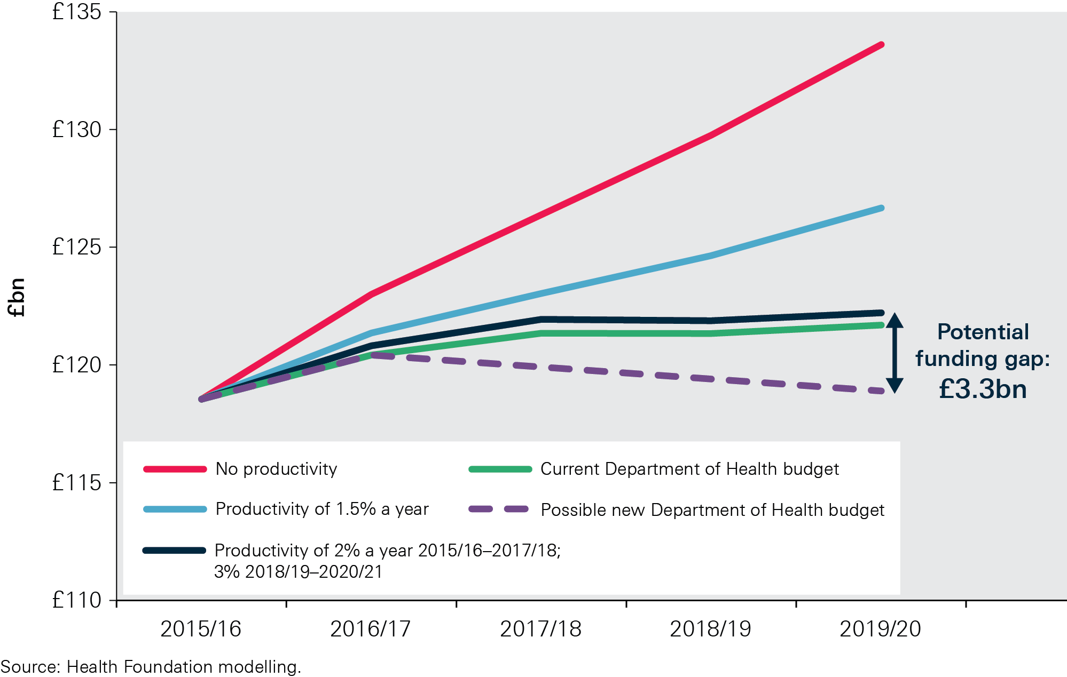
NHS funding gap scenarios, 2015/16–2019/20

Slide 14
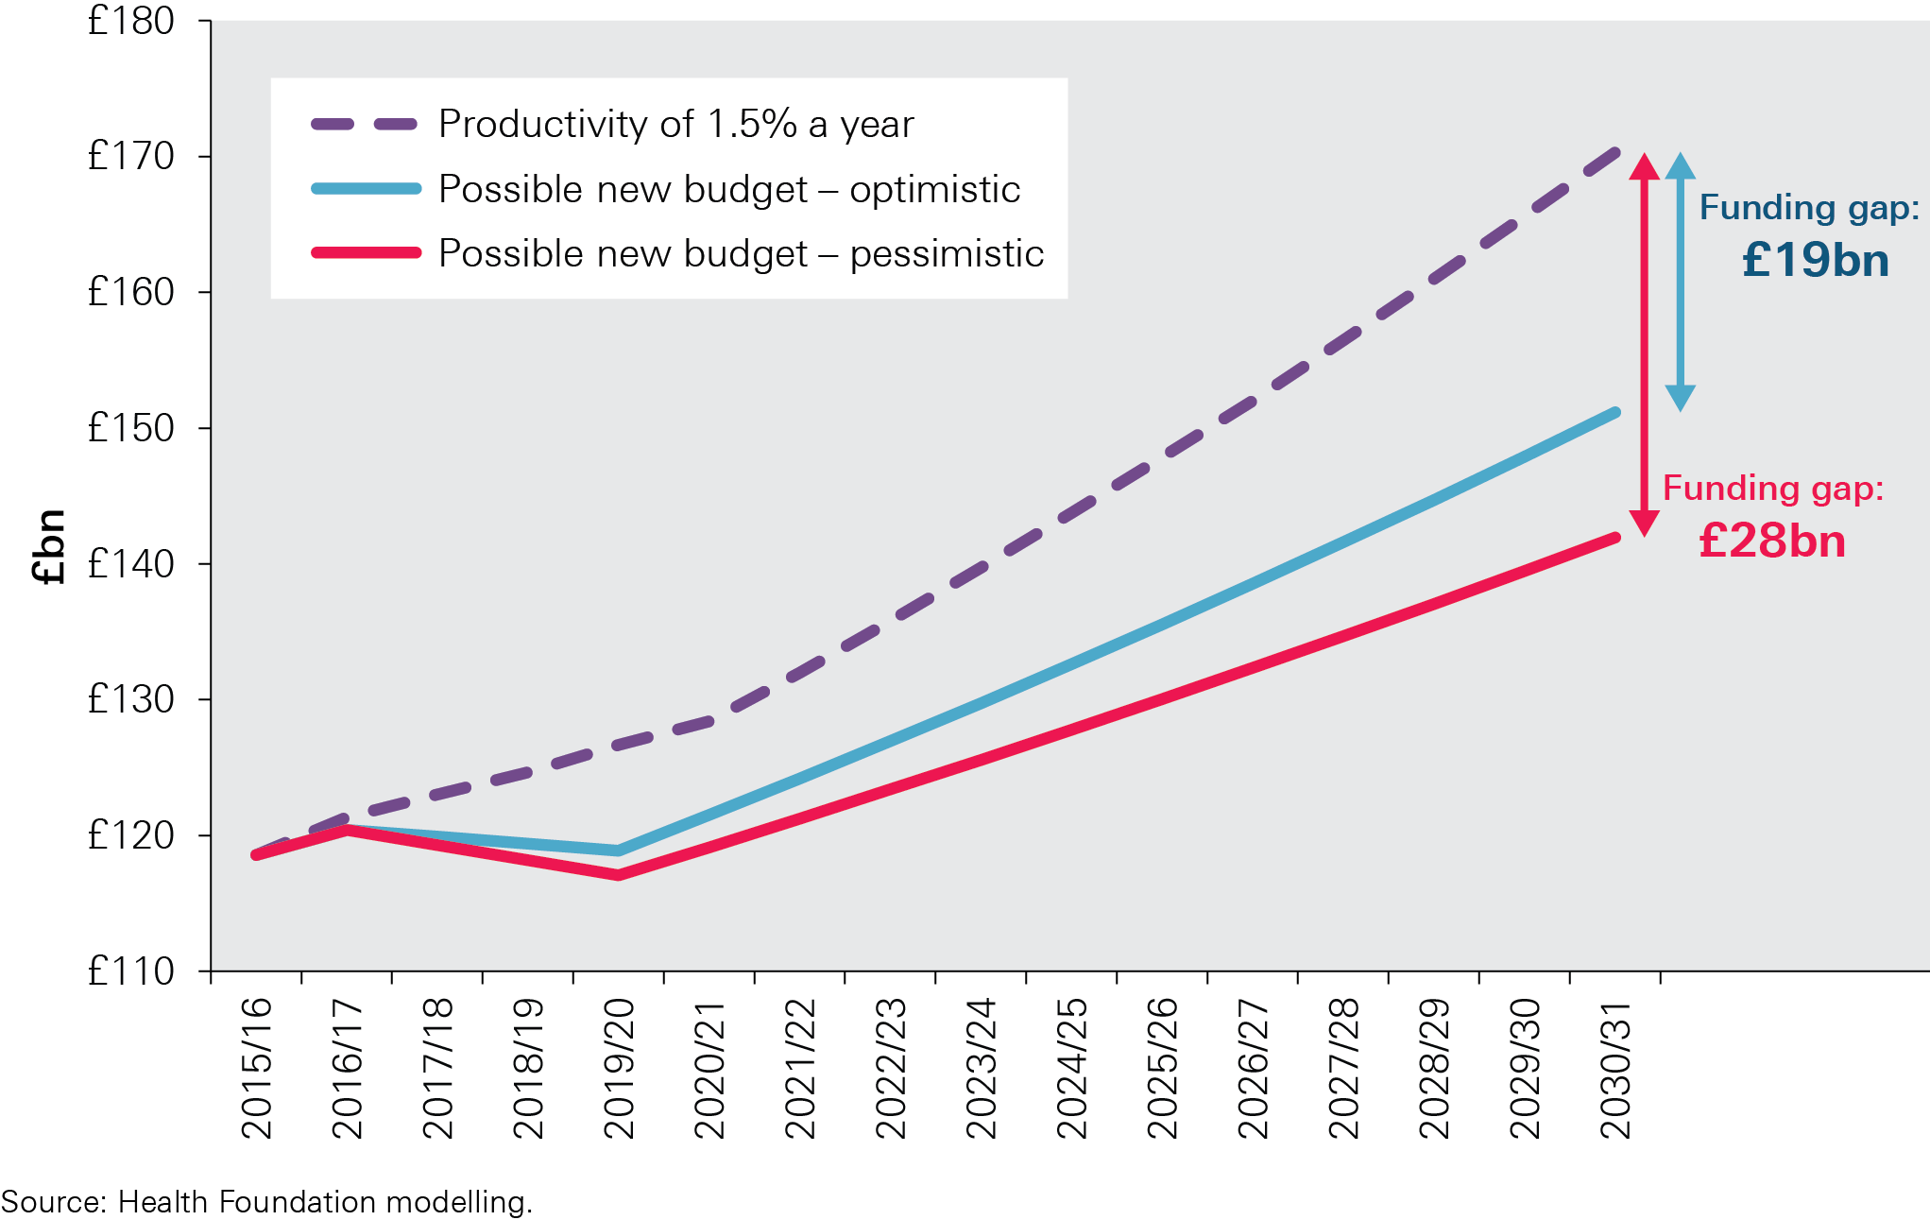
Potential funding gap for the Department of Health in 2030/31
Notes:
Health Foundation modelling

Slide 15
The Health Foundation is an independent charity committed to bringing about better health and health care for people in the UK.
We connect what works on the ground with effective policymaking and vice versa.

Slide 16
Subscribe to our email newsletter
Register for email alerts to be notified about our latest work
Follow us on Twitter, Facebook, youTube or Linkedin

