Slide 1
Health and social care funding explained
health.org.uk/health-and-social-care-funding-explained
2016

Slide 2
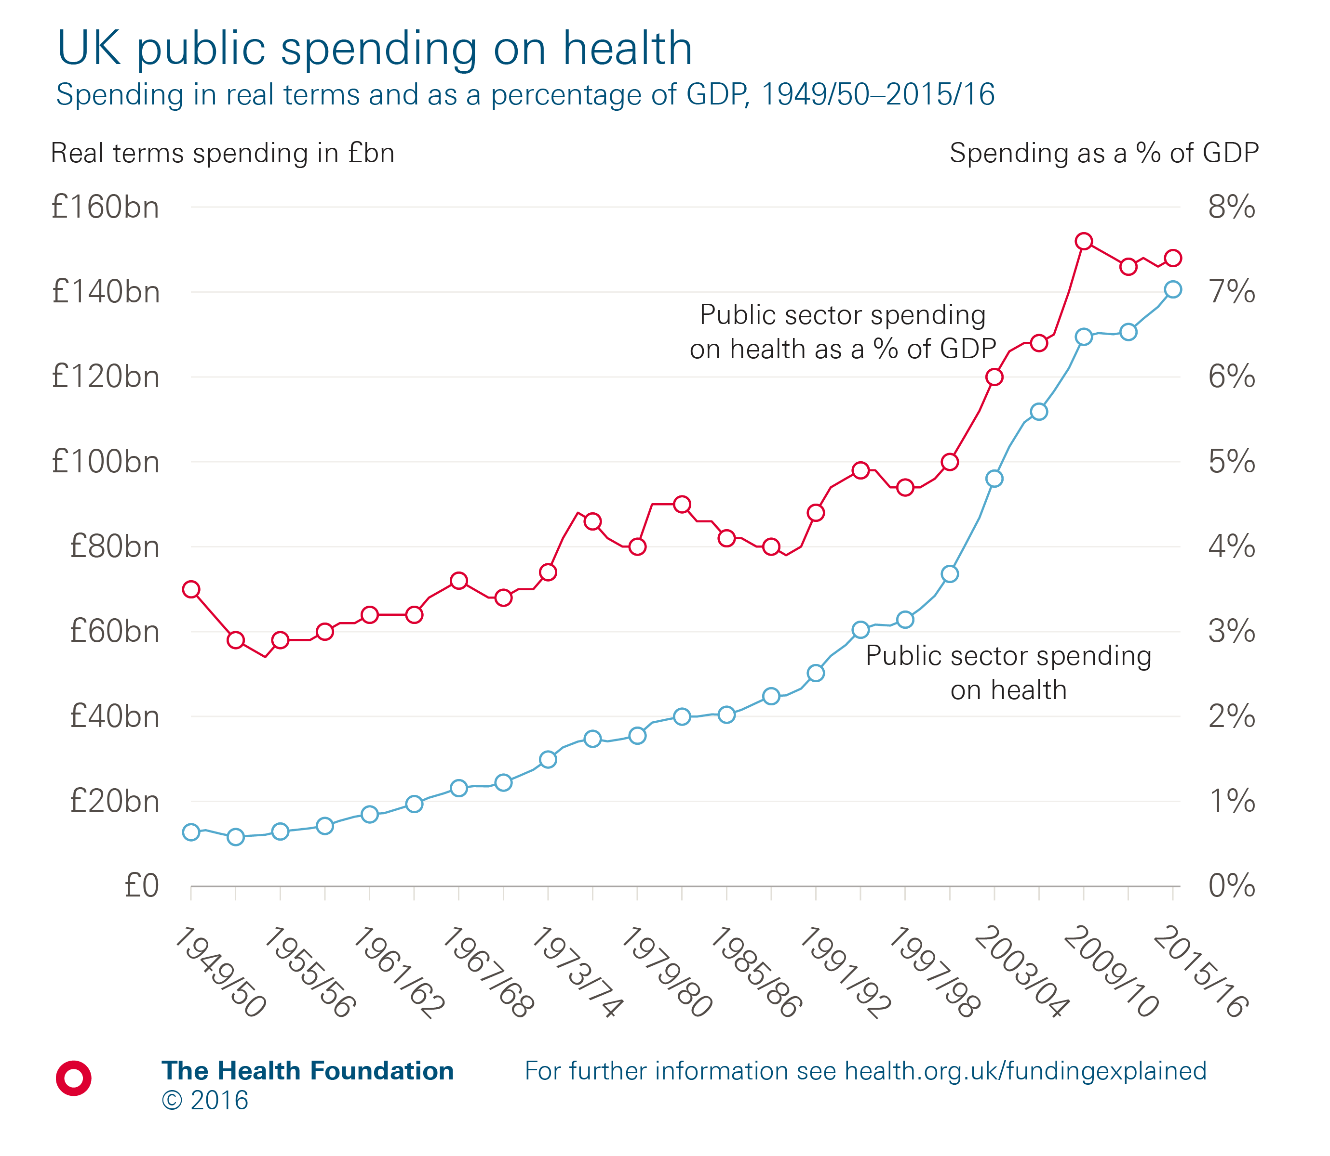
Notes:
Note: Health spending is measured as public spending by health ‘function’, and includes all spending on the NHS in the UK, but excludes administrative costs. It also includes medical research, devolved administrations and local government spending on health.
Source: Health Foundation analyses using data from Public Sector Statistical Analyses 2016 (HM Treasury); Fiscal Facts: Spending by function (Institute of Fiscal Studies); OHE Guide to UK Health and Health Care Statistics 2013 (Office of Health Economics, Hawe E and Cockcroft L); Quarterly National Accounts, Quarter 2 (Apr to June) 2015 dataset (Office for National Statistics); GDP deflators at market prices, and money GDP September 2016 (HM Treasury).

Slide 3
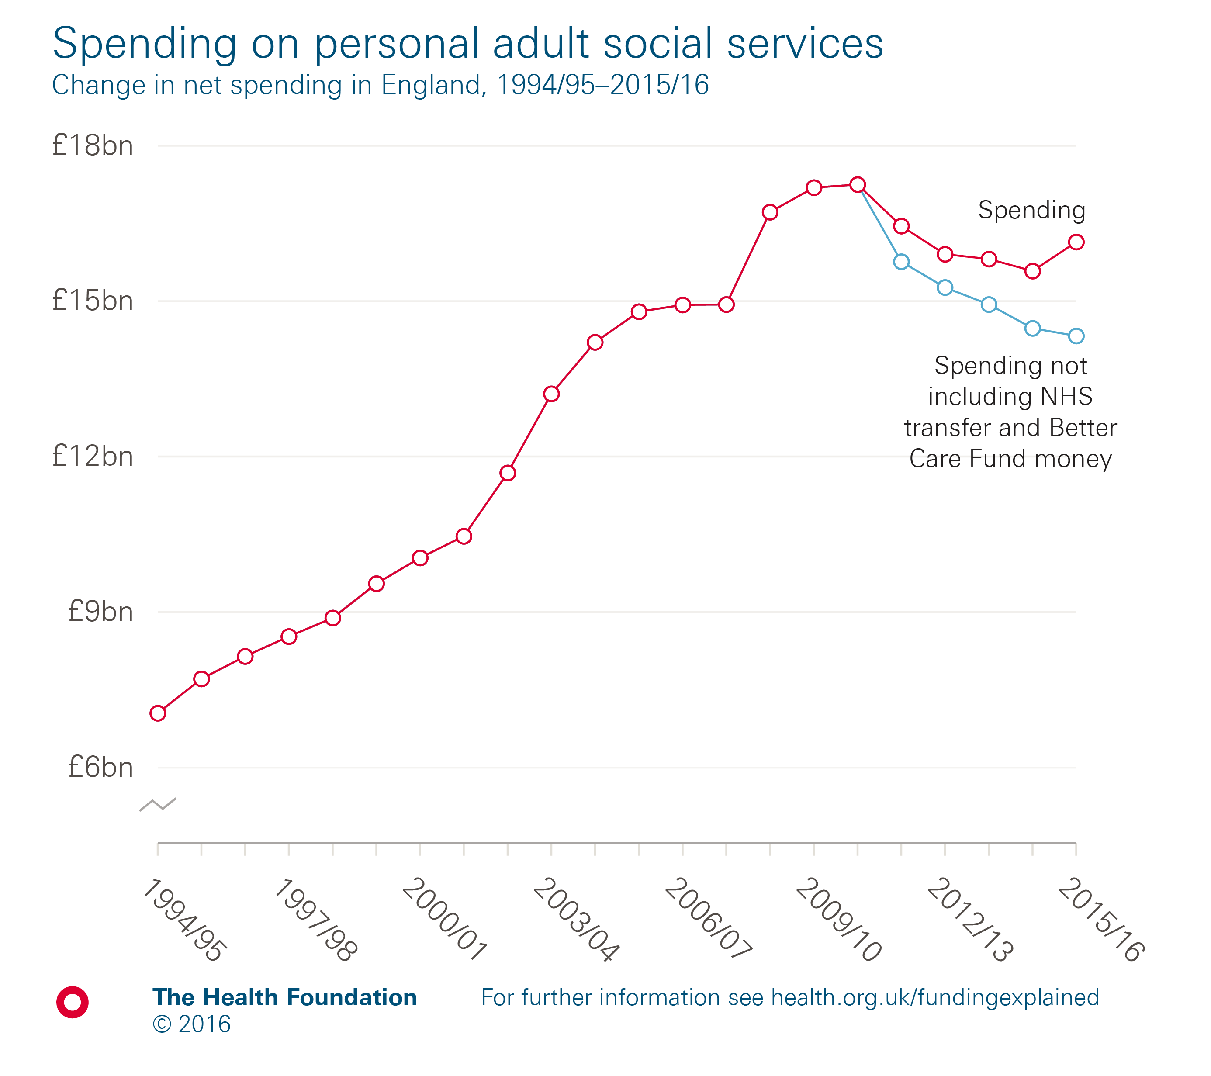
Notes:
Source: Personal Social Services: Expenditure and Unit Costs (NHS Digital).

Slide 4
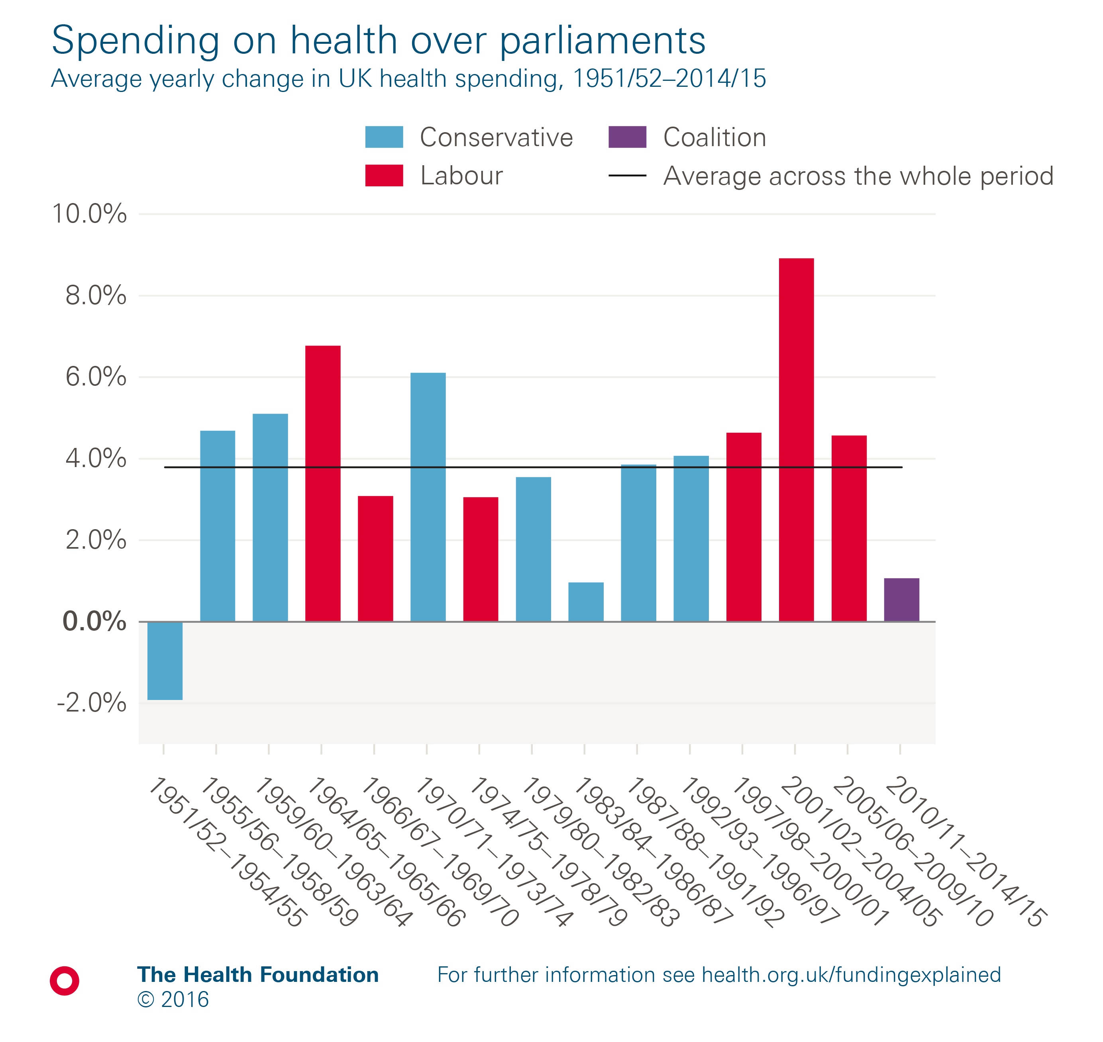
Notes:
Note: Health spending is measured as public spending by health ‘function’, and includes all spending on the NHS in the UK, but excludes administrative costs. It also includes medical research, devolved administrations and local government spending on health.
Source: Health Foundation analyses using data from Public Sector Statistical Analyses 2016 (HM Treasury); Fiscal Facts: Spending by function (Institute of Fiscal Studies); OHE Guide to UK Health and Health Care Statistics 2013 (Office of Health Economics, Hawe E and Cockcroft L); Quarterly National Accounts, Quarter 2 (Apr to June) 2015 dataset (Office for National Statistics); GDP deflators at market prices, and money GDP September 2016 (HM Treasury).

Slide 5
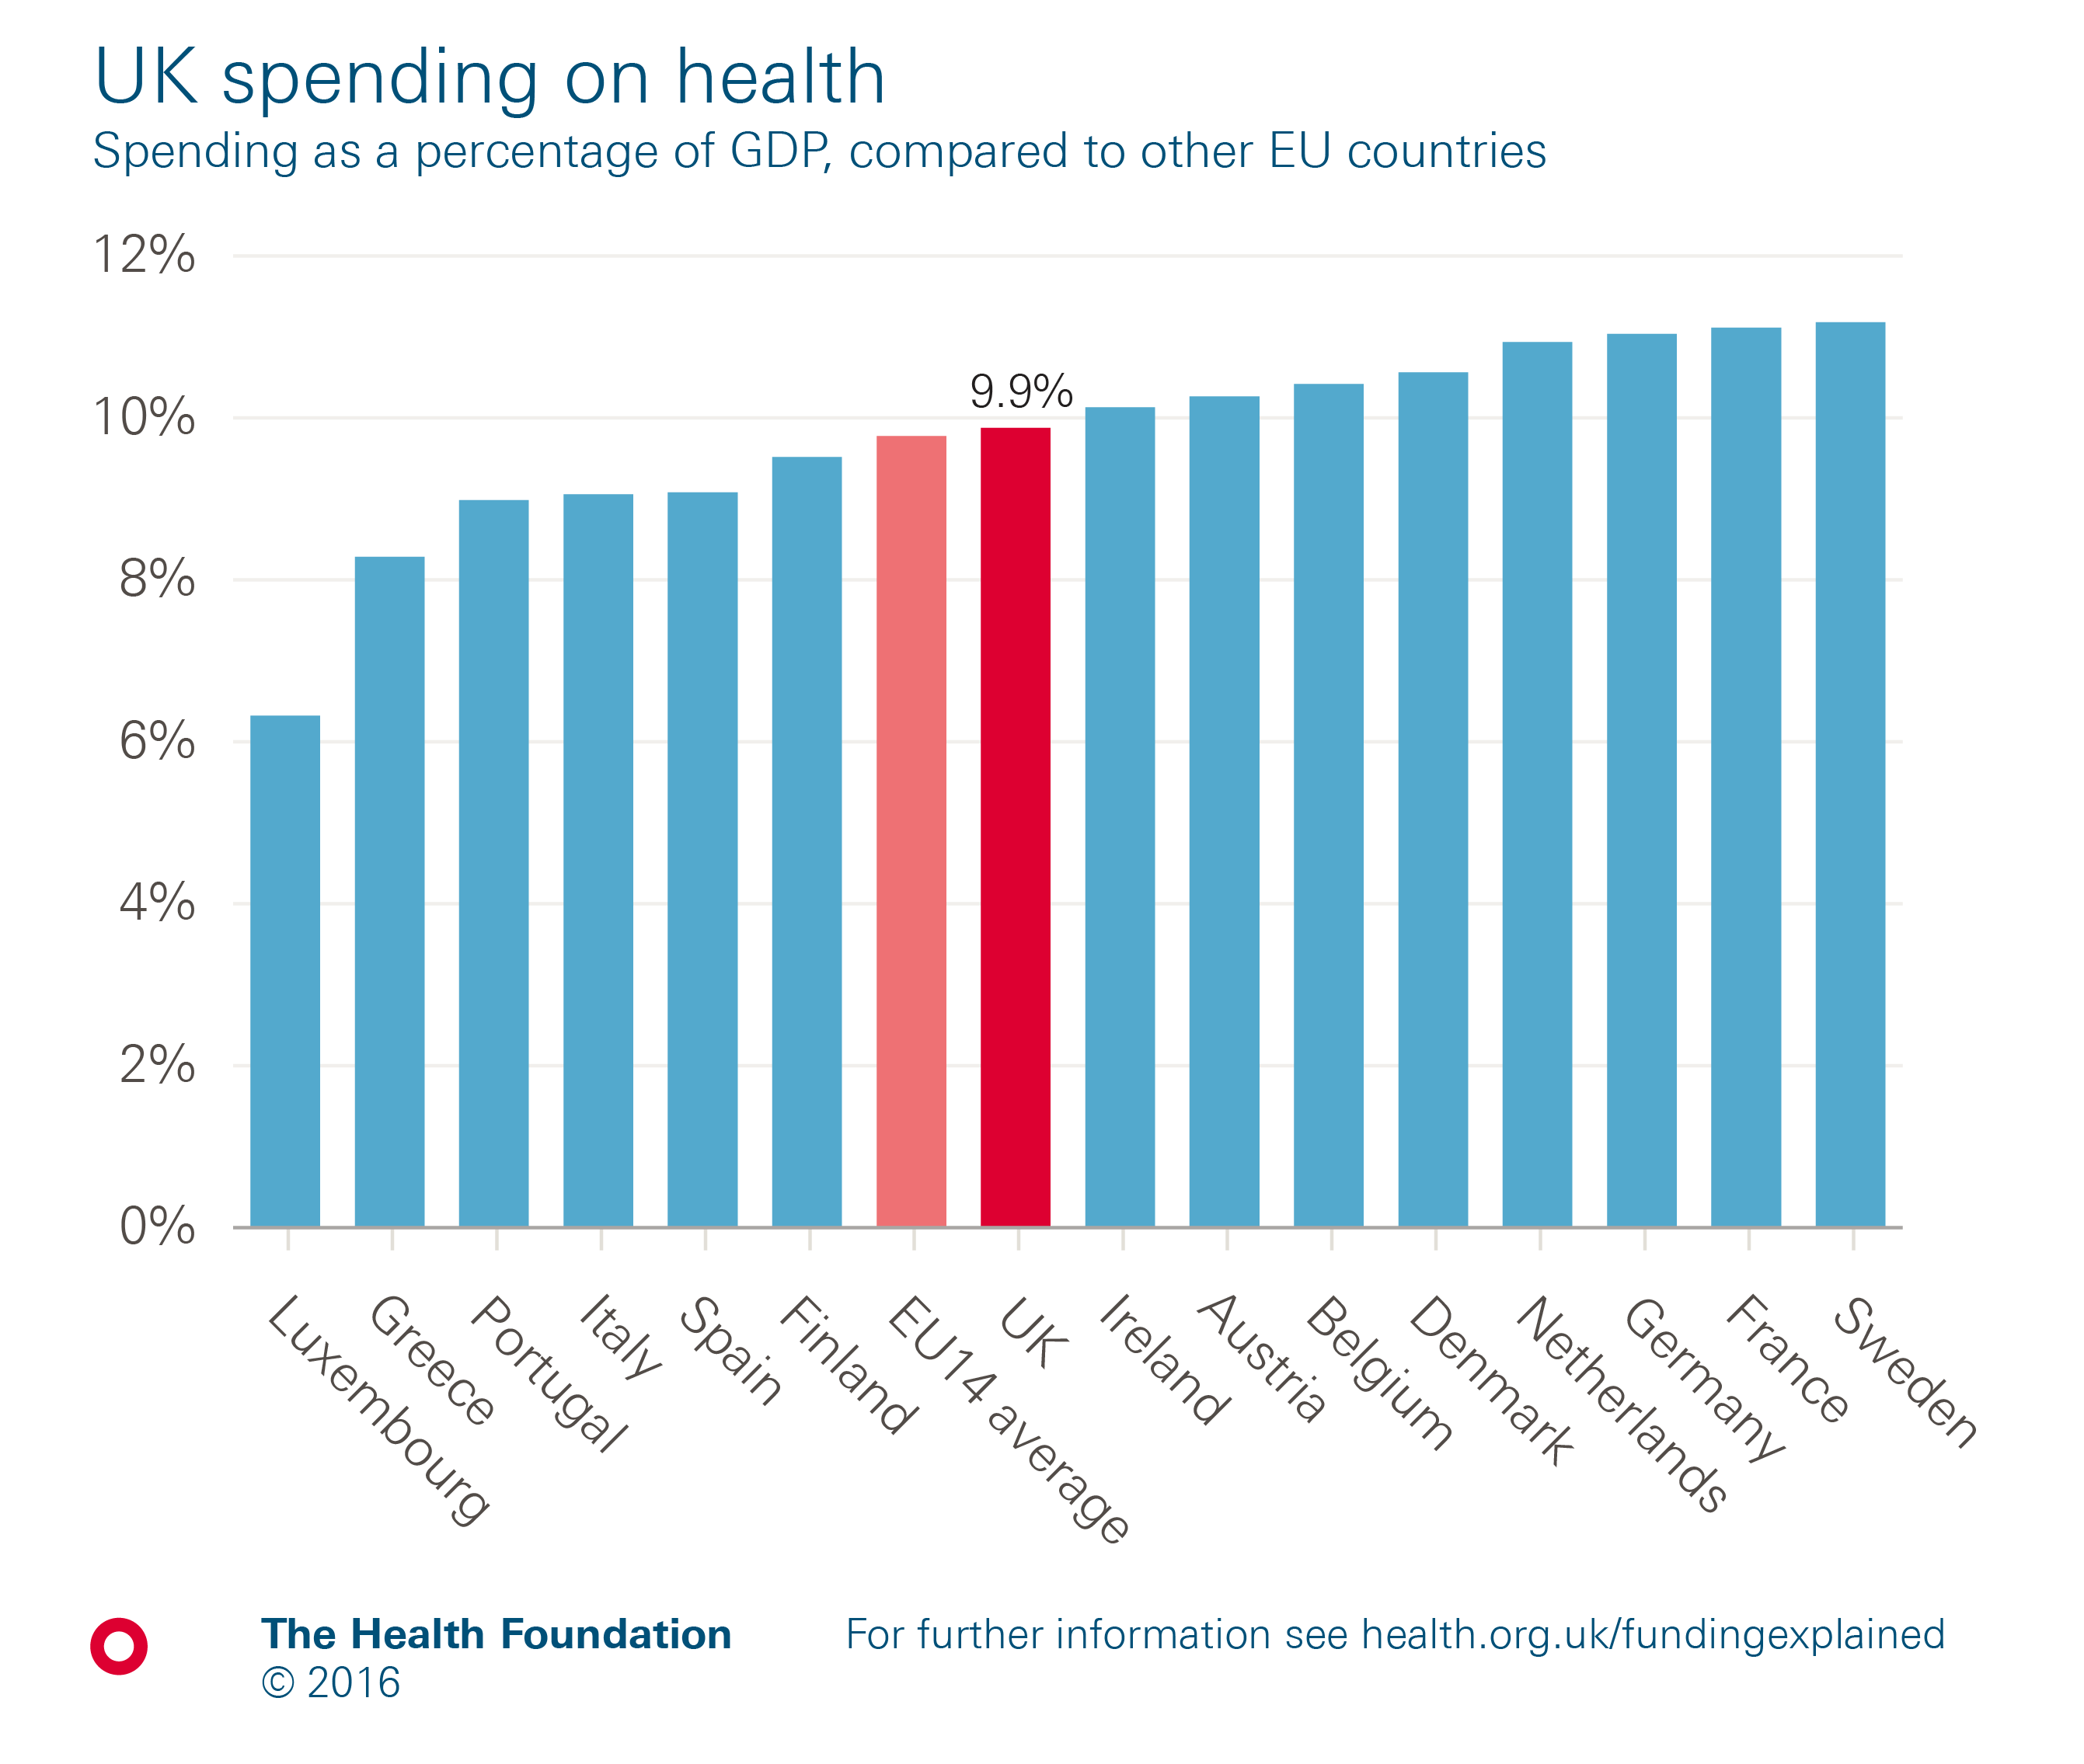
Notes:
Note: EU14 average is the unweighted average of the first 15 countries to join the EU (excluding the UK). The OECD definition of health has been used for international comparison which defines health as all activities with the primary purpose of improving, maintaining and preventing the deterioration of the health status of persons and mitigating the consequences of ill health through the application of qualified health knowledge, medical, paramedical and nursing knowledge, including technology, and traditional, complementary and alternative medicine.
Source: Organisation for Economic Co-operation and Development.

Slide 6
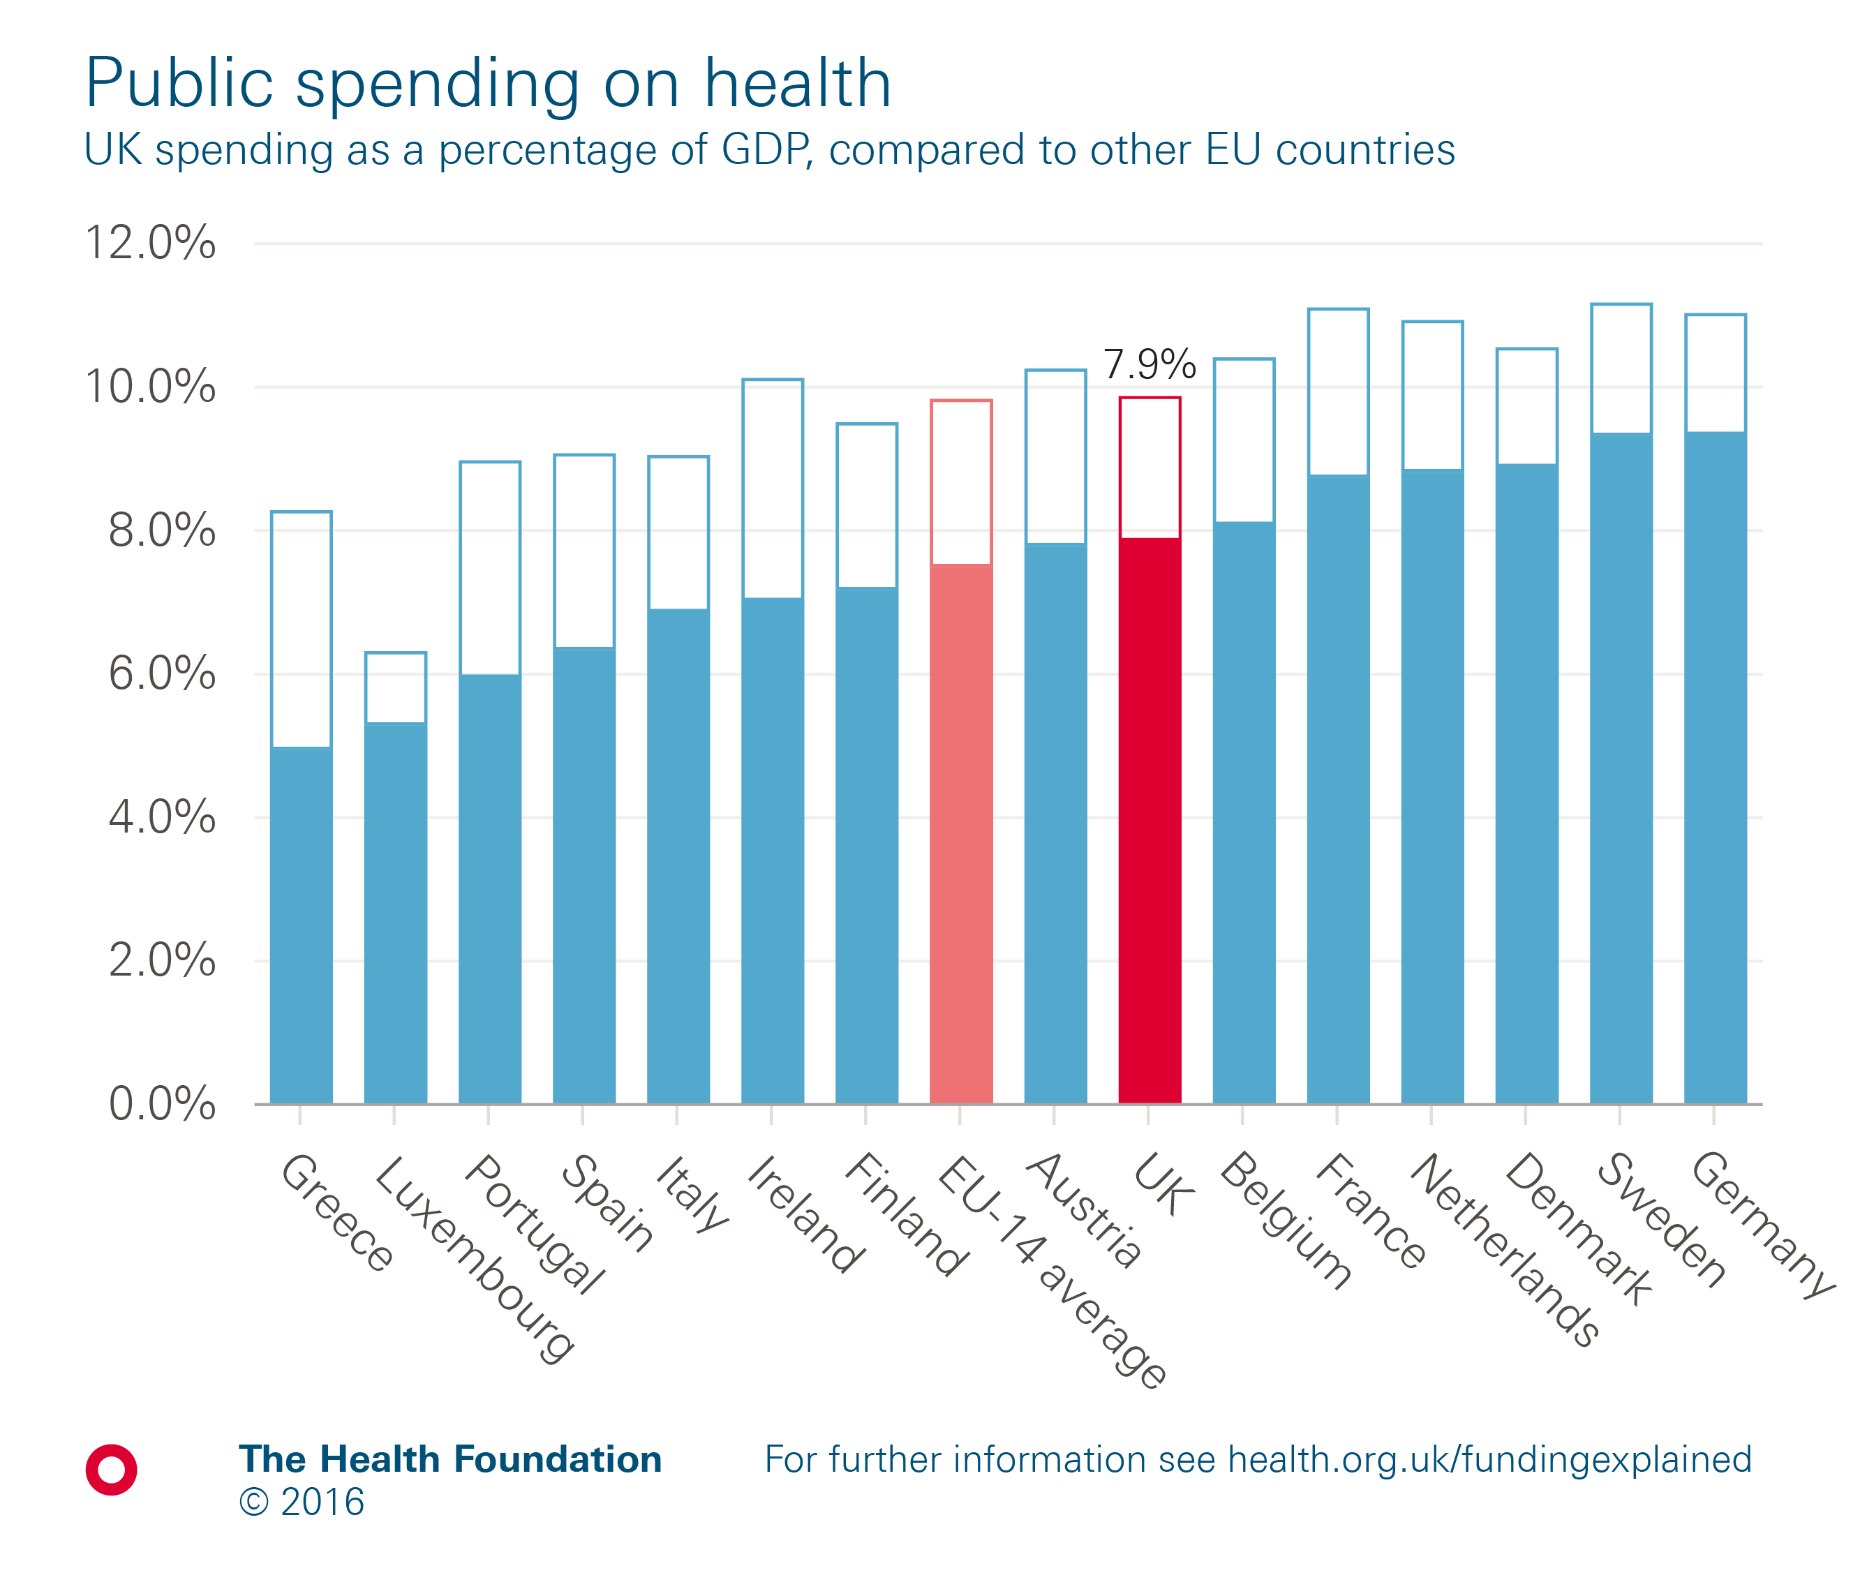
Notes:
Note: EU14 average is the unweighted average of the first 15 countries to join the EU (excluding the UK). Total current spending shown in outline. The OECD definition of health has been used for international comparison which defines health as all activities with the primary purpose of improving, maintaining and preventing the deterioration of the health status of persons and mitigating the consequences of ill health through the application of qualified health knowledge, medical, paramedical and nursing knowledge, including technology, and traditional, complementary and alternative medicine.
Source: Organisation for Economic Co-operation and Development.

Slide 7
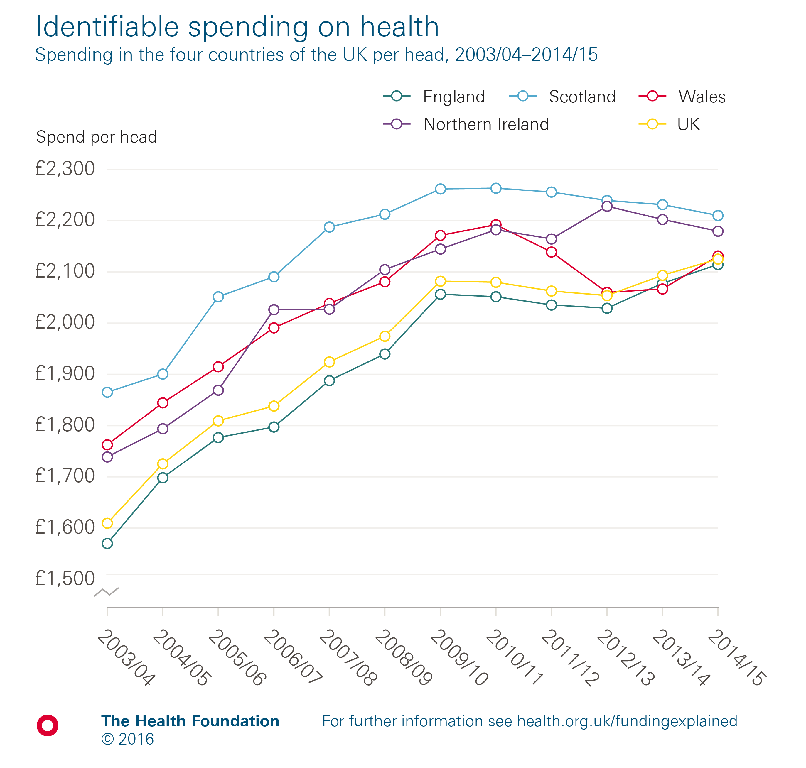
Notes:
Note: Health spending is measured as public spending by health ‘function’, and includes all spending on the NHS in the UK, but excludes administrative costs. It also includes medical research, devolved administrations and local government spending on health.
Source: HM Treasury, Public Expenditure Statistical Analyses 2016, GDP deflators at market prices, and money GDP September 2016.

Slide 8
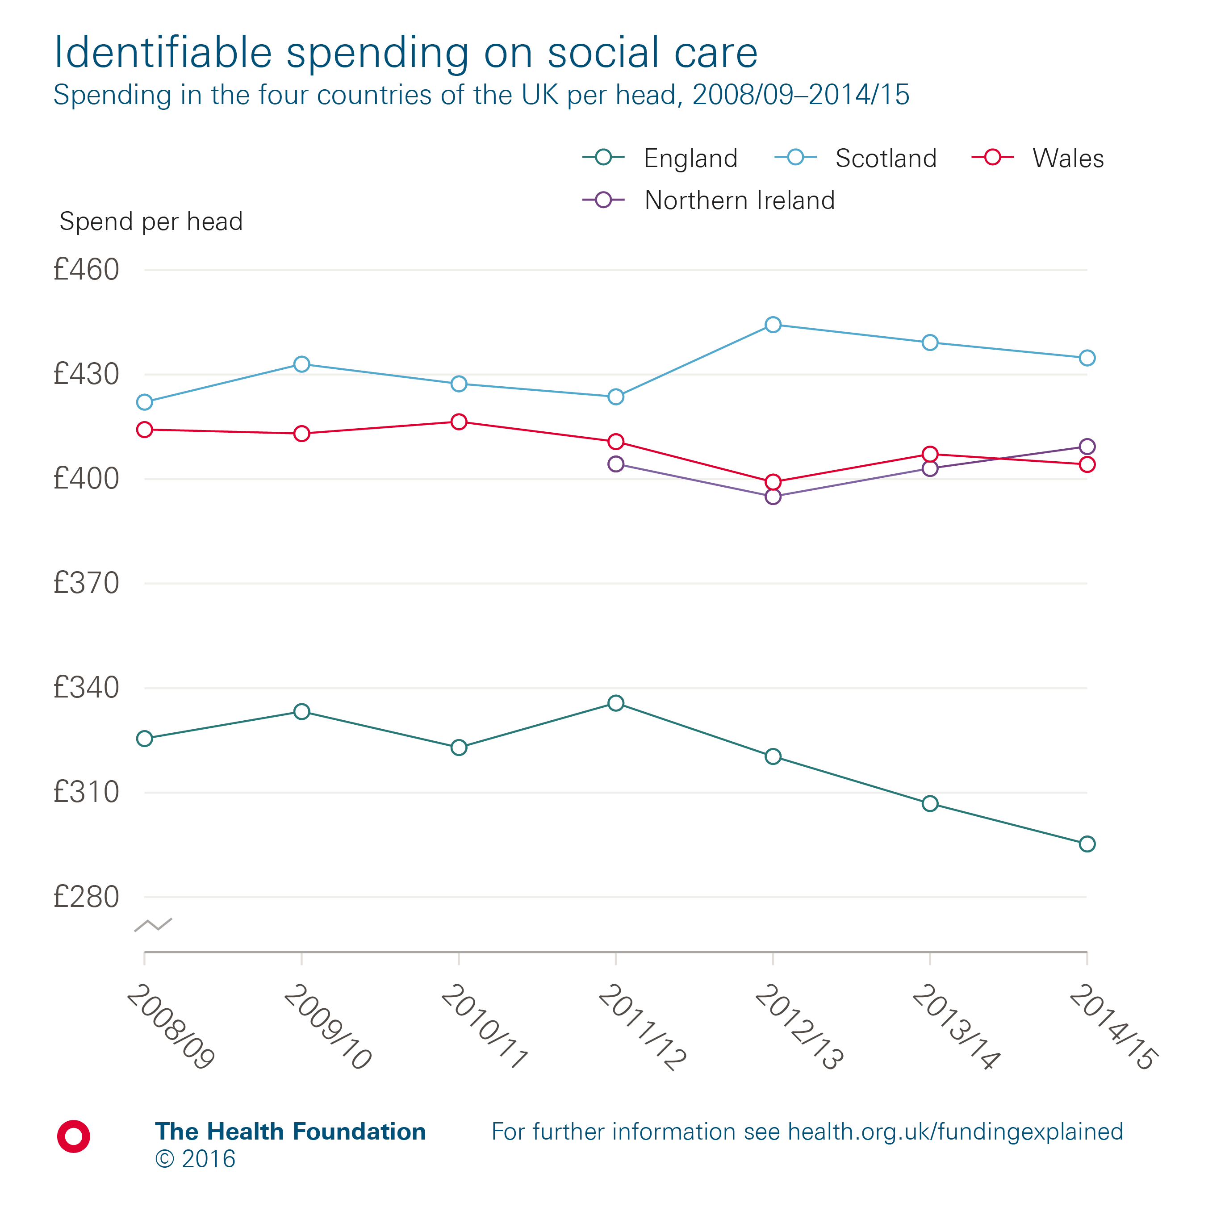
Notes:
Note: pre-2009 figures adjusted to exclude unemployment.
Source: HM Treasury, Public Expenditure Statistical Analyses 2016.

Slide 9
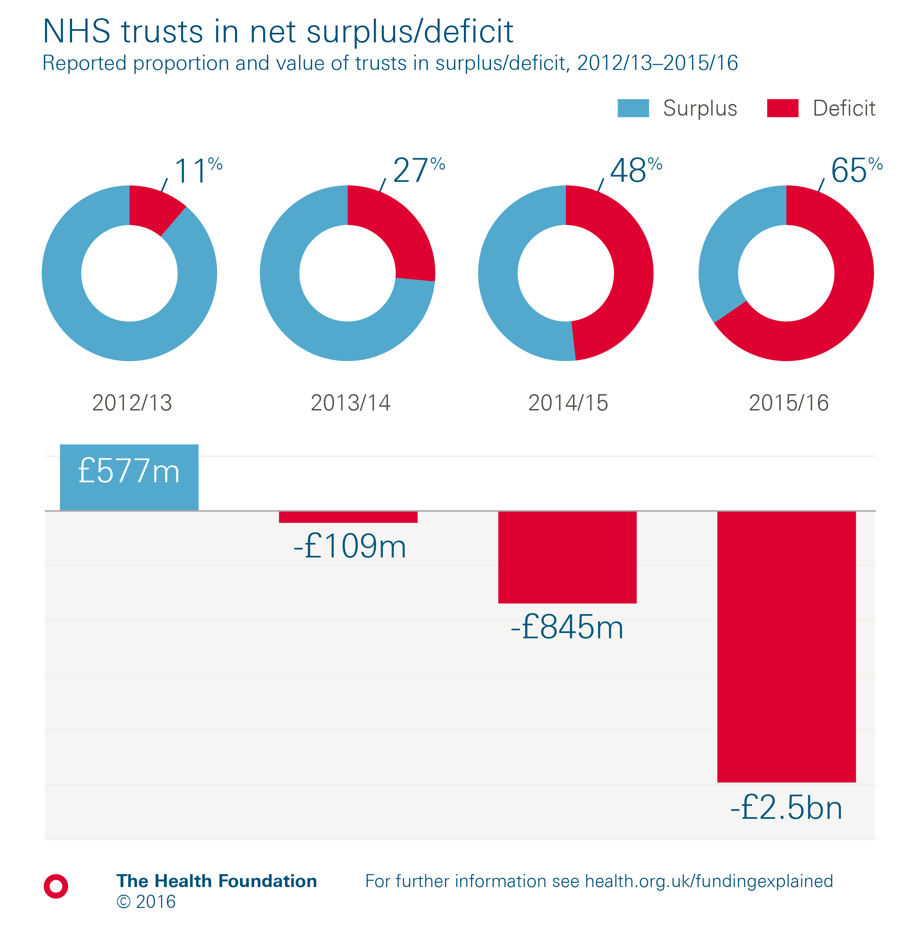
Notes:
Note: Financial performance of trusts measured as end of year net deficit/surplus before impairments and gain/loss from transfer by absorption transfers.
Source: NHS Improvement, NHS Trust Development Authority, Monitor.

Slide 10
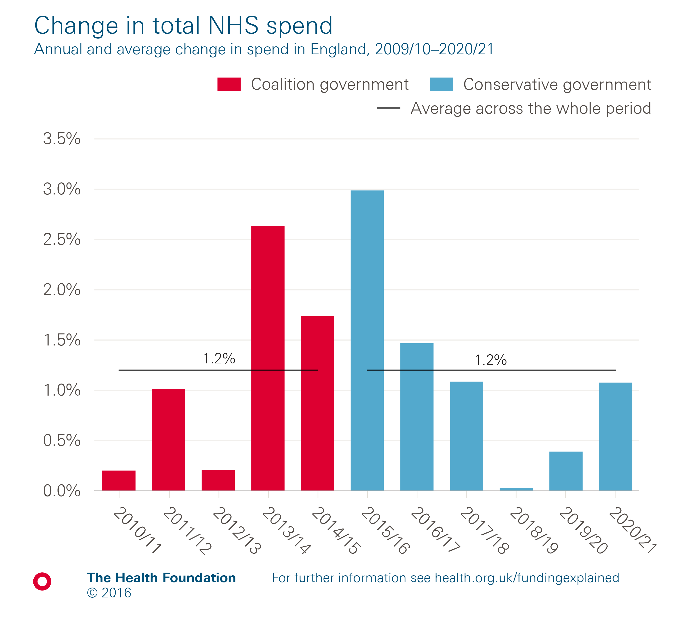
Notes:
Note: The total Department Expenditure Limit (DEL) has been used as a measure of NHS spending.
Source: Department of Health Annual Accounts 2015/16.

Slide 11
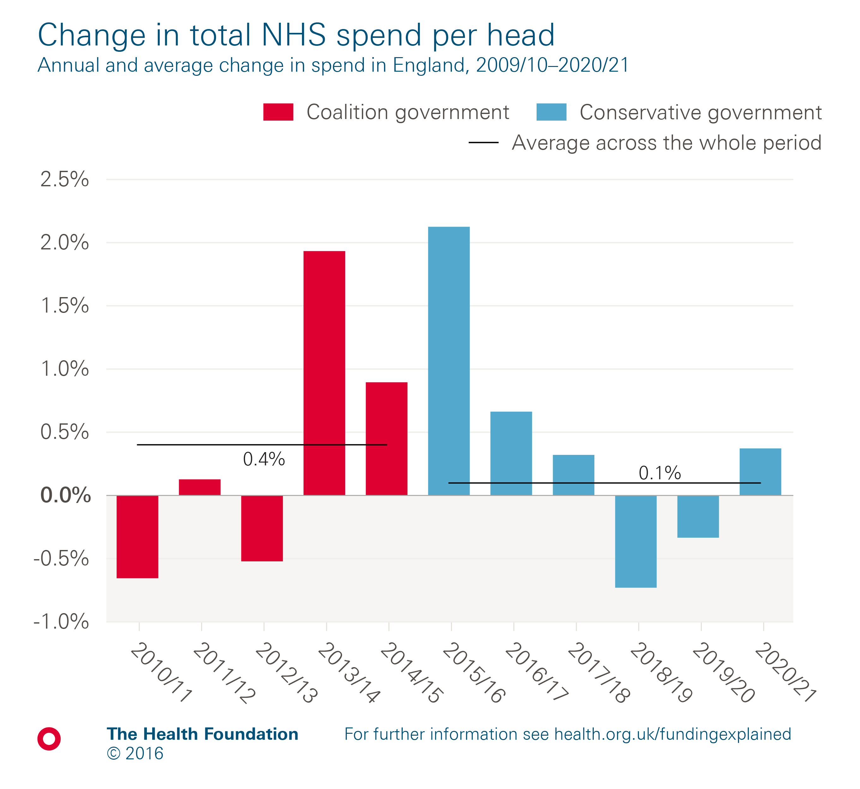
Notes:
Note: The total Department Expenditure Limit (DEL) has been used as a measure of NHS spending.
Source: Department of Health Annual Accounts 2015/16.

Slide 12
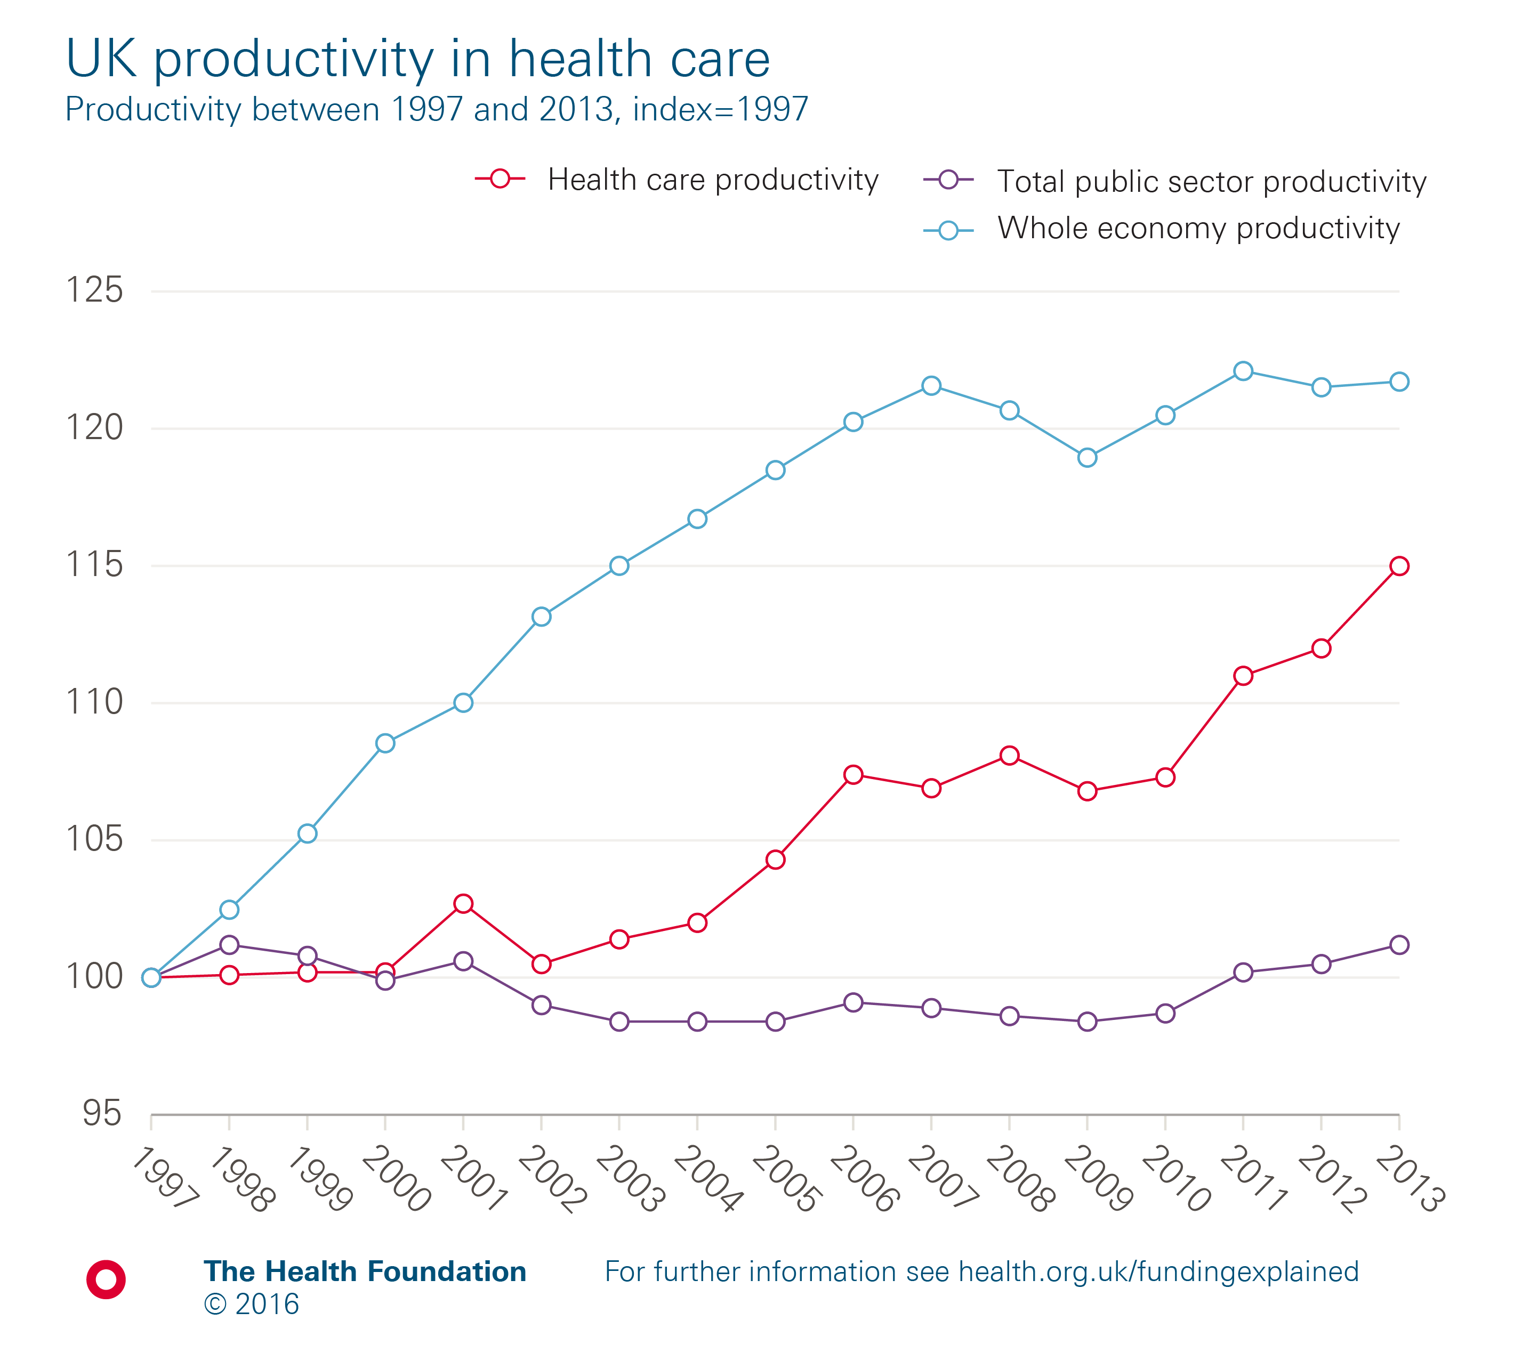
Notes:
Note: UK productivity is measured as constant price GDP per hour worked.
Source: Office for National Statistics.

Slide 13
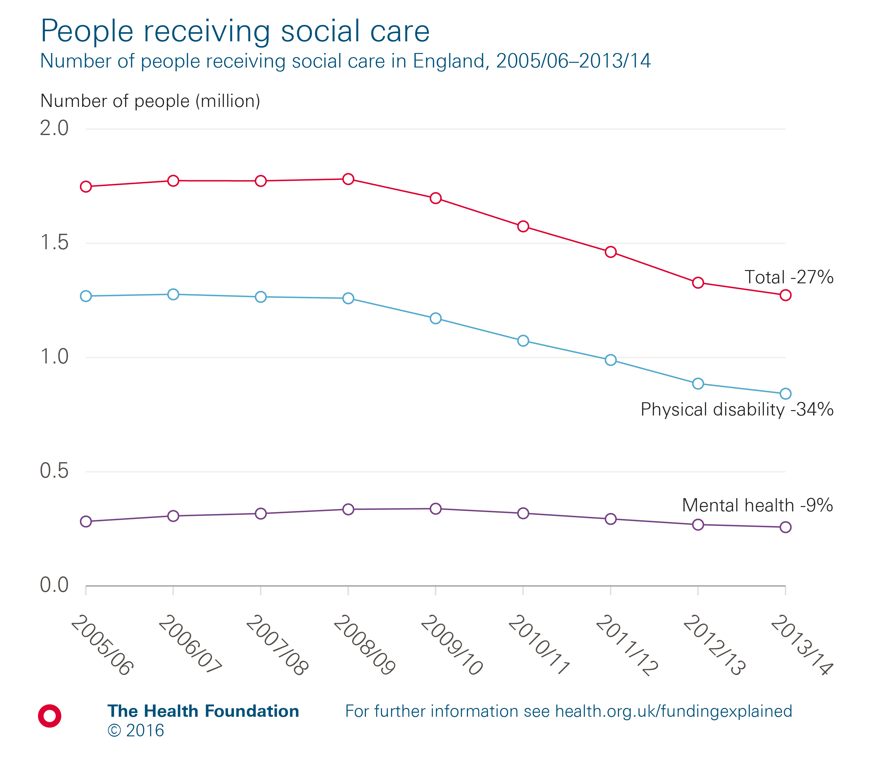
Notes:
Note: Figures relate to the number of people receiving services (community based, residential or nursing care) provided or commissioned by local authorities.
Source: National Adult Social Care Intelligence Service, Referrals and Packages, module P1.

Slide 14
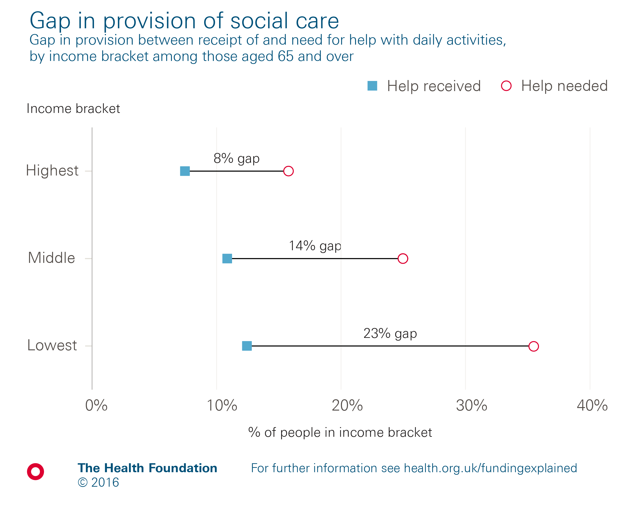
Notes:
Note: Activities of daily living include eating, bathing, dressing.
Source: Health Survey for England.

Slide 15
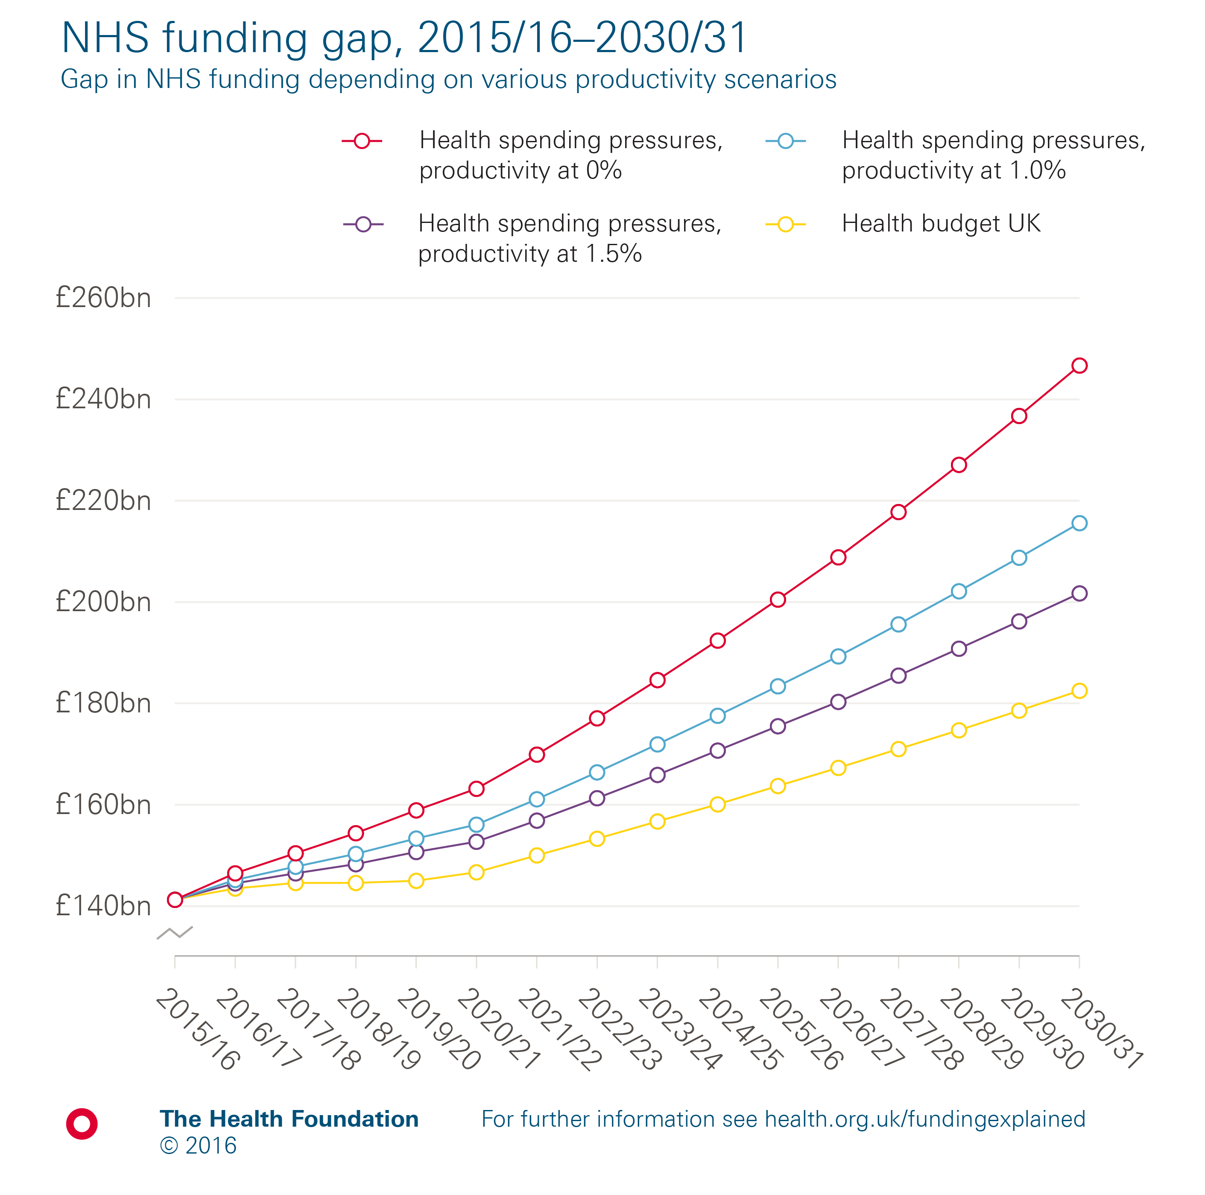
Notes:
Note: It is assumed that pay will increase according to the current plan for public sector earnings (at 1% a year in cash terms until 2019, and at the long-term average rate of 2% a year between 2019/20 and 2030/31). We have included an estimated budget for the UK NHS based on the planned budget for the English NHS (defined as the total department expenditure limit for the Department of Health) between 2015/16 and 2020/21 following the November 2015 spending review. This assumes that the resulting Barnett consequentials for Northern Ireland, Wales and Scotland are applied to their respective health services, with the total budget rising by an average of 0.8% a year. Between 2020/21 and 2030/31 we have assumed the NHS budget rises in line with GDP, estimated at 2.2% a year.
Source: Health Foundation modelling.

Slide 16
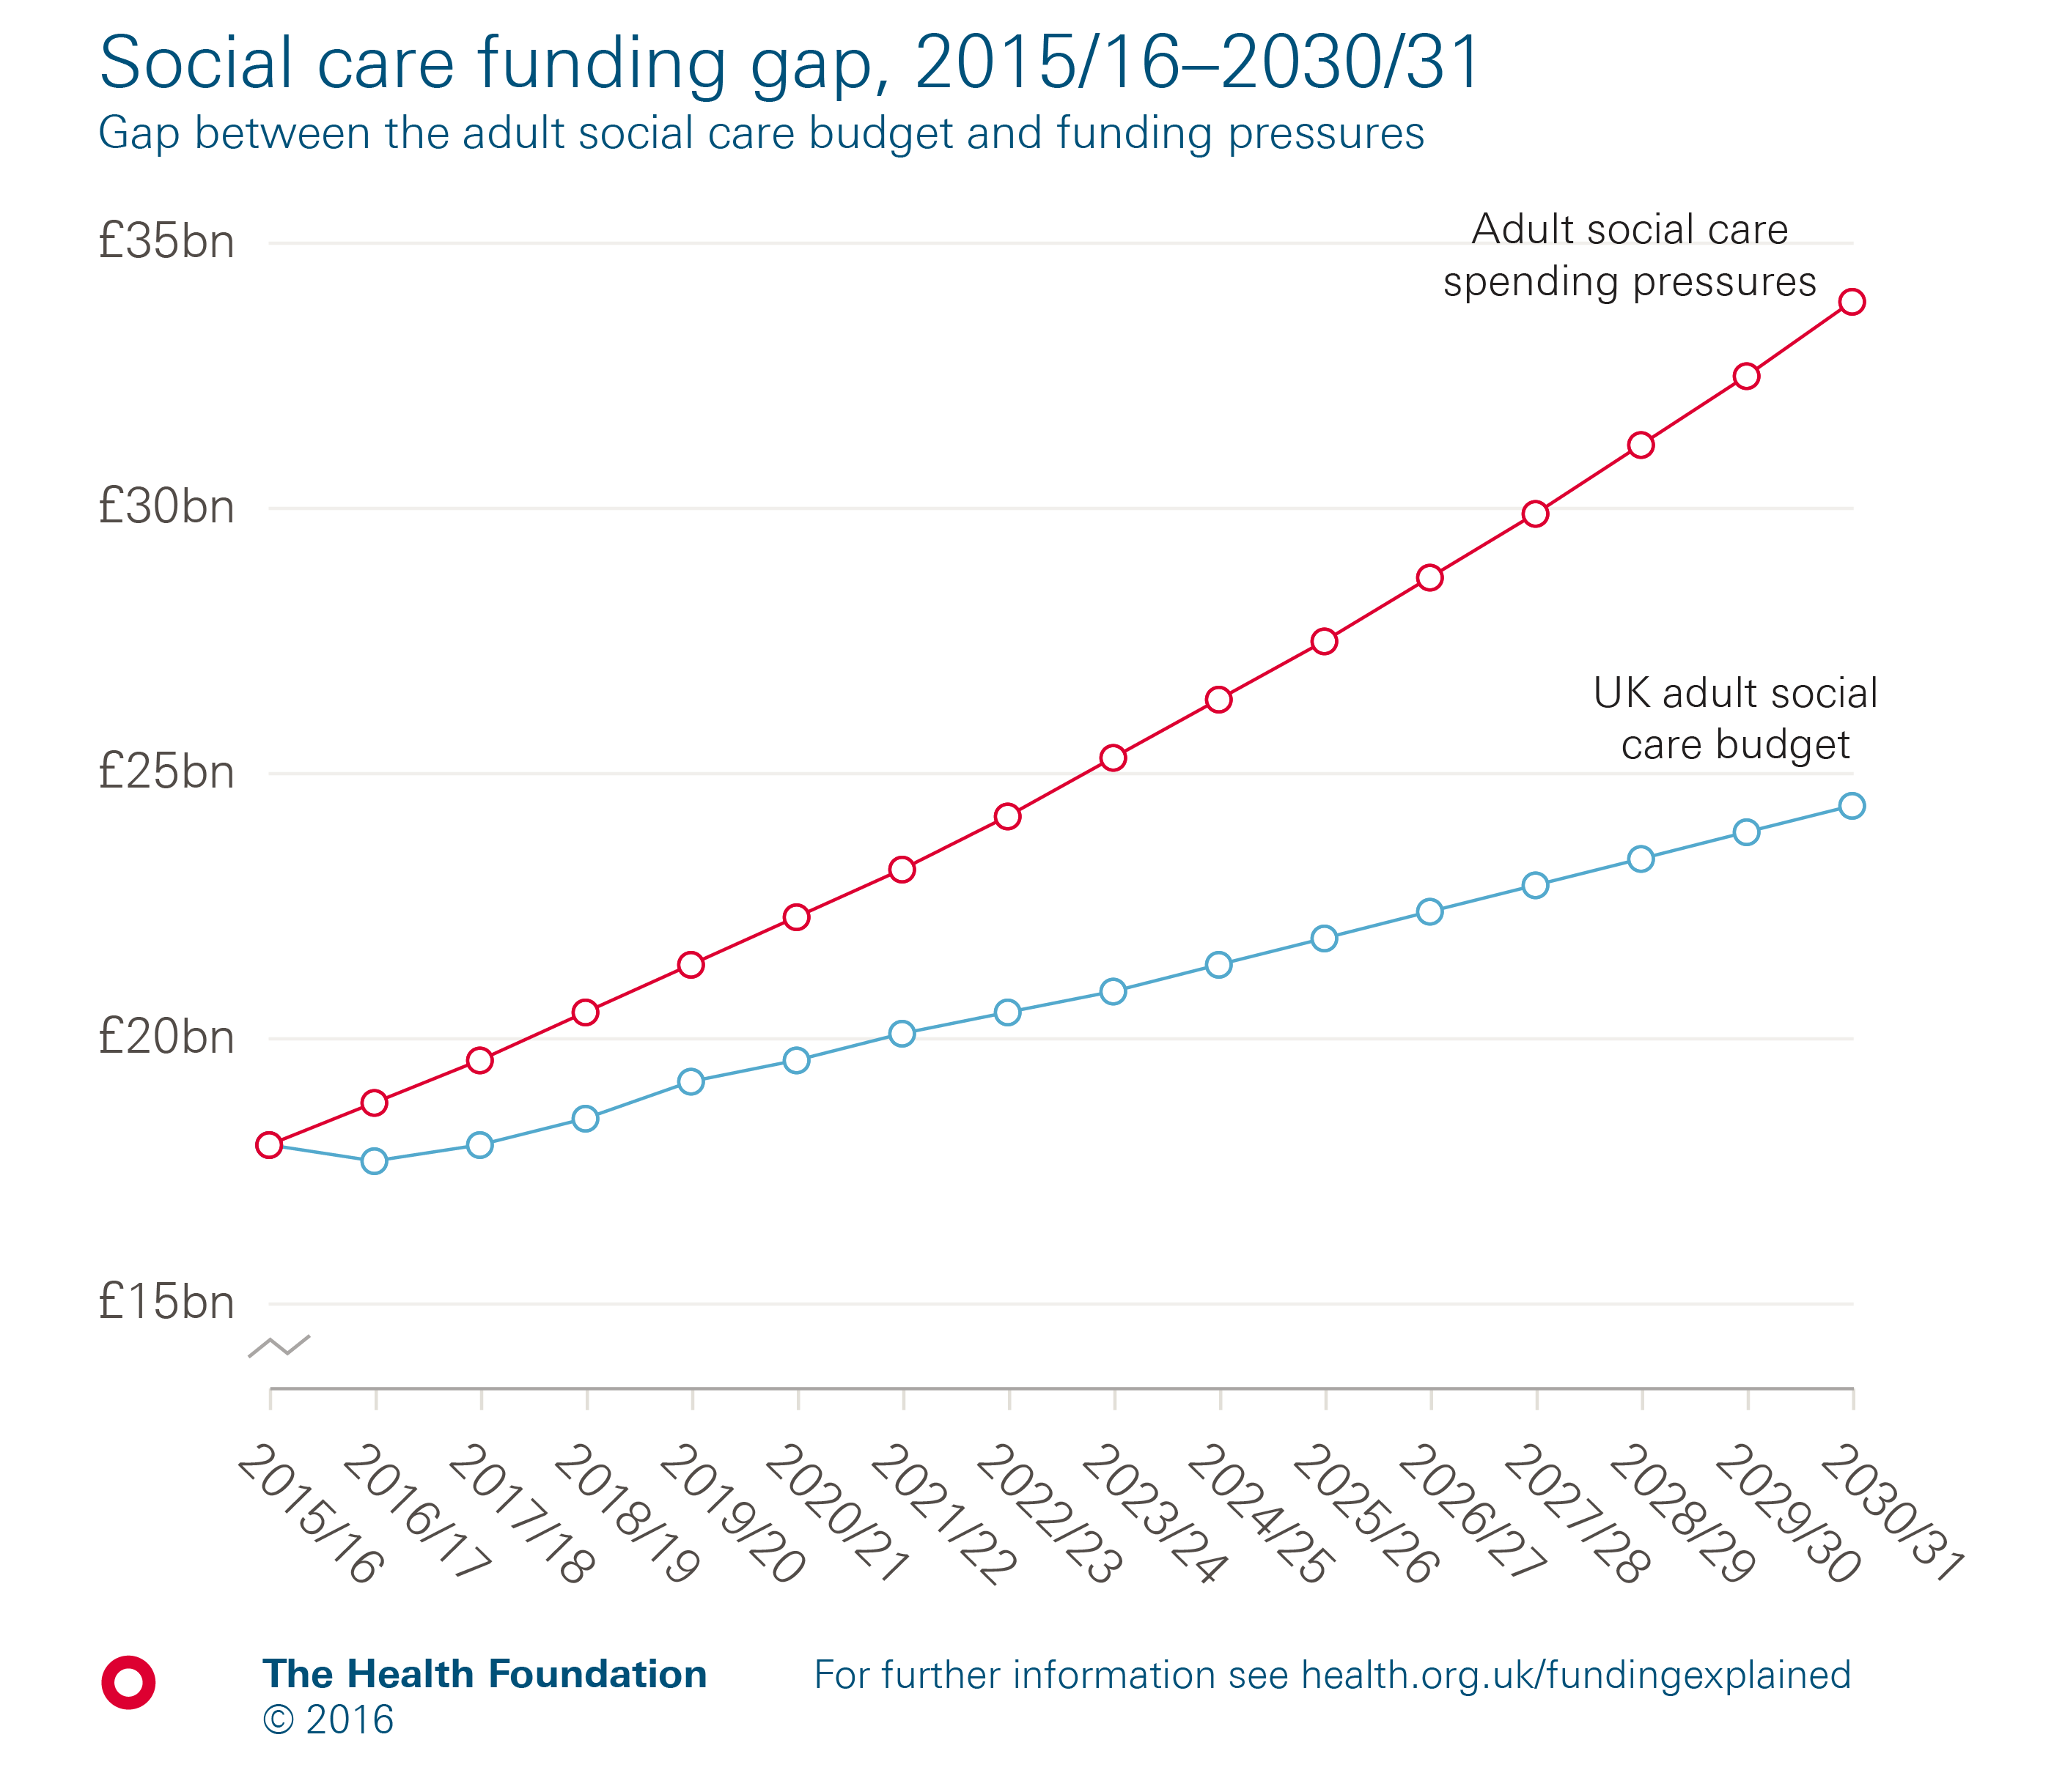
Notes:
Source: Health Foundation analysis using LSE results from Hancock R, Wittenberg R, Hu B, et al. Long-term care funding in England: an analysis of the costs and distributional effects of potential reforms. PSSRU Discussion Paper 2857. London: LSE, 2013.

Slide 17
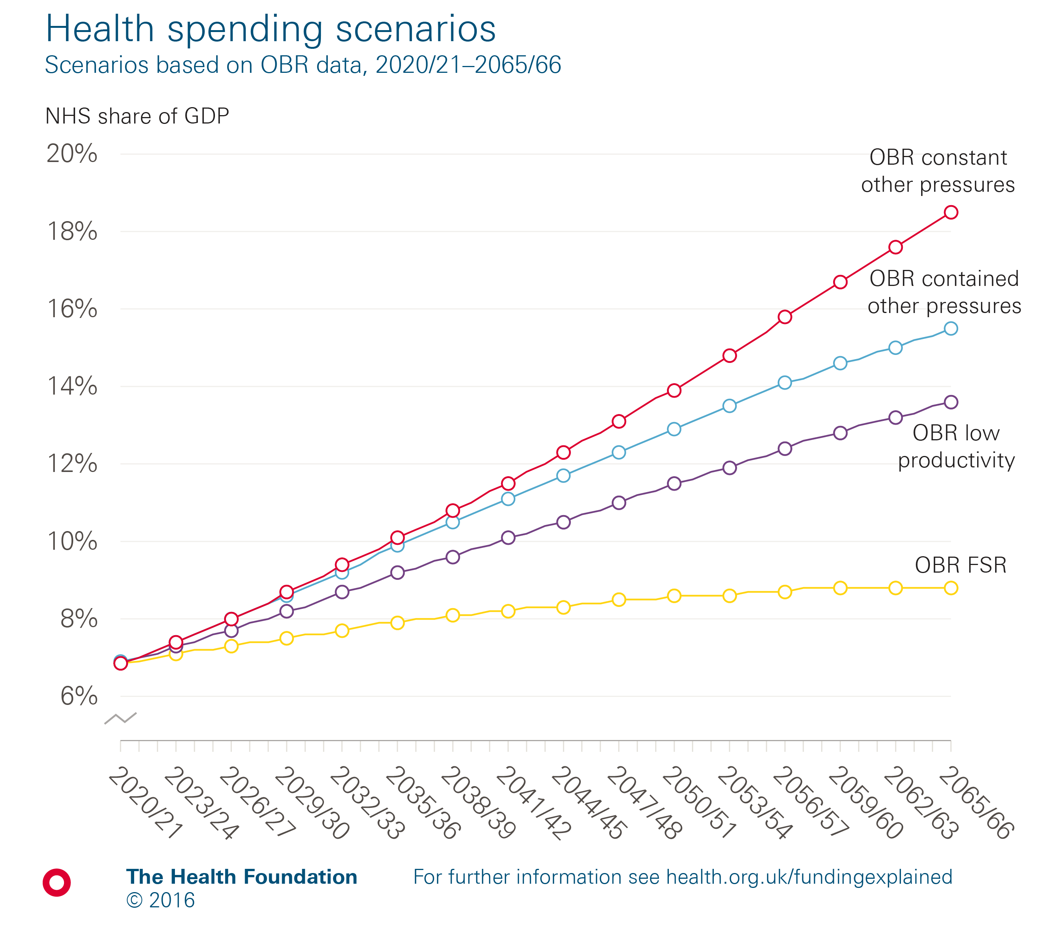
Notes:
Note: OBR FSR refers to the standard scenario of 2.2% productivity growth.
Source: Office for Budget Responsibility.

Slide 18
The Health Foundation is an independent charity committed to bringing about better health and health care for people in the UK.
We connect what works on the ground with effective policymaking and vice versa.

Slide 19
Subscribe to our email newsletter
Register for email alerts to be notified about our latest work
Follow us on Twitter, Facebook, youTube or Linkedin

