Slide 1
COVID-19 health outcomes
Technical supplement 1 for the COVID-19 impact inquiry report
July 2021

Slide 2
About this slide deck
This is the first in a series of four slide decks that accompany the COVID-19 impact inquiry report. These slide decks provide additional evidence and analysis to support arguments made within the main report for readers who are interested. Specifically, these slides contain:
downloadable versions of the figures presented in the report. These can be copied and used as long as credit is given to the Health Foundation: Originally published by the Health Foundation as part of its COVID-19 impact inquiry [link].
analysis referenced in the report where details are not published elsewhere
additional charts produced as part of the analysis
selected evidence that was reviewed as part of the inquiry but not included in the report.
This slide deck relates to section two of the report. The slides follow the sequence of the points made in the report.
If you have any queries about the content of these decks, please contact COVID-19impactinquiry@health.org.uk.

Slide 3
COVID-19 outcomes in the UK
Comparing UK COVID-19 outcomes internationally
What made people in the UK more vulnerable to
COVID-19 ?
The COVID-19 vaccination programme

Slide 4
1.
COVID-19 outcomes in the UK

Slide 5
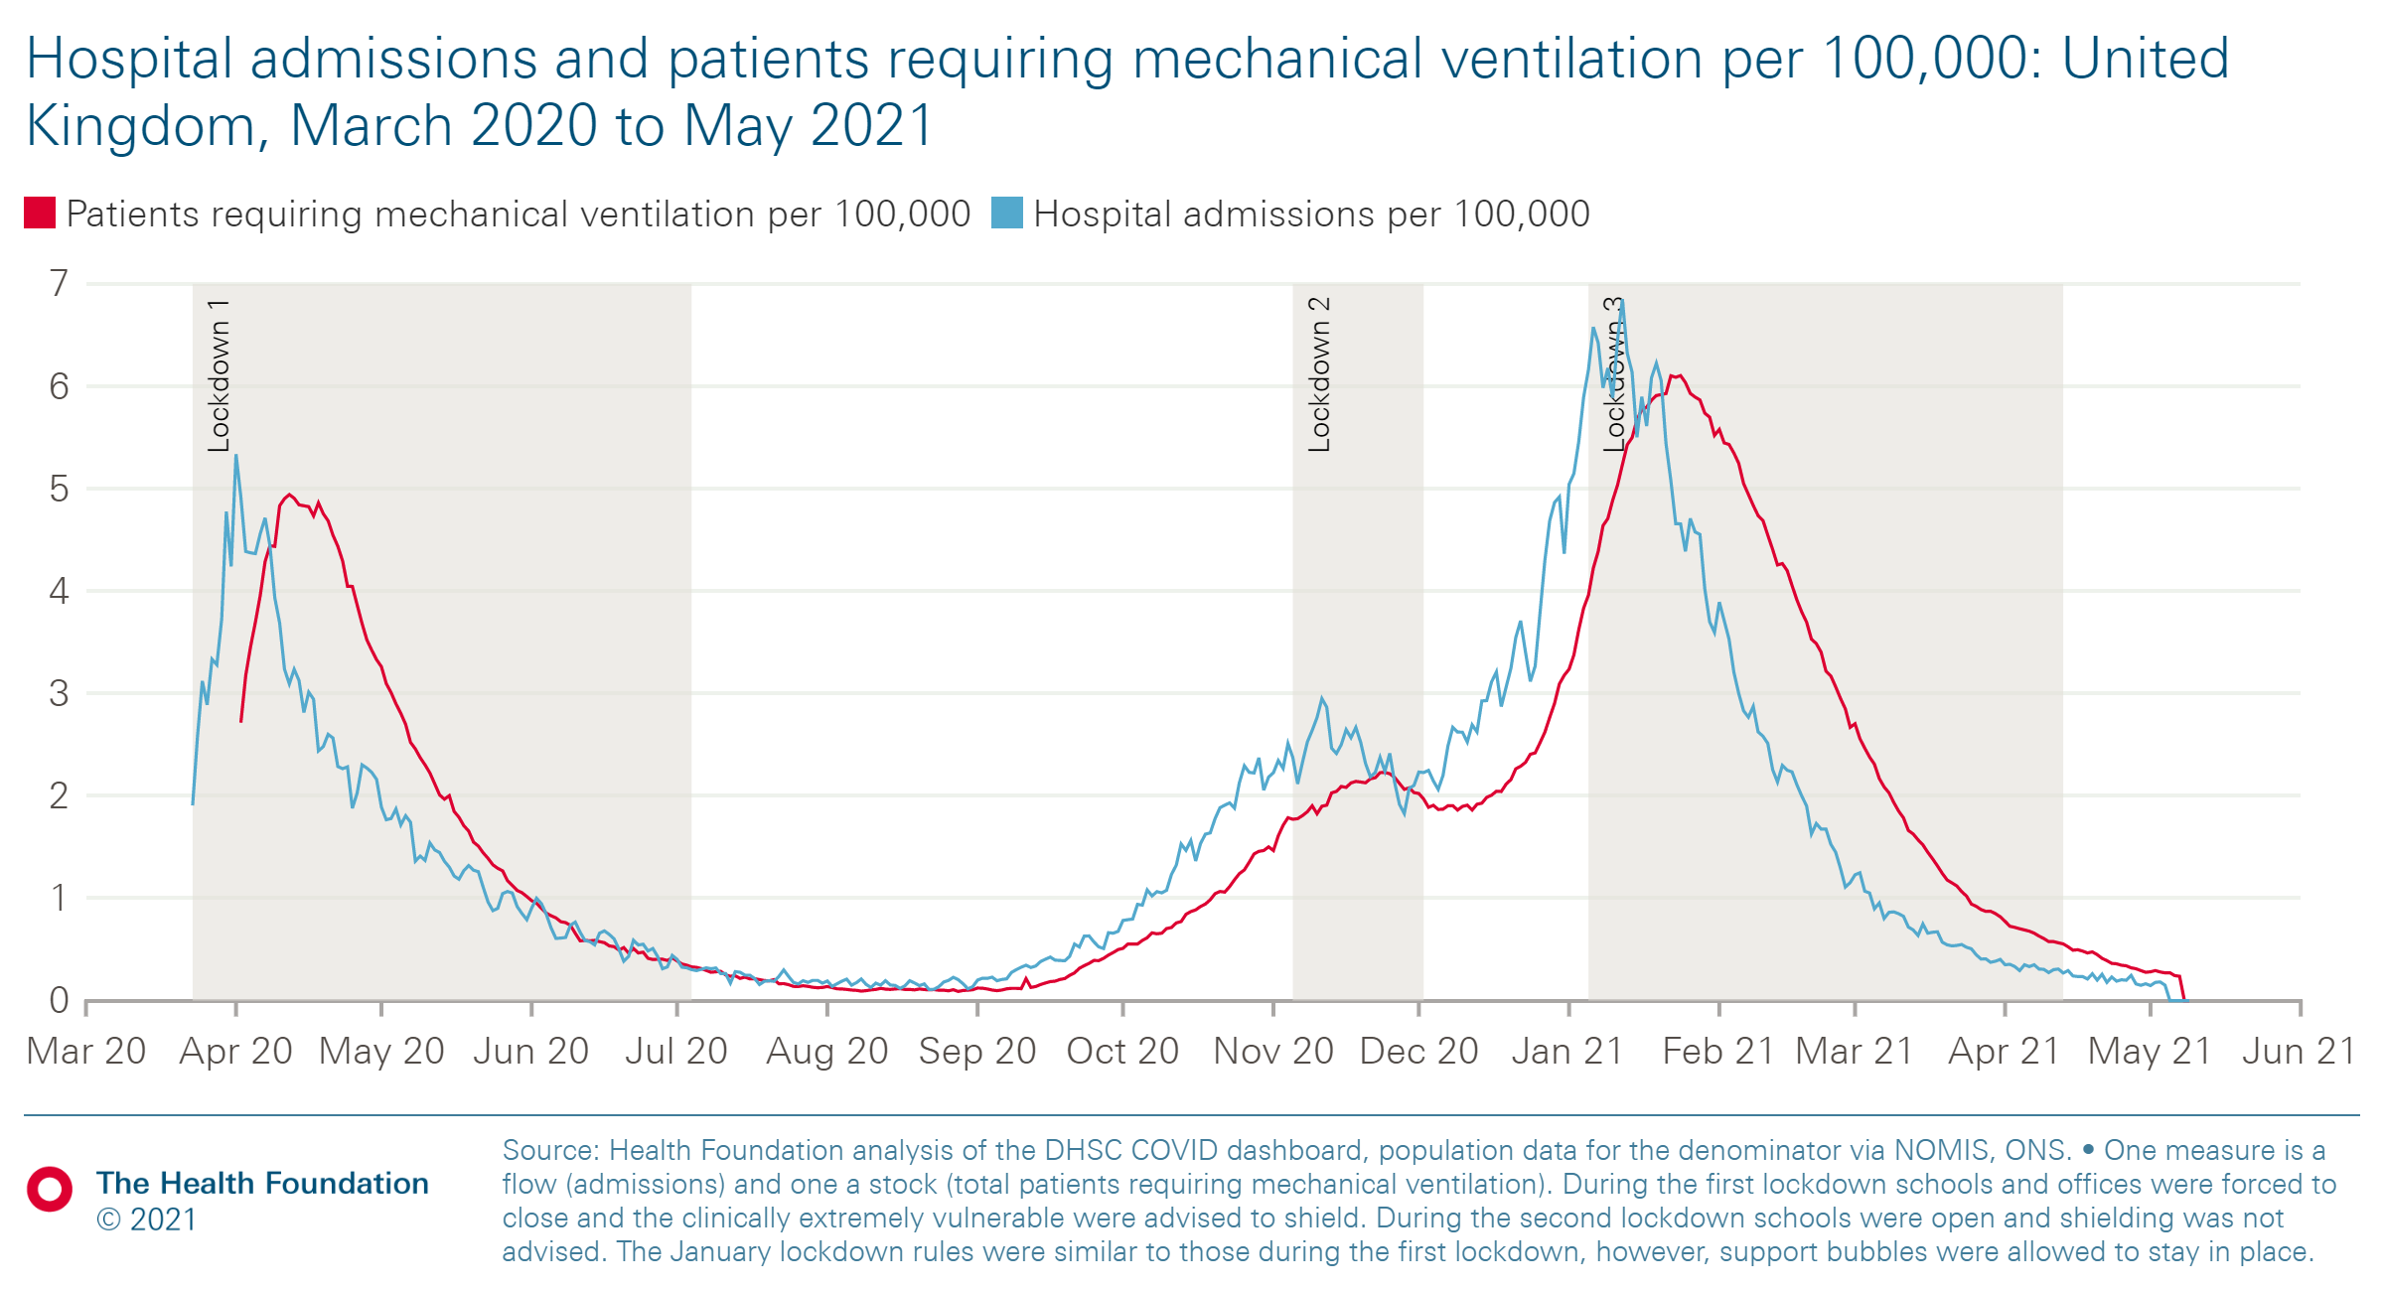
UK COVID-19 admissions and rates of mechanical ventilation
Hospital admissions and patients requiring mechanical ventilation per 100,000: UK, March 2020 to May 2021
Once lockdowns were imposed, there were reductions in flows into hospital and in the total number of patients requiring mechanical ventilation.
The November lockdown had less effect partly due to its length and the emergence of the alpha variant.

Slide 6
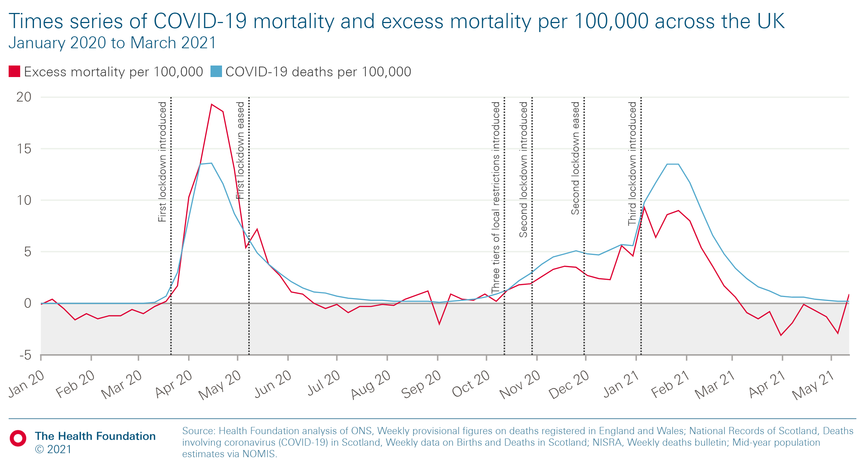
COVID-19 mortality in UK
Report figure 1
Times series of COVID-19 mortality and excess mortality per 100,000 across the UK (January 2020 to March 2021)
Although the COVID-19 death rate was similar in the first and second waves, excess mortality was lower in the second. This was partly because flu deaths were lower than usual and because improved testing led to COVID-19 death rates becoming more accurate.
The second wave was more prolonged than the first.

Slide 7
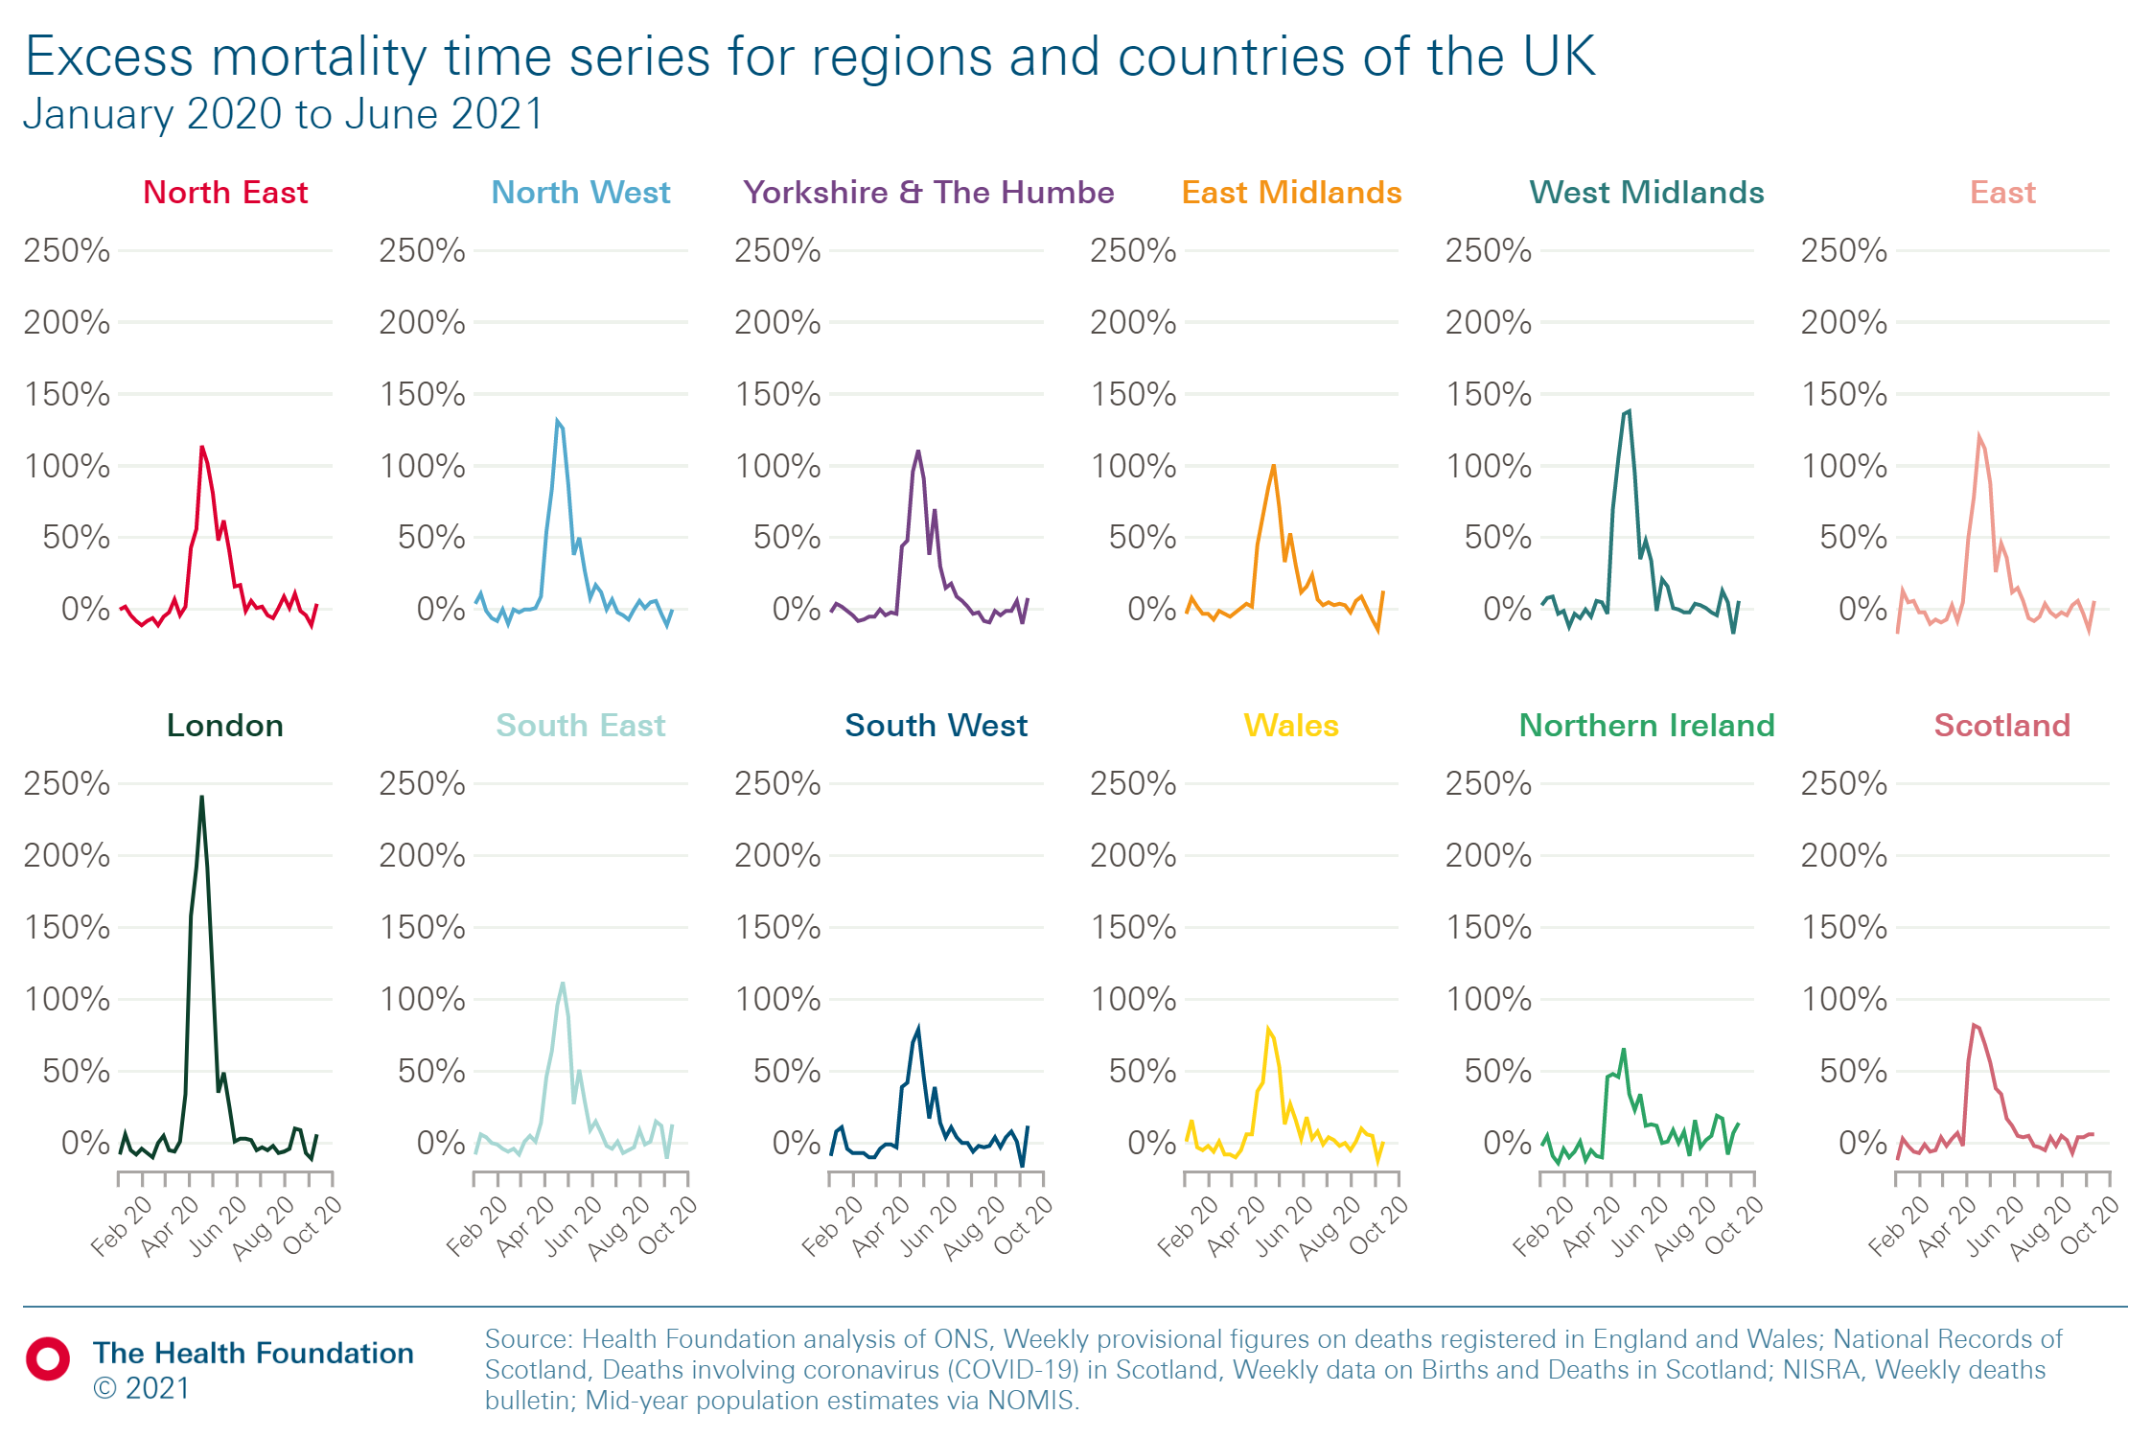
Excess mortality in UK
Report figure 2
Excess deaths as a share of expected deaths by week registered, for regions and countries of the UK, January 2020 to June 2021
In wave one and two, the highest excess mortality peak was in London.
In the north of England, as well as the East Midlands, deaths began to increase from October 2020, compared with November/December in London and parts of the south of England.

Slide 8
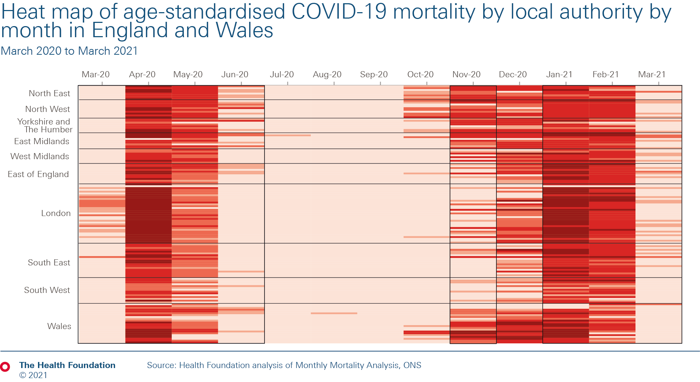
COVID-19 mortality rate across local authorities in England and Wales
Heat map of age-standardised COVID-19 mortality by local authority by month in England and Wales
(March 2020 to March 2021)
Note: Each line on this chart represents an upper tier local authority in England and Wales. The darker the colour, the higher the level of COVID mortality in that month. National lockdowns are indicated by black grids.
London experienced COVID-19 mortality earlier than other regions in spring 2020, and in January 2021 saw some of the highest levels of mortality. In June 2020, COVID-19 mortality remained higher in northern regions than in London.
In October 2020, the North East and North West of England, along with Wales, had relatively high levels of COVID-19 mortality.
Parts of these areas were subject to regional restrictions and, in Wales, a two-week 'circuit-breaker' lockdown from 23 October 2020.

Slide 9
Alpha variant, mortality and lockdown
The alpha variant was the dominant variant in the second wave.
New and Emerging Respiratory Virus Threats Advisory Group evidence review found that this variant was more transmissible and increased severity of infection. Compared with other variants, studies estimated that the odds of deaths were between 1.28 and 1.65, suggesting that there is about a 28 to 65% increased risk of death.
This led to the second wave of COVID-19 coming faster and stronger than expected and the UK government imposing strict restrictions over Christmas and another nationwide lockdown.

Slide 10
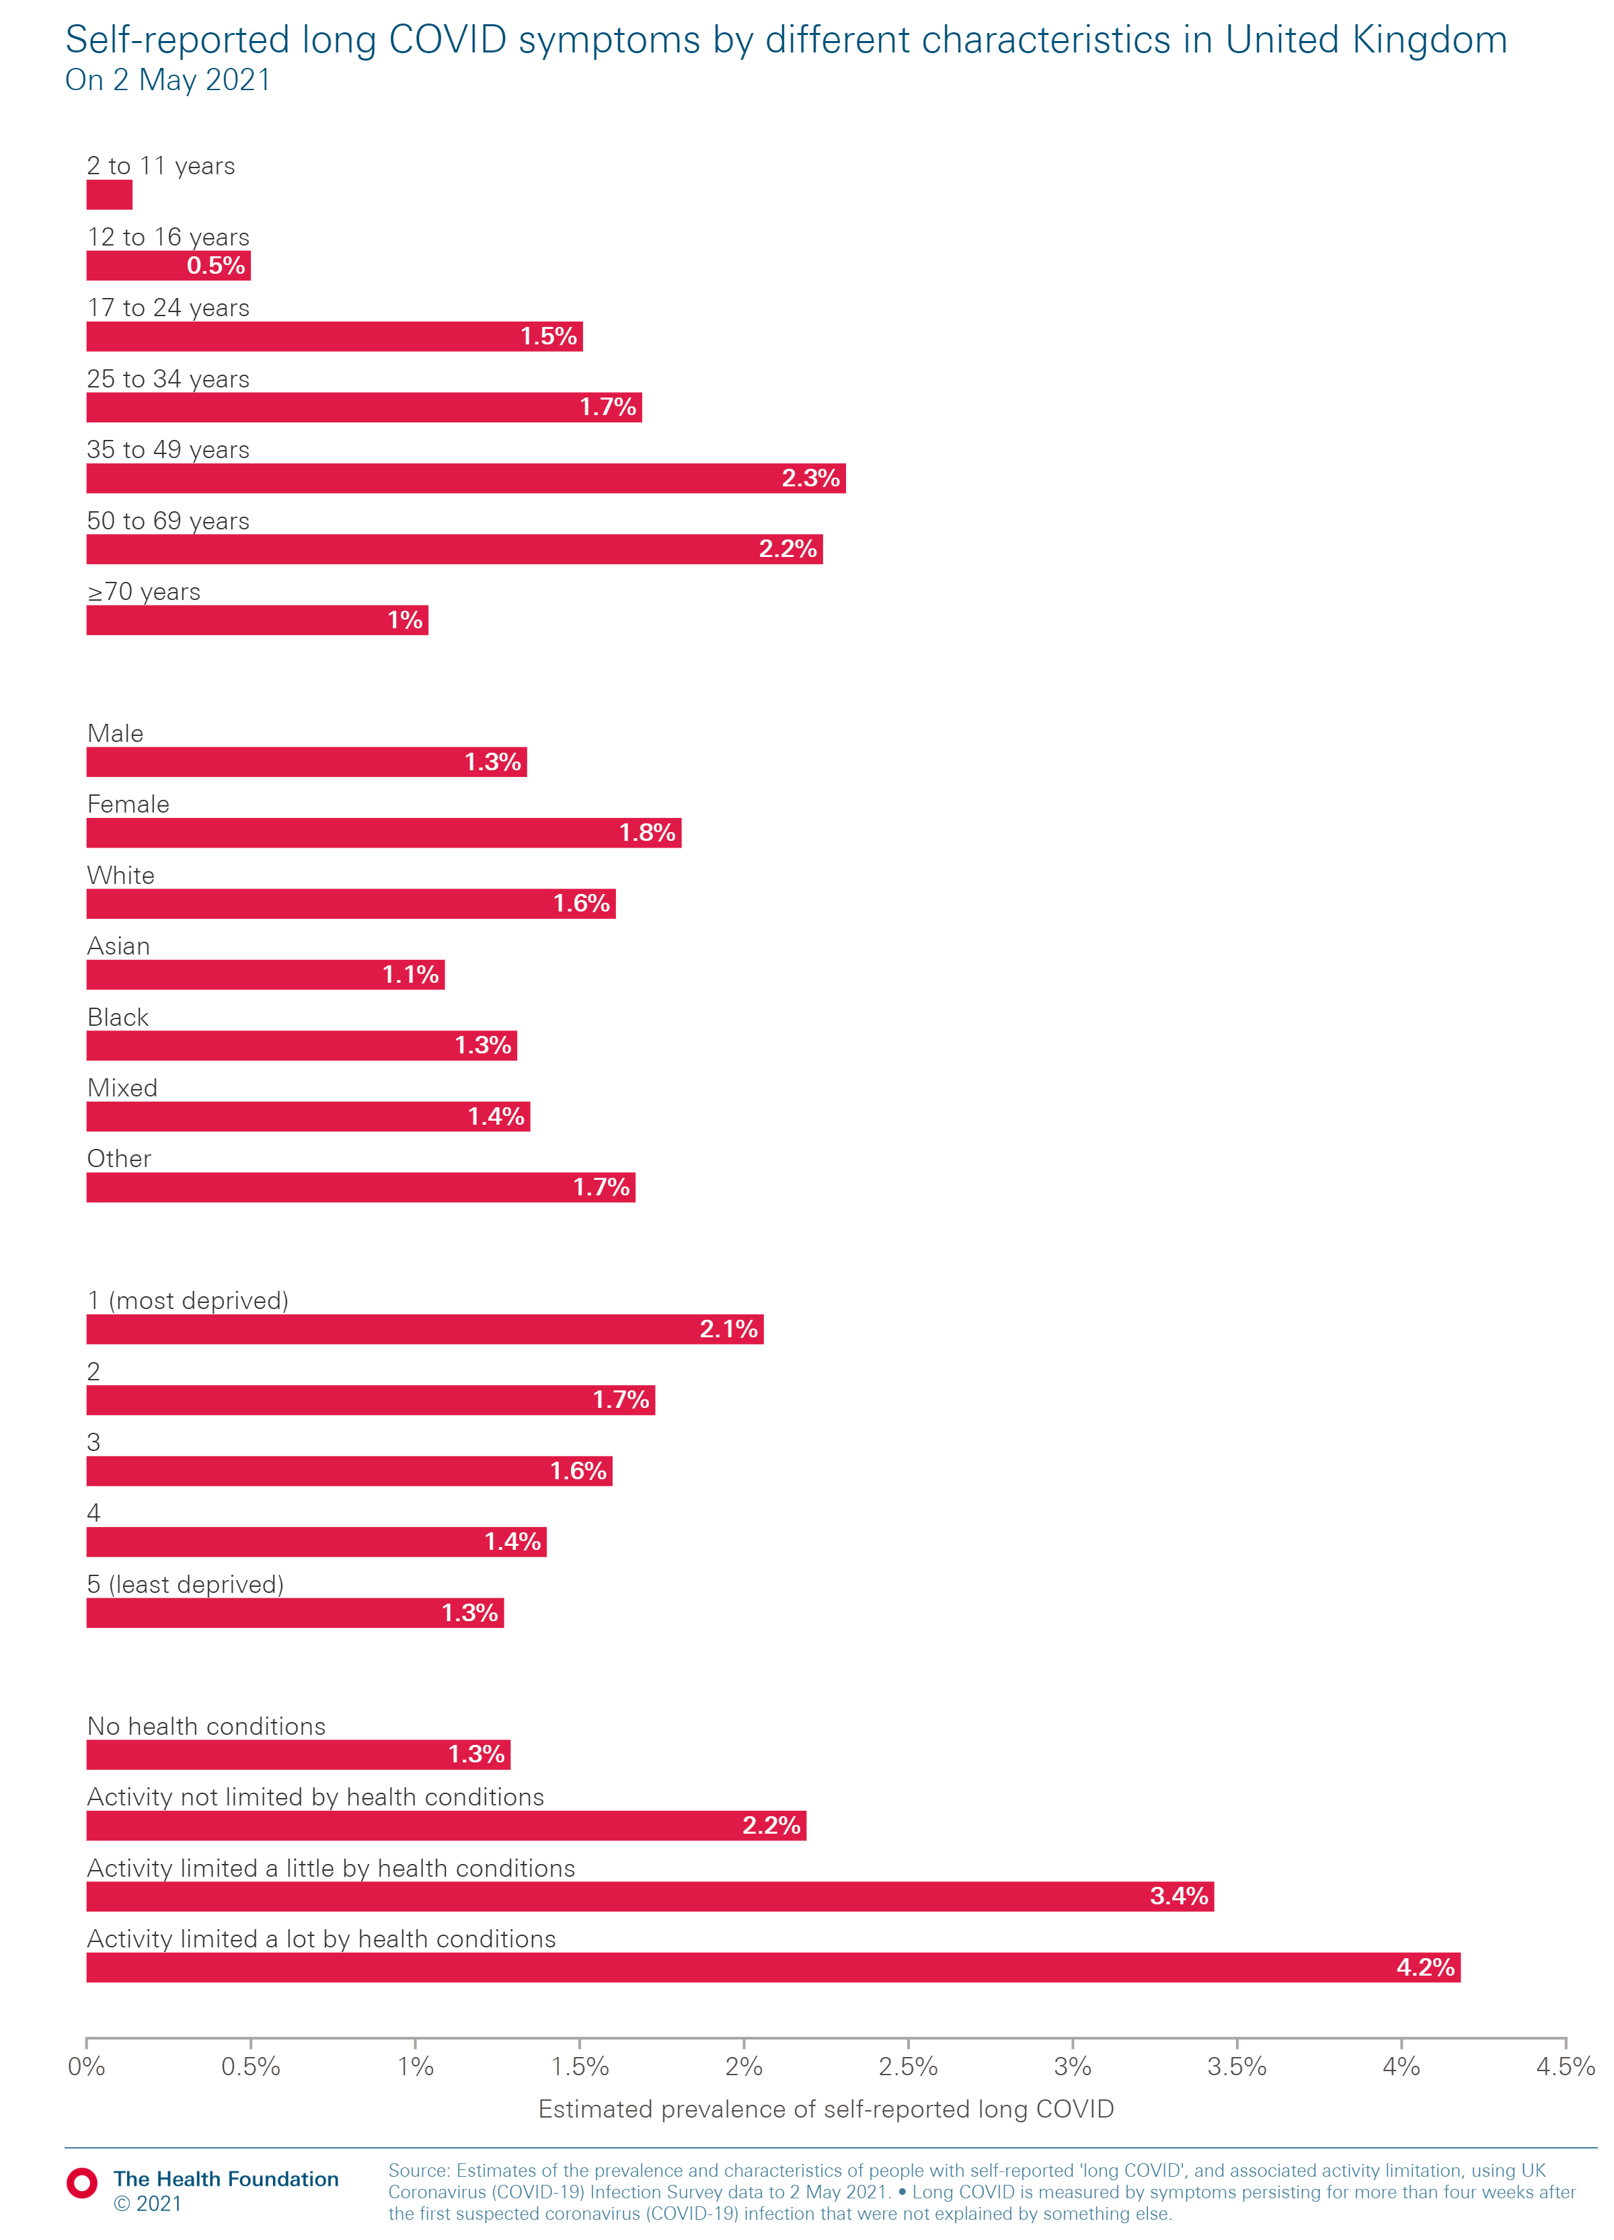
Prevalence of long COVID for different groups
Self-reported long COVID symptoms by different characteristics in the UK (2 May 2021)
In May 2021, 1 million people reported symptoms persisting for more than four weeks (long COVID).
The people most likely to report symptoms
of long COVID
were women, those with underlying health conditions, people from deprived areas and those aged
35–69.
These differences are likely to reflect a mixture of greater risk of exposure to COVID-19 and increased risk of prolonged symptoms once infected.
Evidence related to the scale and implication of long COVID is still limited.
Age
Gender / Ethnicity
Deprivation
Other conditions

Slide 11
2.
Comparing UK COVID-19 outcomes internationally

Slide 12
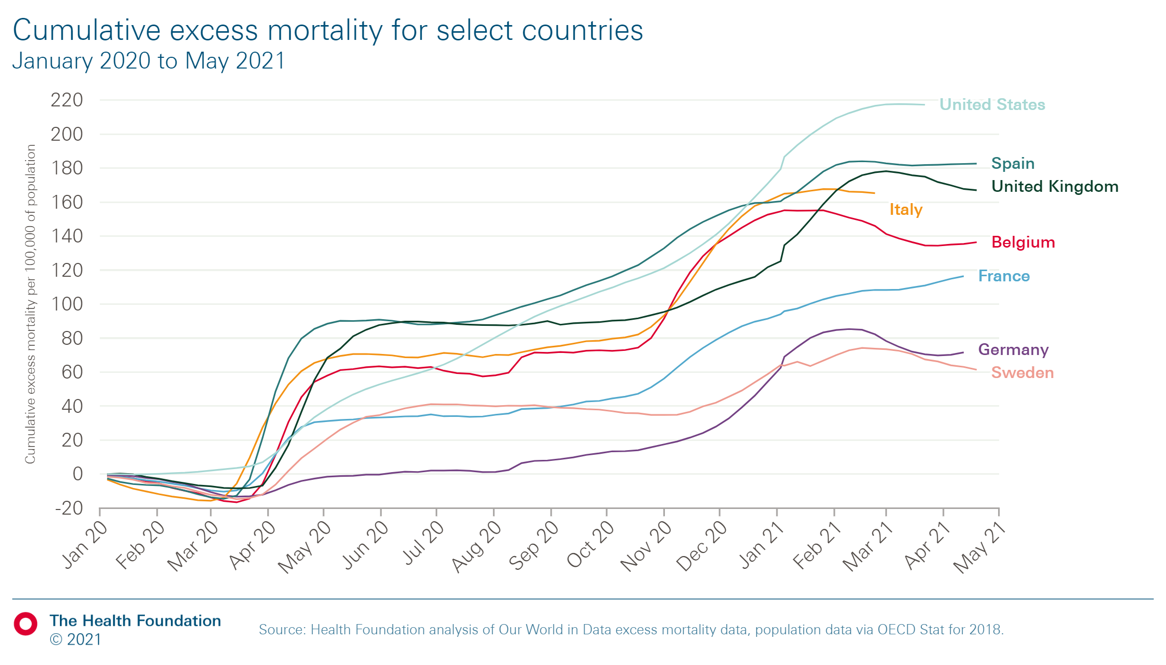
Excess mortality across countries
Report figure 3
Cumulative excess mortality for select countries, January 2020 to May 2021
UK had high levels of excess mortality in the first and second waves
In this comparison, by the end of the first wave, and the second, only Spain and the United States had higher excess mortality

Slide 13
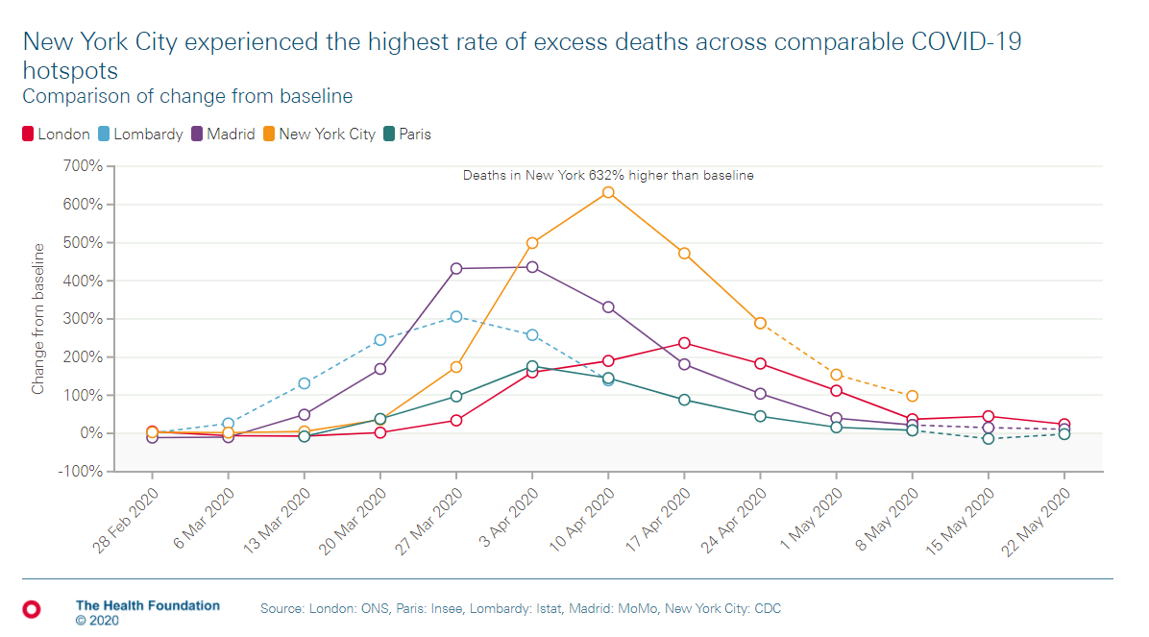
Excess mortality across cities
New York City experienced the highest rate of excess deaths across comparable COVID-19 hotspots
Although the UK had higher excess deaths than many other countries in the first wave, London was not as badly affected as compared to other major cities in the world.
The impact in the UK was more widespread across different regions

Slide 14
Government measures to control the virus
A study modelled deaths from COVID-19 with and without any government intervention and compared these results to actual deaths in 11 European countries between 24 February and 4 May 2020. Its definition of government intervention included social distancing, border closures, school closures, measures to isolate symptomatic individuals and their contacts, and large-scale lockdowns of populations – with all but essential internal travel banned. The study found that lockdown reduced transmission by 75-87% across countries and that within the UK, 370,000 to 580,000 deaths were averted due to government interventions. (Flaxman et al. 2020).
Another study analysed the impact of timing of lockdown on mortality rates in OECD countries that imposed a lockdown in early 2020. It found that had lockdown been imposed a week earlier in the UK, there would have been 17,000 fewer deaths by 21 May 2020 (Balmford et al. 2020).
A regression analysis found that over 75% of variation in mortality across OECD countries was unexplained by socio-economic factors such as age, urban clustering, GDP and inequality. This suggests that policy interventions taken by governments play a more important role (Balmford et al. 2020).
A further study identified high testing rate (per identified case) as an important factor for low mortality in OECD countries (Greener 2021).

Slide 15
Travel and the spread of COVID-19
The average rate of COVID-19 deaths between 31 December 2019 and 8 June 2020 was compared in 37 countries (Pana et al. 2021). The study found that global connectedness, as measured by international arrivals in 2018, was significantly associated with COVID-19 mortality with a 1 million increase in international arrivals linked to a 3.4% increase in the mortality rate.
In an analysis of international tourism in 85 countries before the pandemic, 1% higher level of inbound and outbound travel was associated with 1.2% higher confirmed cases and 1.4% higher confirmed deaths (Farzanegan et al. 2020).
Qualitative comparative analysis in OECD countries found that low international travel (alongside high testing) was the most common pathway to low COVID-19 cases and mortality (Greener 2021).

Slide 16
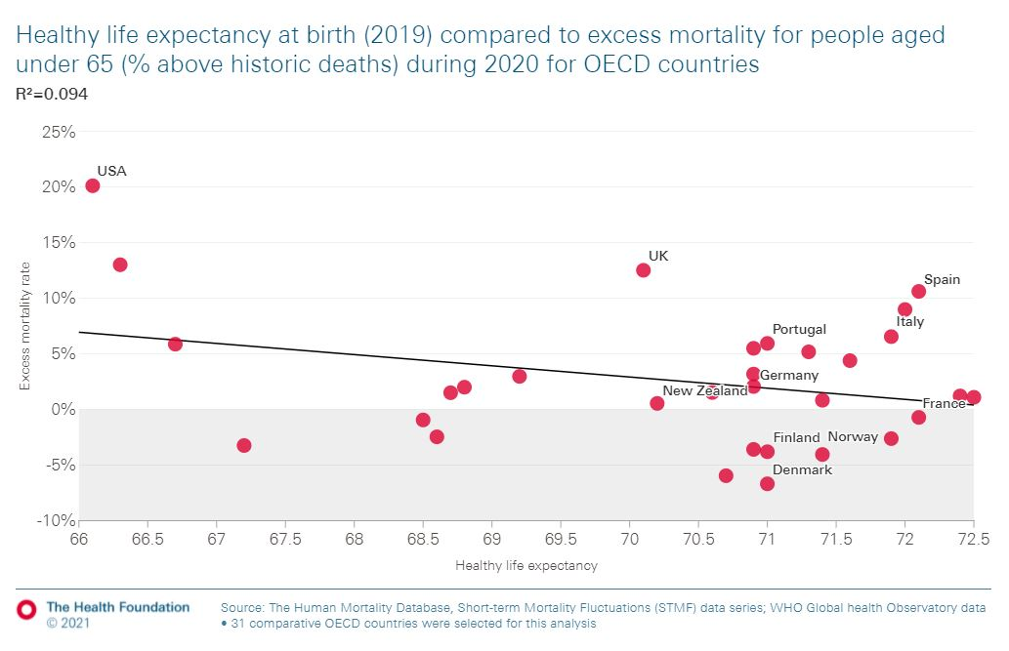
Healthy life expectancy and excess mortality
Healthy life expectancy at birth (2019) compared to excess mortality for people aged under 65 (% above historic deaths) during 2020 for OECD countries
For people aged 0–64, there is no association between levels of Healthy life expectancy and excess mortality.
This suggests that levels of healthy life expectancy play only a small role in explaining the variation in excess mortality among OECD countries.

Slide 17
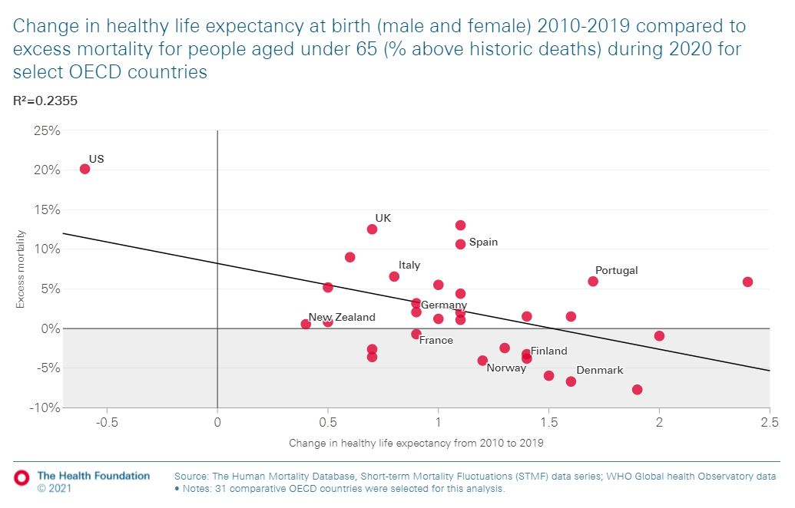
Change in healthy life expectancy and excess mortality
Report figure 4
Change in healthy life expectancy at birth, 2010-2019 compared with excess mortality for people aged under 65 as a share of expected deaths during 2020, selected OECD countries
Changes in HLE between 2010 and 2019 explain about 23% of the variation in excess mortality in 2020 for people aged 0–64 among selected OECD countries.
Countries with the greatest improvements in HLE experienced lower excess mortality during the pandemic.

Slide 18
Underlying health and COVID-19 outcomes
Countries with the highest levels of disability adjusted life years (DALYs) lost to cardiovascular, cancer and chronic respiratory diseases had the highest values of fatality from COVID-19 based on an analysis of 72 countries. (Sorci et al. 2020).
A meta-analysis of 20 studies conducted across the world found that kidney disease (4.9 times), cerebrovascular disease (4.78), CVD (3.05), respiratory disease (2.74), diabetes (1.97), hypertension (1.95) and cancer (1.89) increased risk of COVID-19 mortality (Biswas et al. 2021).
Analysis of the UK Biobank study data between 31 January and 21 September 2020 found an increased risk of COVID-19 mortality associated with the following conditions: cardiovascular disease (Odds Ratio: 1.22), hypertension (1.22), diabetes (1.16) and autoimmune disease (1.14) (Elliott et al. 2021). Another analysis up to 30 June 2020 found that men and women with obesity were, respectively, 1.78 or 2.21 times more likely to die from COVID-19 than those without obesity (Peters et al. 2020).
Health care data of more than 17,450,000 adults in England between 1 February and 9 November 2020 showed that uncontrolled diabetes, severe asthma, dementia and stroke increased risk of COVID-19 death, more so than for non-COVID-19 deaths. Cancer, respiratory disease, chronic heart disease, reduced kidney function and chronic liver disease also increased COVID-19 mortality, but the risk was less pronounced than for non-COVID-19 deaths (Bhaskaran et al. 2021).

Slide 19
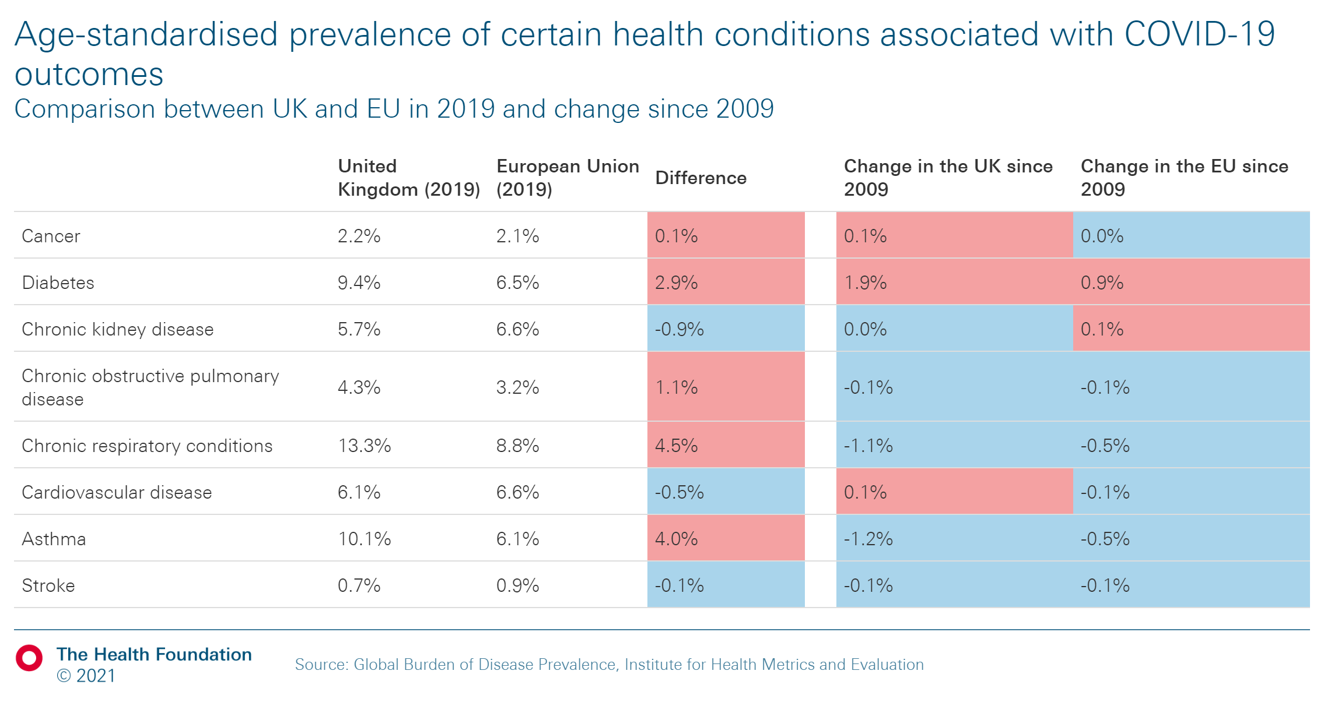
Prevalence of selected comorbidities
Report table 1
Age-standardised prevalence of certain health conditions associated with COVID-19 outcomes, UK and EU, 2019 and change since 2009
UK has a high prevalence of certain health conditions associated with poor COVID-19 outcomes
Some of these have worsened in the last decade, indicating an increasing burden of disease in the UK.

Slide 20
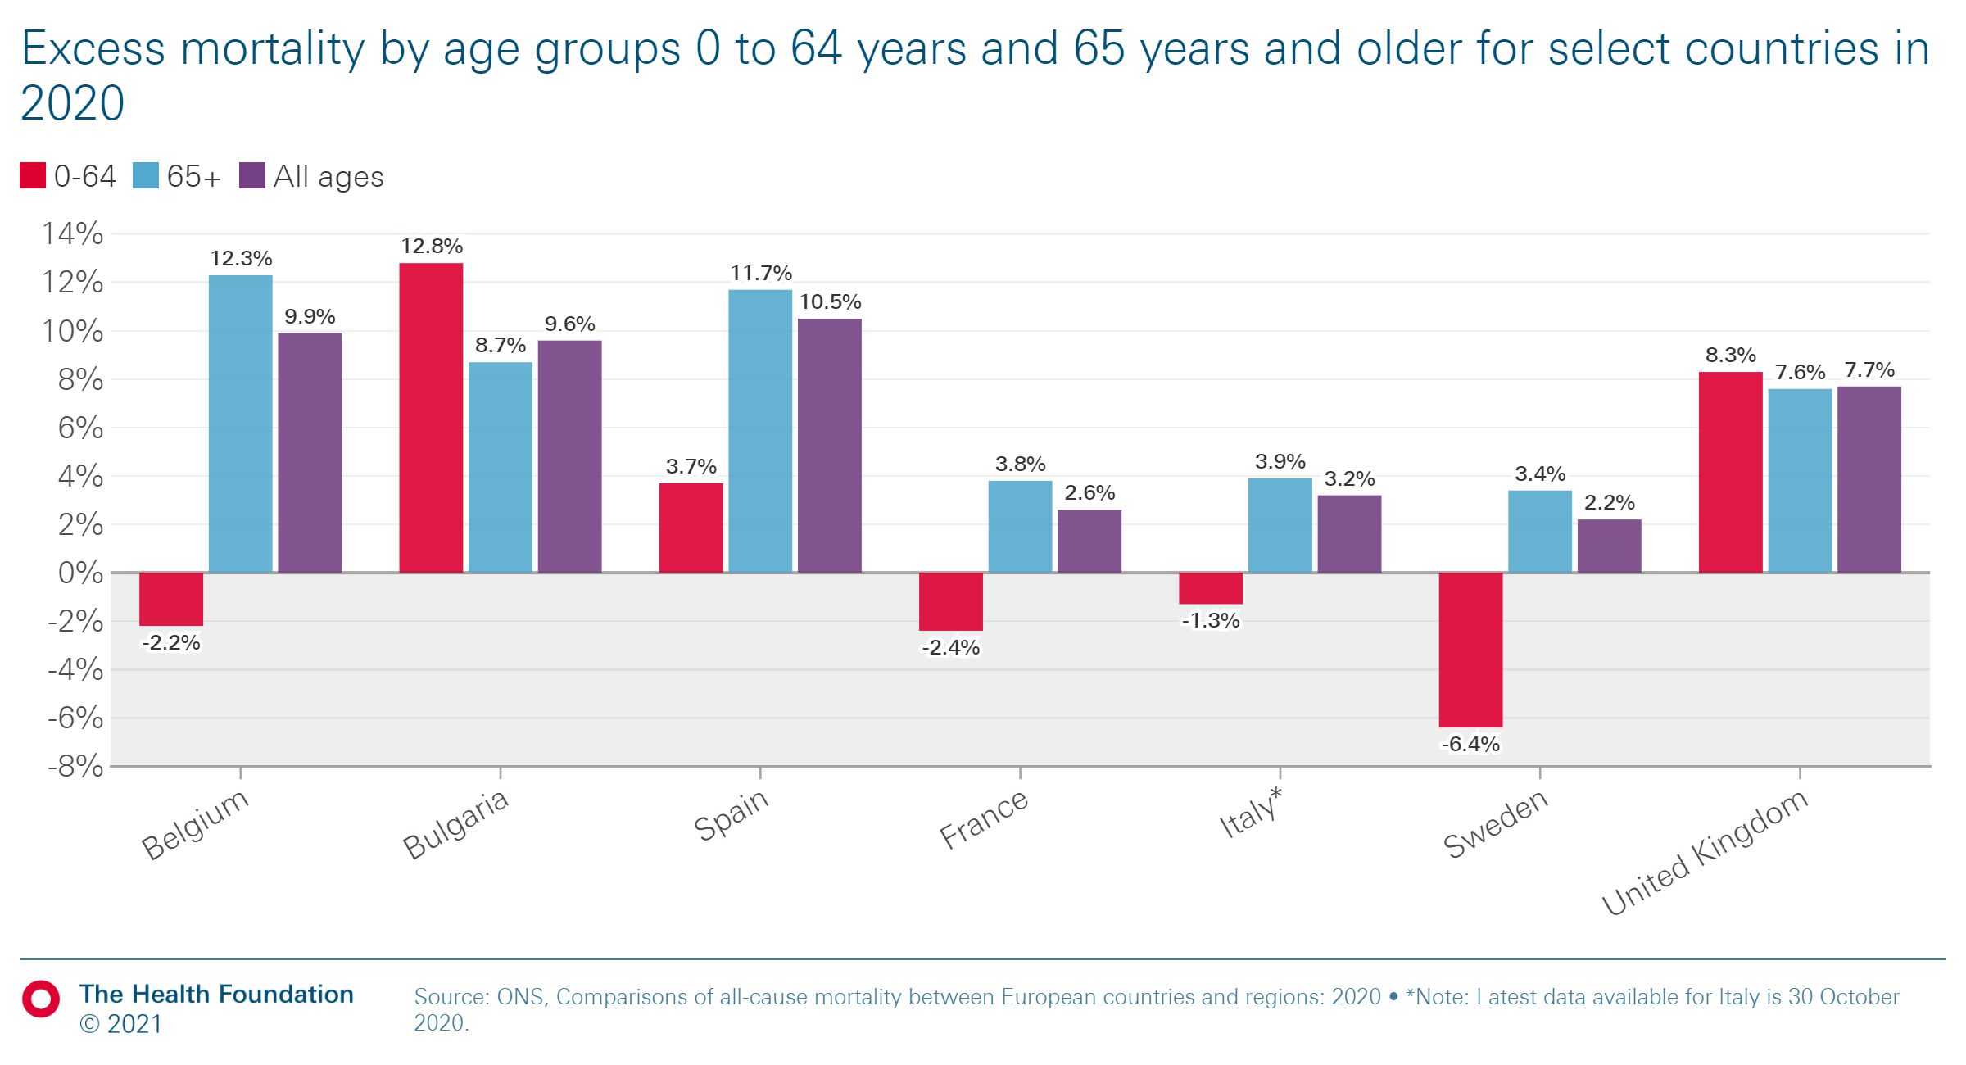
Excess mortality by age group across countries
Report figure 5
Excess mortality by age, selected European countries, 2020.
In Europe, UK was second only to Bulgaria in the rate of excess mortality for those aged 0–64 and in the ratio between excess mortality for those aged 0-64 and overall excess mortality.

Slide 21
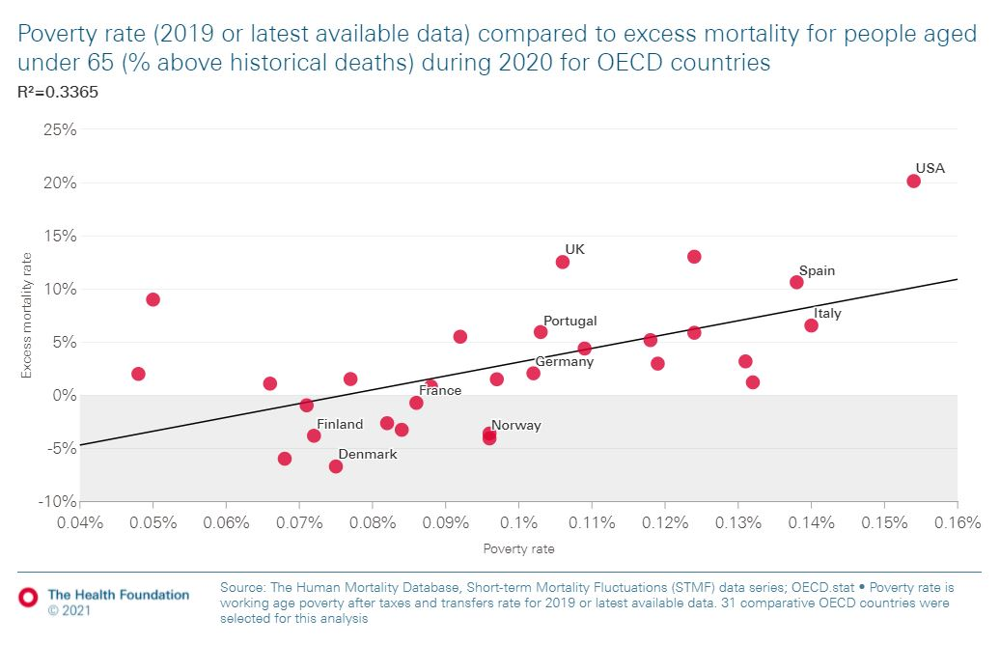
Excess mortality and poverty across countries
Poverty rate (2019 or latest available data) compared to excess mortality for people aged under 65 (% above historical deaths) during 2020 for OECD countries
In 2020, countries with higher working-age poverty rates were more likely to have higher levels of excess mortality for people aged under 65.

Slide 22
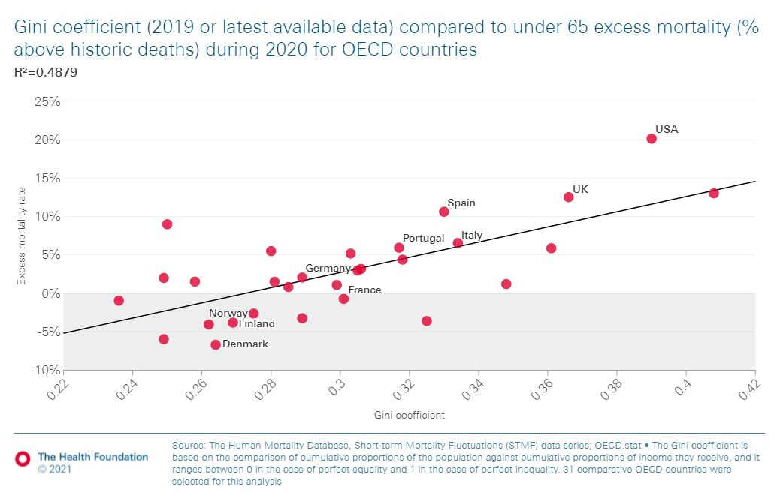
Income inequality and excess mortality across countries
Gini coefficient (2019 or latest available data) compared to under 65 excess mortality (% above historical deaths) during 2020 for OECD countries
Countries that had higher levels of income inequality for people aged 0–64 in 2019 also tended to have higher levels of excess mortality for people aged under 65 in 2020.

Slide 23
3.
What made people in the UK more vulnerable to
COVID-19?

Slide 24
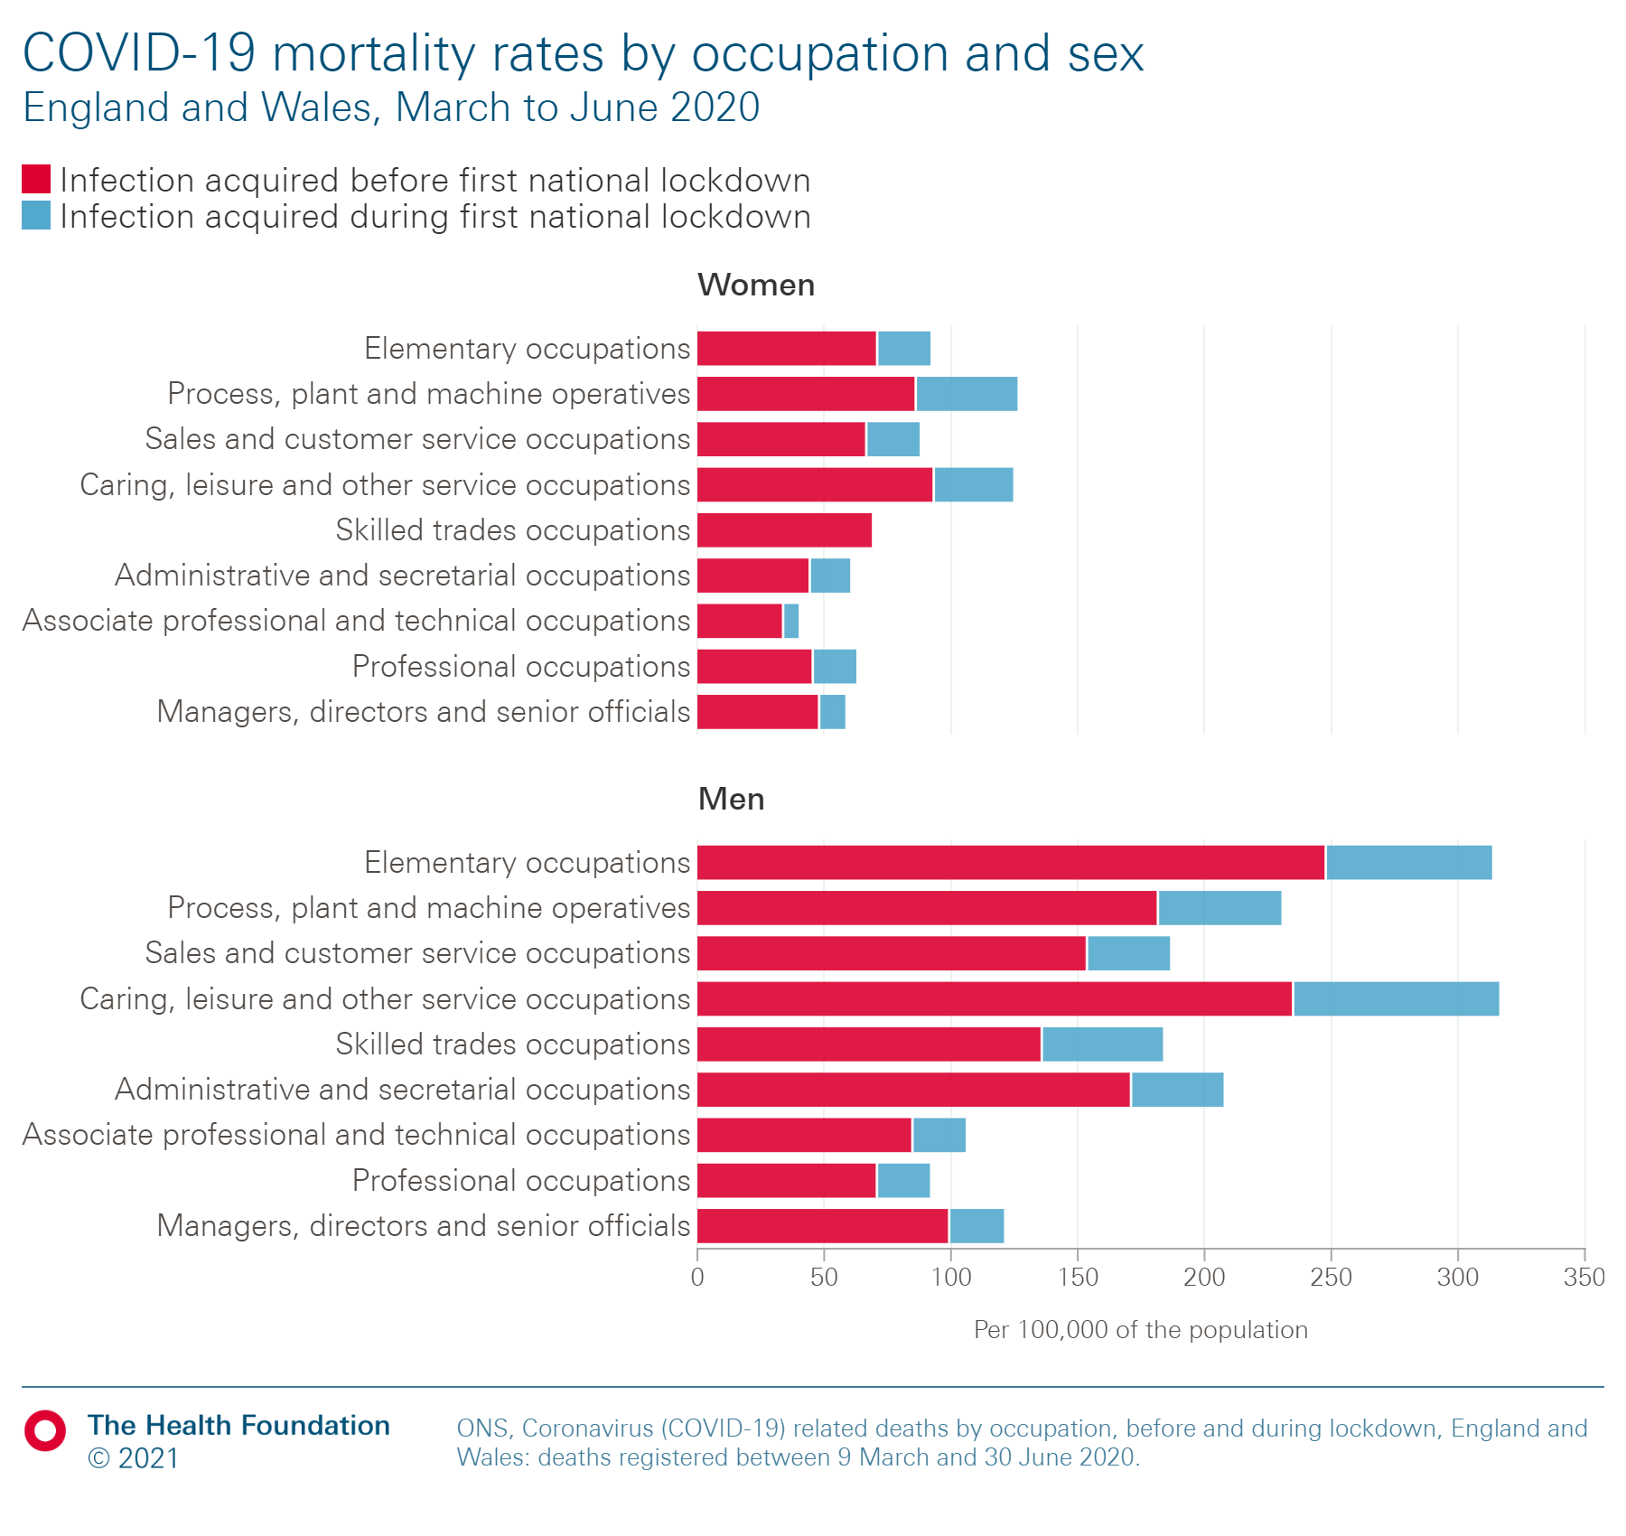
Occupation and COVID-19 mortality
Report figure 6
COVID-19 mortality rates by occupation and sex: England and Wales, March to June 2020
Relative reduction in the COVID-19 mortality rate was higher in occupations where people are less likely to work from home and for those who tended to work in shut down sectors.

Slide 25
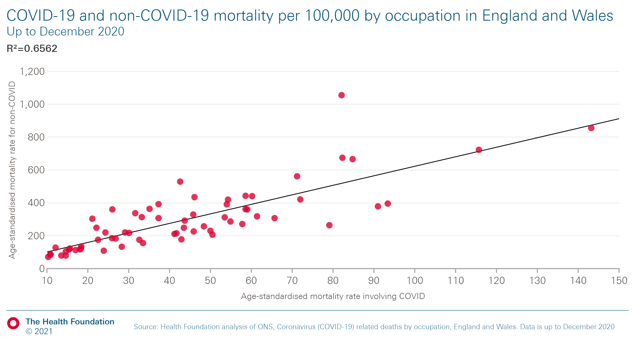
Occupation and mortality
COVID-19 and non-COVID-19 mortality per 100,000 by occupation in England and Wales
Occupations with a higher non-COVID-19 mortality rate also tended to have a higher COVID-19 mortality rate.
This suggests that people working in occupations with higher COVID-19 mortality tend to have poorer
pre-existing health.

Slide 26
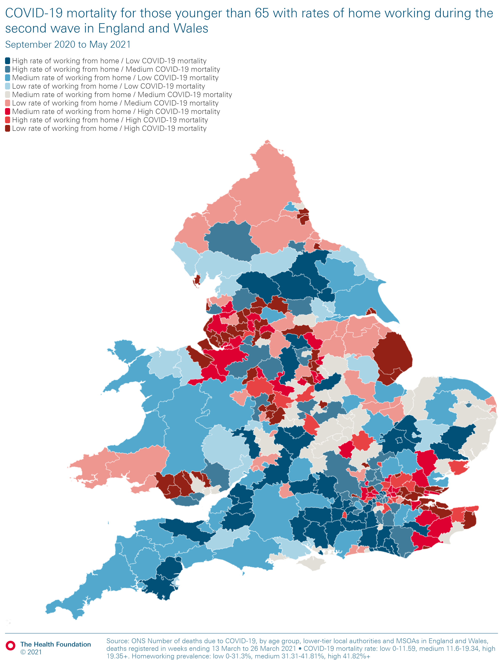
Working from home and COVID-19 mortality
Report figure 7
Mortality rates for deaths due to COVID-19 among those younger than 65 with share of workers that work from home, England and Wales, September 2020 to May 2021
Those able to work from home were able to limit their exposure to the virus and, subsequently, their risk of mortality.

Slide 27
UK social security in international context
Support for individual adults is relatively low by international standards but support for families with children is more generous. Income benefits as a proportion of median income had been decreasing before the pandemic – from around 25% in 2001 for single adults without children to 20% in 2019. For couples with children, this had increased to 43% by 2011 and then fell to 36% before the pandemic.
Unemployment benefits in the UK, as a proportion of the average wage for single adults, are very low (12%) relative to many other countries. (Most western European countries provide a 50–66% replacement).
The UK requires relatively few hours of work at the minimum wage to escape the poverty threshold (12 hours for a couple with two children and 23 for single adults). This reflects the relatively generous in-work support and the high minimum wage.
The UK has the third-lowest mandatory paid sick leave relative to earnings in the OECD after the USA and South Korea.
Source: Health Foundation analysis of data from https://stats.oecd.org/

Slide 28
Access to financial support, COVID-19 and self-isolation
Based on the Vivaldi study – a large-scale survey that looked at COVID-19 infections in 9,081 care homes providing care for dementia patients and older people in England – the ONS found ‘some evidence that in care homes where staff receive sick pay, there are lower levels of infection in residents.’
The Trade Union Congress (TUC) sent Freedom of Information requests to all English councils in January 2021. Across the 233 councils that responded (74%), only 30% of those applying for
self-isolation payments had received a payment. Based on details provided by 152 councils, the success rate for the main scheme was estimated at 37% and for the discretionary scheme about 20%.
Qualitative evidence from Liverpool’s COVID-19 community testing pilot found some people were hesitant to participate in mass testing due to fear of income loss in case of a need to isolate.
The CORSAIR study found that adherence to self-isolation was low (20.2%) between 2 March 2020 and 27 January 2021. ‘Going to work’ was reported as the second most common (15.8%) reason for not self-isolating, behind ‘go to the shops for groceries or to a pharmacy’ (21.5%). Non-adherence was associated with: being male, younger age, having a dependent child in the household, unemployed, lower socioeconomic grade, lower educational qualifications, working in a key sector and experiencing greater hardship (Smith et al. 2021).

Slide 29
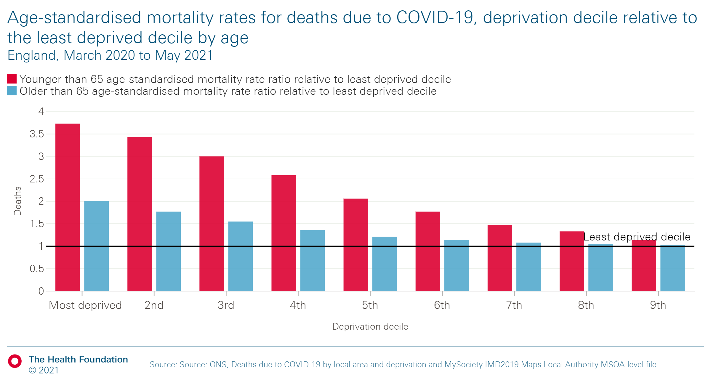
Deprivation and COVID-19 mortality
Report figure 8
Age-standardised mortality rates for deaths due to COVID-19, deprivation decile relative to the least deprived decile by age, England, March 2020 to May 2021
COVID-19 mortality rates were higher among those
from more deprived areas than among those from less deprived areas.
This differential was higher for those aged under 65.

Slide 30
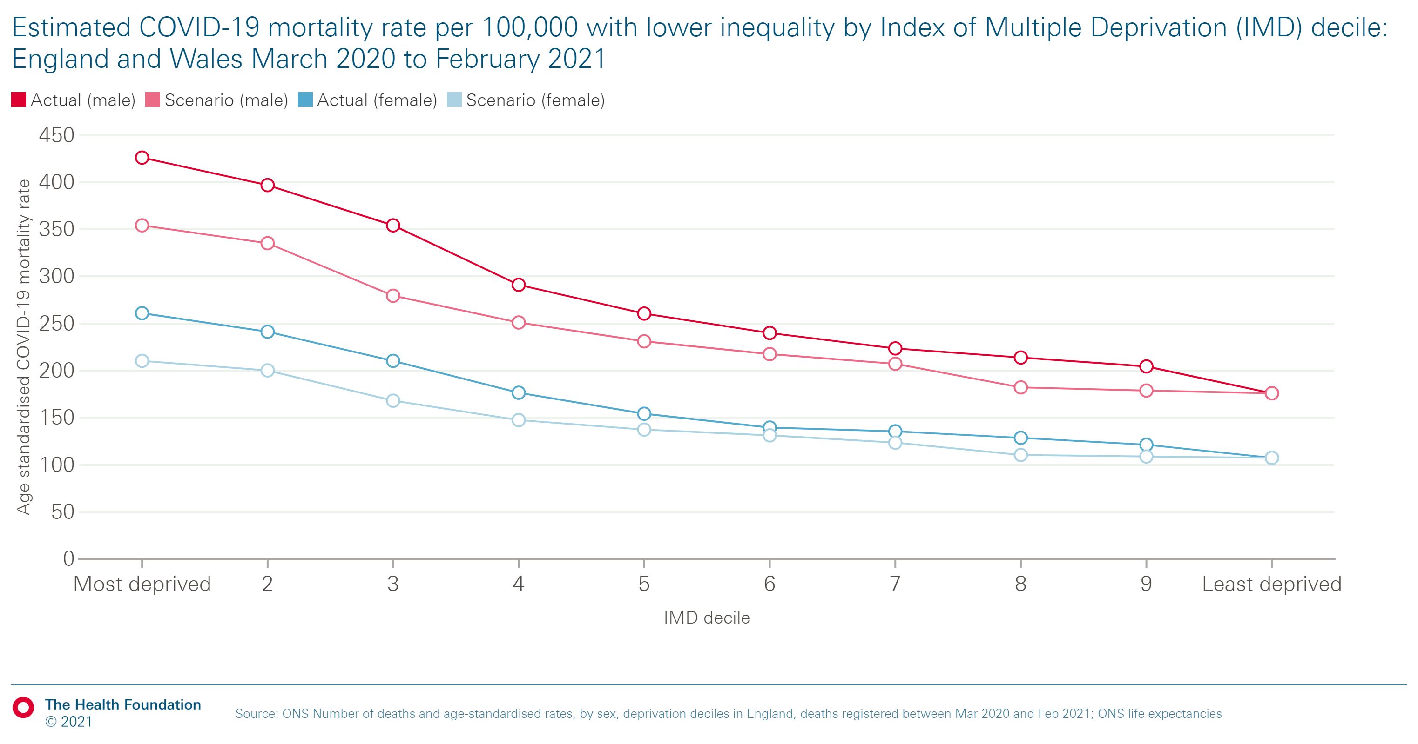
Impact of reducing health inequalities on COVID-19 mortality
Estimated COVID-19 mortality rate per 100,000 with lower inequality by index of Multiple Deprivations (IMD) decile: England and Wales March 2020 to February 2021
The chart models how a lower COVID-19 mortality social gradient would have reduced total deaths.
In this scenario:
Reducing the social gradient: Decile 1 – the most deprived decile – is assumed to have the lower actual COVID-19 mortality rate (354.1 for males and 210.3 for females) of decile 3, and so on. There is no change in decile 10.
Outcome: The COVID-19 mortality rate is reduced by 13%. The 110,000 COVID-19 deaths in this period would have reduced by about 14,000 until end of February 2021.

Slide 31
4.
The COVID-19 vaccination programme

Slide 32
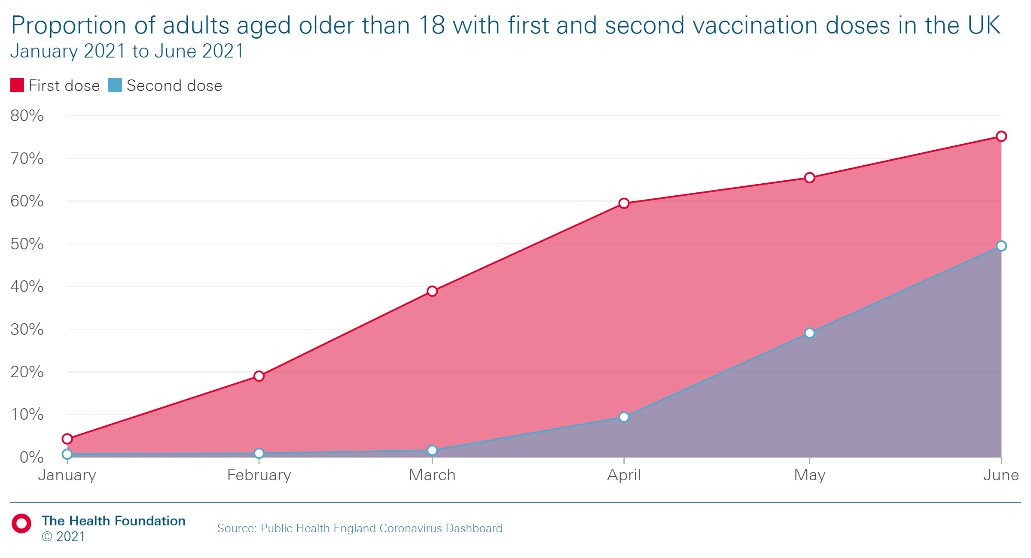
COVID-19 vaccination rates in the UK
Proportion of adults aged older than 18 with first and second vaccination doses in the UK
As of the 8 June 2021, 77% of adults in the UK had received one dose
of a COVID-19 vaccine, and 54% had received two doses.
Public Health England estimated that the vaccination programme
had prevented 42,000 hospitalisations among those aged 65 or older
and 14,000 deaths among those aged 60 or older in England by
30 May 2021.

Slide 33
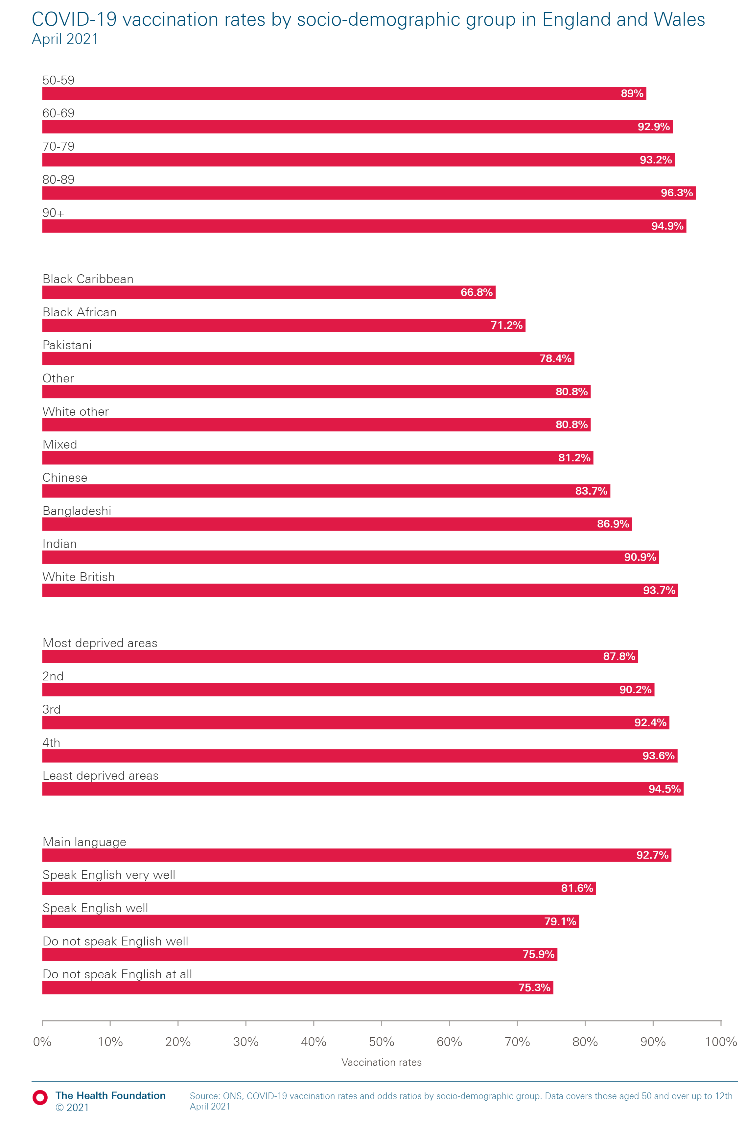
COVID-19 vaccination rates by socio-demographic group across England and Wales
Report figure 9
COVID-19 vaccination rates among people age 50 and older by socio-demographic group, England and Wales, 12 April 2021
By April 2021, a smaller proportion of people who did not speak English, or who were from more deprived areas or ethnic minority communities, had received a vaccination.
Age
Ethnic group
Deprivation
English proficiency

Slide 34
Vaccination take-up
The UK government has worked with partners at the local and national level to facilitate high take-up of vaccines. Local governments have been key to support vaccine
take-up, by engaging hard-to-reach communities and addressing hesitation. Councils have employed innovative ways of working to achieve this. For example:
Hertfordshire council set up COVID information champions to use voluntary sector networks to provide clear and trusted information to communities.
Manchester developed a tracking system to follow up with those declining vaccination, identify patterns and host bespoke clinics. By placing bilingual vaccinators at one such clinic, and accommodating requests such as being vaccinated by a woman, they were able to reach 100 people who had previously turned down a jab.
Wiltshire, in partnership with Bath and North East Somerset, set up a vaccination team that included outreach workers on a boat going down the canal, to reach houseboat communities.

Slide 35
References
Chowdhury J, Simon S, MacAskill A, Marshall ARC. Variant of concern [Webpage]. Reuters Graphics. 2021. (https://graphics.reuters.com/HEALTH-CORONAVIRUS/UK-VARIANT/ygdpzgblxvw/)
Scientific Advisory Group for Emergencies. NERVTAG: Update note on B.1.1.7 severity, 11 February 2021. Gov.uk. 2021. (https://www.gov.uk/government/publications/nervtag-update-note-on-b117-severity-11-february-2021)
Prime Minister’s Office. Prime Minister's statement on coronavirus (COVID-19): 19 December 2020 [Webpage]. Gov.uk. 2020. (https://www.gov.uk/government/speeches/prime-ministers-statement-on-coronavirus-covid-19-19-december-2020)
Prime Minister’s Office. Prime announces national lockdown [Webpage]. Gov.uk. 2021. (https://www.gov.uk/government/news/prime-minister-announces-national-lockdown)
Flaxman S, Mishra S, Gandy A, Unwin HJT, Mellan TA, Coupland H, et al. Estimating the effects
of non-pharmaceutical interventions on COVID-19 in Europe. Nature. 2020;584(7820):257–61.
(https://doi.org/10.1038/s41586-020-2405-7)
Balmford A, Fisher B, Mace GM, Wilcove DS, Balmford B. Analogies and lessons from COVID-19 for tackling the extinction and climate crises. Curr Biol. 2020/09/09. 2020;30(17)
(www.ncbi.nlm.nih.gov/pubmed/32898490)
Balmford B, Annan JD, Hargreaves JC, Altoè M, Bateman IJ. Cross-Country Comparisons of Covid-19: Policy, Politics and the Price of Life. Environ Resour Econ. 2020/08/25. 2020;76(4):525–51. (www.ncbi.nlm.nih.gov/pubmed/32836862)
Greener I. Comparing country risk and response to COVID-19 in the first 6 months across 25 Organisation for Economic Co-operation and Development countries using qualitative comparative analysis. J Int Comp Soc Policy. 2021 (https://doi.org/10.1017/ics.2021.6)
Pana TA, Bhattacharya S, Gamble DT, Pasdar Z, Szlachetka WA, Perdomo-Lampignano JA, et al. Country-level determinants of the severity of the first global wave of the COVID-19 pandemic: An ecological study. BMJ Open. 2021;11(2). (https://bmjopen.bmj.com/content/11/2/e042034)
Farzanegan MR, Gholipour HF, Feizi M, Nunkoo R, Andargoli AE. International Tourism and Outbreak of Coronavirus (COVID-19): A Cross-Country Analysis. J Travel Res. 2021;60(3). (https://doi.org/10.1177/0047287520931593)
Biswas M, Rahaman S, Biswas TK, Haque Z, Ibrahim B. Association of Sex, Age, and Comorbidities with Mortality in COVID-19 Patients: A Systematic Review and Meta-Analysis. Intervirology. 2021;64(1). (https://doi.org/10.1159/000512592)
Elliott J, Bodinier B, Whitaker M, Delpierre C, Vermeulen R, Tzoulaki I, et al. COVID-19 mortality in the UK Biobank cohort: revisiting and evaluating risk factors. Eur J Epidemiol. 2021;36(3).
(https://link.springer.com/article/10.1007/s10654-021-00722-y)
Peters SAE, MacMahon S, Woodward M. Obesity as a risk factor for COVID-19 mortality in women and men in the UK biobank: Comparisons with influenza/pneumonia and coronary
heart disease. Diabetes, Obes Metab. 2021;23(1). (https://doi.org/10.1111/dom.14199)

Slide 36
References
Bhaskaran K, Bacon S, Evans SJ, Bates CJ, Rentsch CT, MacKenna B, et al. Factors associated with deaths due to COVID-19 versus other causes: population-based cohort analysis of UK primary care data and linked national death registrations within the OpenSAFELY platform. Lancet Reg Heal - Eur. 2021;6. (https://doi.org/10.1016/j.lanepe.2021.100109)
Office for National Statistics. Impact of coronavirus in care homes in England: 26 May to 19 June 2020 [Webpage]. Office for National Statistics. 2020. (https://www.ons.gov.uk/peoplepopulationandcommunity/healthandsocialcare/conditionsanddiseases/articles/impactofcoronavirusincarehomesinenglandvivaldi/26mayto19june2020)
High rejection rates show the self-isolation payment scheme isn’t fit for purpose [Webpage]. TUC. 2021. (https://www.tuc.org.uk/blogs/high-rejection-rates-show-self-isolation-payment-scheme-isnt-fit-purpose)
University of Liverpool. Liverpool Covid-19 Community Testing Pilot Interim Evaluation Report. University of Liverpool. 2020. (https://www.liverpool.ac.uk/media/livacuk/coronavirus/Liverpool,Community,Testing,Pilot,Interim,Evaluation.pdf)
Smith L, Potts HW, Amlôt R, Fear N, Michie S, Rubin GJ. Adherence to the test, trace and isolate system: results from a time series of 21 nationally representative surveys in the UK Bmj. 2020. (www.bmj.com/content/372/bmj.n608)
Sorci G, Faivre B, Morand S. Explaining among-country variation in COVID-19 case fatality rate. Sci Rep. 2020;10(1).(https://pubmed.ncbi.nlm.nih.gov/33144595/)
Public Health England. COVID-19 vaccine surveillance report – week 23. Gov.uk. Gov.uk; 2021. (https://assets.publishing.service.gov.uk/government/uploads/system/uploads/attachment_data/file/992741/Vaccine_surveillance_report_-_week_23.pdf)
DHSC. UK COVID-19 vaccine uptake plan[Webpage]. Gov.uk. 2021. (https://www.gov.uk/government/publications/covid-19-vaccination-uptake-plan/uk-covid-19-vaccine-uptake-plan)
Applying behavioural insights to improve COVID vaccination uptake [Webpage]. Local Government Association. (https://www.local.gov.uk/our-support/coronavirus-information-councils/covid-19-service-information/covid-19-vaccinations/behavioural-insights)
COVID-19 vaccination: increasing uptake [Webpage]. Local Government Association. 2021. (https://www.local.gov.uk/case-studies/covid-19-vaccination-increasing-uptake)
Manchester: how a vaccine tracker and outreach work is helping follow-up with those who decline the vaccine first time round [Webpage]. Local Government Association. 2021.
(https://www.local.gov.uk/case-studies/manchester-how-vaccine-tracker-and-outreach-work-helping-follow-those-who-decline)
Wiltshire council: promoting vaccination among traveller and houseboat communities [Webpage]. Local Government Association. 2021. (https://www.local.gov.uk/case-studies/wiltshire-council-promoting-vaccination-among-traveller-and-houseboat-communities)

Slide 37
Learn more:
Read the COVID-19 impact inquiry report: Unequal pandemic, fairer recovery
See all content from the COVID-19 impact inquiry
Discover all of the inquiry's technical supplements:
Supplement 2: The pandemic’s implications for wider health and wellbeing
Supplement 3: Changes in the wider determinants of health
Supplement 4: Experiences of some groups disproportionately affected by the pandemic.
Sign up for ongoing updates about this work.

