Slide 1
Health and social care funding to 2024/25
September 2021

Slide 2
Background – Health and social care funding to 2024/25
An upcoming report from the Health Foundation’s REAL Centre: Health and social care funding projections 2021 will set out long-term funding requirements for health and social care in England to 2030/31. The report is due for publication in September 2021 and will be the first in a series.
The analysis seeks to answer the question of how much funding the health and social care system may need over different periods of time. This includes DHSC budgets, day-to-day NHS funding and the funding made available to local authorities for adult social care.
These slides provide a summary of key results, covering funding requirements to 2024/25.
The work builds on the approach set out in previous Health Foundation publications: Securing the Future (2018, work done jointly with the IFS) and Managing uncertainty (2020).
The REAL Centre’s first report The bigger picture (2020) provides important contextual information on trends in NHS funding and activity.
The report and these slides do not seek to recommend a course of action. Instead they set out the funding implications of choices about, for example, the speed of service recovery and pay. As such, scenarios and sensitivity analysis are presented to reflect uncertainty. This includes that in the external environment, particularly in relation to the path of COVID-19, and in trade-offs and decisions government will need to make in its level of ambition for recovery from the pandemic.

Slide 3
1. Our approach
1) Our approach
2) Underlying funding pressures
4) Results
3) Additional funding pressures
5) Implications

Slide 4
For our health care projections we combine ‘underlying funding pressures’ with ‘additional funding pressures’ to estimate total funding needs
We calculate ‘underlying funding pressures’ based on a set of assumptions about demand-side (eg population growth and ageing) and supply-side (eg pay) factors.
We then calculate ‘additional funding pressures’. These are issues that are largely within control of policymakers, such as performance against waiting times targets, but also covers the impact of COVID-19.
We combine the two in a set of scenarios in order to estimate total funding needs through to 2024/25.
REAL Centre modelling approach

Slide 5
2. Underlying funding pressures
1) Our approach
2) Underlying funding pressures
4) Results
3) Additional funding pressures
5) Implications

Slide 6
For our health care projections we use a component-based modelling approach to project ‘underlying funding pressures’.
Based on a set of assumptions about demand-side drivers (eg population and morbidity), we project how much activity is needed to deliver 2018/19 levels of care (ie prior to the pandemic).
Then, based on a set of assumptions about supply-side drivers (eg pay and productivity) we project the cost of care over time.
We combine projections of activity and cost to estimate the funding required to meet ‘underlying funding pressures’, ie funding required if existing trends in key drivers continued.
Our approach to underlying funding pressures
Note: Our social care modelling approach is set out in detail in the Health Foundation’s REAL Centre publication “Social Care Funding gap”. Estimates of social care demand are based on work by the Care Policy and Evaluation Centre (CPEC) at LSE. Demand projections cover publicly funded social care for all adults, for both community-based and residential care.

Slide 7
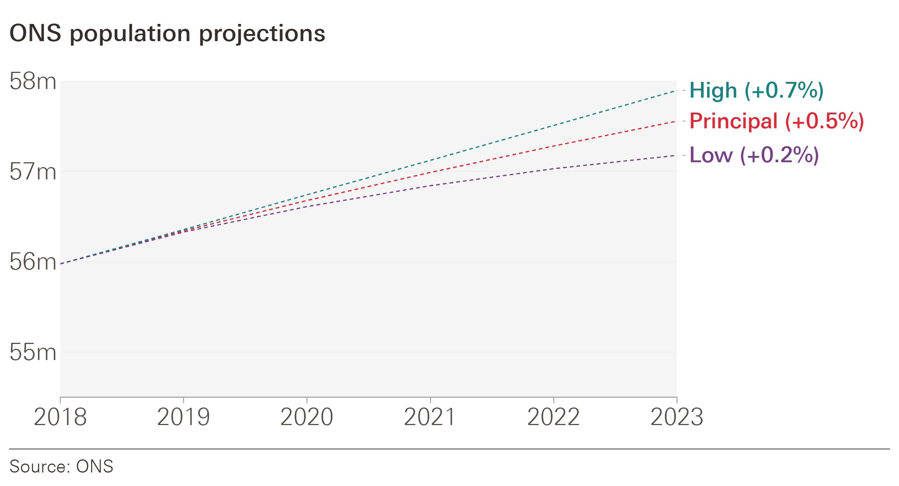
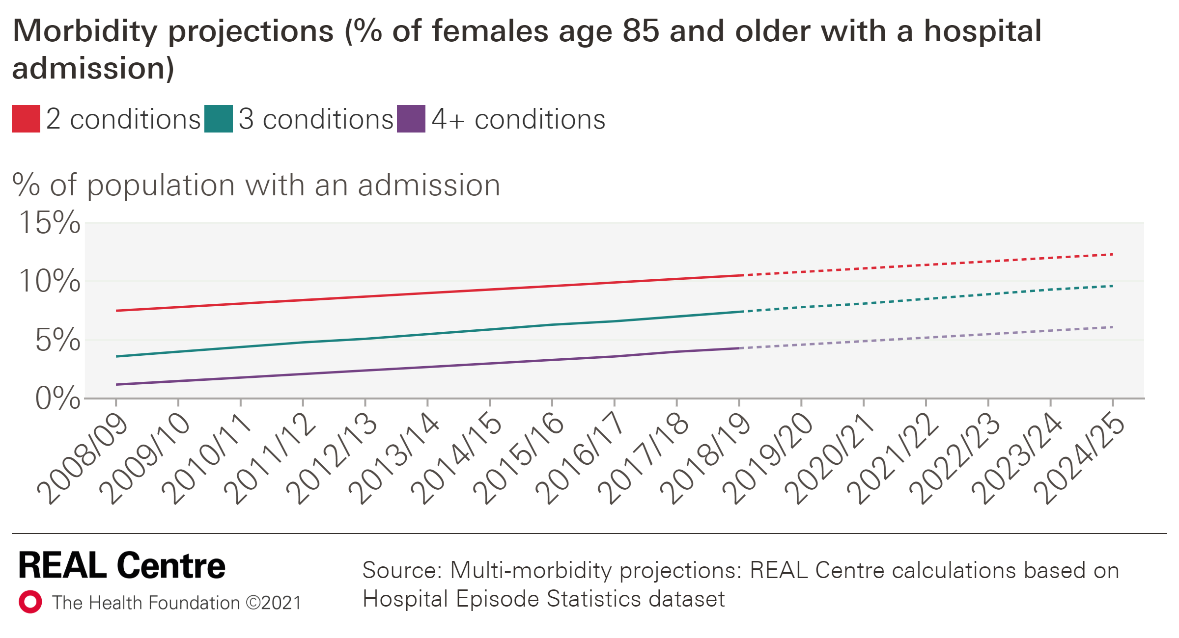
A growing and ageing population, with a higher prevalence of chronic conditions, will drive increased demand for health and social care.
A growing and ageing population
Rising morbidity
The population is growing (at 0.5% per year in the principal projection).
But it is also ageing: the proportion of people aged 65+ will rise from 18.2% to 19.4% between 2018 and 2024.
The number of people living with long term conditions has been growing and is expected to grow further.
The chart below shows the projected proportion of the female population aged 85+ with a hospital admission by number of multiple conditions.

Slide 8
The projected growth in activity varies by service, with the highest growth for hospital admissions.
Health and social care activity would need to increase to meet the demand side pressures.
Projected activity growth varies between areas:
Growth is highest for hospital care, particularly elective (2.5%) and non-elective (2.6%) care;
Growth is lowest for maternity care (-0.7%) (due to a fall in projected number of births) and services such as mental health that are less driven by ageing.
Our projections are broadly in line with trends over the last decade, with some exceptions eg Improving Access to Psychological Therapies (IAPT) and outpatient care are lower; community care is higher.
It is important to note that these are projections are not a statement of what should happen, either to improve patient care or make best use of resources. They are an estimate of what could happen if current patterns of service use are combined with projected changes of the drivers of service use (eg age and morbidity).
Activity projections by service area (annual growth, %)
 | Annual average growth rate |  | Difference (percentage points)
Area | Actual historic (2009/10–2018/19) | Projected growth (2018/19–2024/25)
Outpatient | 4.1% | 1.5% | -2.5
A&E | 1.6% | 0.9% | -0.6
Non-elective | 1.8% | 2.6% | 0.7
Elective | 2.4% | 2.5% | 0.0
Maternity | -0.4% | -0.7% | -0.2
Community care | -0.9% | 2.1% | 3.0
Primary care | 0.9% | 1.4% | 0.5
IAPT* | 16.6% | 0.2% | -16.4
Secondary Mental Health** | 0.8% | 0.8% | 0.0
Community prescriptions | 2.3% | 1.4% | -0.9
Social Care*** | -0.6% | 1.7% | 2.2
Note: Historic rates are *2012/13–2018/19; **2011/12–2018/19; ***2015/16–2018/19. The difference may not exactly match due to rounding of numbers.
Source: REAL Centre calculations

Slide 9
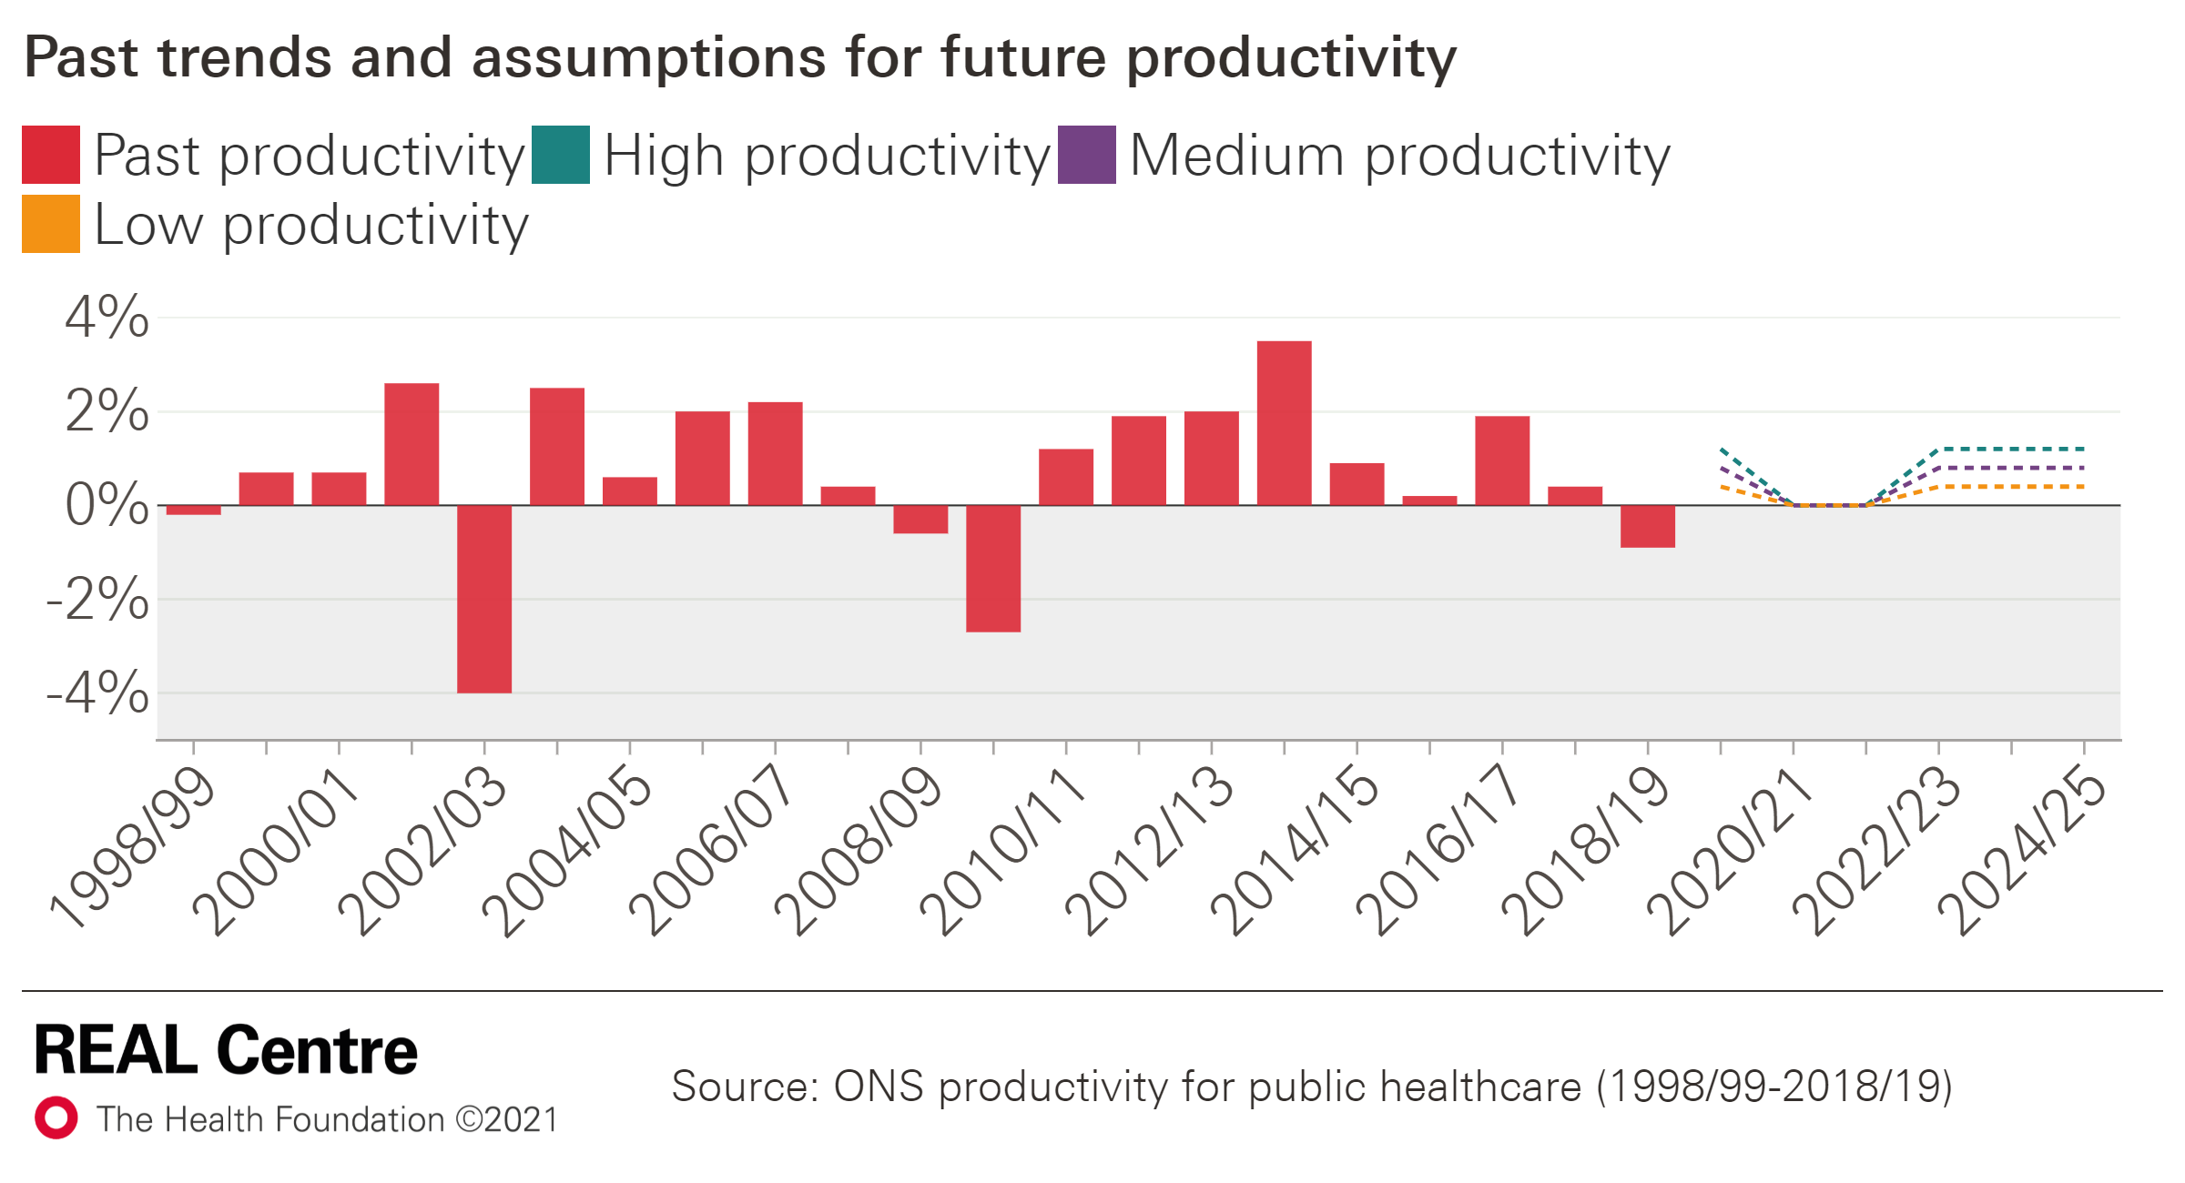
On the supply side, pay and productivity are two key drivers of spending growth, and are areas where government has a degree of control.
Pay: trends and assumptions
Productivity: trends and assumptions
We assume 1.3% real terms growth in pay (medium), 2.6% (high) and -0.4% (low) for 2021/22-2024/25
Productivity (non-quality adjusted) grew 0.8% a year in 1998/99-2018/19 (medium). The highest 10-year average growth was 1.2% (high); lowest was 0.4% (low).
We assume no productivity growth in the pandemic.
Historic real-terms growth in earnings, by staff group
 | 2000–2010 | 2010–2020 | 2000–2020
ONS all employees | 1.2% | -0.1% | 0.6%
ONS nurses | 2.6% | -0.3% | 1.1%
NHS staff pay* | n/a | -0.4% | -0.4%
*Data start in 2011.
Real-term pay growth assumptions
 | 2018/19–2020/21 | 2021/22–2024/25
Low pay | Actual NHS staff pay (-1.4%) | NHS staff pay 2010–2020 (-0.4%)
Medium pay | Actual NHS staff pay (-1.4%) | 2021 OBR all-economy forecast (1.3%)**
High pay |  | Nurse pay growth 2000–2010 (2.6%)
**2018 OBR all-economy forecast for 2021/22 – 2030/31 was higher, at 1.8% on average in real terms.

Slide 10
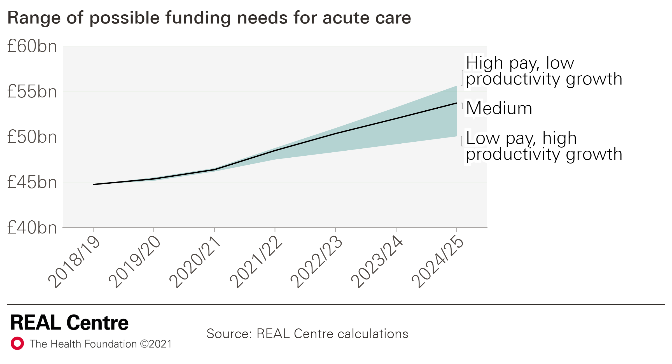
The combination of pay and productivity is crucial for determining how much funding is needed to meet demand.
Productivity growth reduces cost pressure by enabling more output (eg admissions) to be delivered for the same or less input (eg staff).
Pay growth, on the other hand, increases cost pressure. (Although, pay increases must be set against the need to fill vacancies and the associated cost of expensive bank/agency staff.)
The chart illustrates the range of funding needs for acute care under different combinations of pay and productivity through to 2024/25.*
As per the table, the range of potential funding growth is broad, from 1.9% to 3.7%.
Annual growth in acute funding under different productivity and pay assumptions
Possible assumptions | Annual growth 2018/19–2024/25 (%)
LOW (low pay / high productivity) | 1.9%
MEDIUM (medium pay / medium productivity) | 3.1%
HIGH (high pay / low productivity) | 3.7%
*We use actual pay growth up to 2021/22; productivity growth is flat during the pandemic.

Slide 11
3. Additional funding pressures
1) Our approach
2) Underlying funding pressures
4) Results
3) Additional funding pressures
5) Implications

Slide 12
We then explore a number of ‘additional funding pressures’. These are policy choices that may respond to public expectation, political commitments or the impact of COVID-19.*
COVID-19 | Costs of ongoing COVID-19 Vaccination programme Additional mental health demand from the pandemic
Policy choices | Pay policy Long Term Plan funding commitments (primary, community and mental health care) Elective care backlog and Constitutional standards Referral To Treatment (RTT) wait time target Bed occupancy and performance against A&E 4-hour wait target
Social care | Improving pay and offering additional social care packages
*A selection of these additional funding pressures are presented in this slide pack with the full analysis to be included in our upcoming report Health and Social Care Funding Projections 2021.

Slide 13
We estimate the cost of treating the elective backlog based on a series of assumptions about activity and costs.
The health system was not meeting the 18-week referral to treatment target going into the pandemic.
During the pandemic, referrals fell significantly. We estimate there were almost 8 million ‘missing patients’ between February 2020 and May 2021, some of whom will be referred later (returning patients).
In June 2021, the waiting list was 5.5 million. But it is expected to grow further as referrals increase.
We estimate the impact of different proportions of ‘missing patients’ returning (50%, 75% and 90%)
Admitted patient care is more expensive than non-admitted: £2,332 vs. £716 in 2018/19 (2021/22 prices).
Normally, patients on the waiting list longer than 18 weeks are more likely than usual to be admitted (39% admitted vs. overall rate of 22%).
The fall in care during the pandemic was more marked for admitted care, as such we assume that returning ‘missing patients’ are also more likely than usual to need admitted patient care (39% admitted).
There is likely to be a premium to pay for additional activity – for instance, if care is delivered by the independent sector. This premium is likely to be higher the quicker the backlog is cleared.
Finally, government will have to decide what level of performance is desired. We estimate the cost to meet the 18-week RTT and to return to 2018/19 levels of performance (87% within 18-weeks).

Slide 14
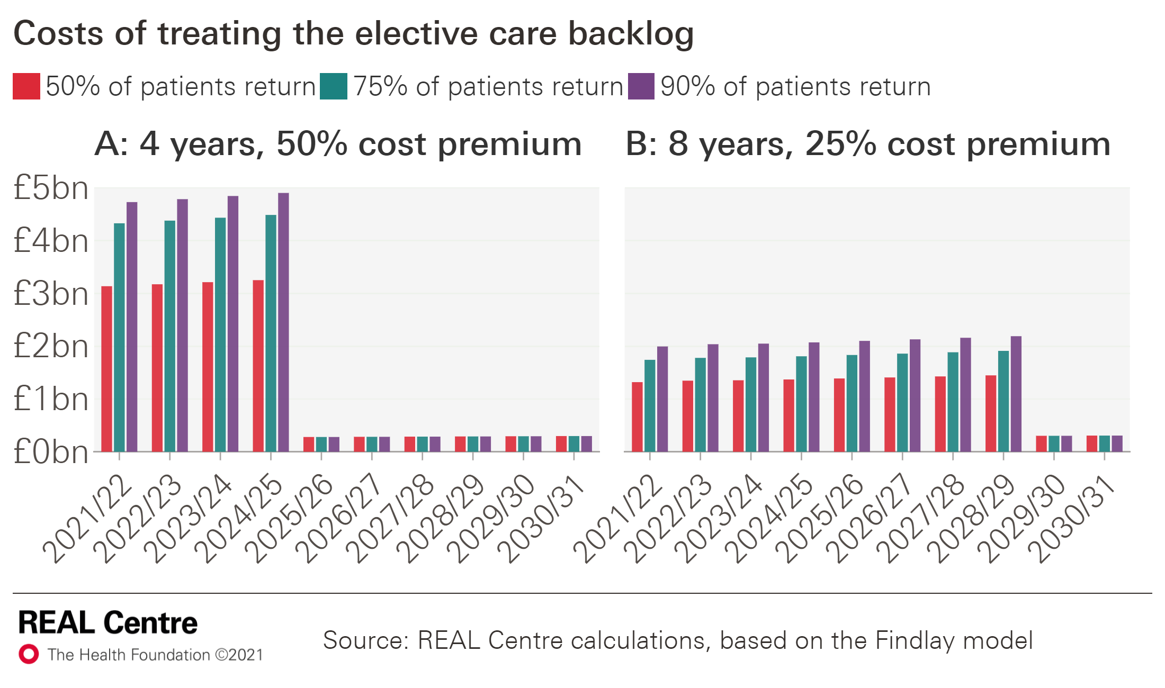
The cost of meeting the backlog varies considerably in our scenarios, both in absolute terms and in profile over time.
Scenario A
Average annual cost over 10 years ranges from £2.1bn (90% return of missing patients) to £1.5bn (50%).
But this is not spread evenly: costs fall almost entirely in the next 4 years (from an average of £4.8bn to £3.2bn).
There is some recurring cost each year to meet the target (~£300m).
The cumulative cost of clearing the backlog (non-recurrent) would be £15.7bn (75% of patient returning) and £16.8bn to clear the backlog and return to 18 weeks waiting time standard.
Scenario B
The annual cost over 10 years is lower (£1.7bn–£1.2bn) and is spread over a longer time; the average cost over the next 4 years would be £1.3bn–£2.0bn.
The cumulative cost of clearing the backlog (non-recurrent) would be £12.3bn (75% of patient returning)

Slide 15
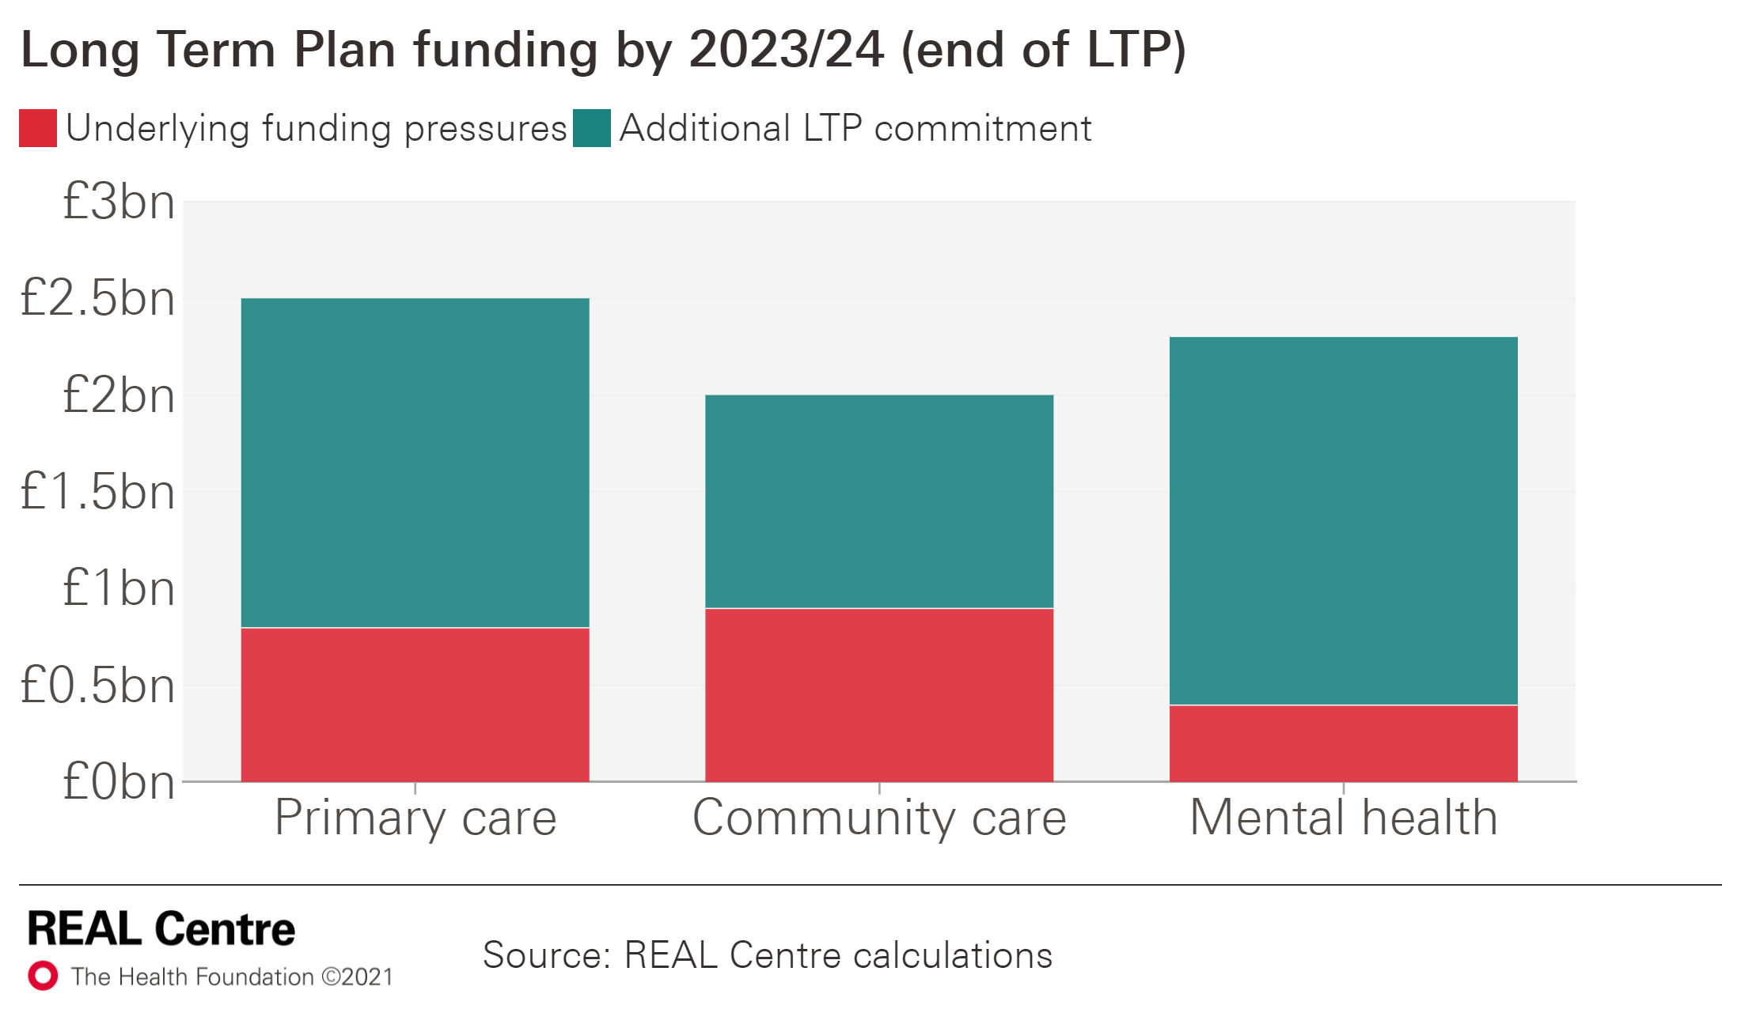
We estimate funding committed through the Long Term Plan (LTP) over the next four years for community care, primary care and mental health.
The Long Term Plan (LTP) committed an additional £4.5bn in real terms for primary and community care by 2023/24.
We apportion this according to the respective size of the budgets in 2018/19.
The mental health implementation plan committed £2.3bn in real terms by 2023/24.
The figure shows the additional funding represented by these commitments by 2023/24 (when they end).
The majority of the funding is additional to our underlying funding estimates.

Slide 16
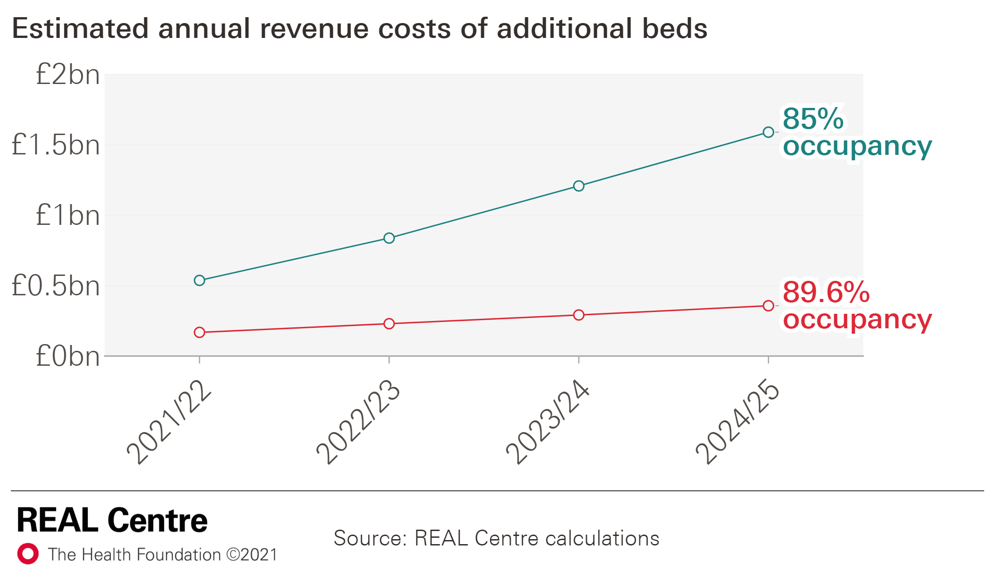
We estimate the cost of reducing the bed occupancy rate in order to increase resilience and meet the A&E 4-hour wait standard
Prior to COVID-19, bed occupancy rates had increased, with an average occupancy in 2018/19 of 89.6%.
Bed occupancy rates are a key determinant of meeting the 4-hour A&E standard and of health care system resilience more generally.
We model the expected revenue cost associated with increasing inpatient bed capacity to return to the 4-hour A&E waiting times target.
The chart shows the annual costs of reducing bed occupancy to:
85% by 2024/25 (NAO guidelines) – representing almost £1.6bn in 2024/25
89.6% (2018/19 bed occupancy rate) – rising to around £0.4bn in 2024/25

Slide 17
We estimate the number of additional mental health referrals arising from COVID-19 and the cost meeting this demand
Additional mental health referrals arising from COVID-19
Additional referrals | 2020/21 | 2021/22 | 2022/23 | 2023/24 | Annual average
Low | 241,000 | 691,000 | 225,000 | 38,000 | 299,000
Point (central) | 375,000 | 1,079,000 | 373,000 | 64,000 | 473,000
High | 546,000 | 1,593,000 | 636,000 | 129,000 | 726,000
We know the pandemic has had a significant impact on the mental health of the population. We model the impact of the pandemic on certain risk groups in the population.
We estimate there could be an additional 300,000-725,000 referrals for mental health services per year between 2020/21–2023/24*.
We estimate the total additional cost of the COVID-19 pandemic for mental health services could range from £1.6bn–£3.6bn, an annual average of £410m–£900m.
As most mental health referrals come through primary care, this implies a significant additional pressure on general practice.

Slide 18
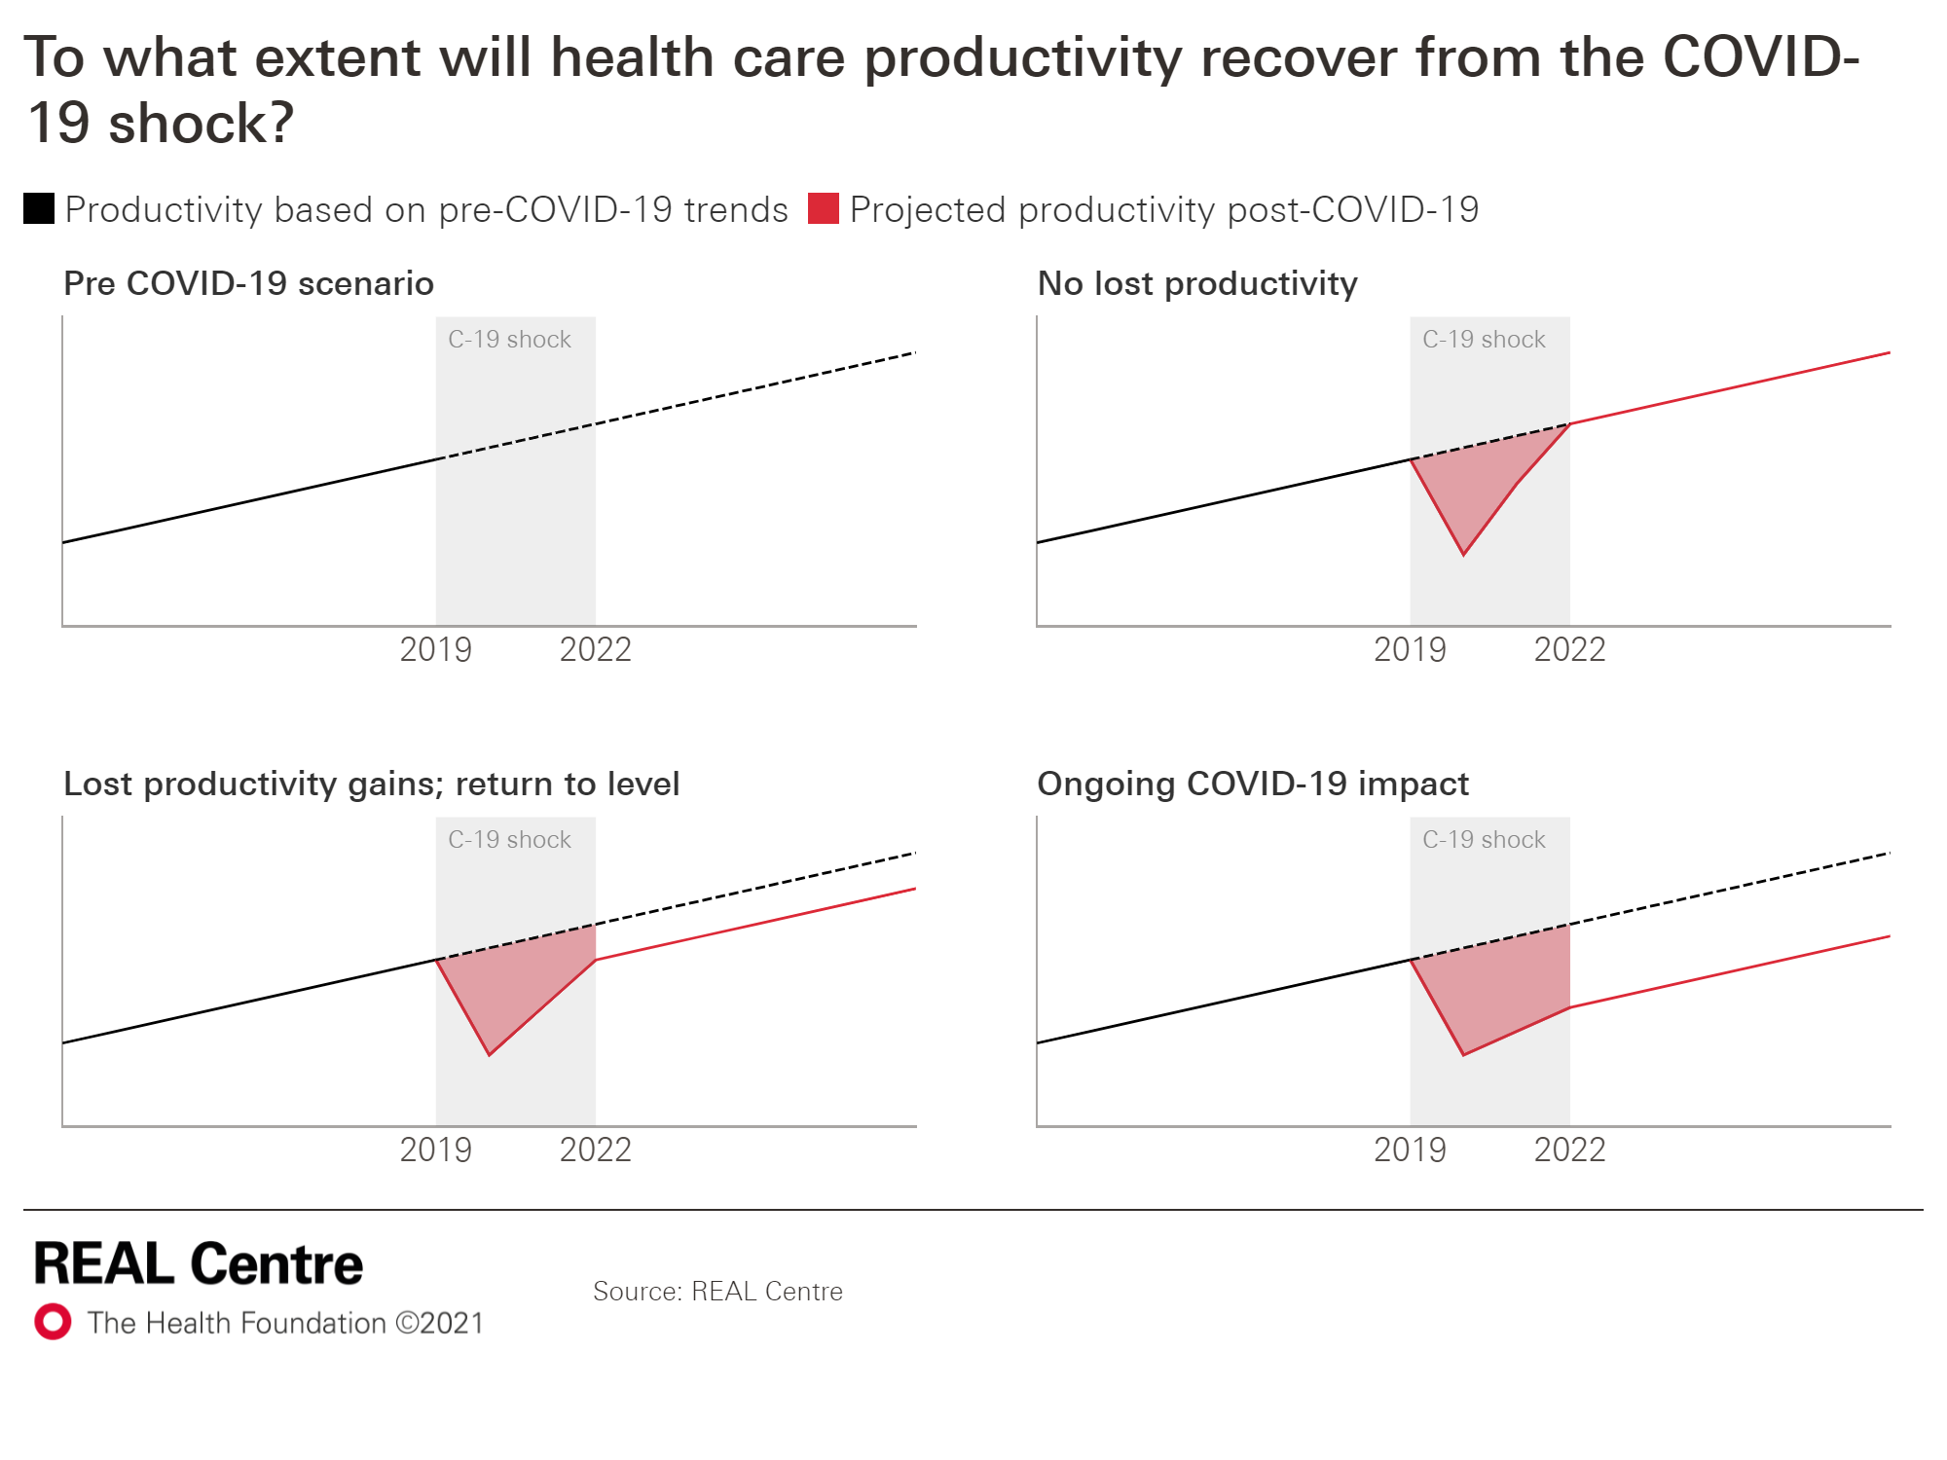
We also consider the potential costs of ongoing COVID-19. These are uncertain but crucial for determining funding needs.
During the pandemic, infection prevention and control (IPC) measures, social distancing and higher-than-usual staff absences impacted delivery in the NHS.
This meant more inputs (eg beds and staff) were needed to deliver less output (eg admissions). We consider this a productivity shock.
We estimate the associated costs are greater than the direct costs of treating COVID-19 patients.
In the diagram we illustrate different possible paths of productivity. A crucial question is whether these costs will continue (‘Ongoing COVID-19 impact’) or whether productivity can return to its pre-pandemic level.
Illustration of potential impacts of COVID-19 on productivity

Slide 19
4. Results
1) Our approach
2) Underlying funding pressures
4) Results
3) Additional funding pressures
5) Implications

Slide 20
We model two scenarios – Stabilisation and Recovery – in order to bring this range of analysis and assumptions into a coherent whole.
Stabilisation | Recovery
Lower pay growth though positive in real terms, and lower, but positive productivity growth | A decade of high productivity and pay growth
The elective backlog from COVID-19 met by end of 2028/29 (double the time of recovery) | The elective backlog from COVID-19 met by end of 2024/25
A&E and elective waiting times back to 2018/19 levels*, but still below NHS Constitution standards | NHS Constitution standards for A&E and elective waiting times being met again by 2024/25
Public health spending growing in line with NHS budget; additional funding for social care packages, but not care workers wages | Public health spending growing in line with NHS budget; increased access to social care packages and higher rates of pay for care workers
The scenarios set out two different levels of ambition for government and would lead to different experiences for staff and patients and service users in health and social care.
See Annex for a full list of assumptions.

Slide 21
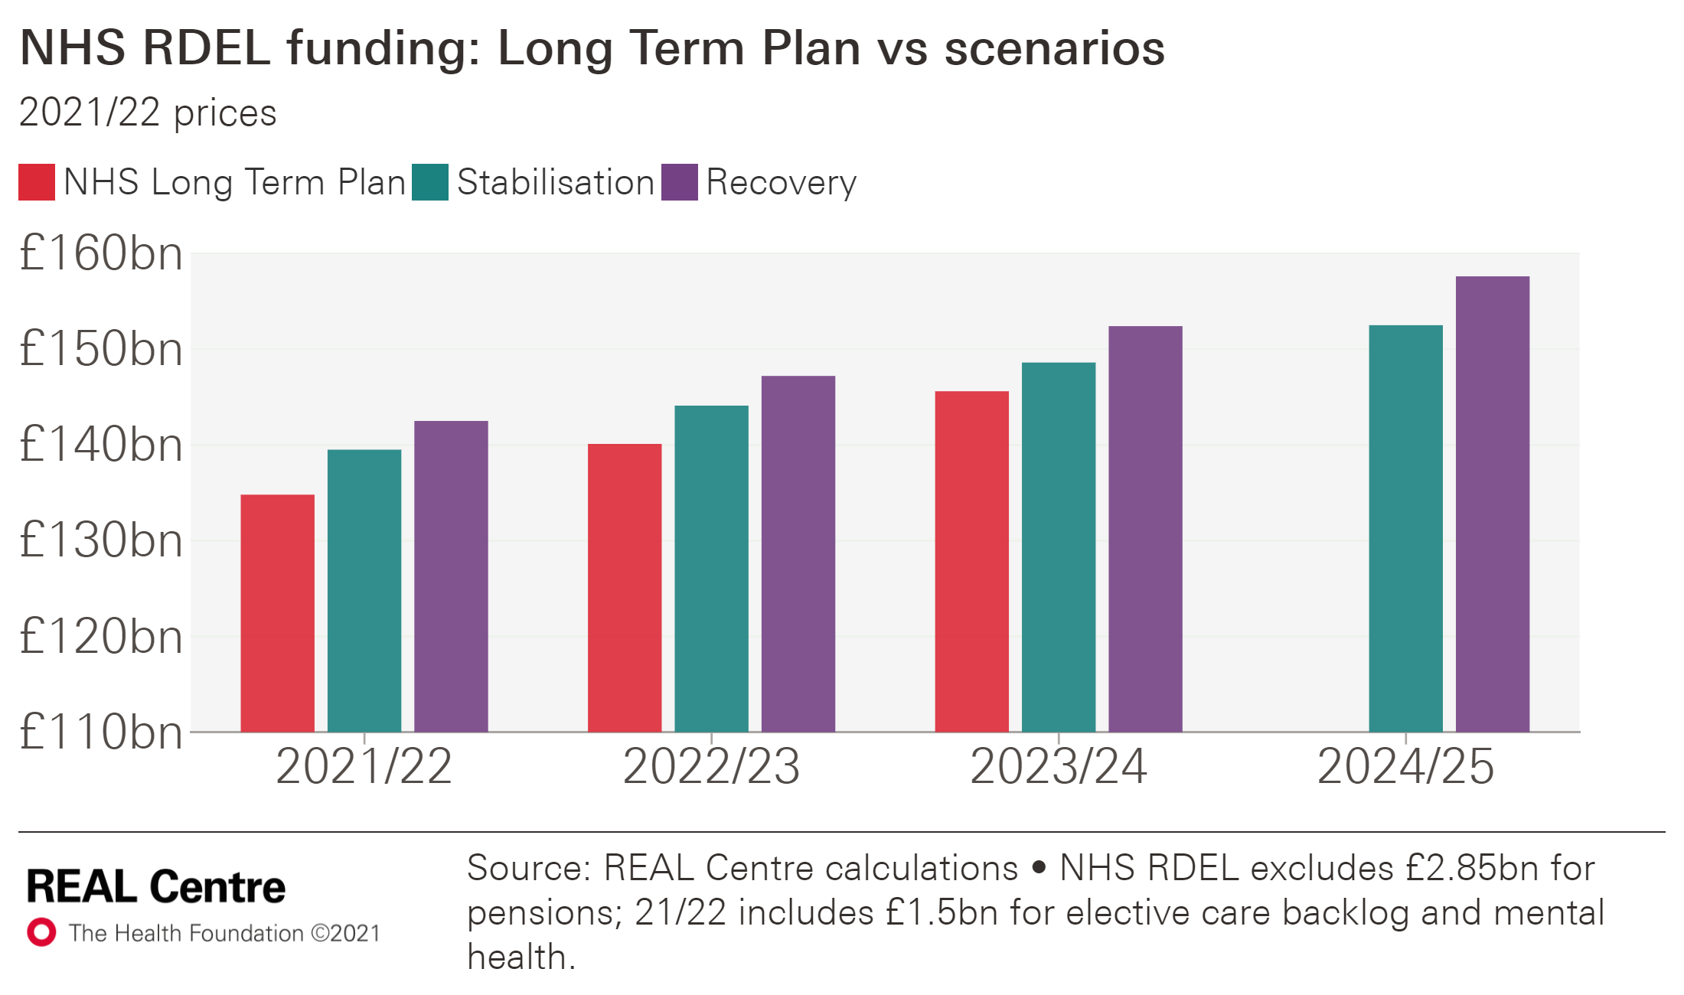
Our projections suggest NHS funding plans have been blown off course by the pandemic.
For NHS day-to-day spending (NHS RDEL) our projections imply the following profile above the Long-Term Plan (LTP) funding (which ends 2023/24)
Stabilisation: an additional £4.7bn in 2021/22, £4.0bn in 2022/23 and £2.9bn in 2023/24.
Recovery: an additional £7.7bn in 2021/22, £7.1bn in 2022/23 and £6.7bn in 2023/24.
In 2024/25, NHS RDEL would need to be £158bn in Recovery and £153bn in Stabilisation (excluding pension costs*).
The main reasons for higher costs in these early years are the funding needs for meeting the elective backlog and increasing hospital capacity.
Additional funding required (2021/22 prices)
 | 2021/22 | 2022/23 | 2023/24
Stabilisation | £4.7bn | £4.0bn | £2.9bn
Recovery | £7.7bn | £7.1bn | £6.7bn
* Note, the absolute values exclude an NHS pensions adjustment of £2.85bn in nominal terms.

Slide 22
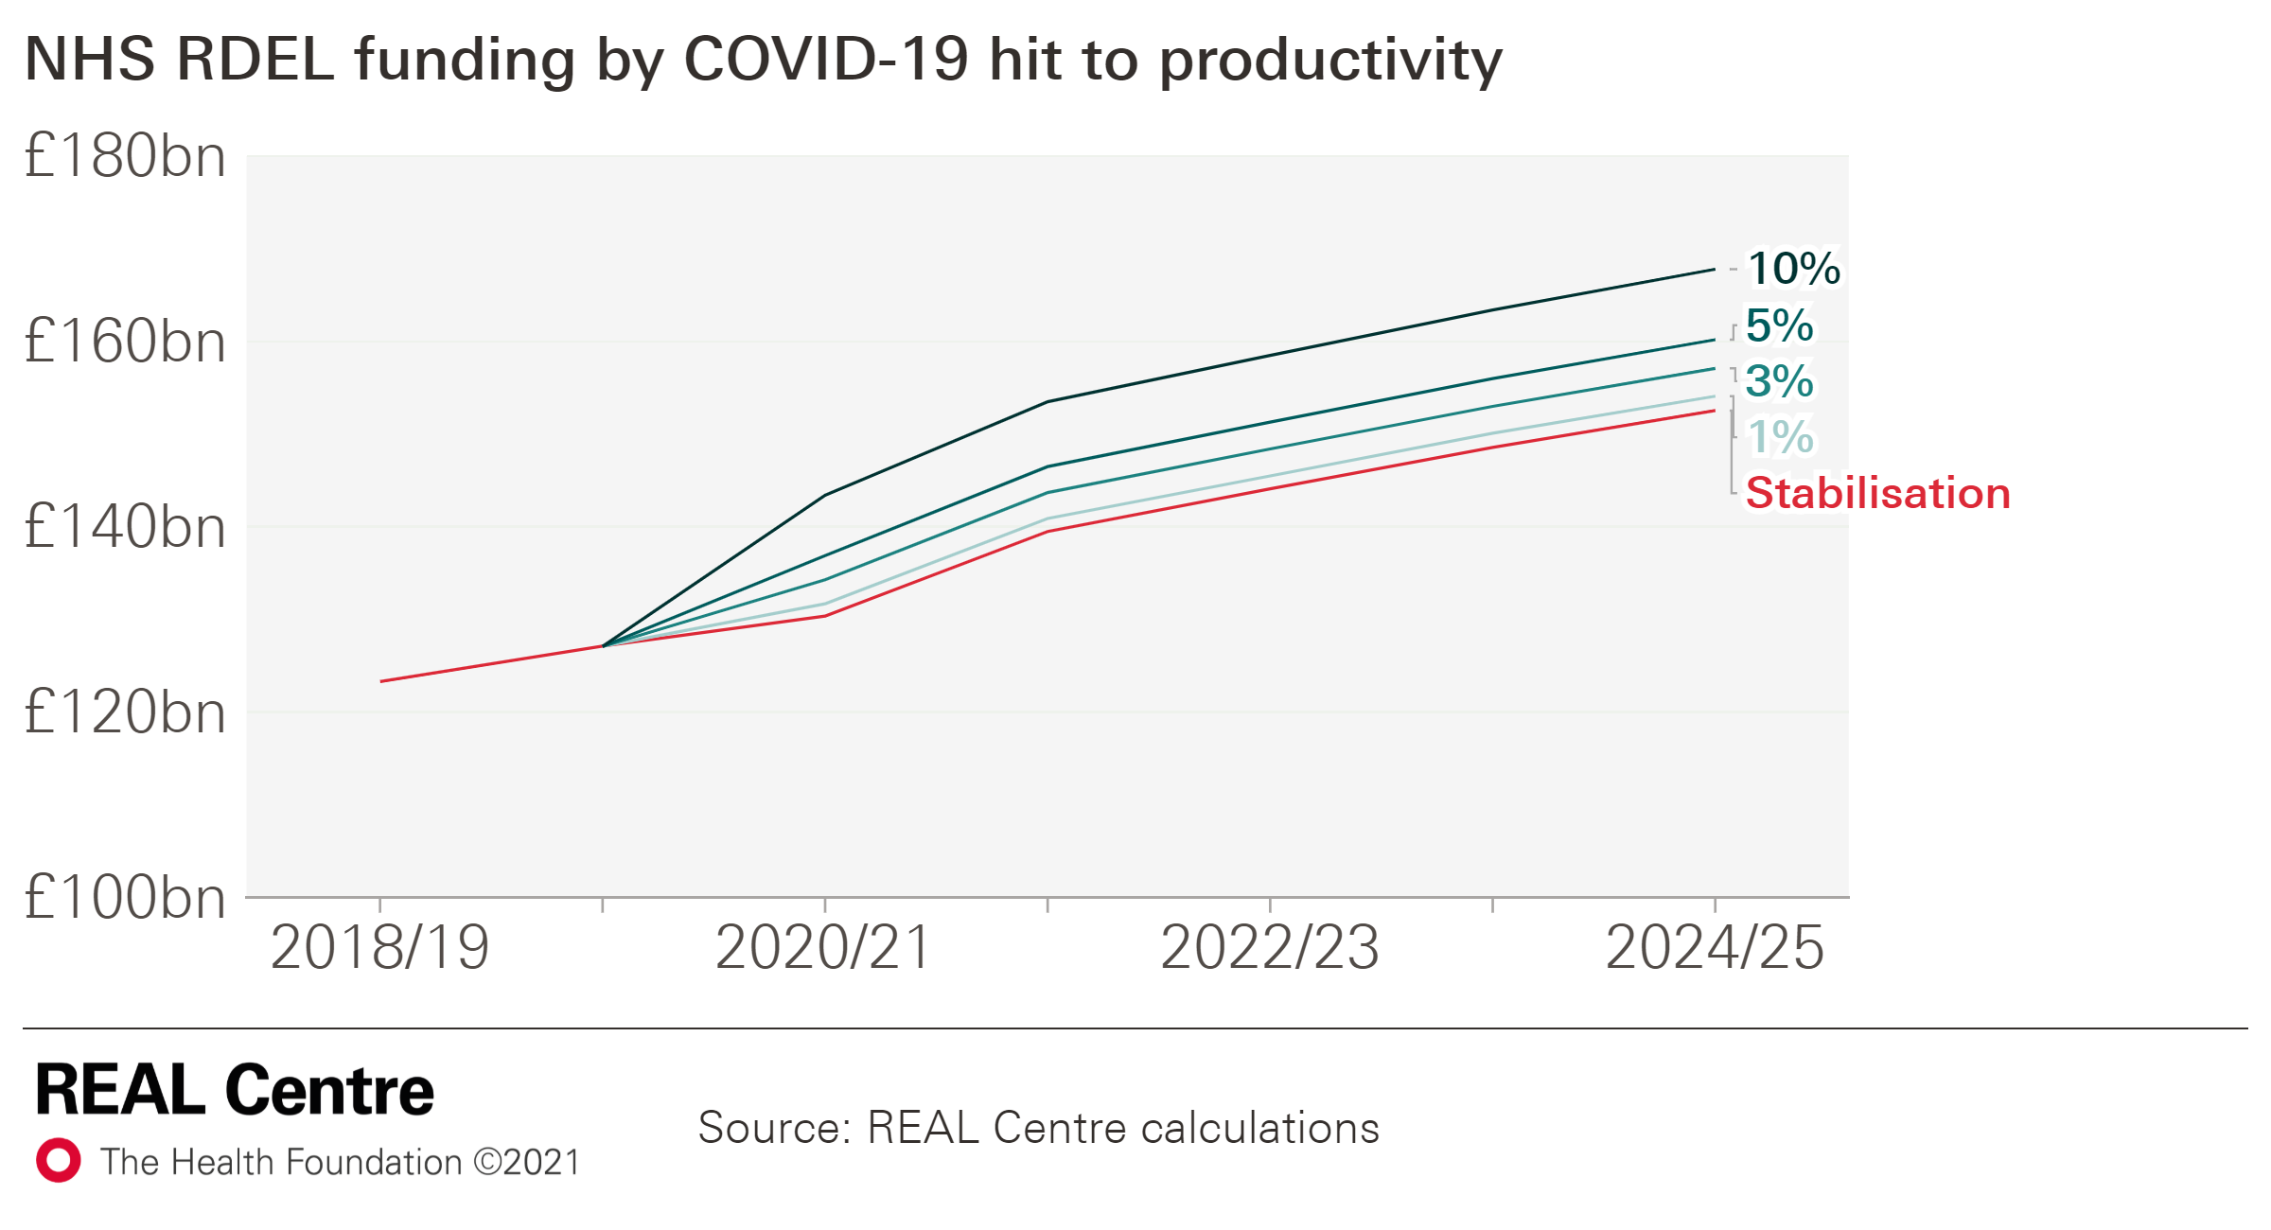
These estimates don’t include the costs of COVID-19 and should be seen as a minimum. We estimate every 1% hit to NHS productivity requires ~£1.5bn.
These numbers exclude ongoing COVID-19 costs for running the NHS.
We estimate these costs separately, as this is so uncertain and depends on the path of the pandemic and the need to retain these measures.
In our scenarios every 1% hit to productivity arising from e.g. Infection Prevention Control (IPC) measures, would require around £1.5bn per year in addition.
A 10% hit would require £14-16bn per year over this period.
Additional funding for COVID-19 hit to productivity:
Stabilisation scenario
Recovery scenario
£bn, 21/22 prices | 2021/22 | 2022/23 | 2023/24 | 2024/25
1% | 1.4 | 1.4 | 1.5 | 1.5
3% | 4.2 | 4.3 | 4.5 | 4.6
5% | 7.0 | 7.2 | 7.4 | 7.6
10% | 14.0 | 14.4 | 14.9 | 15.3
£bn, 21/22 prices | 2021/22 | 2022/23 | 2023/24 | 2024/25
1% | 1.4 | 1.5 | 1.5 | 1.6
3% | 4.3 | 4.4 | 4.6 | 4.7
5% | 7.1 | 7.4 | 7.6 | 7.9
10% | 14.2 | 14.7 | 15.2 | 15.8

Slide 23
Substantial increases in funding would be needed for Adult Social Care in order to expand access and improve pay
Short-term funding requirements, social care
In adult social care, funding is needed to expand access to care, pay more for care to sustain the provider sector and pay higher wages.
Funding would need to be £4.8bn to £9.3bn higher than projected spending power by 2024/25 in Stabilisation and Recovery, respectively.
These figures are for core spending on adult social care under the existing means tested system. In addition, this analysis assumes no productivity improvements in the sector, nor any additional costs associated with COVID-19.
£bn, 21/22 prices |  | 2021/ 22 | 2022/23 | 2023/ 24 | 2024/25
Core spending power (excluding one-off COVID-19 funding) | £bn | 20.1 | 20.3 | 20.5 | 20.7
 | Real terms growth | 0.6% | 0.9% | 1.1% | 1.0%
Stabilisation (Meeting future demand and improve access to care) | £bn | 23.1 | 24.0 | 24.7 | 25.5
 | Additional funding (vs. core spending power) | 3.0 | 3.7 | 4.2 | 4.8
 | Real terms growth | 8.6% | 3.6% | 3.2% | 3.2%
Recovery (Meet future demand, improve access to care and pay more for care) | £bn | 27.2 | 28.2 | 29.1 | 30.0
 | Additional funding (vs. core spending power) | 7.1 | 7.9 | 8.6 | 9.3
 | Real terms growth | 17.4% | 3.6% | 3.2% | 3.2%
Note, the level of funding needed is sensitive to how quickly access can be expanded under the Stabilisation and Recovery scenarios. The analysis illustrates this happening in 2021/22, but in practice achieving this objective would likely be smoothed over a few years.

Slide 24
Funding growth for both health and social care would need to be significantly higher than in recent years to meet care needs.
Average annual increase in funding for health care
Under our scenarios, healthcare funding (DHSC RDEL) would require average real terms increases of 3.7% and 4.3% for Stabilisation and Recovery, respectively.
These growth rates are at or higher than the average annual increase since 1950.
For social care, both the Stabilisation (5.5%) and Recovery (9.0%) scenarios imply much higher growth than in recent years.
Addressing the issue of catastrophic care costs through introducing a cap of care costs as recommended in the Dilnot review and enacted in the 2014 Care Act would add to these costs.
Government | Years | Average annual increase for health care
Whole period | 1949/50 to 2019/20 | 3.7%
Coalition government | 2009/10 to 2014/15 | 1.1%
Cameron and May Conservative governments | 2014/15 to 2018/19 | 1.5%
Johnson Conservative government (Long term plan) | 2018/19 to 2023/24 | 3.4%
Scenarios | 2018/19 to 2024/25 | Projected growth rates
 |  | Stabilisation | Recovery
 |  | 3.7% | 4.3%
Average annual increase in funding for adult social care
Government | Years | Average annual increase for social care
Coalition government | 2009/10 – 2014/15 | -2.0%
Cameron and May governments | 2014/15 – 2018/19 | 1.8%
Johnson Conservative government | 2018/19 – 2020/21 | 1.7%
Scenarios | 2019/20 – 2024/25 | Projected growth rates
 |  | Stabilisation | Recovery
 |  | 5.5% | 9.0%

Slide 25
Our projections imply an increase of more than 20% in the healthcare workforce and a 28% increase in LA-funded adult social care jobs.
Funding is a vital part of the solution but so too is the workforce.
Even before the pandemic there were significant staff shortages. Pandemic-related burn-out and sickness absence have only added to the challenge.
Tackling the backlog and meeting demand imply the NHS workforce would need to grow by more than a fifth by 2024/25.
Improving social care may require the workforce to increase by more than a quarter.
Productivity gains may be labour saving but this sets out the scale of the challenge.
Increase in the NHS and social care workforces
 |  | 2018/19 | 2024/25 | Extra FTE | % change
Stabilisation | Health care | 1,218,000 | 1,482,200 | 264,200 | 22%
 | Of which:
 | Doctors | 146,200 | 179,200 | 33,000 | 23%
 | Nurses | 300,900 | 366,600 | 65,700 | 22%
 | LA-funded social care | 91,700 | 117,500 | 25,800 | 28%
Recovery | Healthcare | 1,218,000 | 1,495,500 | 277,500 | 23%
 | Of which:
 | Doctors | 146,200 | 180,400 | 34,200 | 23%
 | Nurses | 300,900 | 370,500 | 69,600 | 23%
 | LA-funded social care | 91,700 | 117,500 | 25,800 | 28%

Slide 26
Funding increases for the NHS would also need to be matched by funding for the public health grant, Health Education England and DHSC capital to ensure the system has the resources it needs.
Funding requirements, all budgets
Staffing needs can't be fixed overnight but investment should start now.
This means further funding for Health Education England.
To keep up with growth in NHS funding and improve prevention, the public health grant would need to rise.
Finally, significant investment in capital is also needed, including for additional beds and diagnostic equipment.
£bn (2021/22 prices) | 2018/19 | 2024/25
Stabilisation scenario
DHSC RDEL* | 134.2 | 169.5
Of which:
NHS RDEL* | 123.3 | 155.3
Public Health grant | 3.5 | 4.3
Health Education England | 4.4 | 5.5
DHSC CDEL | 6.4 | 10.2
DHSC TDEL | 140.6 | 179.6
Social Care (2019/20 baseline) | 19.5 | 25.5
Recovery scenario
DHSC RDEL* | 134.2 | 175.0
Of which:
NHS RDEL* | 123.3 | 160.4
Public Health grant | 3.5 | 4.4
Health Education England | 4.4 | 5.7
DHSC CDEL | 6.4 | 10.3
DHSC TDEL | 140.6 | 185.3
Social Care (2019/20 baseline) | 19.5 | 30.0
Source: REAL Centre calculations
*Absolute values for 2024/25 include NHS pensions adjustment of £2.85bn in nominal terms; growth rates exclude the pensions adjustment since it is not present in the baseline.

Slide 27
5. Implications
1) Our approach
2) Underlying funding pressures
4) Results
3) Additional funding pressures
5) Implications

Slide 28
Key implications of our analysis
Rising numbers of older people, chronic conditions and deaths in the coming decade imply high underlying pressures for care; the outlook for pay will be critical to the funding implications associated with those pressures.
The ongoing impact of COVID-19, in particular the impact on service productivity, affect funding requirements significantly.
There are key policy choices and funding requirements associated with the speed and ambition for clearing the NHS elective backlog.
Similarly, the government has key policy choices for its level of ambition for adult social care and funding requirements to improve the service are higher than the NHS.
Additional capacity is needed to return to NHS constitutional standards and clear the elective backlog.
The NHS and adult social care workforce will need to grow to meet these pressures and deliver policy.
* Absolute values include NHS pensions adjustment of £2.85bn in nominal terms; growth rates exclude pension adjustment

Slide 29
Annex – scenario assumptions

Slide 30
A number of assumptions are held constant across both scenarios. These include those relating to underlying pressures, and some relating to policy choices.
 |  |  | Stabilisation | Recovery
Scenario summary |  |  | The system is stabilised after the COVID-19 shock | The ongoing effects of COVID-19 are limited and more ambitious policy choices are made to fund recovery.
Assumptions held constant across all scenarios | Demand factors | Demand factors | Size and age structure of the population Mortality and birth rates
 | Supply factors | Supply factors | Hospital drug price growth (5.9% in real terms) and community drug price growth (flat in real terms) Actual NHS pay growth (2018/19 to 2020/21) Flat productivity during COVID-19 pandemic (2020/21 to 2021/22) Capital funding grows with plans and with NHS RDEL Public Health grant and Health Education England funding grows in line with NHS RDEL Specialised services grow in line with trend (4.6% in real terms)
 | Additional funding pressures and policy choices | Additional funding pressures and policy choices | Long term plan commitments for primary care, community care and mental health Ongoing vaccination programme linked to COVID-19 Addressing the additional COVID-19 related mental health demand.

Slide 31
Other assumptions are varied between scenarios. Our results are sensitive to assumptions about the ongoing impact of COVID-19 on productivity, how ambitious the government is in policy aims and decisions about pay.
 |  |  |  | Stabilisation | Recovery
Assumptions varied between scenarios | Demand factors | Supply factors | Pay | Medium: 1.3% real-term annual increase from 2021/22 | High: 2.6% real-term annual increase from 2021/22
 | Supply factors | Additional funding pressures and policy choices | Post COVID-19 productivity | Medium: 0.8% annual growth from 2021/22 | High: 1.2% annual growth from 2021/22
 |  |  | Policy choices and constitutional standards | Increase in bed capacity to return to 2018/19 occupancy rates (89.6%) from 2021/22 | Increase in bed capacity to reach 85% occupancy rate from 2024/25
 |  |  |  | RTT waiting time back to 2018/19 levels (but not 18-week target) by 2028/29 | RTT waiting times back to 18-week target by 2024/25
 |  |  |  | Public health grows in line with NHS RDEL | Public health grows in line with higher rate of NHS RDEL growth
 |  |  |  | Post LTP, mental health growing with underlying funding pressures | Post LTP, mental health growing in line with rest of the budget
 |  |  | Social care | Additional care packages | Additional care packages and higher staff pay

