Slide 1


Saving Young Lives
Learning through innovation and collaboration
Dr Heather Duncan¹, Dr B. R. Matam¹, Dr Vinod Diwakar¹ and Dr Peter van Manen²
1. Birmingham Children’s Hospital, UK
2. McLaren Electronic Systems, UK

Slide 2
Young Lives
The challenge
Life-threatening events in children are frequently preceded by early warning signs. However, these are frequently missed or not acted upon.
We aimed to deliver a system that would provide continuous monitoring and identify deterioration in very sick children in Paediatric Intensive Care (PIC).
The response
We partnered with McLaren Electronic Systems to translate real time, continuous monitoring and analysis for F1 racing cars into a similar system adapted to the needs of healthcare.
The system was designed to create an adaptive, patient-specific algorithm that can learn the trends in patient physiology and thus identify deterioration early.

Slide 3
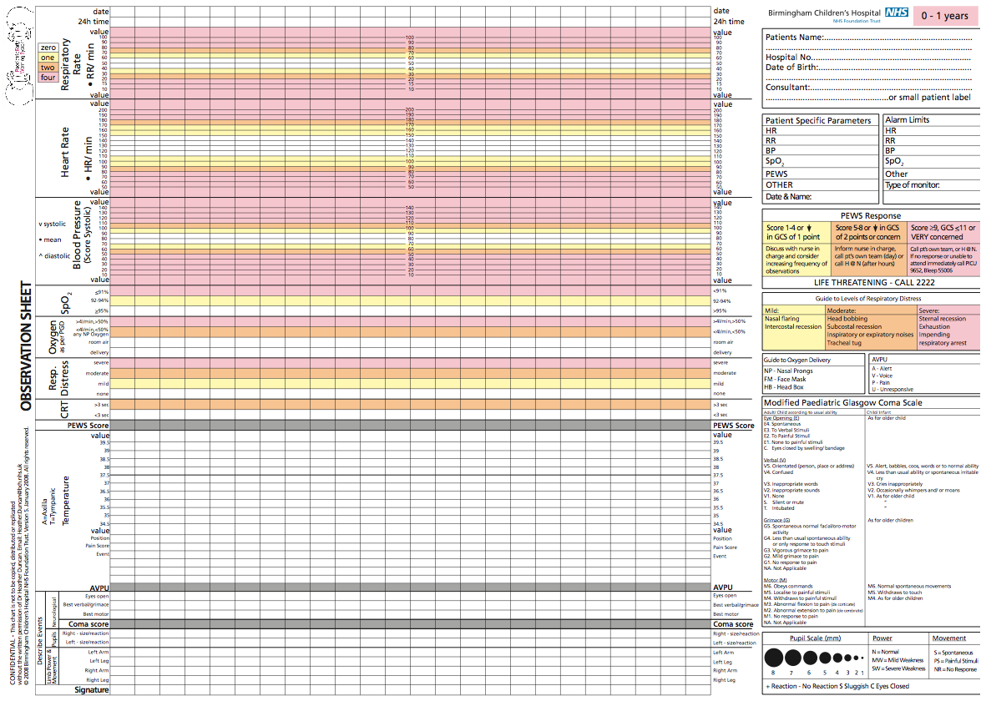
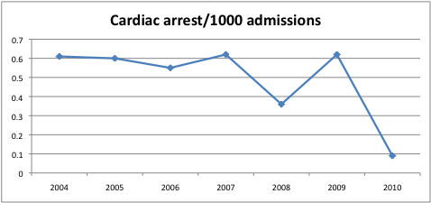
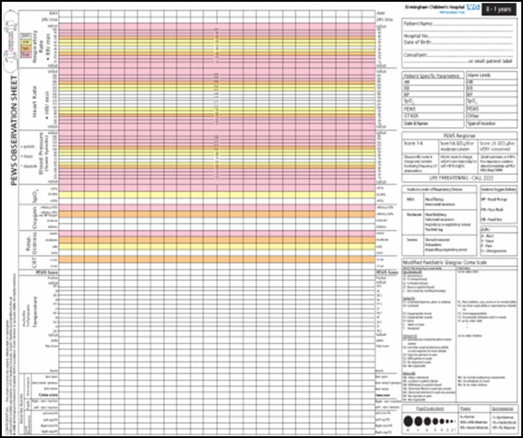
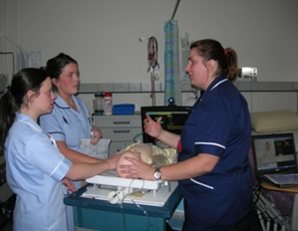
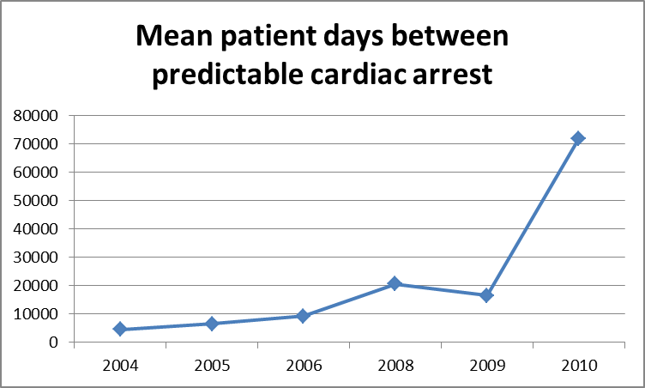
18/yr → 4/yr
Survival
⅓ → ½ → ⅔

Slide 4
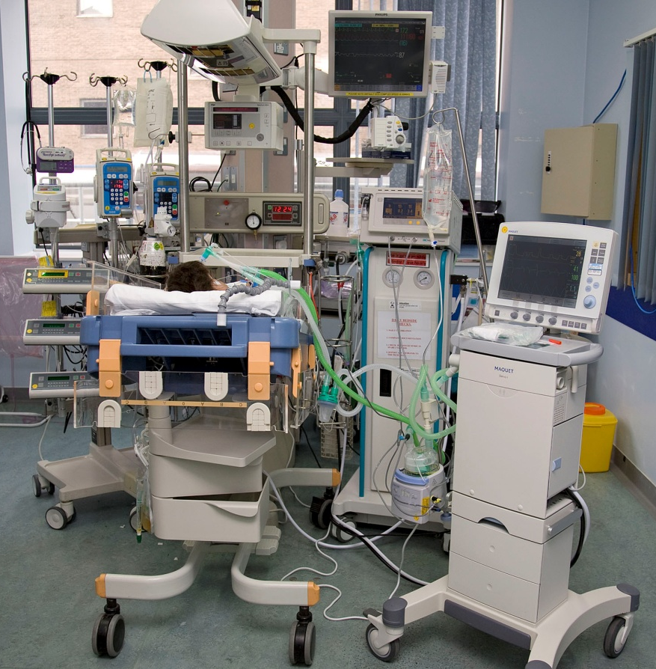
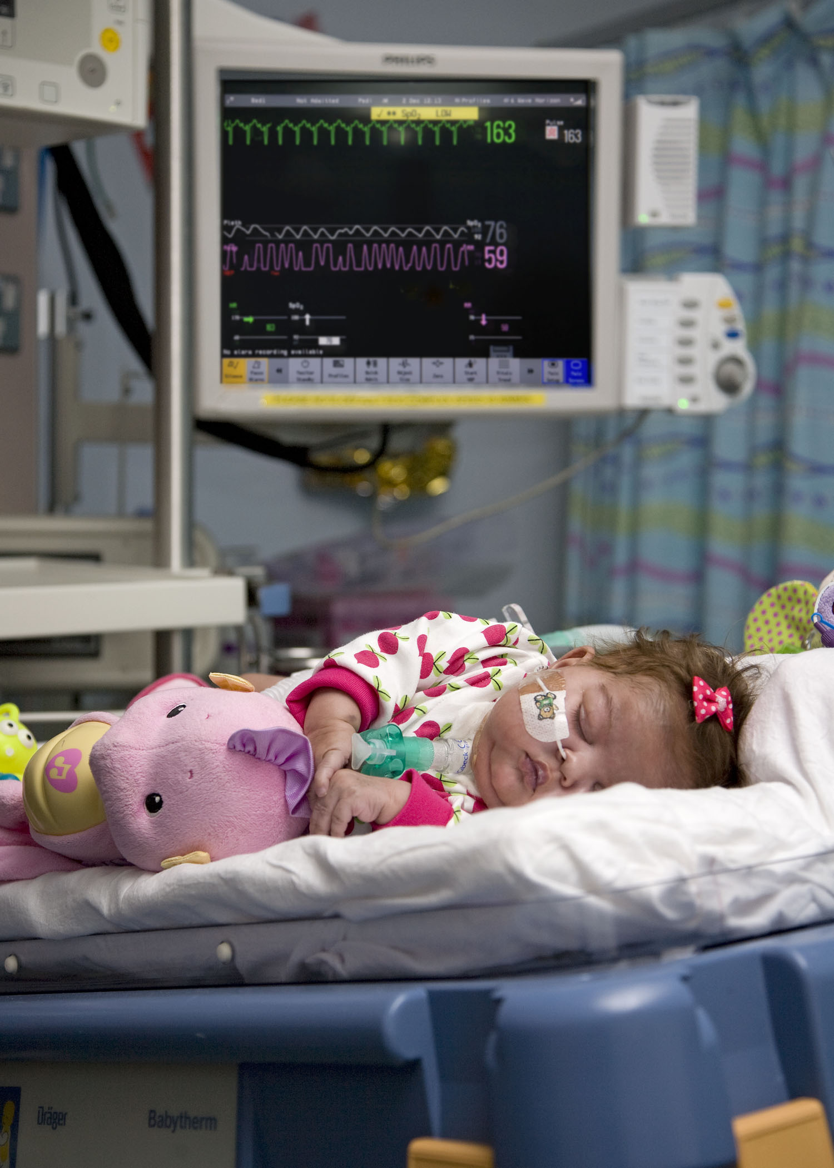
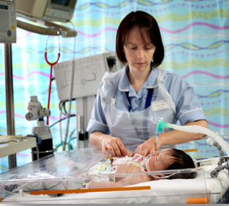
Intensive
Care Unit

Slide 5
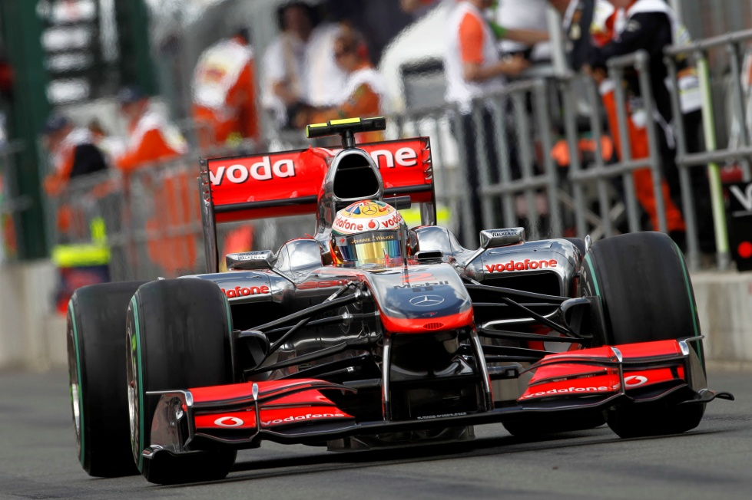
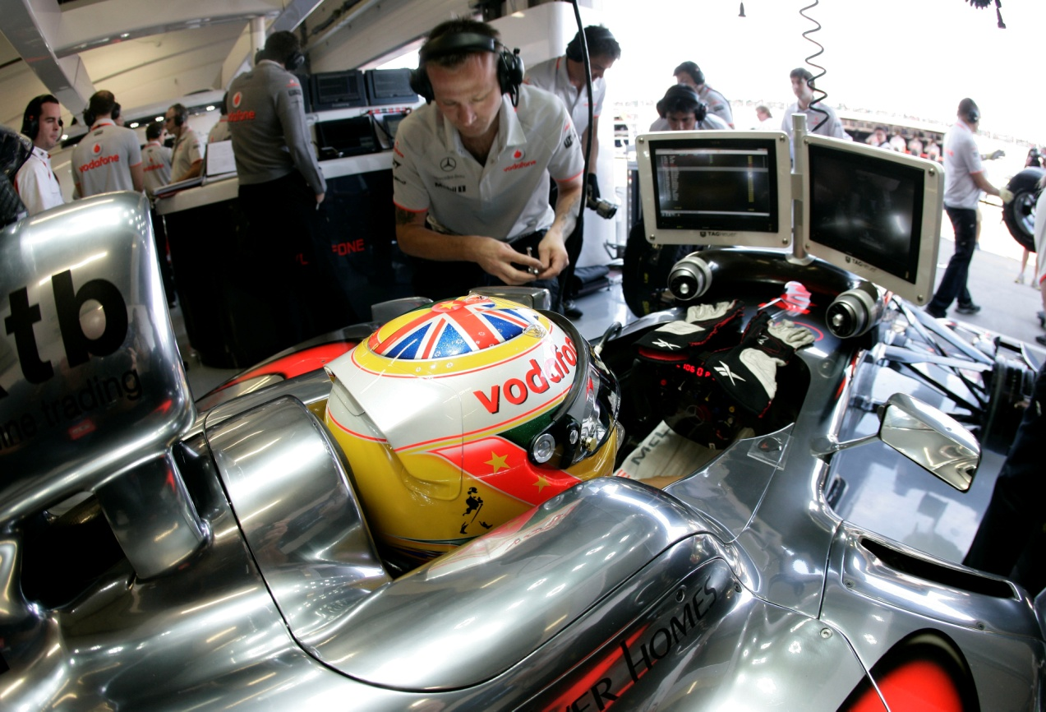
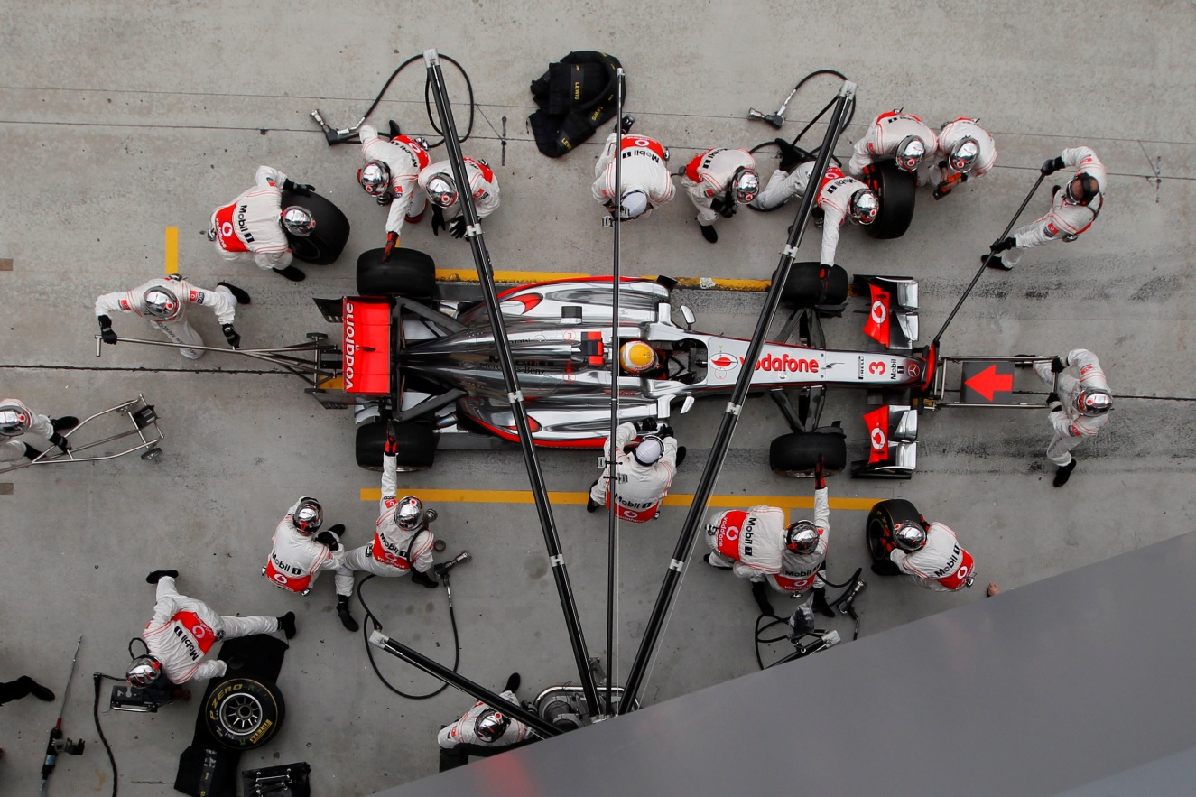
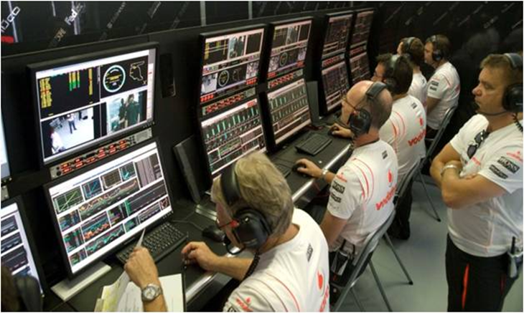
Formula One

Slide 6
Innovation
The Health Foundation Model

Slide 7
Saving Young Lives
Aims
  Adaptive algorithms to present risk for that patient
  Highly sensitive and specific warning
BCH offers clinical expertise, Aston Bioengineering offers analysis expertise and & McLaren technology platform
Challenges
  Funding
  Contracts
  Intellectual property
Potential
  Decision support to all critically ill patients when & where they need it
  Continuous remote monitoring to wards, transport, and 1st contact
  £3m savings over 1 year in PIC by reducing length of stay
  Acute care, primary care and emergency services
  Hardware, software, decision support tools

Slide 8
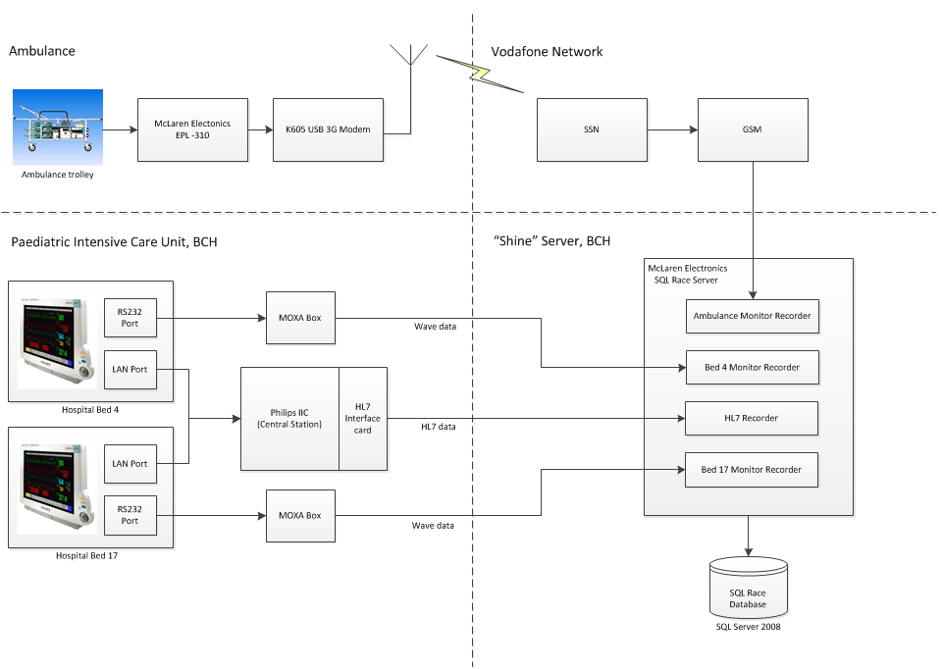

Slide 9
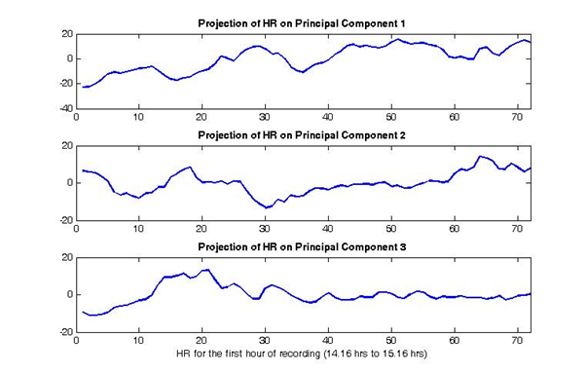
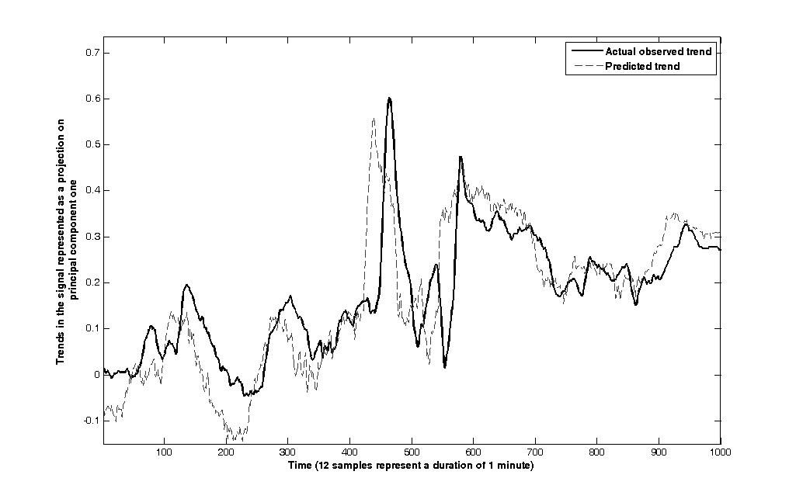
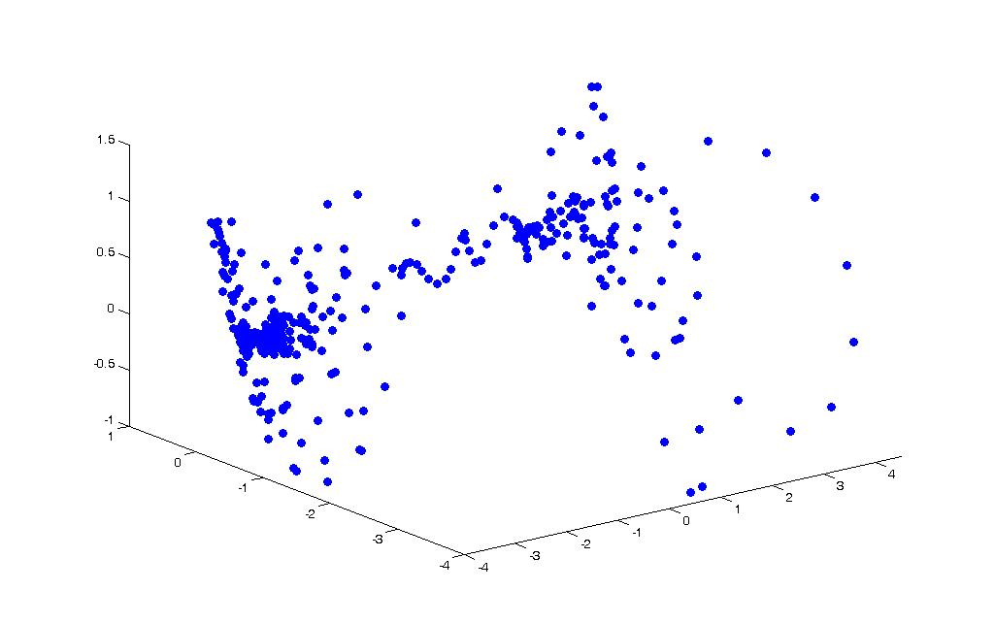
-Health Foundation SHINE grant £75k
-Ethics: Opt out consent
-National portfolio
-Recruited 850 patients
-Length of stay stable at 108 hours
-21 monitors linked
-Normal from abnormal
-Principal component analysis
-Predict deterioration 2 minutes before

Slide 10
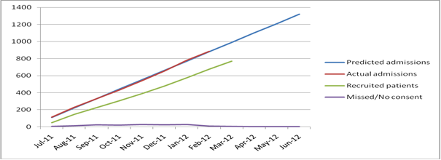
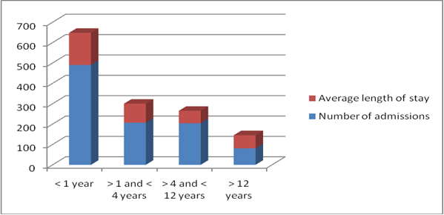

Slide 11


Slide 12
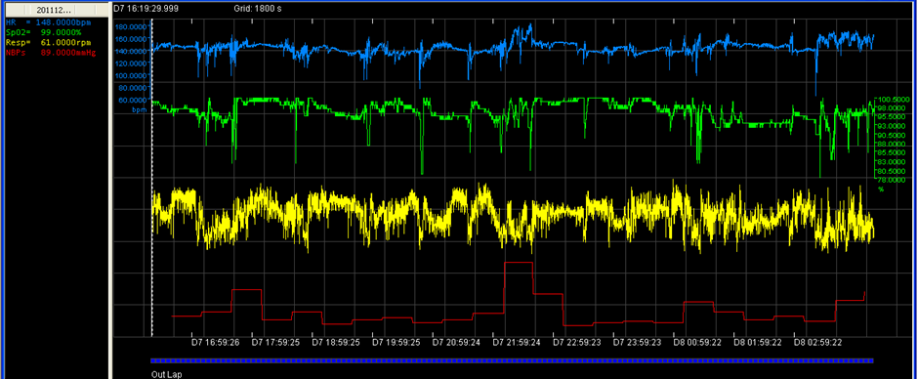
Trends are important

Slide 13
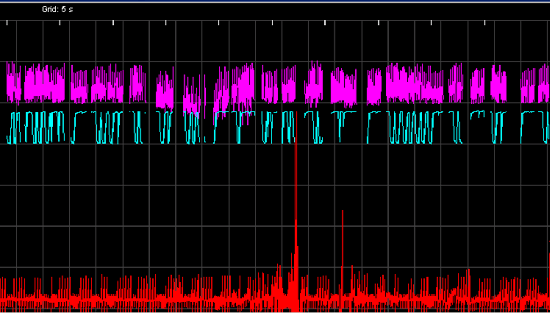
Trends are important

Slide 14
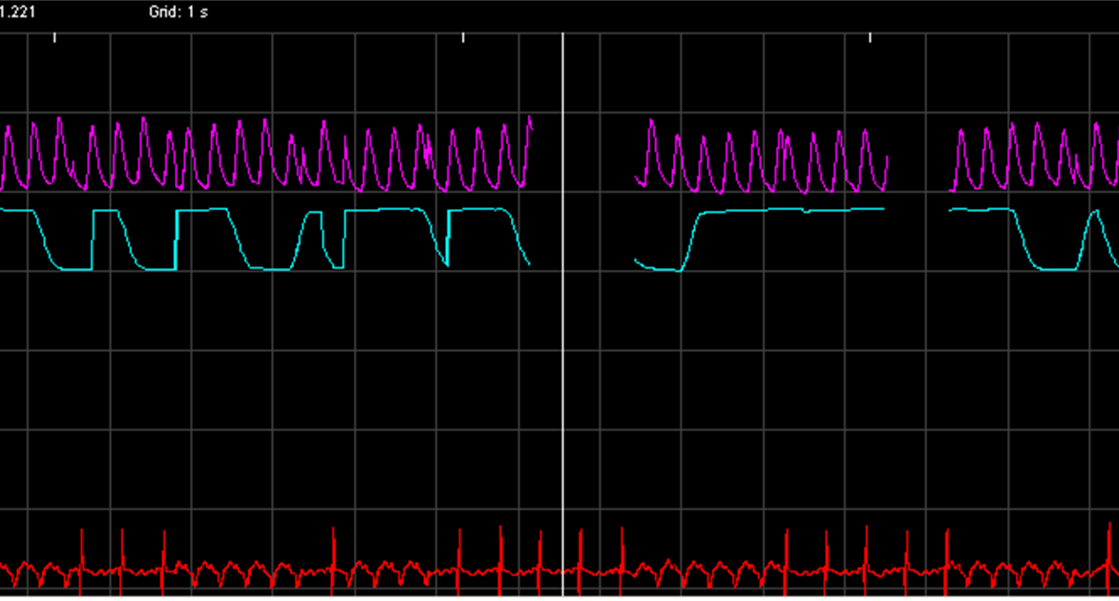
Changing rhythm

Slide 15
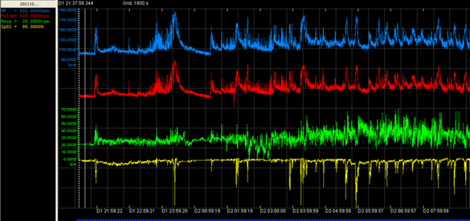
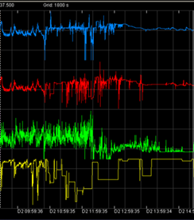
Pattern change 90 min before cardiac arrest

Slide 16
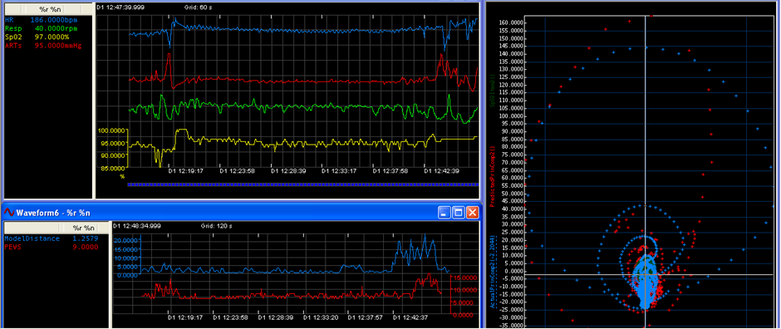
Trends, SpO2 PCA model & PEWS

Slide 17
Focus groups with young people between the ages of 10 – 18 years of age
“It’s a really good study, especially if it can prevent fatalities.”
Younger generations expect this type of technological advance in healthcare and trust it, “we have been born into a world of technology.”
“Less worry for parents when children are transferred from intensive care to other wards – especially when faced with less nurse support compared to [Paediatric Intensive Care].”

Slide 18
Lessons learnt
Challenging and time-consuming to translate the technology developed specifically for decision support in F1 to healthcare
More time (contracts, intellectual property, analysis)
More money
  VAT
  National Portfolio adoption (FSF funding)
A small, dedicated and flexible team was vital

Slide 19
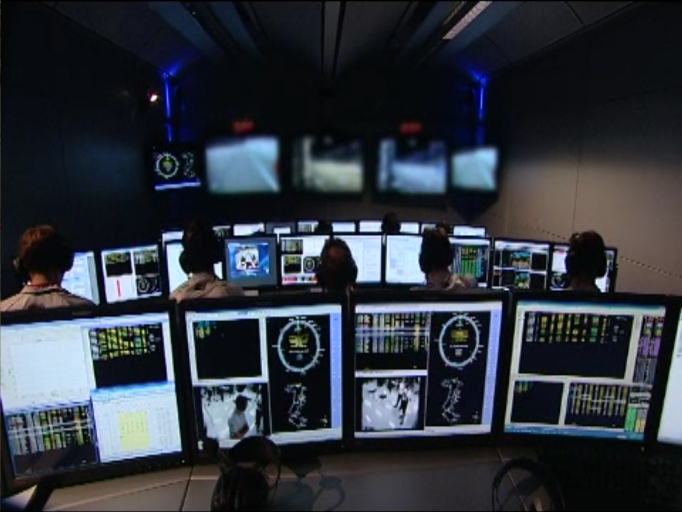

Slide 20
PICU Layout
8
9
10
11
12
13
WMPRS Bed
5
6
7
14
15
16
21
4
17
22
3
2
1
20
19
18

Slide 21
Each Bed
Stable Needs attention? Critical
Bed 1: Abc Xyz
1 yr
Bed 1: Abc Xyz
1 yr
Bed 1: Abc Xyz
1 yr

Slide 22
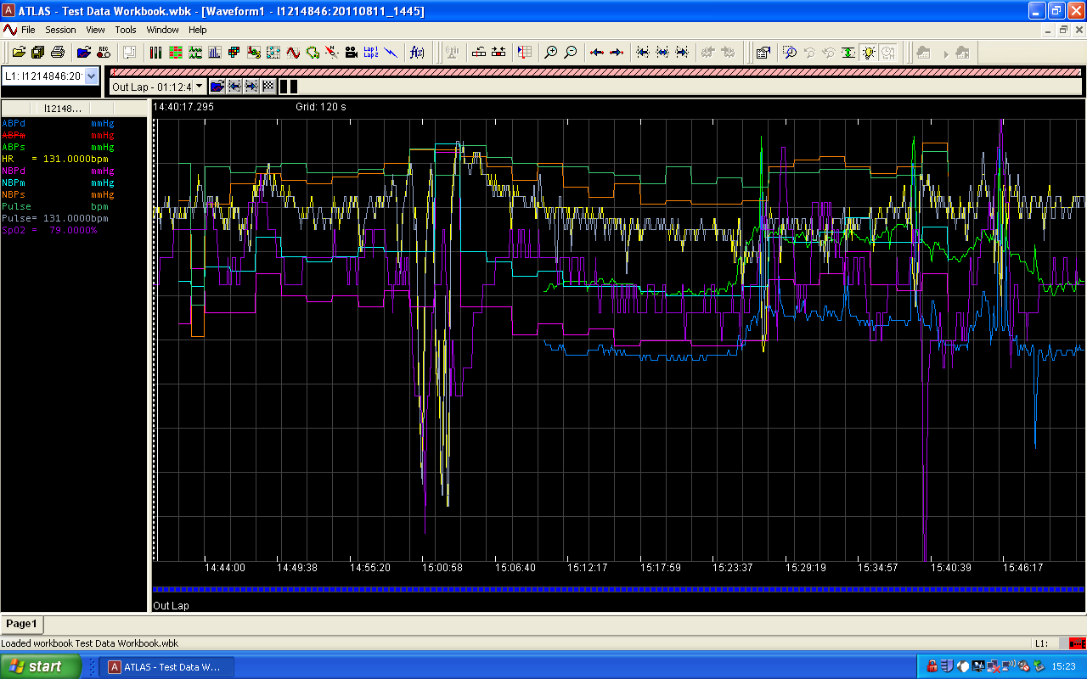
Bed 1: Abc Xyz
1 yr
TT
Trends with PEWS:
Time
HR
RR
SpO2
BP
Temp
Analysis metrics :
Video (only for WMPRS)
Data from WMPRS
Time HR HRV

