Slide 1
EMPOWERING PATIENTS WITH COPD TO ACCESS HIGH QUALITY CARE: THE IMPACT OF PERSONALISED SCORECARDS
Mike Roberts
Gulsen Gungor
Kirsty Barnes
Rob Meaker
John Craig
James Mountford
Robyn Hudson

Slide 2
Aims
To produce a quality score card for people with COPD that could be used by them to negotiate better care
To reduce hospital admissions by improving standards of COPD management

Slide 3
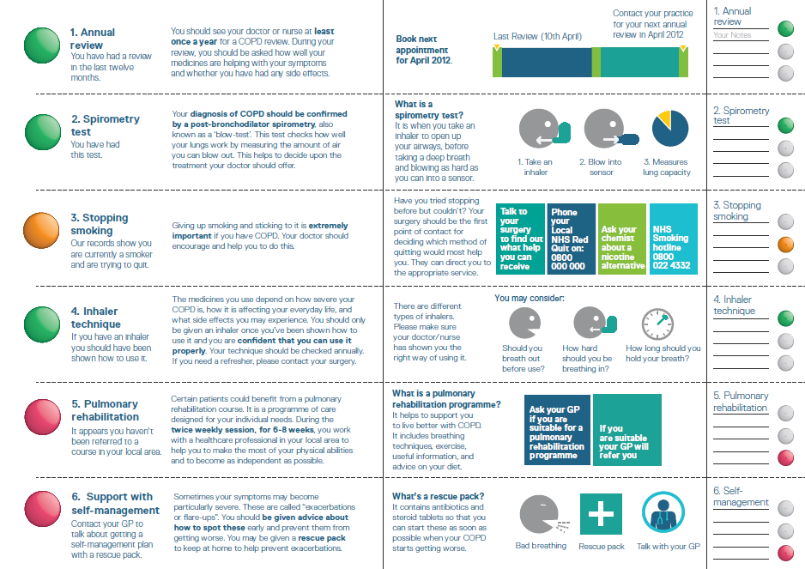

Slide 4
Lessons
We can co-create a product for patients with patients
Its value may lie with health staff as well as with patients
Assessing impact on health resource use is difficult in a constantly changing environment
The true impact is yet to be realised- it takes time.... longer than you think!

