Slide 1
Election briefing: Quality of care in the English NHS
In the balance
May 2017

Slide 2
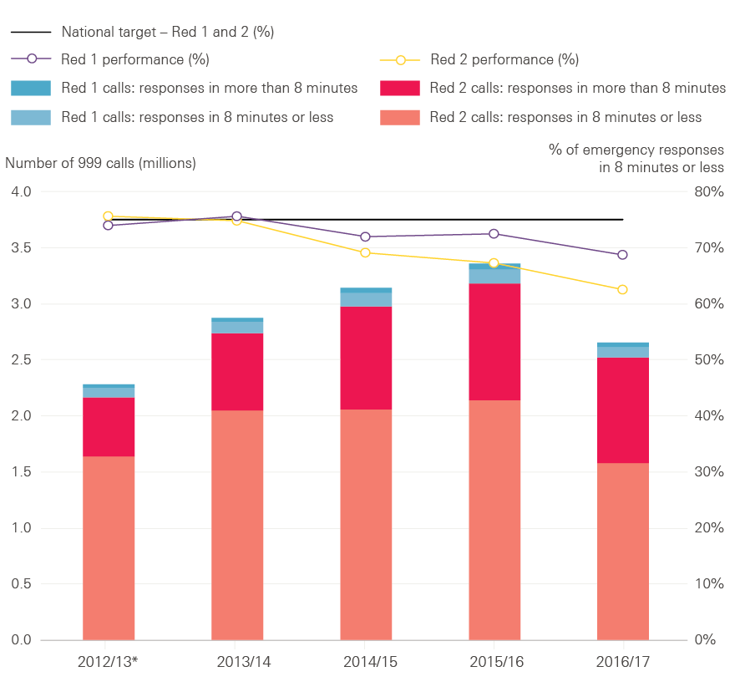
Figure 1: Ambulance response times to Red 1 and 2 calls, England, 2012/13* to 2016/17**
* Data are not available for April or May 2012, so only 10 months of data are included for 2012/13.
**Full 2016/17 data are not available for South Western, Yorkshire and West Midlands ambulances services, so numbers of calls are not directly comparable with previous years.
Source: NHS England, 2017

Slide 3
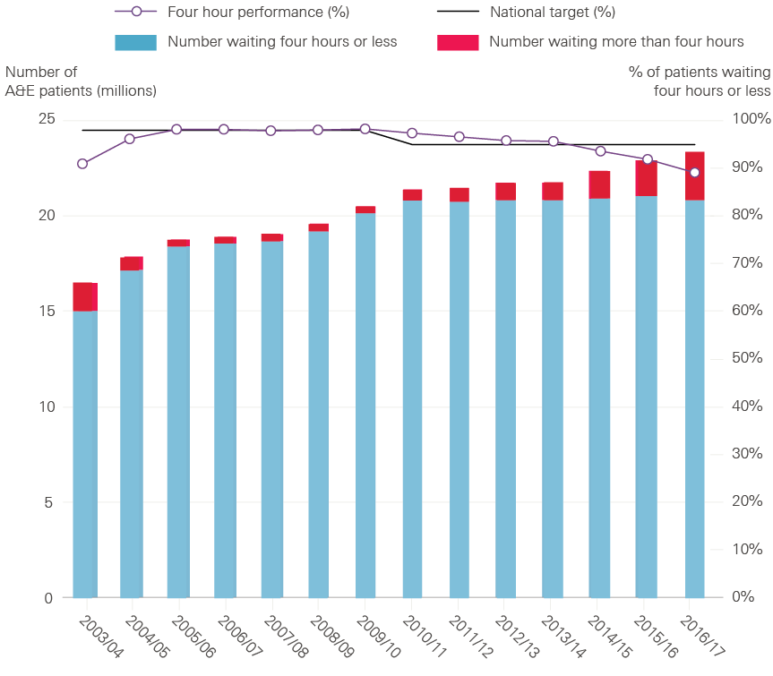
Figure 2: A&E waiting times in England, 2003/04 to 2016/17
Source: NHS England, 2017

Slide 4
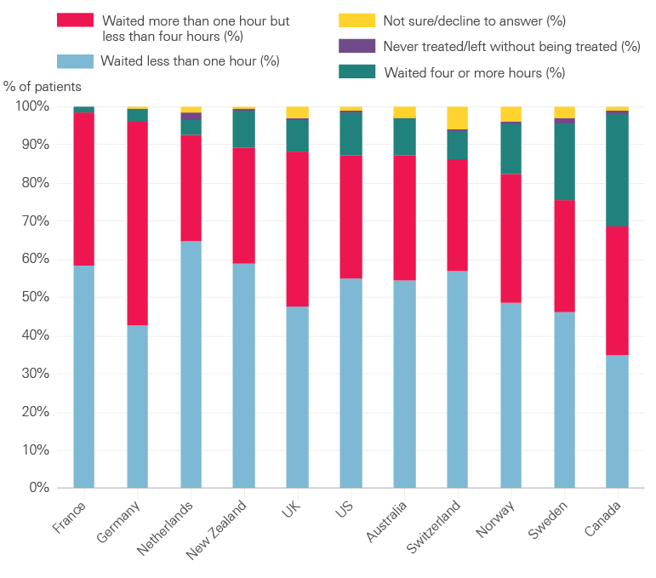
Figure 3: The last time you went to the A&E department, how long did you wait before being treated?
Source: Commonwealth Fund, International Health Policy Survey of Adults, 2016

Slide 5
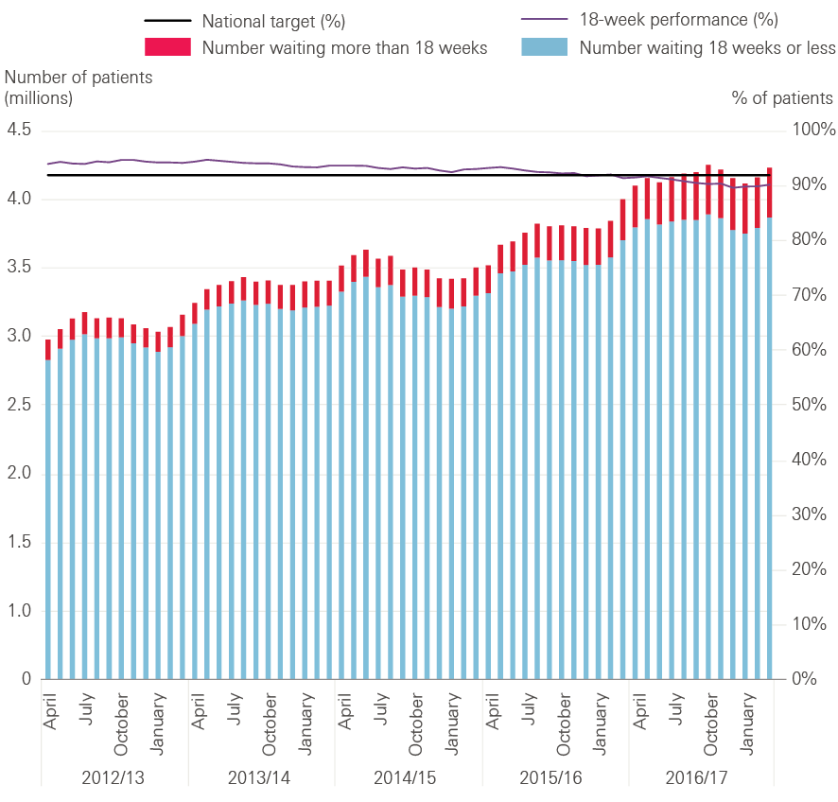
Figure 4: Referral to treatment waiting times for non-emergency and elective care in England, 2012/13 to 2016/17
Source: NHS England, 2017

Slide 6
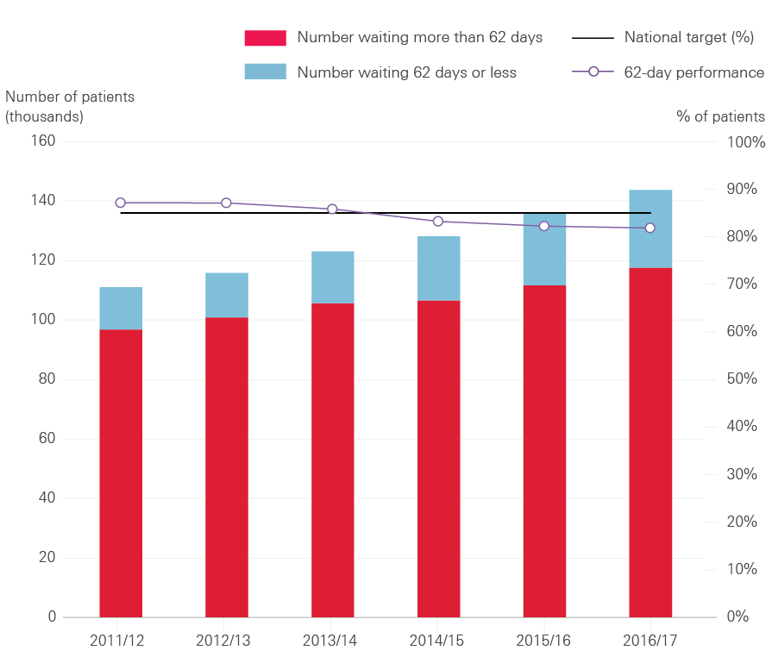
Figure 5: Patients starting treatment within 62 days of GP referral for suspected cancer, 2011/12 to 2016/17
Source: NHS England, 2017

Slide 7
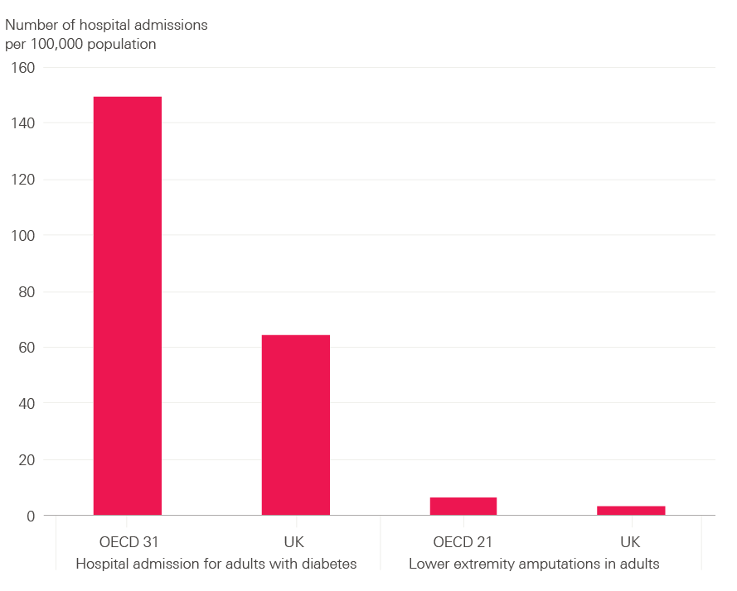
Figure 6: Diabetes care, age-standardised rates per 100,000 population, OCED average vs UK, 2013
Source: OECD, 2015

Slide 8
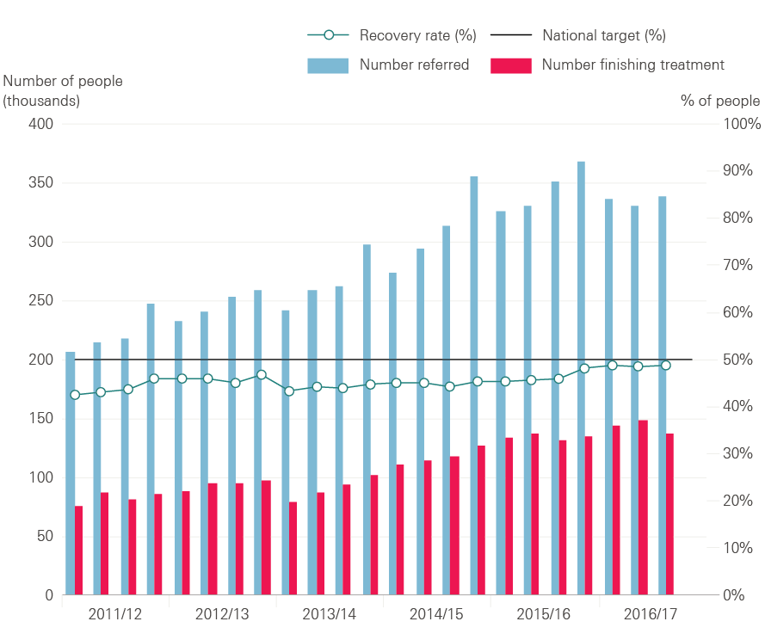
Figure 7: Numbers of people referred to IAPT services, finishing a course of treatment and recovery rate, 2011/12 to 2016/17
Source: NHS Digital, 2017

Slide 9
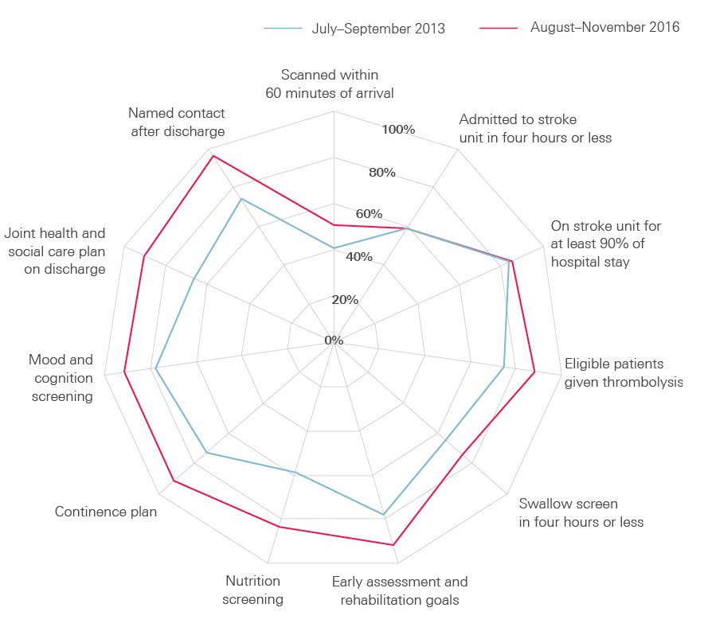
Figure 8: Percentage of patients receiving stroke services that meet quality standards in England, Northern Ireland and Wales, July–September 2013 and August–November 2016
Source: Sentinel Stroke National Audit Programme, 2017

Slide 10
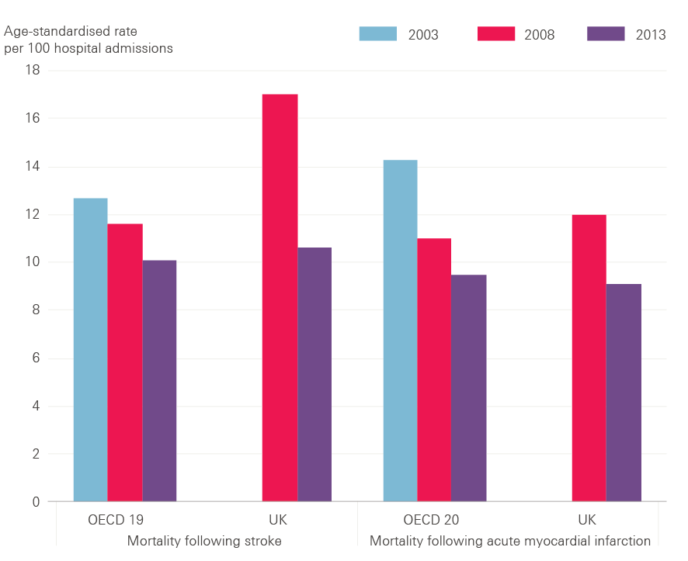
Figure 9: Mortality following admission to hospital for stroke and acute myocardial infarction, OECD average vs UK
Source: OECD, 2015

Slide 11
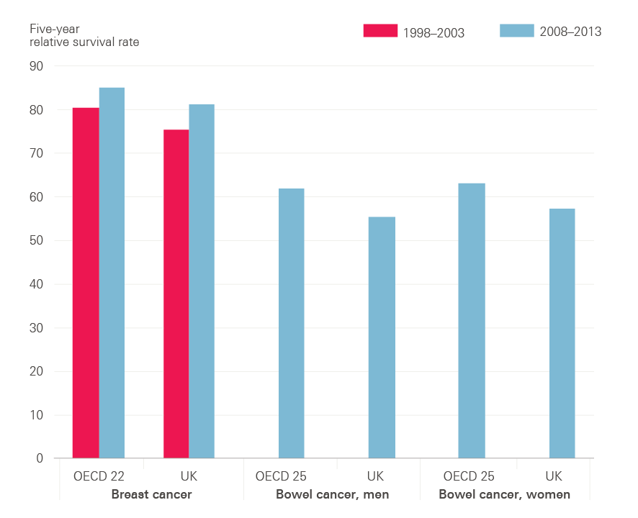
Figure 10: Breast and bowel cancer five-year relative survival rates, OECD average vs UK
Source: OECD, 2015

Slide 12
The Health Foundation is an independent charity committed to bringing about better health and health care for people in the UK.
We connect what works on the ground with effective policymaking and vice versa.

Slide 13
Subscribe to our email newsletter
Register for email alerts to be notified about our latest work
Follow us on Twitter, Facebook or LinkedIn

Slide 14
Subscribe to our email newsletter
Register for email alerts to be notified about our latest work
Follow us on Twitter, Facebook or LinkedIn

