Slide 1
Election briefing: A sustainable workforce
The lifeblood of the NHS and social care
May 2017

Slide 2
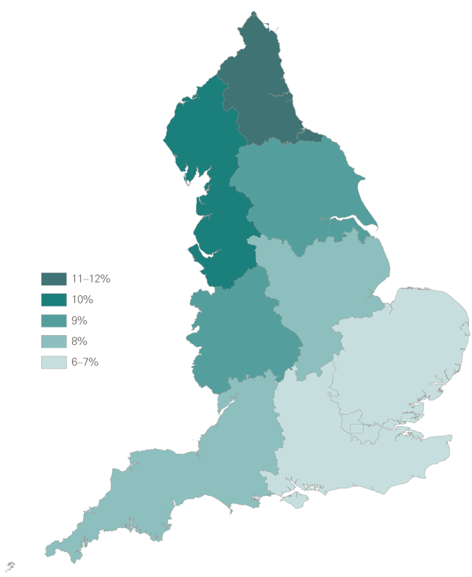
Figure 1: Health and social care workers as percentage of the total workforce, 2015/16
Source: Social care data are from Skills for Care, The state of the adult social care sector and workforce in England, 2016.
NHS data are from NHS Digital (2017), NHS workforce statistics.

Slide 3
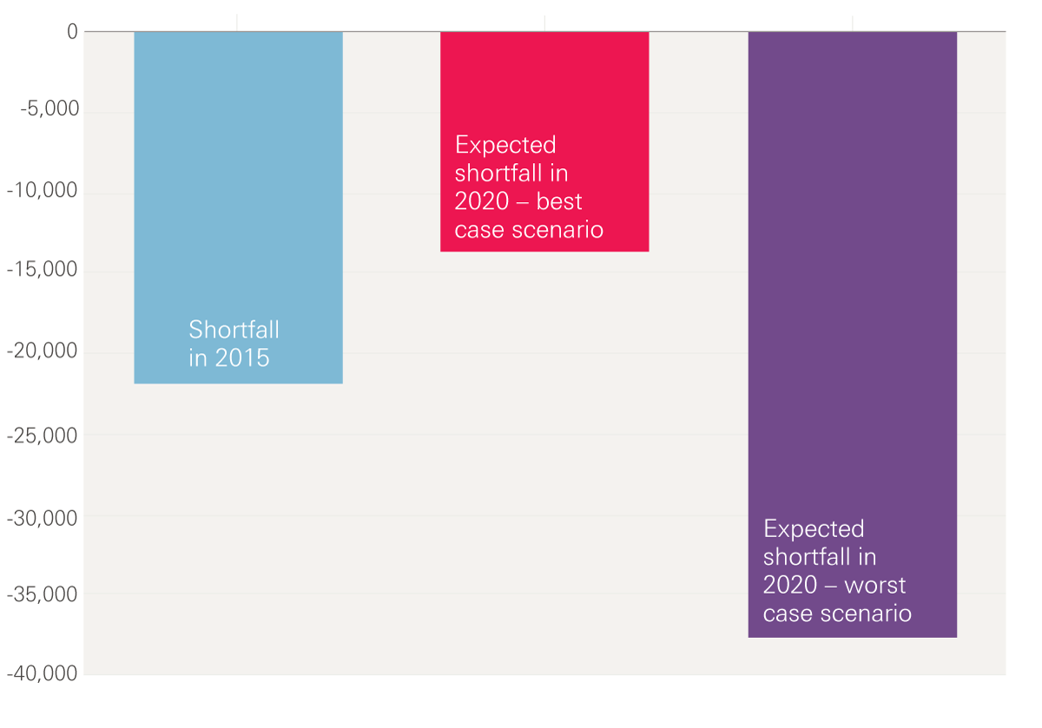
Figure 2: The shortfall of nurses specialising in caring for adult patients, 2015 and 2020
Note: Data relate to nurses specialising in caring for adult patients. High and low supply projections are based on different assumptions about, eg international recruitment, conversion rates of student commissions into NHS staff and turnover.
Source: Health Education England, Workforce Plan for England.

Slide 4
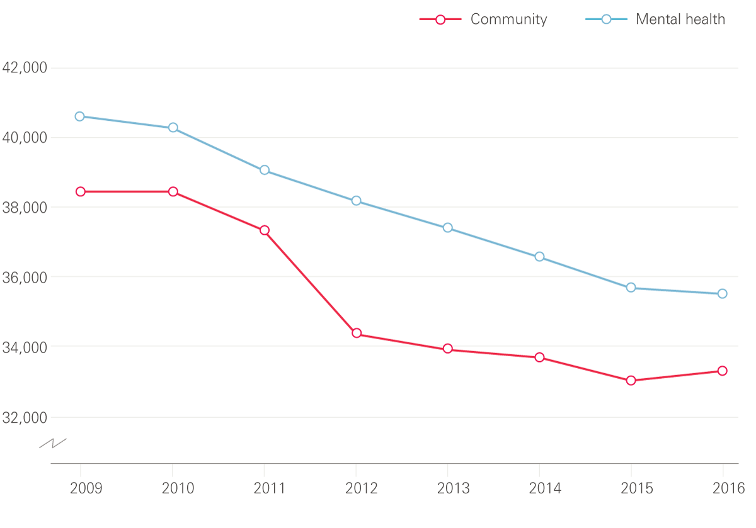
Figure 3: Number of community and mental health nurses, 2009–16
Source: NHS Digital (2017), NHS workforce statistics.

Slide 5
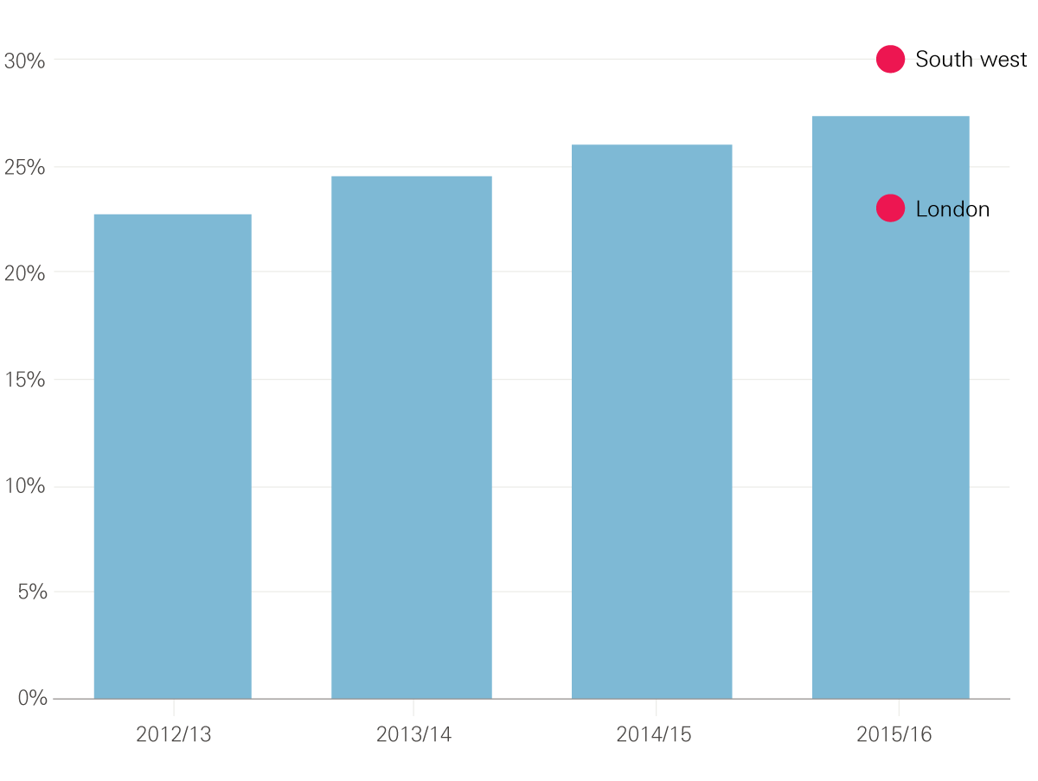
Figure 4: Rate of staff leaving jobs in adult social care
Source: The state of the adult social care sector and workforce in England, Skills for Care, September 2016 .

Slide 6
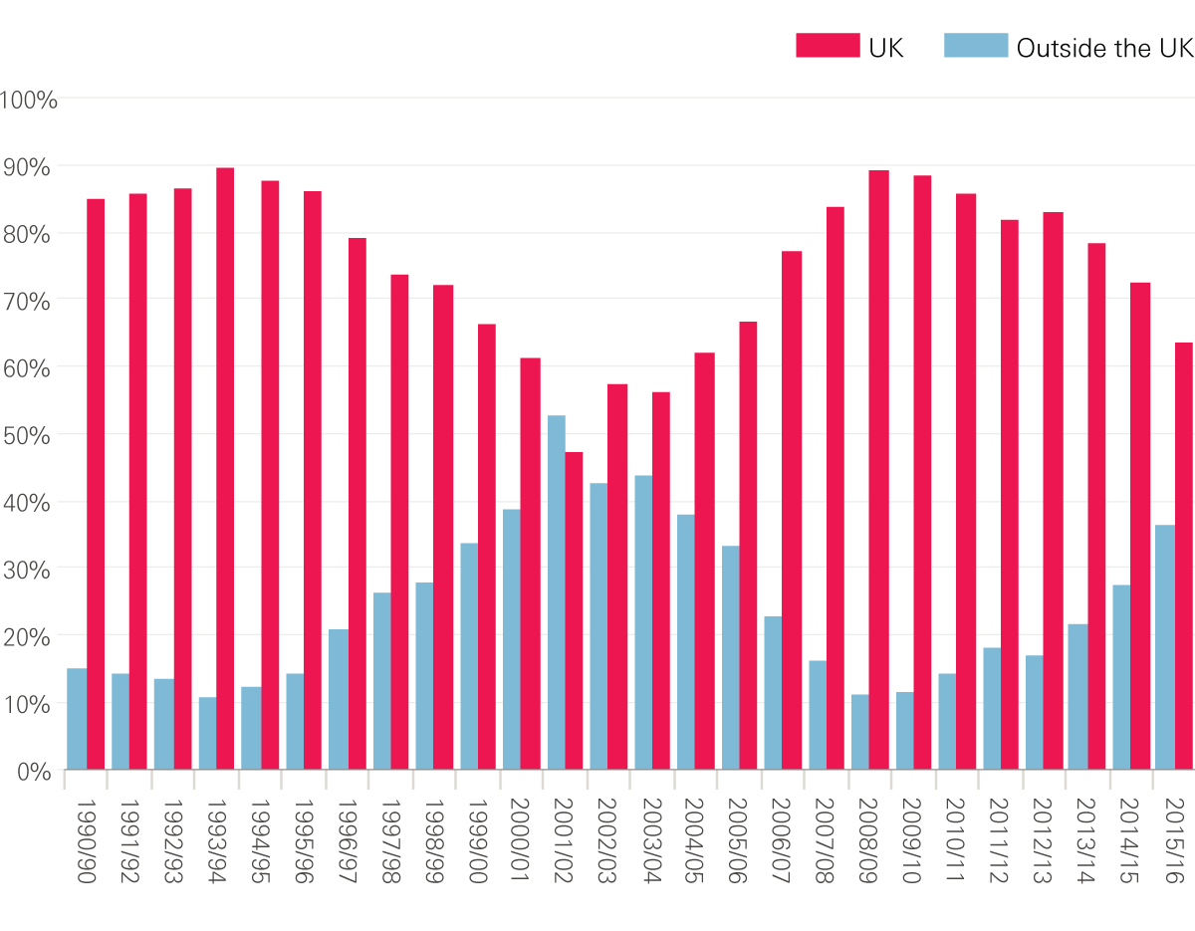
Figure 5: Percentage of people joining the UK nursing register by where they gained their qualification, 1990/91–2015/16 (initial registrations)
Source: The Health Foundation based on UKCC/NMC data.

Slide 7
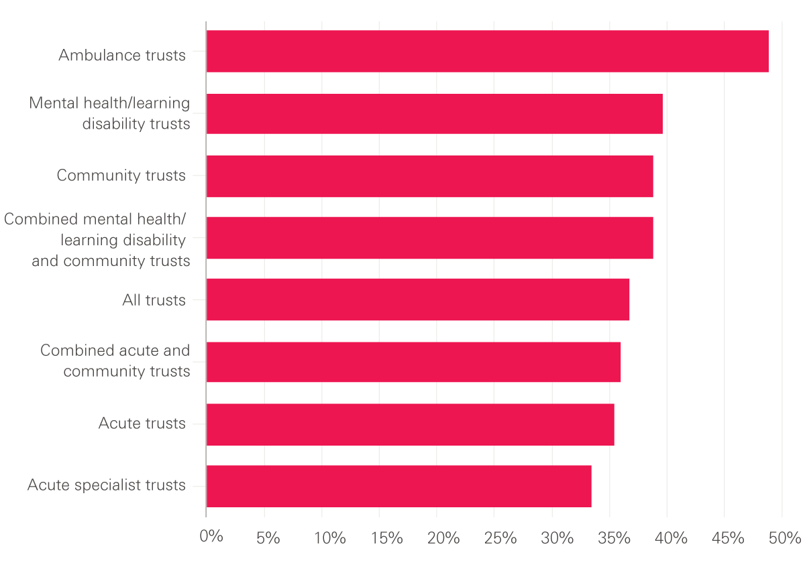
Figure 6: Responses by trust type to the 2016 NHS staff survey question: ‘Has work-related stress made you ill in the last 12 months?’
Source: NHS Staff Survey 2016.

Slide 8
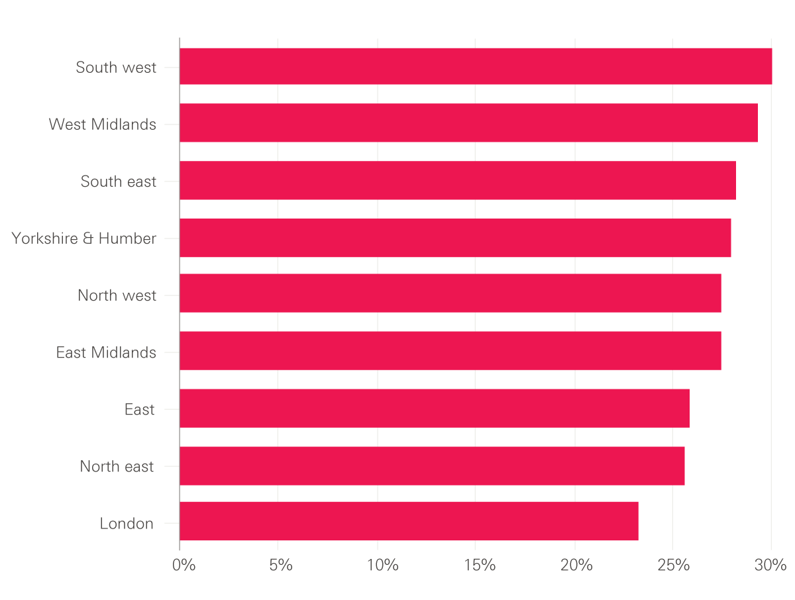
Figure 5: Rate of staff leaving jobs in adult social care by region
Source:

Slide 9
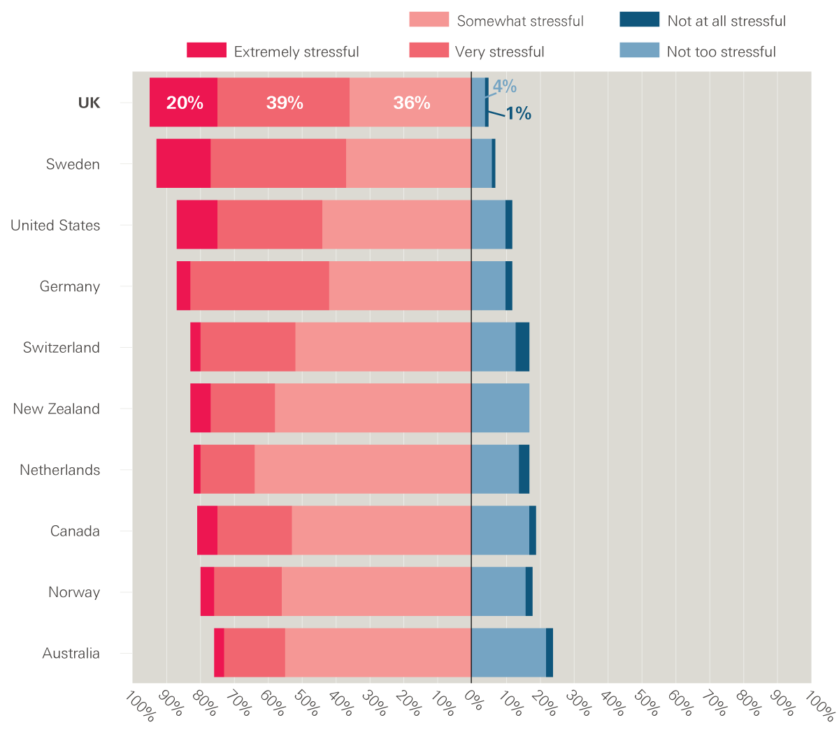
Figure 7: Percentage of respondents to the 2016 NHS staff survey who said they find general practice very or extremely stressful
Source: Commonwealth Fund data analysed in the Health Foundation's Under pressure: What the Commonwealth Fund’s 2015 international survey of general practitioners means for the UK.

Slide 10
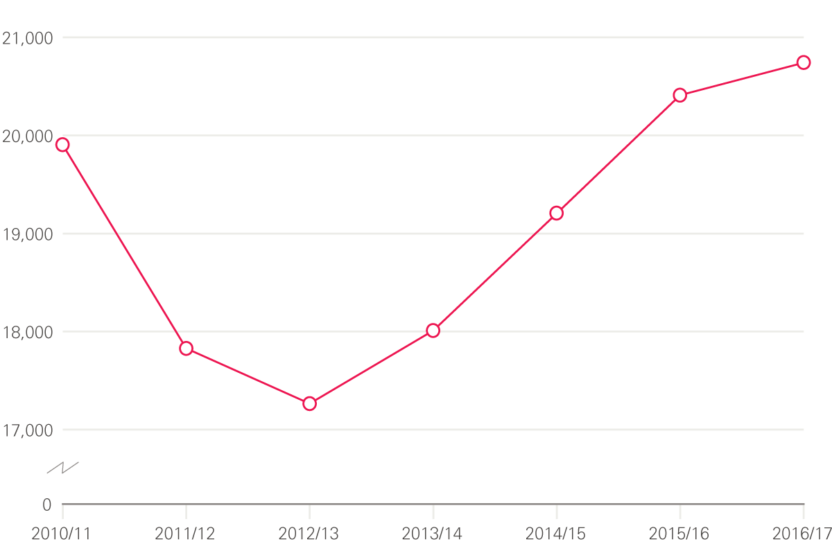
Figure 8: Total nurse training places, 2010/11­-2016/17
Source: Health Education England, Workforce Plan for England.

Slide 11
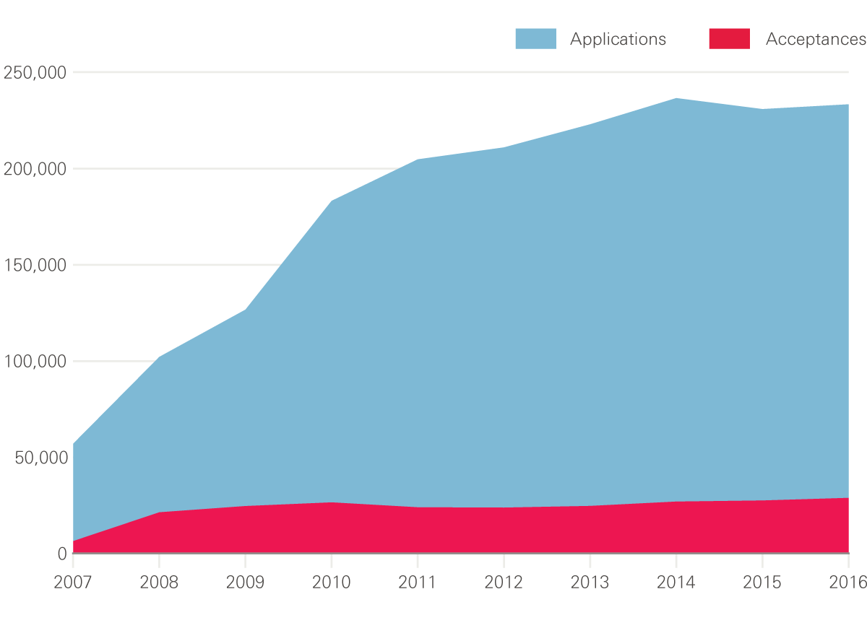
Figure 9: Volume of total applications and acceptances for nursing degree courses in the UK, 2007–16
Note: Data include multiple applications for each person.
Source: UCAS.

Slide 12
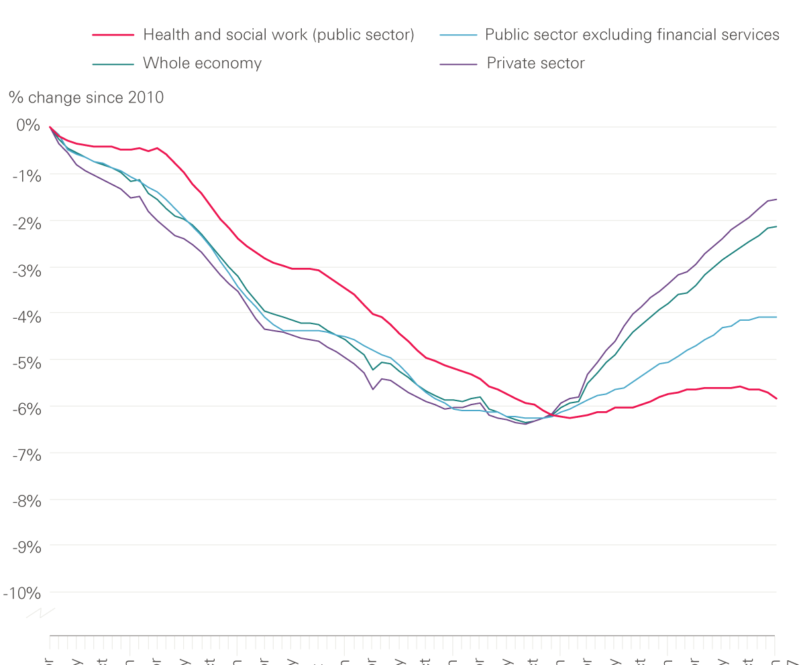
Figure 11: Changes in pay since 2010, adjusted for the Consumer Price Index
Source: Health Foundation analysis of Office for National Statistics data.

Slide 13
The Health Foundation is an independent charity committed to bringing about better health and health care for people in the UK.
We connect what works on the ground with effective policymaking and vice versa.

Slide 14
Subscribe to our email newsletter
Register for email alerts to be notified about our latest work
Follow us on Twitter, Facebook or LinkedIn

Slide 15
Subscribe to our email newsletter
Register for email alerts to be notified about our latest work
Follow us on Twitter, Facebook or LinkedIn

